Slide 1
A MINIPROJECT On Online Pet Website BACHELOR OF TECHNOLOGY IN COMPUTER SCIENCE & ENGINEERING BY Abhilash Hari : PRP20CS001 Abijith K A : PRP20CS003 Aiswarya K S : PRP20CS009 Haritha S Kumar : PRP20CS034 Jayaram S Kumar : PRP20CS036 Under the Guidance of Remyamol R ACADEMIC BATCH: 2020-2024

Slide 2
CONTENTS
Introduction
Existing model
Problem Statement
Objectives
Scope
Literature Survey
Technology stack
System Architecture
Detailed Design
System Implementation
Results And Discussion
Conclusion
References

Slide 3
Introduction
Our project aims to provide a convenient online platform for farmers in Kerala to sell their domestic animals. By eliminating the need for middlemen or brokers, our platform can help farmers get a fair price for their livestock, and buyers can have access to a wider range of options at competitive price. By eliminating the need for middlemen or brokers, our platform can help farmers get a fair price for their livestock.

Slide 4
Existing Models
Sl No | Approach | Methodology | Advantages | Disadvantages
1 | Only4Pets
2 | Karshika
….

Slide 5
Problem Statement
Online activities do not stop. Keep in mind that your online sales will
never stop. As a result, your customers will be able to purchase your
goods 24 hours a day, seven days a week. If you have a physical
store, on the other hand, you will
only be available to provide customer service at specific time.

Slide 6
Objectives
To make it user and shopkeer to connect each other in a locality via our platform
Direct sale of their pets to
each other.
It also creates a direct connection between users in order to facilitate direct selling.
Eliminate middleman in selling of pets.

Slide 7
Scope
User can easily find there favorite pet around there specified locality.
User can also sell there domestic animals by simply taking a seller account.
Easy to confirm there booking
Seller may be people of pet shop owners or farmers
Seller can easy the details of there pets with simply filling the form

Slide 8
Literature Survey
Year | Authors | Title | Methodology | Conclusion/ Result

Slide 9
Technology Stack
Browser:Web Application
Programming Language:HTML,CSS,JS
Frameworks:Bootstrap
Database:Firebase and MongoDB
Web Server:Express server
Operating System:Windows

Slide 10
System Architecture
Front-end Components
HTML: The markup language for structuring web pages.
CSS: The styling language for enhancing the presentation of web pages.
Handlebars: The template engine for generating dynamic HTML content.
JavaScript: The programming language for implementing interactivity and client-side logic.

Slide 11
Back-end Components
Node.js: A JavaScript runtime environment for building server-side applications.
Express.js: A web application framework for Node.js, used for routing and handling HTTP requests.
MongoDB: A NoSQL database for storing and retrieving data.
Firebase: A cloud-based platform for managing various backend services and real-time database.

Slide 12
Detailed Design
User Interface Design
HTML is used for building the pages and CSS for styling.
We used a bootstrap framework to ease our design process. It contains various inbuilt classes which saves time.
With the help of handlebars template engine we render our pages to the frontend.
.

Slide 13
Application Logic Design
We used MVC pattern for implementing our backend.
Node js and express js are used for handling routing
and request handling. The app listens for a specific port and when ever any request comes the express server will handle the request and render appropriate pages.

Slide 14
Data Storage and Database Design
1.User
User ID (Primary Key)
Name
Email
Password
2.Pet
Pet ID (Primary Key)
Name
Price

Slide 15
Description
Location
Category
User ID (Foreign Key)
Image1
Image2
Image3

Slide 16
System Implementation
We employed a combination of technologies and frameworks, including Node.js, Express, MongoDB, Firebase, HTML, CSS, and the Handlebars template engine.
To handle the server-side logic, we chose Node.js as our runtime environment.
we utilized MongoDB and Firebase as our database solution.

Slide 17
One of the key features of our online pet shop was the ability for users to upload images of their pets. To implement this functionality, we stored the uploaded images on the server.
In the frontend development, we utilized HTML, CSS, and the Handlebars template engine. Handlebars provided a convenient way to render dynamic web pages, allowing us to display pet details and other relevant information to users in an organized and visually appealing manner.

Slide 18
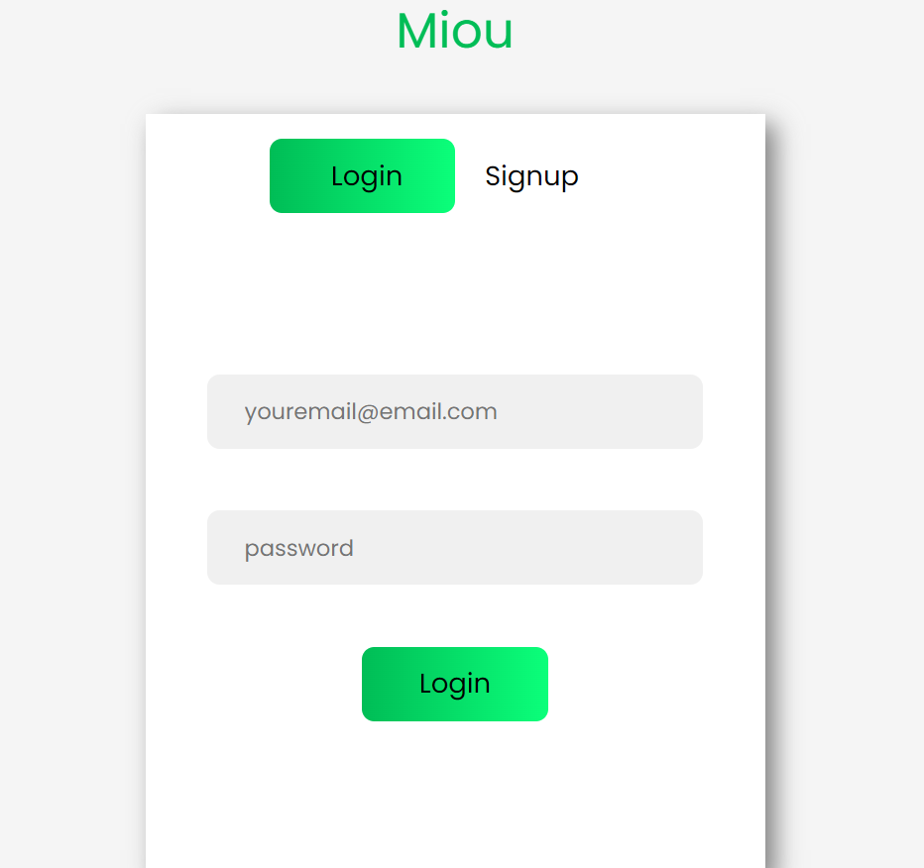
Results And Discussion

Slide 19
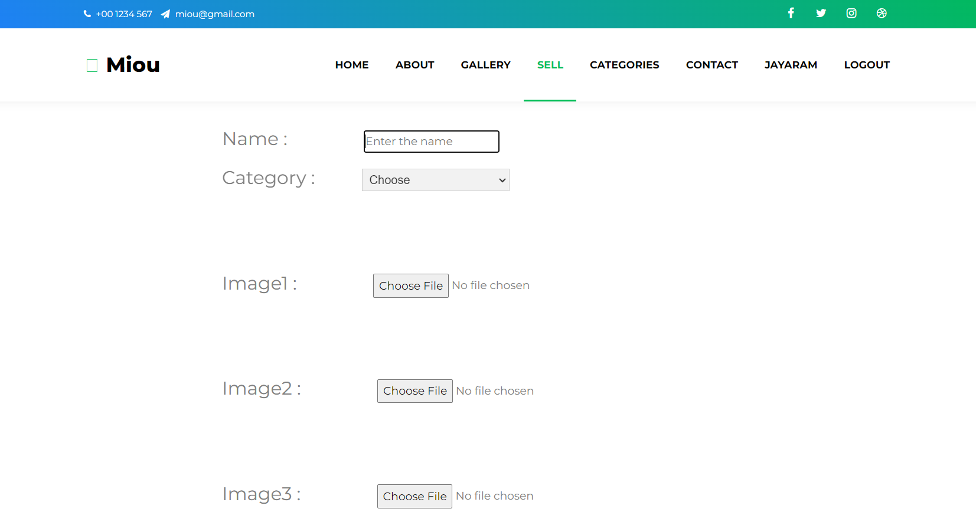

Slide 20
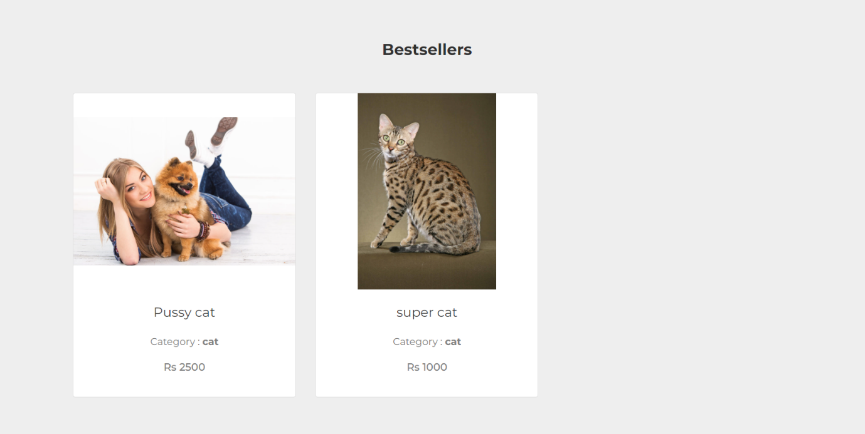
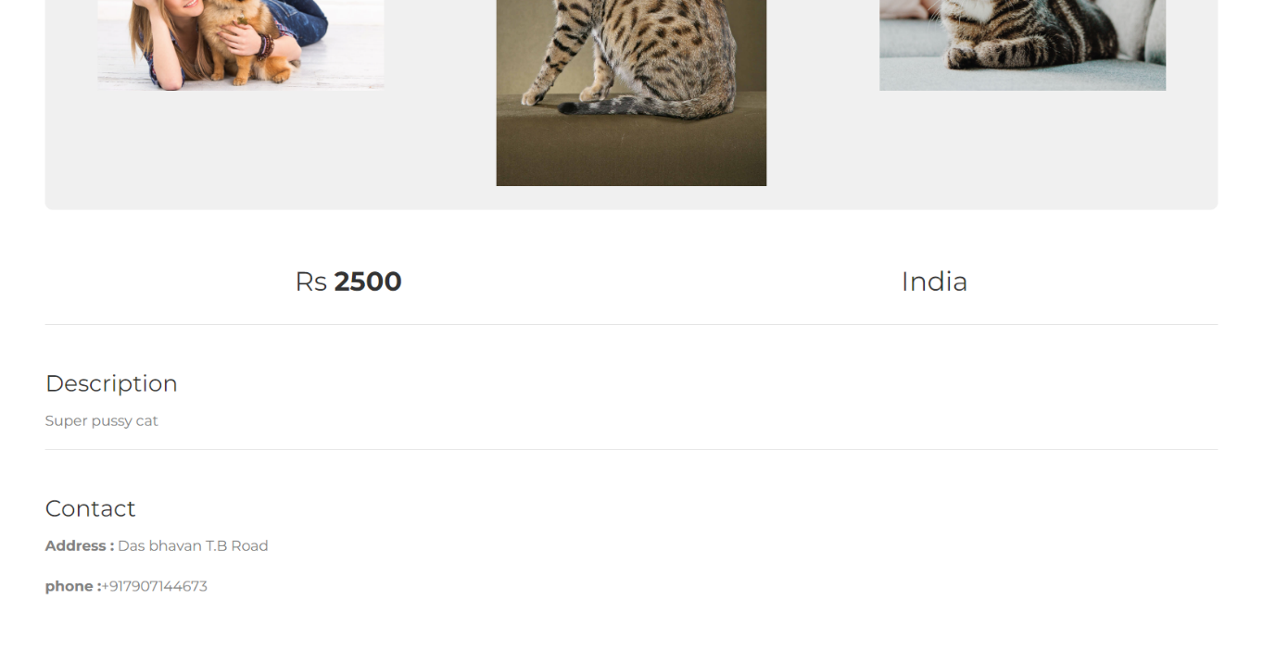

Slide 21
Conclusion
In conclusion, our pet selling website provides a reliable platform for connecting responsible breeders with potential pet owners. With an extensive database of quality-bred pets, detailed profiles, and transparent information, we prioritize the well-being and ethical treatment of animals.

Slide 22
References
We have gathered information from various websites like Only4Pets and Karshika regarding the features and functionalities it provides.

