Slide 1
YouTube Data Classification & Predictions
Data Types (Group 10)
Nitish Joshi (013736320)
Rohan Kamat(013759252)
Chaitanya Krishna Kasaraneni (013772642)

Slide 2
Introduction
Performing analysis and predictions on YouTube video dataset.
Task 1: Predicting the Category of a YouTube video based on its Title.
Task 2: Predicting the number of views (popularity) of a particular video given its Title.
Task 3: Sentiment analysis of the description, tags and title.

Slide 3
Datasets
YouTube Trending Video Dataset.
Several months of data on daily trending YouTube videos.
Data is included for the US, GB, DE, IN, CA, RU, MX and FR regions (USA, Great Britain, Germany, India, Canada, Russia, Mexico and France, respectively)
200 listed trending videos per day.
US, GB, IN, CA datasets for our project.
Size: 5 million
Source: https://www.kaggle.com/datasnaek/youtube-new

Slide 4
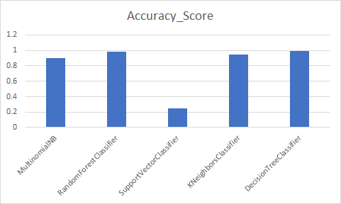
Category Prediction of a YouTube video.
Preprocessing:
Title
Category & Category_ID
Algorithms:
Multinomial NB
Support Vector Classifier
Random Forest Classifier
K Neighbors Classifier
Decision Tree Classifier
Evaluation & Results:
accuracy_score from sklearn.metrics
Random Forest Classifier - 0.987
Decision Tree Classifier - 0.9885

Slide 5
Popularity Prediction (views) for a Video
Preprocessing:
Lowercase, numeric values, removing links, punctuations & symbols, stemming, stopwords.
Algorithms:
Linear Regression
Random Forest Regressor
Gradient Boosting regressor
Ridge Regression
ElasticNet
Results/Evaluation:
RMSE from ml_metrics
Lowest RMSE - linear regression (1.0632)

Slide 6
Sentiment Analysis of Description, Tags and Title
Preprocessing:
Removing redundant data & duplicates
Removing punctuation
Algorithms/Techniques:
TextBlob
Support Vector Machine
Logistic Regression
Results/Evaluation:
classification_report from scikit-learn
Accuracy for SVM was around 99.60%
Accuracy for Linear Regression was 98.3%

Slide 7
Thank you!

