Slide 1
Capstone
Project

Slide 2
The Juke Box
Mentor-
Vaibhav Diwan
Charul Bapna
Created By-
Abhinav Pandey

Slide 3
Overview
Database Structure
Flow Of The Project

Slide 4
Database Structure
In the jukebox database, I have three tables naming :
Song
Genre
Artist
Playlist
PlaylistContents
Structure of each table is on next slides

Slide 5
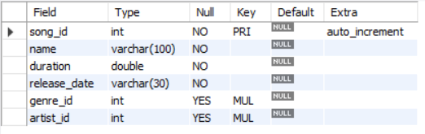
Song Table Structure

Slide 6

Genre Table Structure

Slide 7

Artist Table Structure

Slide 8

Playlist Table Structure

Slide 9

PlaylistContents Structure

Slide 10
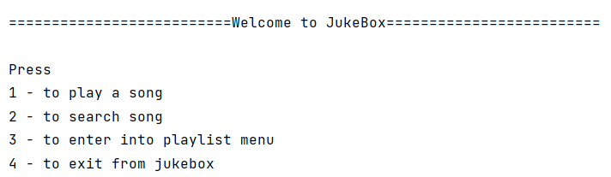
Flow Of The Project
Main menu
From this menu user can select any of the options

Slide 11
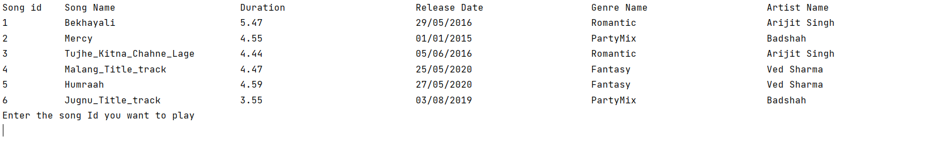
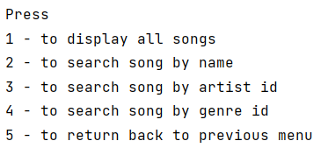
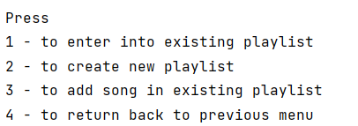
After selecting first option
After selecting second option
After selecting third option
The flow of options will continue till the user exits the jukebox

Slide 12
Thank You

