Slide 1

DEPARTMENT OF COMPUTER SCIENCE AND ENGINEERING
SPCB1503 - JAVA FULLSTACK DEVELOPMENT
Online E-Commerce Store
JAVA FULLSTACK
43110018 – Abhinav T K
43110431 – K. Jayanth Reddy

Slide 2
ABSTRACT
This project presents a modern e-commerce marketing website developed using React 18, featuring an interactive product showcase and shopping cart functionality. The application incorporates a dynamic product catalog with real-time cart management and responsive design ensuring seamless performance across all devices. Built with React Router DOM, HTML5/CSS3, and JavaScript, the website employs modern CSS techniques for optimal layout management. The final product delivers a professional marketing platform that effectively showcases products while providing users with an intuitive shopping experience, demonstrating proficiency in contemporary web development practices.

Slide 3
EXISTING SYSTEM
Traditional e-commerce marketing websites rely on static HTML pages with limited interactivity and poor mobile responsiveness. These legacy systems feature basic product listings without dynamic filtering, rudimentary shopping cart functionality requiring page refreshes, and inconsistent user experiences across devices. Most existing solutions use outdated technologies like jQuery without component-based architecture, making maintenance challenging. The absence of responsive design leads to suboptimal
mobile viewing experiences, while limited animations create less engaging interfaces compared to modern web standards.

Slide 4
PROPOSED SYSTEM
The proposed e-commerce marketing website utilizes React 18 with component-based architecture to deliver a dynamic, interactive user experience. The system features real-
time shopping cart functionality, responsive design across all devices, and smooth animations for enhanced engagement. Built with React Router DOM and modern CSS Grid/Flexbox, the platform provides instant product filtering, dynamic updates, and professional UI/UX design. The modular architecture enables easy maintenance and scalability while ensuring consistent performance on desktop, tablet, and mobile devices.

Slide 5
ADVANTAGES
• Enhanced User Experience - Real-time interactions and smooth animations
• Mobile Responsiveness - Consistent performance across all devices
• Faster Loading Times - Component-based architecture optimization
• Better Maintainability - Modular design for easy updates
• Seamless Navigation - No page refreshes required
• Dynamic Content Updates - Real-time cart and product management
• Professional UI/UX - Modern design increases user retention
• Future-Proof Technology - Built with latest React standards
• Improved SEO Performance - Better search engine optimization
• Easy Debugging - Component-based testing capabilities

Slide 6
DISADVANTAGES
• Learning Curve - Requires knowledge of React and modern JavaScript
• Initial Setup Complexity - More complex than basic HTML/CSS websites
• Browser Compatibility - May not work on very old browsers
• SEO Challenges - Client-side rendering can affect search indexing
• Development Time - Takes longer to build than static websites
• Dependency Management - Relies on external libraries and packages
• Performance Overhead - JavaScript framework adds processing load
• Hosting Requirements - May need specific hosting configurations

Slide 7
MODULES
Core Modules:
• Home Module - Landing page with featured products
• Product Module - Product catalog and listings
• Cart Module - Shopping cart functionality
• Navigation Module - Routing and page navigation
• UI Module - Responsive design and animations
Components:
• Product Display - Product cards and details
• Cart Management - Add/remove items and calculations
• Layout Components - Header, footer, and grid structure
• Form Handling - User input and validation
• State Management - Application data flow

Slide 8
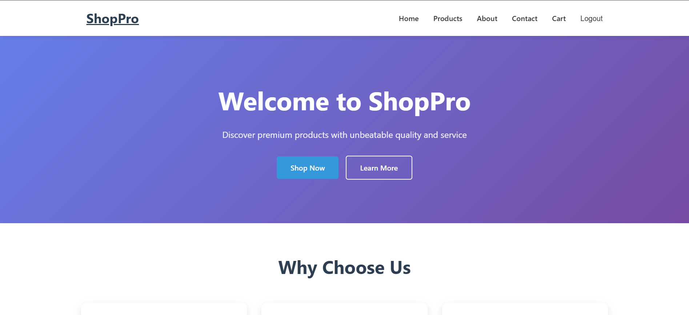
SAMPLE OUTPUT
Fig: Home Page

Slide 9
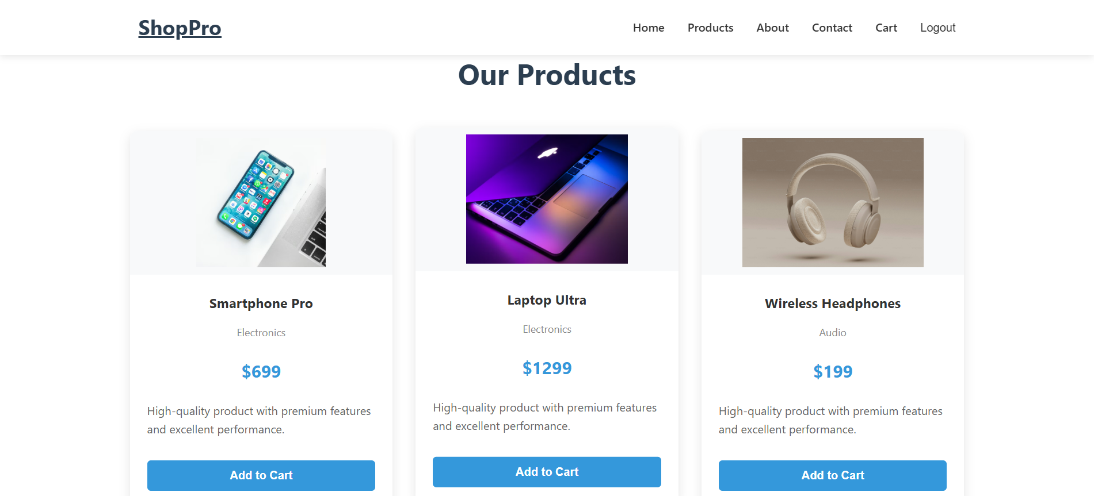
SAMPLE OUTPUT
Fig: Product page

Slide 10
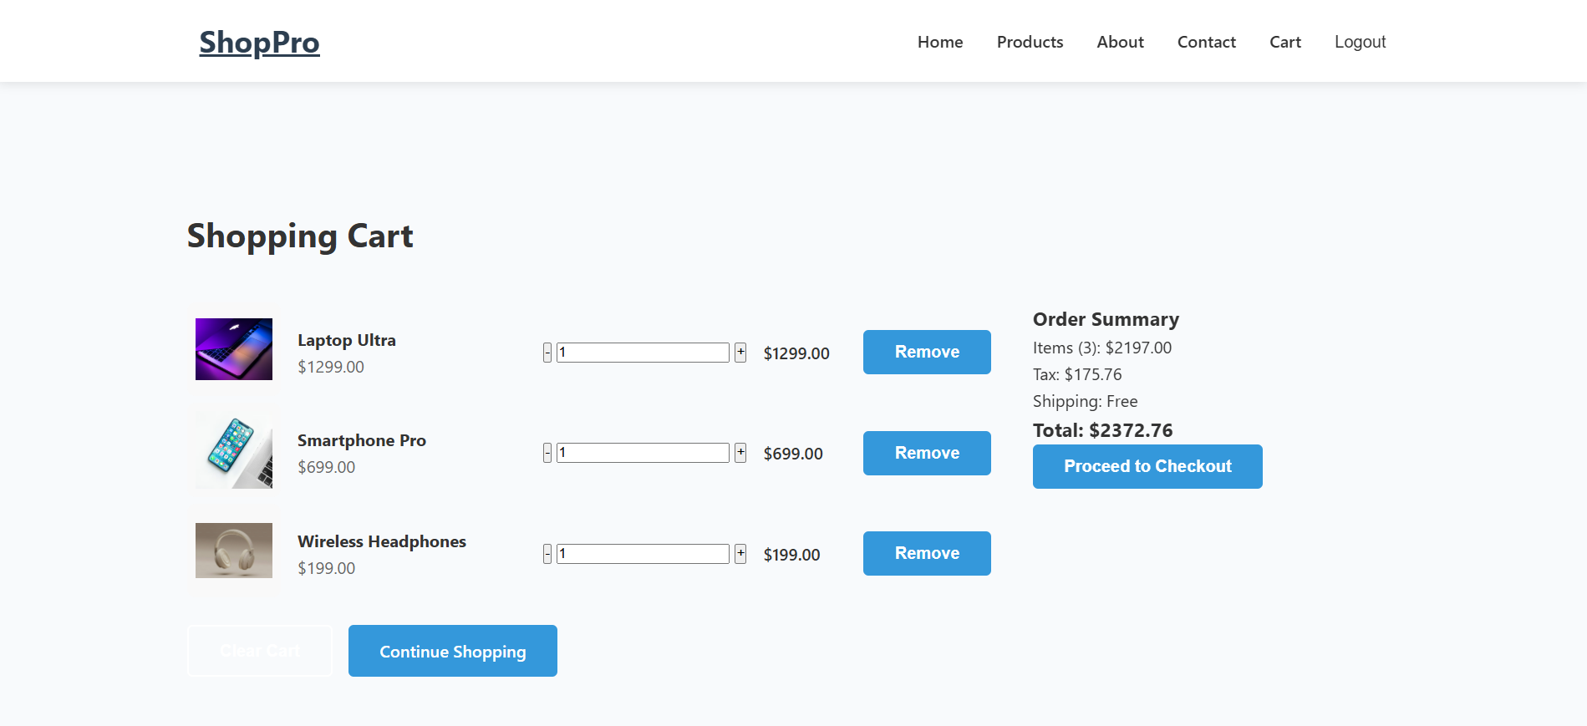
SAMPLE OUTPUT
Fig: Cart page

Slide 11
CONCLUSION
The e-commerce marketing website successfully demonstrates modern web development using React, delivering a responsive and interactive user experience. The component-based architecture with real-time shopping cart functionality and smooth animations creates a professional platform that addresses traditional website limitations. The project showcases proficiency in React, responsive CSS, and JavaScript, resulting in improved user engagement and maintainability. This marketing website serves as an effective foundation for e-commerce businesses seeking a modern online presence with optimal cross-device compatibility.

