Slide 1

OLA Data Analyst Project
A hands-on synthetic dataset project for aspiring analysts — covering dataset design, SQL queries, and Power BI dashboards using real-world ride-hailing scenarios from Bangalore.
SQL
POWER BI
DATA MODELING

Slide 2
Dataset Overview
The dataset contains 19 columns modeling real OLA ride bookings from Bangalore — including booking metadata, vehicle types, location data, cancellation reasons, ratings, and payment details.
Booking Info
Date · Time · Booking ID (CNR + 10 digits) · Status · Customer ID
Ride Details
Vehicle Type · Pickup · Drop (50 Bangalore areas) · Distance · Value
Performance
V-TAT · C-TAT · Driver Ratings · Customer Ratings
Cancellations
Customer & Driver cancel reasons · Incomplete rides · Payment Method

Slide 3





Vehicle Types & Booking Status
7 Vehicle Categories
Auto · Prime Plus · Prime Sedan
Mini · Bike · eBike · Prime SUV
Booking Status Distribution
o Success — 62%
Fare, ratings, and TAT data populated
🚗 Cancelled by Driver —
≤18%
Personal issues, customer-related reasons
👤 Cancelled by Customer — ≤7%
Change of plans, wrong address, AC issues
⚠ Incomplete — <6%
Breakdown, customer demand, other issues

Slide 4
Data Constraints & Distribution Rules
Key rules that shape the synthetic dataset for realistic analysis.
62%
Success Rate
Only successful rides carry fare, ratings, and TAT data
7%
Max Customer Cancels
Customer-initiated cancellations capped at 7%
18%
Max Driver Cancels
Driver-initiated cancellations capped at 18%
70%
Orders Under ₹500
28% above ₹500, remaining above ₹1,000
Weekend and match-day orders have higher volume and booking values. Booking IDs follow the format CNR + 10 digits.

Slide 5
10 SQL Questions
Practice queries covering filtering, aggregation, grouping, and ranking on the OLA dataset.
01 02
Retrieve all successful bookings Average ride distance per vehicle type
03 04
Total rides cancelled by customers Top 5 customers by number of rides
05 06
Driver cancellations due to personal & car issues Max & min driver ratings for Prime Sedan
07 08
All rides paid via UPI Average customer rating per vehicle type
09 10
Total booking value of successful rides All incomplete rides with reasons

Slide 6
SQL Answers — Part 1
Q1 — Successful Bookings
Q4 — Top 5 Customers
CREATE VIEW Successful_Bookings AS
CREATE VIEW Top_5_Customers AS
SELECT * FROM bookings
SELECT Customer_ID,
WHERE Booking_Status = 'Success';
COUNT(Booking_ID) AS total_rides
FROM bookings
Q2 — Avg Distance by Vehicle
GROUP BY Customer_ID
ORDER BY total_rides DESC LIMIT 5;
CREATE VIEW ride_distance_for_each_vehicle AS
Q5 — Driver Cancel Reasons
SELECT Vehicle_Type,
AVG(Ride_Distance) AS avg_distance
FROM bookings
CREATE VIEW Rides_cancelled_by_Drivers_P_C_Issues AS
GROUP BY Vehicle_Type;
SELECT COUNT(*) FROM bookings
WHERE cancelled_Rides_by_Driver
Q3 — Customer Cancellations
= 'Personal & Car related issue';
CREATE VIEW cancelled_rides_by_customers AS
Q6 — Max/Min Ratings (Prime Sedan)
SELECT COUNT(*) FROM bookings
WHERE Booking_Status = 'cancelled by Customer';
CREATE VIEW Max_Min_Driver_Rating AS
SELECT MAX(Driver_Ratings) AS max_rating, MIN(Driver_Ratings) AS min_rating
FROM bookings
WHERE Vehicle_Type = 'Prime Sedan';

Slide 7
SQL Answers — Part 2
Q7 — UPI Payments
CREATE VIEW UPI_Payment AS SELECT * FROM bookings WHERE Payment_Method = 'UPI';
Q8 — Avg Customer Rating by Vehicle
CREATE VIEW AVG_Cust_Rating AS SELECT Vehicle_Type,
AVG(Customer_Rating) AS avg_customer_rating FROM bookings
GROUP BY Vehicle_Type;
Q9 — Total Successful Ride Value
CREATE VIEW total_successful_ride_value AS SELECT SUM(Booking_Value)
AS total_successful_ride_value FROM bookings
WHERE Booking_Status = 'Success';
Q10 — Incomplete Rides with Reasons
CREATE VIEW Incomplete_Rides_Reason AS SELECT Booking_ID, Incomplete_Rides_Reason
WHERE Incomplete_Rides = 'Yes';
FROM bookings
Retrieve all views: Run
SELECT * FROM view_name;
for each of
the 10 views to access results.

Slide 8





10 Power BI Visuals
Five dashboard categories covering volume, vehicles, revenue, cancellations, and ratings.
Overall
Ride Volume Over Time · Booking Status Breakdown
Vehicle Type
Top 5 Vehicle Types by Ride Distance
Revenue
Revenue by Payment Method · Top 5 Customers · Ride Distance Distribution
Cancellation
Cancelled Rides Reasons — Customer & Driver
Ratings
Driver Ratings Distribution · Customer vs. Driver Ratings

Slide 9
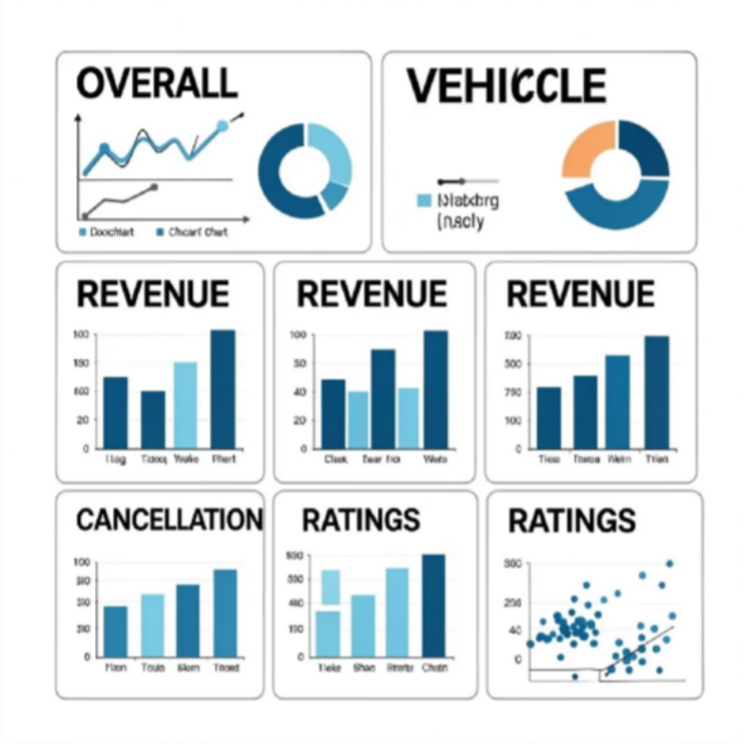
Power BI Visual Details
Recommended Chart Types
Line chart — Ride volume over time
Doughnut — Booking status breakdown
Bar chart — Top vehicles, cancel reasons
Stacked bar — Revenue by payment method
Histogram — Ride distance distribution
Scatter plot — Customer vs. driver ratings
Box plot — Driver rating distribution

Slide 10



Key Takeaways
Three pillars of this end-to-end data analyst project.
Build the Dataset
Model 19 columns with realistic constraints — 62% success rate, capped cancellations, weekend spikes, and Bangalore locations.
Write SQL Queries
Create 10 views covering SELECT, AVG, COUNT, GROUP BY,
MAX/MIN, and SUM — then query each view for clean results.
Design Power BI Dashboards
Build five dashboard categories — Overall, Vehicle, Revenue, Cancellation, and Ratings — with purpose-built chart types.

