Slide 1

COURSE NAME : APPLIED MACHINE LEARNING FOR TEXT ANALYSIS COURSE CODE : 24ALT3101
ML-Based Personalized Nutrition Recommendation System

Slide 2
Team Members :
2420030380 | M. Bharath
2420030263 | K. Abhinav

Slide 3
Problem Statement
Generic diet plans ignore individual biology — age, BMI, biomarkers (glucose, HbA1c), and medical conditions.
Existing academic models predict calories/macros but rarely turn predictions into real, verified meal plans.
LLM-based meal generators can produce nutrition claims not grounded in real food data.
Recommendation quality (relevance, ranking) is almost never formally evaluated in prior work.

Slide 4
Objectives
To develop a predictive model that estimates personalized calorie and macronutrient needs using NHANES health data.
To design a stronger ensemble prediction model by combining LightGBM, XGBoost, and Random Forest.
To develop a medical safety mechanism that enforces biomarker-based constraints (HbA1c, glucose) on recommendations.
To design an explainability module using SHAP that justifies every recommendation made by the system.

Slide 5
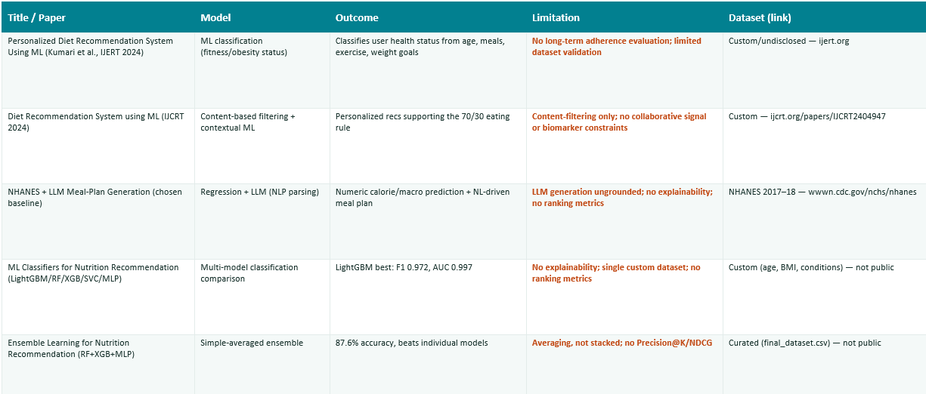
Literature Survey

Slide 6
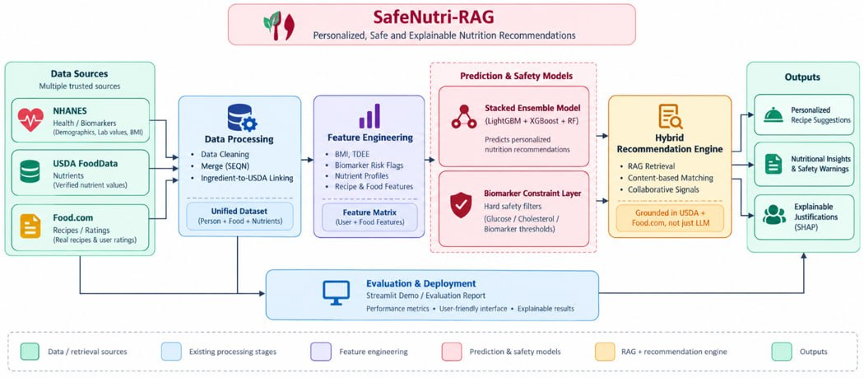
Proposed Model Architecture diagram

Slide 7
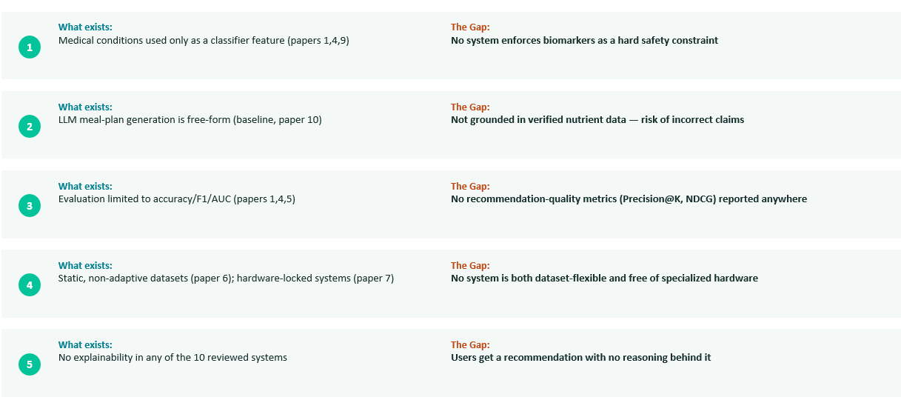
Research Gap

Slide 8
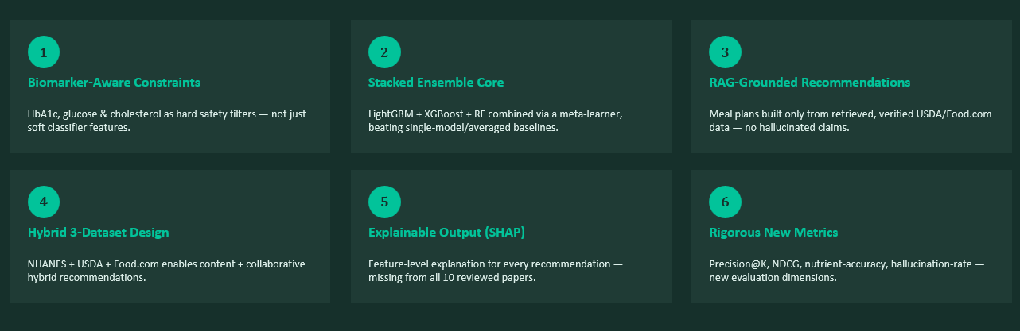
Innovation, Creativity & Novelty

Slide 9
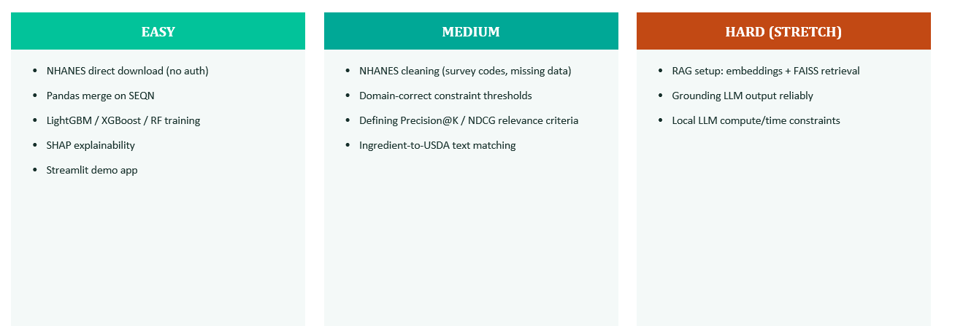
Feasibility Analysis

Slide 10
Implementation
Core pipeline implemented and executed on an 80/20 train-test split; RAG and TreeExplainer SHAP remain planned.
1. Data Preparation
2. Feature Engineering
3. Stacked Prediction
4. Safety Constraint
• Merge NHANES records using SEQN
• Treat NHANES non-response codes as missing
• Compute BMI, BMI category and TDEE
• Create activity and biomarker risk flags
• Permutation importance used for executed feature analysis
base_learners = [
("hist_gb", HistGradientBoostingRegressor(max_depth=5)),
("grad_b", GradientBoostingRegressor(n_estimators=200,
max_depth=3)),
("rf", RandomForestRegressor(n_estimators=300,
max_depth=8))
]
model = StackingRegressor(
estimators=base_learners,
final_estimator=Ridge(alpha=1.0), cv=5
)
model.fit(X_train, y_train)
Safety test from executed run
Diabetic profile: HbA1c 7.2% → carbs 220g → 165g
Healthy profile: HbA1c 5.1% → unchanged
if row["HBA1C"] >= 6.5:
cap = predicted_carbs_g * 0.75
adj_carbs = cap
Status: prediction + safety layers implemented. RAG meal generation and SHAP TreeExplainer are future-work components in the paper.

Slide 11
Code Execution & Results
Real outputs reported by the executed core pipeline in the reference paper.
80/20 train-test split
Feature permutation importance
ACTIVITY_SCORE 0.998
BMI 0.244
AGE 0.216
GENDER_M 0.143
CHOLESTEROL_MGDL 0.001
HBA1C 0.001
GLUCOSE_MGDL 0.0003
Model
RMSE
MAE
R²
HistGradientBoosting
213.24
170.88
0.739
GradientBoosting
209.03
165.91
0.749
Random Forest
206.63
164.11
0.755
Stacked Ensemble
206.51
164.57
0.755
Interpretation
• Activity, BMI and age drive calorie prediction.
• Biomarkers have low permutation importance for calorie prediction and are routed to safety constraints.
Proposed stacked model matches the best individual learner (RF)
and slightly improves over both boosting analogs.
Important limitation: RMSE/MAE values come from the paper's synthetic dataset. The paper states that absolute errors are expected to change after retraining on real NHANES 2017–2018 data.

Slide 12
Thank You
ML-Based Personalized Nutrition Recommendation System
SafeNutri-RAG • Proposed Model • Implementation • Results

