Slide 1

AgriIQ: AI-Driven Crop Recommendation & Agricultural Advisory System
SOA Project Review-1
20-08-26
 | Under the Guidance of [Dr. Neelima Gogineni] Professor, Department of Computer Science and Engineering, KLH CSE Bowrampet Campus
Team Members KONGARI ABHINAV-2420030263 SONTIREDDY SRINIKA-2420030617 ISRAJIWADI SRIVALLI-2420030742

Slide 2
Outline of Project Work
Focus
Introduction
Literature Survey
Challenges
Research Objectives
Conclusion & Future Work
References
Publications Details

Slide 3
Problem Statement
Farmers often choose crops based on tradition and guesswork rather than the actual soil nutrients (N, P, K), pH, temperature, humidity, and rainfall of their land, leading to reduced yield and wasted resources.
Timely, reliable advisory information on fertilizer usage, irrigation, and pest management is not always accessible to small and marginal farmers once a crop has been chosen.
Existing ML/DL-based crop recommendation research mostly stays at the model-accuracy stage and is rarely delivered as a secure, deployable, multi-user application.
There is a need for an accessible, secure system that combines crop recommendation with practical, crop-specific advisory guidance in one platform.

Slide 4
Objectives
To design and implement AgriIQ, a Service-Oriented Architecture (SOA) based system using Spring Boot, Spring Cloud Gateway, and JWT authentication.
To build a Crop Recommendation Service that suggests suitable crops based on soil nutrients (N, P, K), pH, temperature, humidity, and rainfall.
To build an Advisory Service that provides fertilizer, irrigation, and pest-management guidance for the recommended crop.
To secure all services with JWT-based authentication and role-based access control (Farmer / Admin).
To follow the database-per-service principle and validate the system using Postman API testing and a GitHub Actions CI/CD pipeline.

Slide 5
Literature Survey
Authors | Title of the Paper | Methodology | Inferences | Limitation/Future work
Dahiphale et al. [3] | Smart Farming: Crop Recommendation using ML, IEEE Access, 2023 | Compared KNN, Decision Tree, Random Forest on soil + weather features | Random Forest gave the best accuracy (~95%) among the models tested | Stops at model benchmarking; no deployable app or service architecture
Gosai et al. [4] | Crop Recommendation System using ML, IJSRCSEIT, 2021 | Random Forest + Genetic Algorithm tuning on N, P, K, pH, weather data | ~99.3% accuracy recommending the right crop among 22 crop classes | Offline model only; no secure multi-user or service-based deployment
Advancing CRS with XAI [5] | Advancing CRS with Supervised ML and Explainable AI, Sci. Reports, 2025 | Gradient Boosting model + Explainable AI (XAI) for interpretability | ~99.27% accuracy; XAI used to justify recommendations to agronomists | Research prototype only; no auth, SOA design, or advisory component

Slide 6
Problem Gap Identification
Most existing crop recommendation research (SVM, Random Forest, Gradient Boosting) focuses on maximizing model accuracy but stops at the notebook or research-paper stage.
Very few solutions are packaged as secure, deployable, multi-user web systems with authentication and role management.
Crop prediction and agricultural advisory (fertilizer, irrigation, pest guidance) are rarely combined into a single, connected platform for the farmer.
Existing systems are typically monolithic in design, making them harder to scale, secure, or extend service by service as new features are added.

Slide 7
Innovation, Creativity, and Novelty
Combines crop recommendation with actionable agricultural advisory in a single connected platform, rather than a prediction-only tool.
Designed as an SOA/microservices system (Auth, Crop Recommendation, Advisory Service) instead of a single monolithic script.
Secures the platform with JWT-based authentication and role-based access, a layer typically missing from academic crop-recommendation prototypes.
Follows a database-per-service architecture with independent scaling and CI/CD automation via GitHub Actions, reflecting production-style engineering practice.

Slide 8
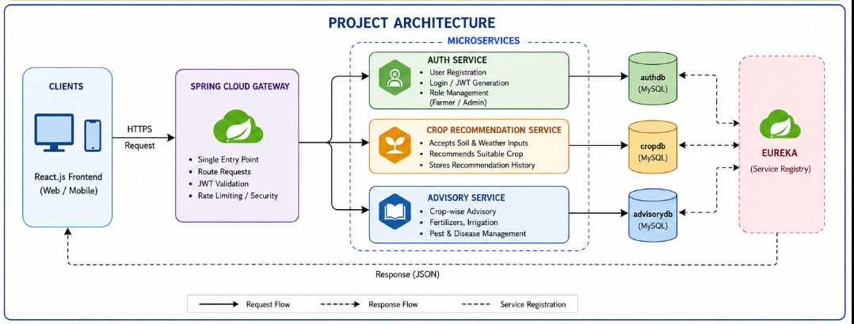
Project Architecture/Project Overview:

Slide 9
React.js Frontend → Spring Cloud Gateway (single entry point, JWT validation) → routed to one of three independent Spring Boot microservices, each with its own MySQL database:
• Auth Service (authdb) – registration, login, JWT issuance, role management
• Crop Recommendation Service (cropdb) – accepts soil/weather inputs, returns recommended crop, stores history
• Advisory Service (advisorydb) – serves fertilizer, irrigation, and pest-management guidance per crop
React.js Frontend → Spring Cloud Gateway (single entry point, JWT validation) → routed to one of three independent Spring Boot microservices, each with its own MySQL database:
• Auth Service (authdb) – registration, login, JWT issuance, role management
• Crop Recommendation Service (cropdb) – accepts soil/weather inputs, returns recommended crop, stores history
• Advisory Service (advisorydb) – serves fertilizer, irrigation, and pest-management guidance per crop

Slide 10
Feasibility and Project Plan
The project is feasible within the review timeline using a rule-based (non-ML) recommendation engine, keeping the entire stack in Java/Spring Boot.
Phase 1 (Week 1): Requirement analysis, architecture design, and database schema for all 3 services
Phase 2 (Week 2-3): Auth Service – registration, login, JWT issuance, role management
Phase 3 (Week 4-5): Crop Recommendation Service – rule-based logic, input validation, endpoints
Phase 4 (Week 6): Advisory Service – crop care data and endpoints
Phase 5 (Week 7): API Gateway integration, JWT validation across services, Postman testing
Phase 6 (Week 8): React frontend, GitHub Actions CI/CD pipeline, and final documentation

