Slide 1


SMART INDIA HACKATHON 2024
TITLE PAGE
Problem Statement ID– 1649
Problem Statement Title– DDoS Protection System for Cloud: Architecture and Tool
Theme– Blockchain and Cybersecurity
PS Category- Software
Team ID- SW310
Team Name- Kurukshetra Coders

Slide 2
Cloud Kavach
Kurukshetra Coders
Proposed Solution
Comprehensive DDoS Protection Strategy: Cloud Kavach will be built on a robust AWS Cloud architecture, incorporating AWS WAF, AWS Shield, AWS Route 53,AWS WAF Bot Control and AWS IAM. This combination ensures a multi-layered defense across all critical layers of the OSI model, providing resilient and proactive protection for the hosted website.
Automated Threat Detection and Response: Leveraging a integrated machine learning algorithm deployed on AWS WAF, the system automatically detects DDoS (Distributed Denial of Service) threats and activates the necessary security tools. AWS WAF, positioned at the initial user entry point, efficiently blocks threats at Layer 7 of the OSI model, complemented by AWS's advanced DDoS protection and bot control features.
Seamless Recovery and High Availability: In the event of an attack, Cloud Kavach employs AWS EC2 Auto Scaling Groups, Elastic Load Balancers, and Application Load Balancers to maintain high availability. These components dynamically adjust to increased traffic, ensuring minimal downtime and rapid recovery, thereby sustaining optimal website performance.
Scalable and Resilient Cloud Architecture: The cloud infrastructure is designed using AWS best practices, ensuring scalability and resilience. It automatically adjusts to traffic demands, offering a flexible platform that adapts to varying levels of attack intensity while maintaining consistent service availability.
Proactive Defense and Continuous Monitoring: The security framework incorporates continuous monitoring and proactive threat management through AWS CloudWatch Logs, enabling real-time logging and analysis of system activities. This ensures that any potential vulnerabilities are promptly identified and mitigated, enhancing the overall security posture of the website.

Slide 3
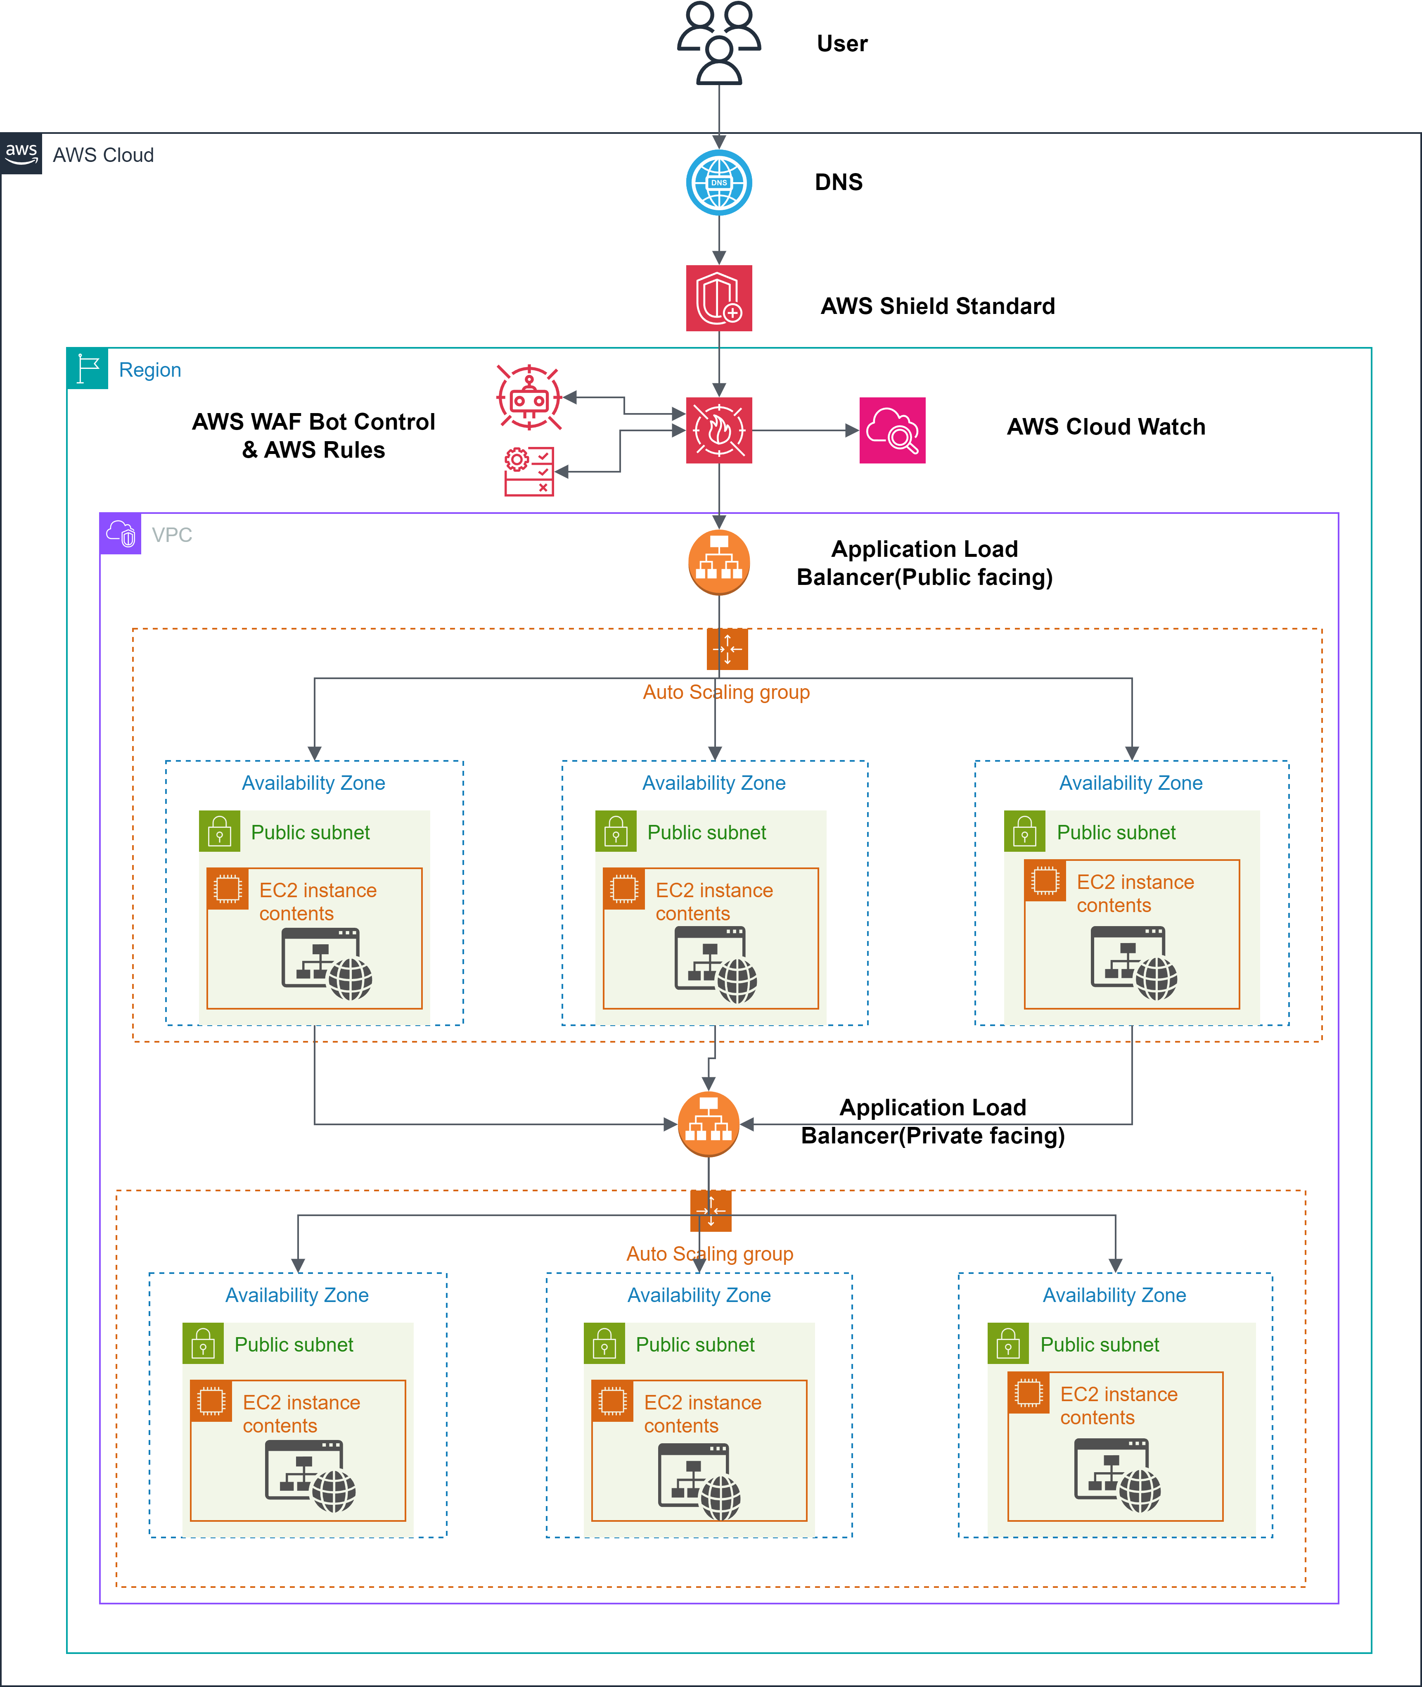
TECHNICAL APPROACH
Kurukshetra Coders
Multi-layered Defense: AWS WAF, AWS Shield, and AWS IAM form a multi-layered defense, safeguarding at every level.
AWS EC2 Auto Scaling groups adjust resources in real-time, ensuring optimal performance under attack and AWS CloudFront caches content globally, delivering it to users with blazing speed.
AWS WAF-powered threat detection keeps site secure and efficient.
Implementing a multi-layered defense using both private and public-facing Application Load Balancers within AWS VPC, ensuring high availability and rapid recovery against all types of DDoS attacks.
Proactive Monitoring: Implementing continuous monitoring using AWS CloudWatch Logs to identify potential vulnerabilities and threats.
Cloud-Native Architecture: Taking advantage of AWS's scalable and resilient cloud infrastructure to provide a flexible and adaptable platform.

Slide 4
FEASIBILITY AND VIABILITY
Kurukshetra Coders
Feasibility Analysis:
Technical: Leverages AWS services with ML integration for automated DDoS defense.
Operational: Scalable, low-maintenance infrastructure using AWS.
Economic: Cost-efficient with optimized resource allocation.
Market: High demand across multiple industries for DDoS protection.
Potential Challenges and Risks:
Complexity: Implementing a multi-layered DDoS protection strategy can be complex, requiring careful planning and configuration.
Cost: Maintaining a robust DDoS protection system can be expensive, especially for smaller organizations.
Evolving Threats: New DDoS attack techniques may emerge, requiring continuous updates to the protection system.
Strategies for Overcoming the above Challenges:
Phased Implementation: Cloud Kavach will be built in phases to manage complexity and costs.
Cost Optimization: Cloud Kavach will be built on cost-saving measures, such as utilizing reserved instances and optimizing resource usage.
Stay Updated: Staying informed about the latest DDoS attack trends and update the protection system accordingly.

Slide 5
IMPACT AND BENEFITS
Kurukshetra Coders
Enhanced Security: Robust protection using AWS WAF, Shield, and AWS Bot Control to defend against DDoS attacks across OSI layers, ensuring website resilience.
Automated Detection & Response: Machine Learning on AWS WAF enables quick threat detection and response, reducing downtime and maintaining availability.
High Availability: AWS Auto Scaling and Load Balancers ensure seamless service by dynamically adjusting to traffic, minimizing disruption during attacks.
Scalable Cloud Architecture: Built on AWS best practices, the architecture scales with demand, providing long-term resilience and stability.
Continuous Monitoring: AWS CloudWatch Logs and proactive defense mechanisms ensure real-time threat detection and mitigation, enhancing overall security.
Target Audience: E-commerce, Finance, Education, Healthcare, Government—any sector requiring secure, high-availability online services.

Slide 6
RESEARCH AND REFERENCES
Kurukshetra Coders
K. Kumari and M. Mrunalini, “Detecting Denial of Service attacks using machine learning algorithms,” Journal of Big Data, vol. 9, no. 1, Apr. 2022, doi: https://doi.org/10.1186/s40537-022-00616-0.
I. Manoja, N. S. Sk and D. R. Rani, "Prevention of DDoS attacks in cloud environment," 2017 International Conference on Big Data Analytics and Computational Intelligence (ICBDAC), Chirala, Andhra Pradesh, India, 2017, pp. 235-239, doi: 10.1109/ICBDACI.2017.8070840.
S. Bhingarkar and D. Shah, "A survey: Cloud hosted website protection using soft computing techniques," 2017 7th International Conference on Cloud Computing, Data Science & Engineering - Confluence, Noida, India, 2017, pp. 325-330, doi: 10.1109/CONFLUENCE.2017.7943170.
A. Rukavitsyn, K. Borisenko and A. Shorov, "Self-learning method for DDoS detection model in cloud computing," 2017 IEEE Conference of Russian Young Researchers in Electrical and Electronic Engineering (EIConRus), St. Petersburg and Moscow, Russia, 2017, pp. 544-547, doi: 10.1109/EIConRus.2017.7910612. ‌

