Slide 1
PL/ SQL
Procedural Language extension of SQL.

Slide 2
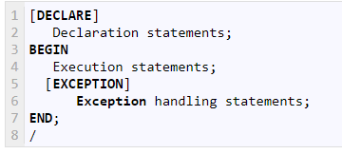

Slide 3
Types of PL/SQL block
Anonymous blocks-
which do not have any names assigned to them
they will not be stored in the server as database objects.
These blocks start with the keyword 'DECLARE' or 'BEGIN'.
Named Blocks
have a specific and unique name for them.
They are stored as the database objects in the server.
it will start with the keyword 'CREATE'
Named blocks are basically of two types:
Procedure
Function

Slide 4
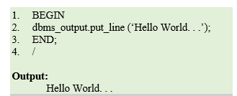

Slide 5
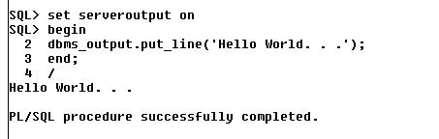

Slide 6
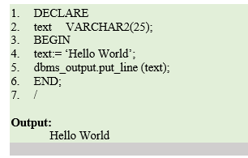

Slide 7
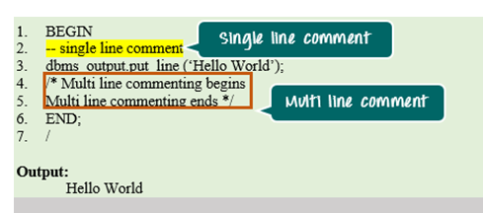

Slide 8
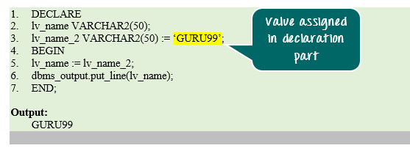

Slide 9
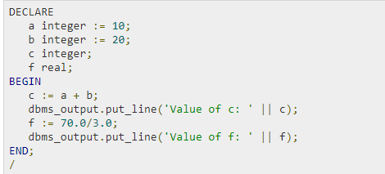
pi constant number := 3.141592654;

Slide 10
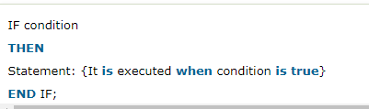
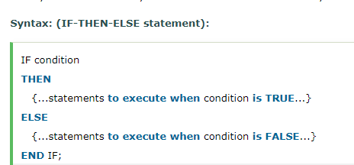

Slide 11
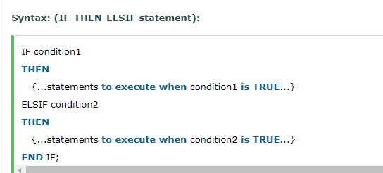

Slide 12
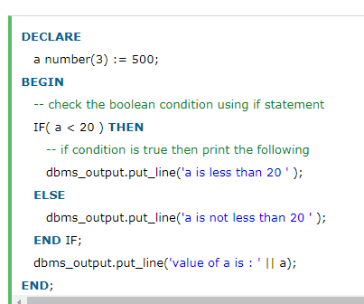

Slide 13
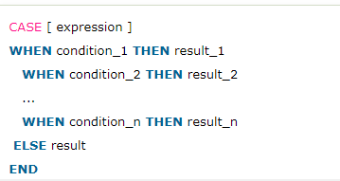

Slide 14
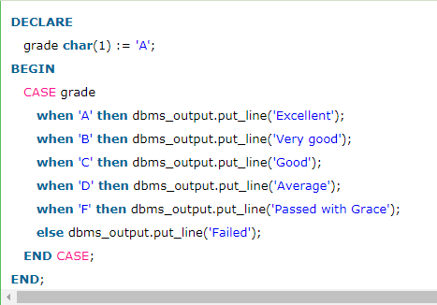

Slide 15
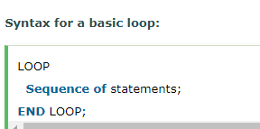
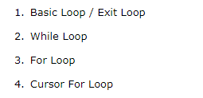

Slide 16
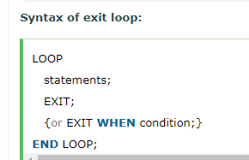
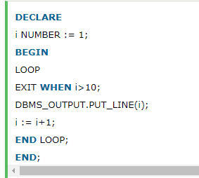

Slide 17
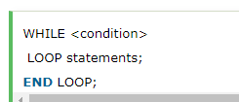
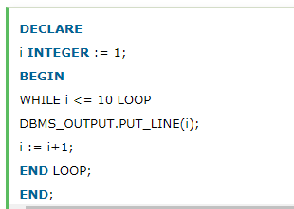

Slide 18
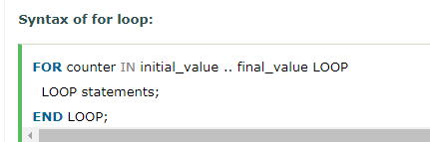
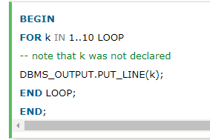
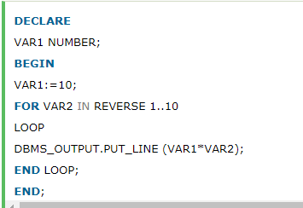

Slide 19
%type
v_ename VARCHAR2(10);
v_deptno NUMBER(2);
BEGIN
SELECT ename, deptno INTO v_ename, v_deptno FROM emp WHERE empno = 1; DBMS_OUTPUT.PUT_LINE('Name : ' || v_ename);

Slide 20
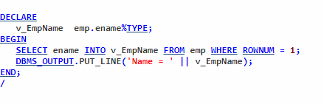
%TYPE :
is used to declare a field with the same type as -- that of a specified table's column

Slide 21
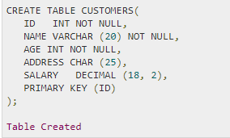
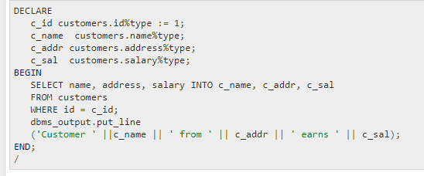

Slide 22
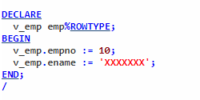
%ROWTYPE
is used to declare a record with the same types as -- found in the specified database table, view or cursor:

Slide 23
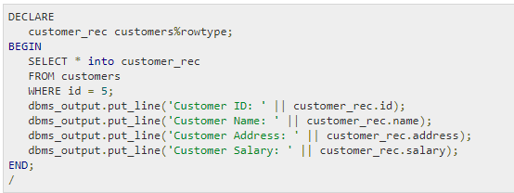

Slide 24
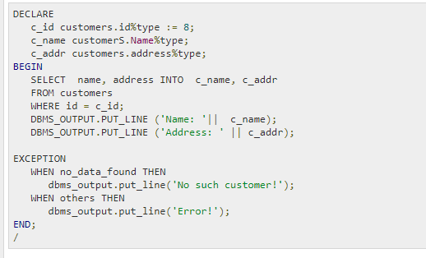
exception

