Slide 1


COMPUTER NETWORKS
24CS2202
Topic:
Guided and unguided media
Session - 6

Slide 2



AIM OF THE SESSION
To familiarize students with different transmission media in Computer networks.
INSTRUCTIONAL OBJECTIVES
This Session is designed to:
Describe different guided transmission media.
Describe different unguided transmission media.
LEARNING OUTCOMES
At the end of this session, you should be able to:
Describe guided and unguided transmission media.
Understand the characteristics of twisted, untwisted, coaxial cable and fiber optic cables.
Understand characteristics of radio, microwave and infrared waves and explain how they transmit data.

Slide 3
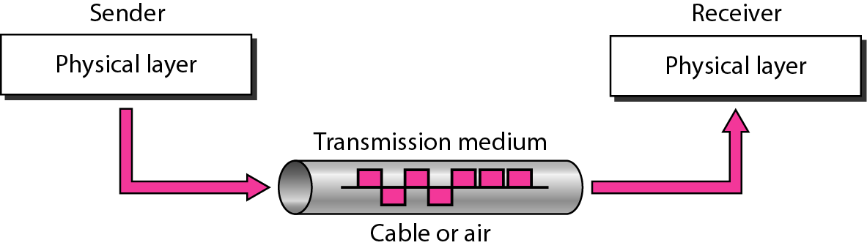
TRANSMISSION MEDIA
Transmission media are located below the physical layer and are directly controlled by the physical layer.
Its main functionality is to carry information from the sender to the receiver in the form of bits (Either as Electrical signals or Light pulses).

Slide 4
TRANSMISSION MEDIA
Factors for designing the Transmission Media:
Bandwidth: Refers to the maximum data transfer rate the media can handle.
Transmission impairment: Degradation in signal quality, when travels for long distance.
Interference: The process of disturbing a signal when it travels over a communication medium due to the addition of some unwanted signal.

Slide 5
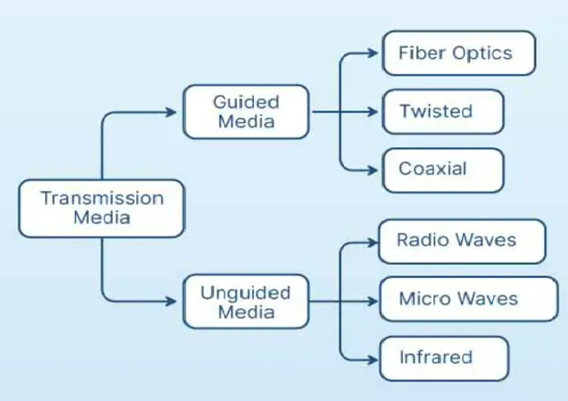
CLASSIFICATION OF TRANSMISSION MEDIA

Slide 6

GUIDED MEDIA : Twisted Pair
Twisted Pair:
Twisted pair is a physical media made up of a pair of cables twisted with each other.
Cheap as compared to other transmission media.
Installation is easy, and it is a lightweight cable.
The frequency range for twisted pair cable is from 0 to 3.5KHz.
A twisted pair consists of two insulated copper wires arranged in a regular spiral pattern.
Increasing the number of turns per foot decreases noise interference.

Slide 7
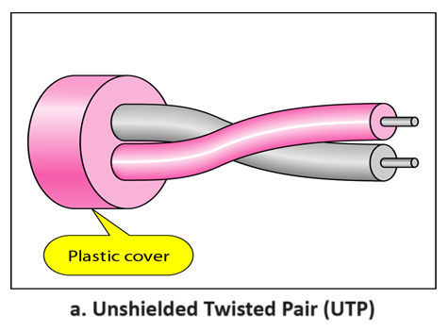
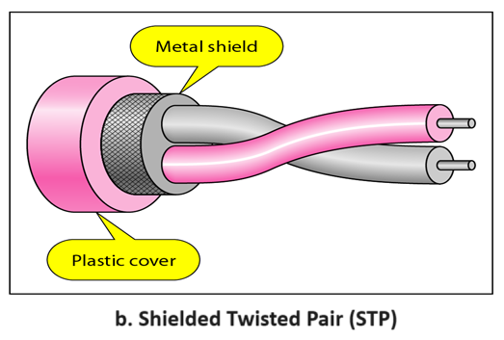
GUIDED MEDIA : Twisted Pair
Types of Twisted Pairs:
Unshielded Twisted Pair: An unshielded twisted pair is widely used in telecommunication.
Shielded Twisted Pair: A shielded twisted pair is a cable that contains the mesh surrounding the wire that allows the higher transmission rate.

Slide 8
GUIDED MEDIA : Twisted Pair
UTP | STP
Advantages | Advantages
It is cheap. Installation of the unshielded twisted pair is easy. It can be used for high-speed LAN. | An installation of STP is easy. It has higher capacity as compared to unshielded twisted pair cable. It is shielded that provides the higher data transmission rate.
Disadvantages | Disadvantages
This cable can only be used for shorter distances because of attenuation. | It is more expensive as compared to UTP and coaxial cable.

Slide 9
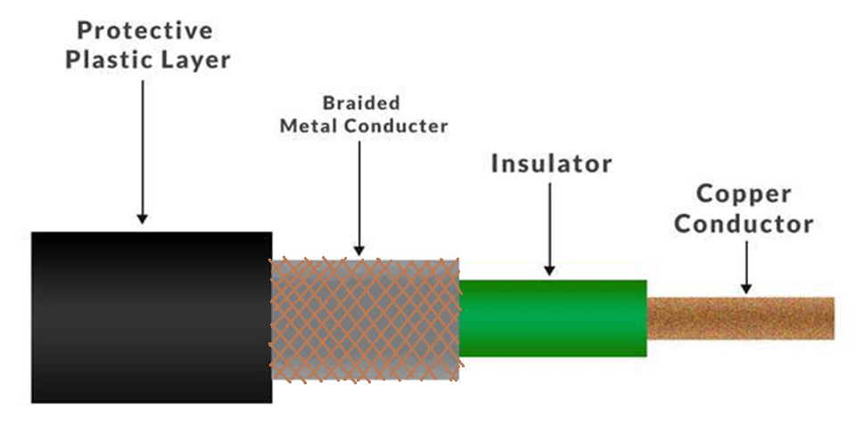
GUIDED MEDIA : Coaxial Cable
Coaxial cable is very commonly used transmission media, for example, TV wire is usually a coaxial cable.
It has a higher frequency as compared to Twisted pair cable.
It contains two conductors parallel to each other.
The inner conductor of the coaxial cable is made up of copper, and the outer conductor is made up of copper mesh.
The middle insulator is made up of non-conductive cover that separates the inner conductor from the outer conductor.

Slide 10
GUIDED MEDIA : Coaxial Cable
Coaxial Cable Types:
Baseband transmission: It is defined as the process of transmitting a single signal at high speed.
Broadband transmission: It is defined as the process of transmitting multiple signals simultaneously.
Advantages of Coaxial Cable | Disadvantages of Coaxial Cable
The data can be transmitted at high speed. It has better shielding as compared to twisted pair cable. It provides higher bandwidth. | It is more expensive as compared to twisted pair cable. If any fault occurs in the cable causes the failure in the entire network.

Slide 11
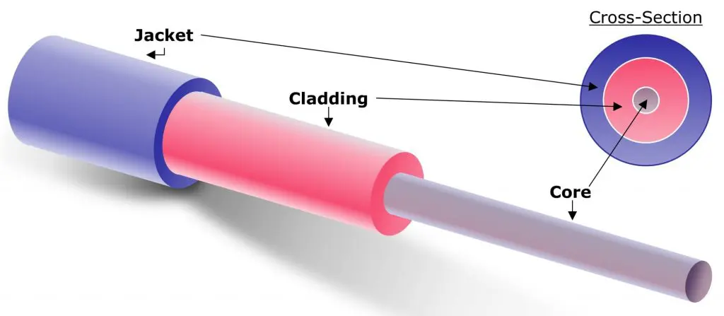
GUIDED MEDIA : Fibre Optic Cable
It holds the optical fibres coated in plastic that are used to send the data by pulses of light.
The plastic coating protects the optical fibres from heat, cold, electromagnetic interference from other types of wiring.
Fibre optics provide faster data transmission than copper wires.
Core: Strand of glass through which the light waves are transmitted. The more the area of the core, the more light will be transmitted through the fibre.
Cladding: The concentric layer of glass that is used to cause the reflection within the core so that the light waves are transmitted through the fibre.
Jacket: The protective coating that is used to preserve the fibre strength, absorb shock and extra fibre protection.

Slide 12
GUIDED MEDIA : Fibre Optic Cable
Advantages of Fibre Optic:
Greater Bandwidth: Fibre optic cable provides more bandwidth and therefore it carries more data as compared to copper cable.
Faster speed: Fibre optic cable carries the data in the form of light and thus it carries the signals at a higher speed.
Better reliability: Fibre optic cable is more reliable than the copper cable as it is immune to any temperature changes.
Thinner and lighter: Fibre optic cable is thinner and lighter in weight.

Slide 13
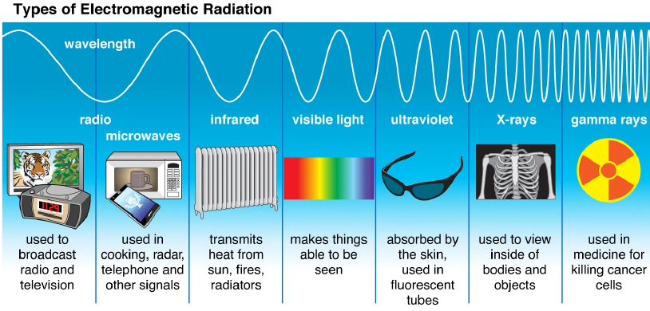
UNGUIDED MEDIA
In unguided media, air is the media through which the electromagnetic energy can flow easily. Radio waves, Micro waves, and Infrared waves are unguided medias

Slide 14
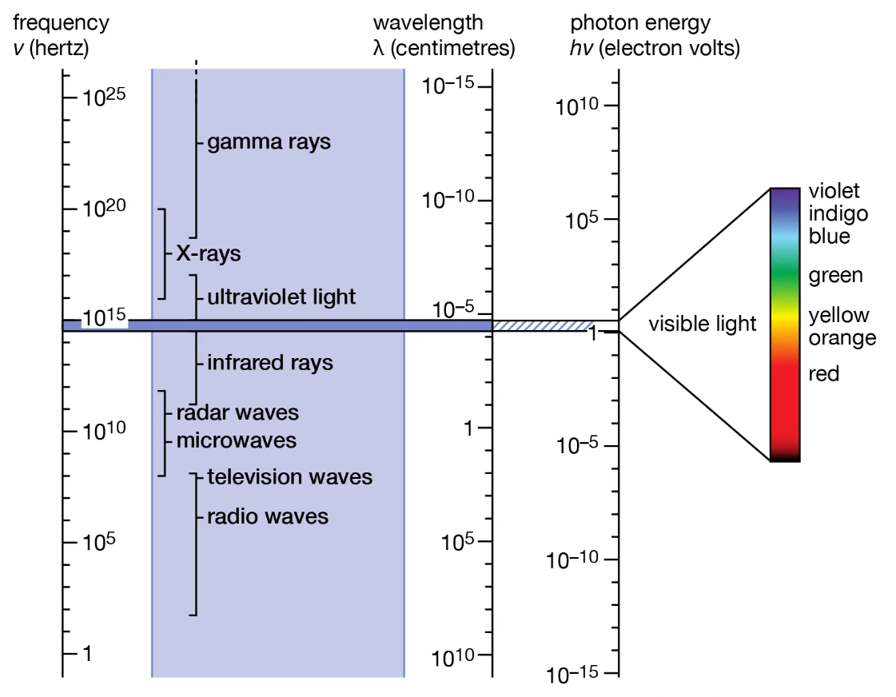

Slide 15
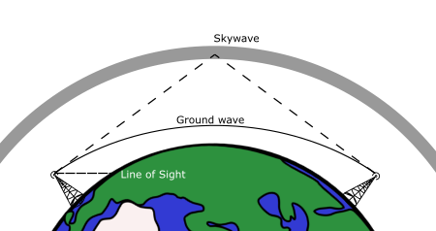
UNGUIDED MEDIA : Radio Waves
Radio Waves:
Radio waves are the electromagnetic waves that are transmitted in all the directions of free space.
Radio waves are omnidirectional, i.e., the signals are propagated in all the directions.
The range in frequencies of radio waves is from 3Khz to 1Ghz.
The sending and receiving antenna are not aligned, i.e., the wave sent by the sending antenna can be received by any receiving antenna.
An example of the radio wave is FM radio.

Slide 16
UNGUIDED MEDIA : Radio Waves
Applications Of Radio waves:
A Radio wave is useful for multicasting when there is one sender and many receivers.
Examples of Radio Waves: FM radio, Television, Cordless phones.
Advantages Of Radio transmission:
Radio transmission is mainly used for wide area networks and mobile cellular phones.
Radio waves cover a large area.
Radio transmission provides a higher transmission rate.

Slide 17
UNGUIDED MEDIA : Micro Waves
Micro Waves:
Electromagnetic waves having frequencies between 1 and 300 GHz are called microwaves.
Microwaves are unidirectional. The sending and receiving antennas need to be aligned.
A pair of antennas can be aligned without interfering with another pair of aligned antennas.
Types of Microwaves:
Terrestrial Microwave: Microwaves that transmits the beam of a radio signal from one ground-based antenna to another ground-based antenna.
Satellite Microwave: Microwaves that transmits data (in form of radio signals) between a ground-based station and an orbiting satellite.

Slide 18
UNGUIDED MEDIA : Infrared Waves
Infrared Waves:
An infrared transmission is a wireless technology used for communication over short ranges.
The frequency range of the infrared is 300 GHz to 400 THz.
It is used for short-range communication such as data transfer between two cell phones, TV remote operation, data transfer between a computer and cell phone resides in the same closed area.
Characteristics Of Infrared:
It supports high bandwidth, and hence the data rate will be very high.
Infrared waves cannot penetrate the walls. Therefore, the infrared communication in one room cannot be interrupted by the nearby rooms.
An infrared communication provides better security with minimum interference.

Slide 19
SELF-ASSESSMENT QUESTIONS
Which of this is not a guided media?
Fiber Optic Cable
Coaxial Cable
Wireless LAN
Twisted Pair
Coaxial cable consists of _______ concentric copper conductors.
1
2
3
4
3. _____ cable can carry signals of higher frequency ranges than _____ cable.
Twisted pair; Fiber Optic
Twisted pair; Fiber Optic
Fiber Optic; Coaxial Cable
None

Slide 20
SELF-ASSESSMENT QUESTIONS
Which of this is not a guided media?
Fiber Optic Cable
Coaxial Cable
Wireless LAN
Twisted Pair
Coaxial cable consists of _______ concentric copper conductors.
1
2
3
4
3. _____ cable can carry signals of higher frequency ranges than _____ cable.
Twisted pair; Fiber Optic
Twisted pair; Fiber Optic
Fiber Optic; Coaxial Cable
None

Slide 21

Topic Summary
Transmission Media
Guided Media
Twisted pair
Coaxial Cable
Fiber-Optic Cable
Unguided Media
Radio Waves
Micro Waves
Infrared Waves

Slide 22
REFERENCES FOR FURTHER LEARNING OF THE SESSION
Reference Books:
A.S. Tanenbaum, David J. Wetheral “Computer Networks” Pearson, 5th Edition.
Kurose, J and Ross, K Computer Networking: A Top-Down Approach Addison-Wesley- 6th edition.
Sites and Web links:
https://www.geeksforgeeks.org/types-of-transmission-technology/
https://www.tutorialspoint.com/data_communication_computer_network/computer_network_topologies.htm
3. https://www.javatpoint.com/computer-network-transmission-modes

Slide 23
THANK YOU
Team – Computer Networks

