Slide 1
Traffic Management Through CloudFirewall
Members -
Abhiranjan Singh
Nirav Patil

Slide 2
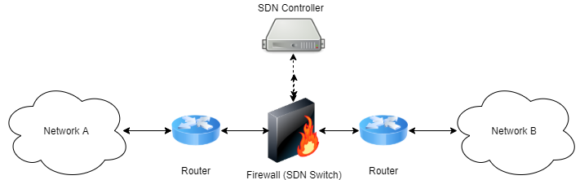
What is Traffic management through CloudFirewall?
CloudFirewall is a SDN based firewall, which can be used to block or forward the different types of traffic between two different networks.
It supports three different work modes: white-list based forwarding, black-list based blocking and a pass-through mode which forwards all traffic, but still gathers different statistics on it.

Slide 3
How Does it Works?
Cloud Firewall is implemented as an SDN controller, which is programmed to forward or block certain TCP/UDP flows, where a TCP/UDP flow can be uniquely identified by the five-tuple.
Source IP
Destination IP
Transfer Protocol Type
Source Port
Destination Port
This SDN controller controls, using the OpenFlow protocol, an underlying SDN switch which interconnects two certain networks.
Whenever the packet starting the new flow is received at the switch. it passes it to the controller, which in turn decides whether this flow should be passed to the other network or otherwise blocked there only. This decision based upon the firewall's current work mode (black-list / white-list / pass-through) and its current defined rules set.

Slide 4

Implementation
The implementation consist of two different parts.
SDN Firewall : It is written in Python and is built above the POX framework. It exposes an XML-RPC based API which allows manipulating the firewall's behavior.
The Web UI : The firewall's UI is implemented as a web application. It's back-end is written in Python above the Flask micro-framework.

Slide 5
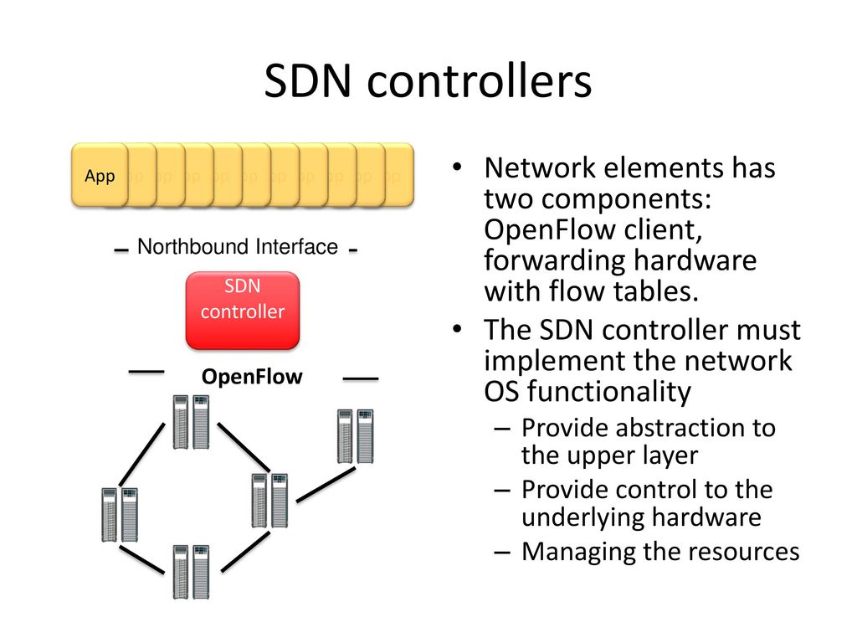
SDN Controller

Slide 6
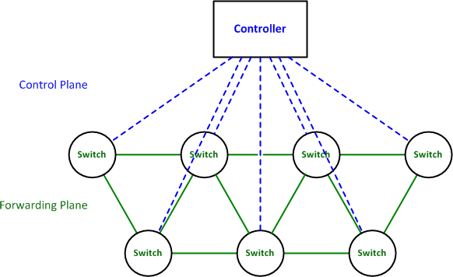
SDN Switch
SDN Switch is the network switch that will use the packets switching data to process, receive or forward data between devices within computer network.

Slide 7
Pros & Cons
Pros
Agile
Directly programmable
Centrally managed
Research and experimenting is not too expensive
Cons
Lack of hardware security
Distributed denial-of-service attacks

Slide 8
Objective
This first and the basic objective to build this project is to totally control the flow of the data packets across the entire network
Maintaining the complete logs of all the communications that are passing through the firewall controller
Preventing the Active attacks
Preventing internal and External threats
Dealing with the structured and unstructured attacks
Confidentiality: Keeping the information safely in the servers and avoid unauthorize access to the servers.
Maintaining the integrity of the network, if the data is within the network

Slide 9
Platforms Used
Python
Linux
Mininet v2.2.2 64bit
POX

Slide 10
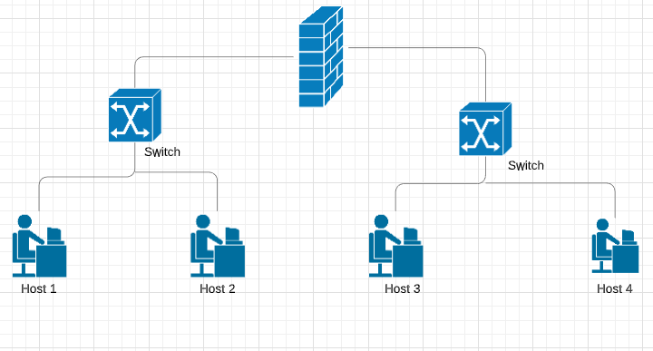
Diagram

Slide 11
Firewall as a monitoring server(Log Server)
The Firewall is configured such that there are three modes
Whitelist
Blacklist
Passthrough
Each packet that is flowing through the firewall is monitored and can be used to analyze in case of any issues

Slide 12
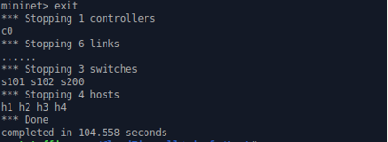
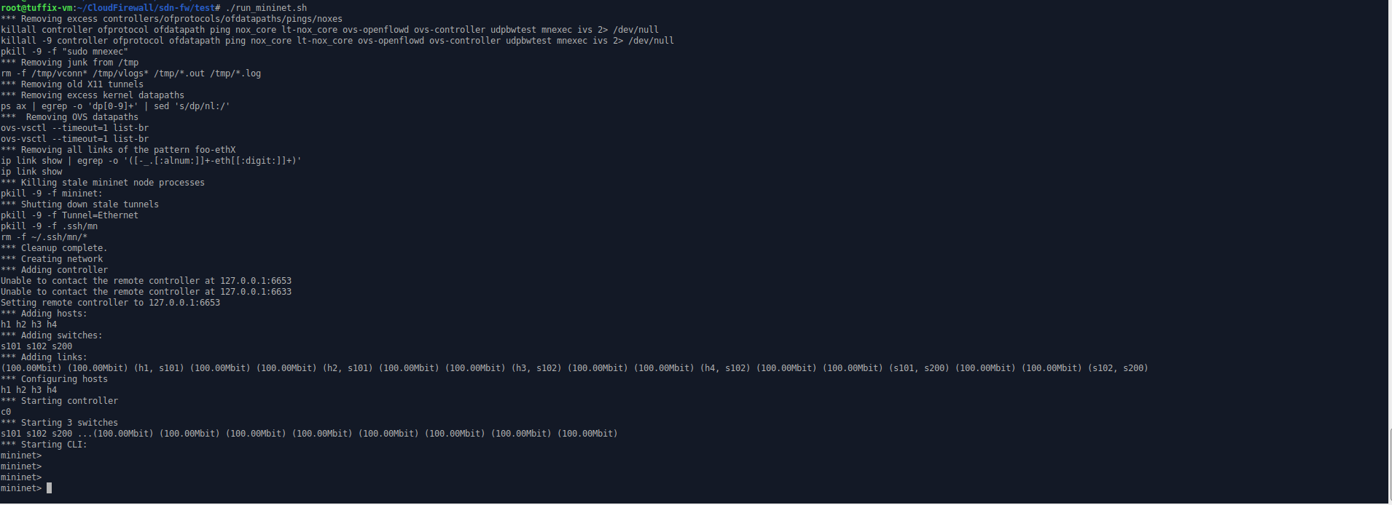
Screenshots for the test network

Slide 13
Open Flow
An open flow is the software programmed technology that forwards the packets in the Software Defined Networks
OpenFlow separates the programming of network device from underlying hardware, and offers a standardized way of delivering
The OpenFlow switch communicates with the controller and the controller manages the switch via the OpenFlow switch protocol
OpenFlow (OF) is considered one of the first software-defined networking (SDN) standards
To work in an OF environment, any device that wants to communicate to an SDN Controller must support the OpenFlow protocol

Slide 14
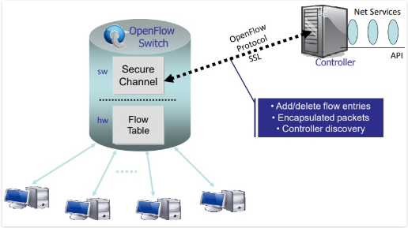
OpenFlow Switch vs Conventional Switch
Traffic can be isolated without the need for vlans, the SDN controller of OpenFlow switch can just refuse certain connections
The SDN controller can easily implement load-balancing at high data rates by just directing different flows to different hosts, only doing the set-up of the initial flow’s
With OpenFlow enabled switch, the SDN controller could route non critical/bulk traffic on longer routes that are not fully utilized

Slide 15
Milestones achieved
Getting the Web UI for the Firewall
Creating and Disabling the Rules in the Firewall through the Console in Linux(mininet)
Creating the network as planned

Slide 16
Issues Faced
Trouble in getting the links to be connected
Searching the stable version of mininet for the proper simulation
Issues in getting the logs in the firewall dashboard

Slide 17
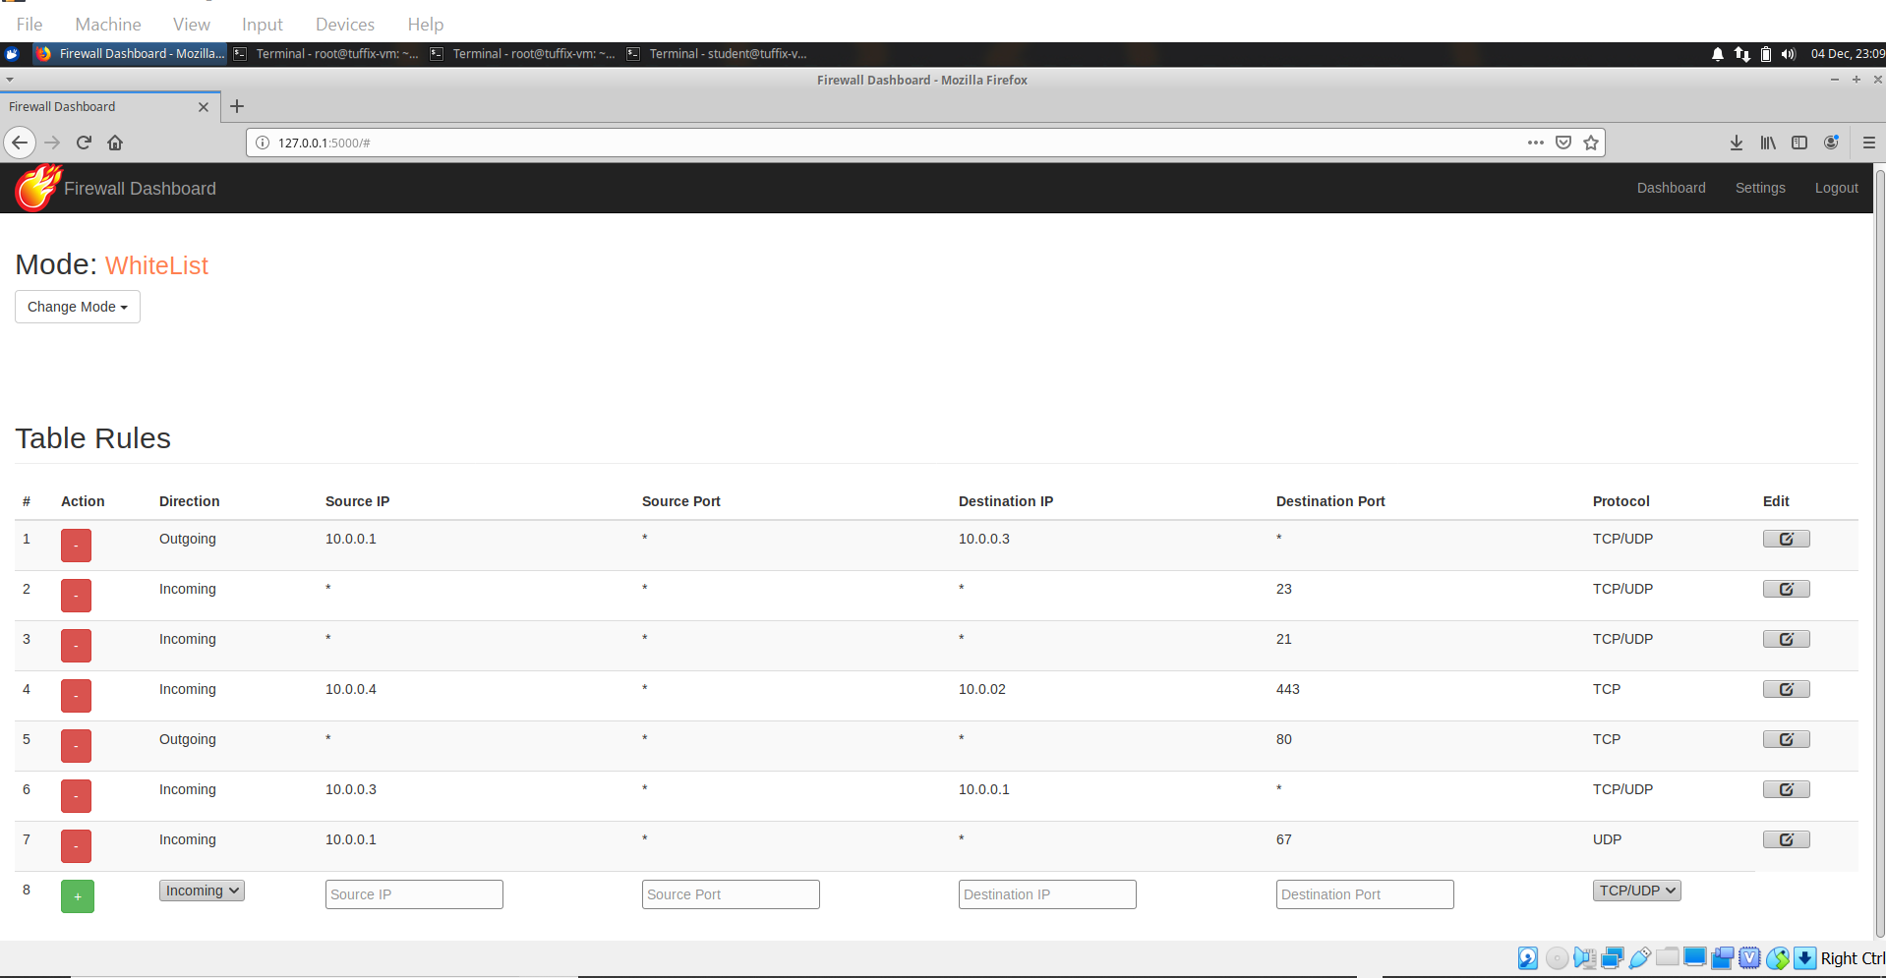
Firewall Dashboard

Slide 18

DEMO

