Slide 2
POWER TREE
462.4mA
191mA
2mA
I/O Expander
DFR0559
AMS1117S 3.3
15.5mA
5V, 1A
3V3, 1A
Si5351
2mA
INA219
19mA
Arduino NANO
80mA
3.7 V, 3.4Ah
NEO 6M
90mA
ESP32 WROOM 32
8.5mA
2P LGMJI18650
HW-290
150mA
ESP32 CAM
83mA
SX1278(Lora)
0.4mA
74HCT125
Req. Energy / hour | 3.36 Wh
Max battery energy | 25.16 Wh
Usable energy (70%) | 17.61 Wh
Backup time | ≈ 5.2 h
Est. Flight Time | = 3-4 h
9mA
DTMF
1060mA
60mA
SA868 (VHF)
1000mA
SA868 (UHF)

Slide 3
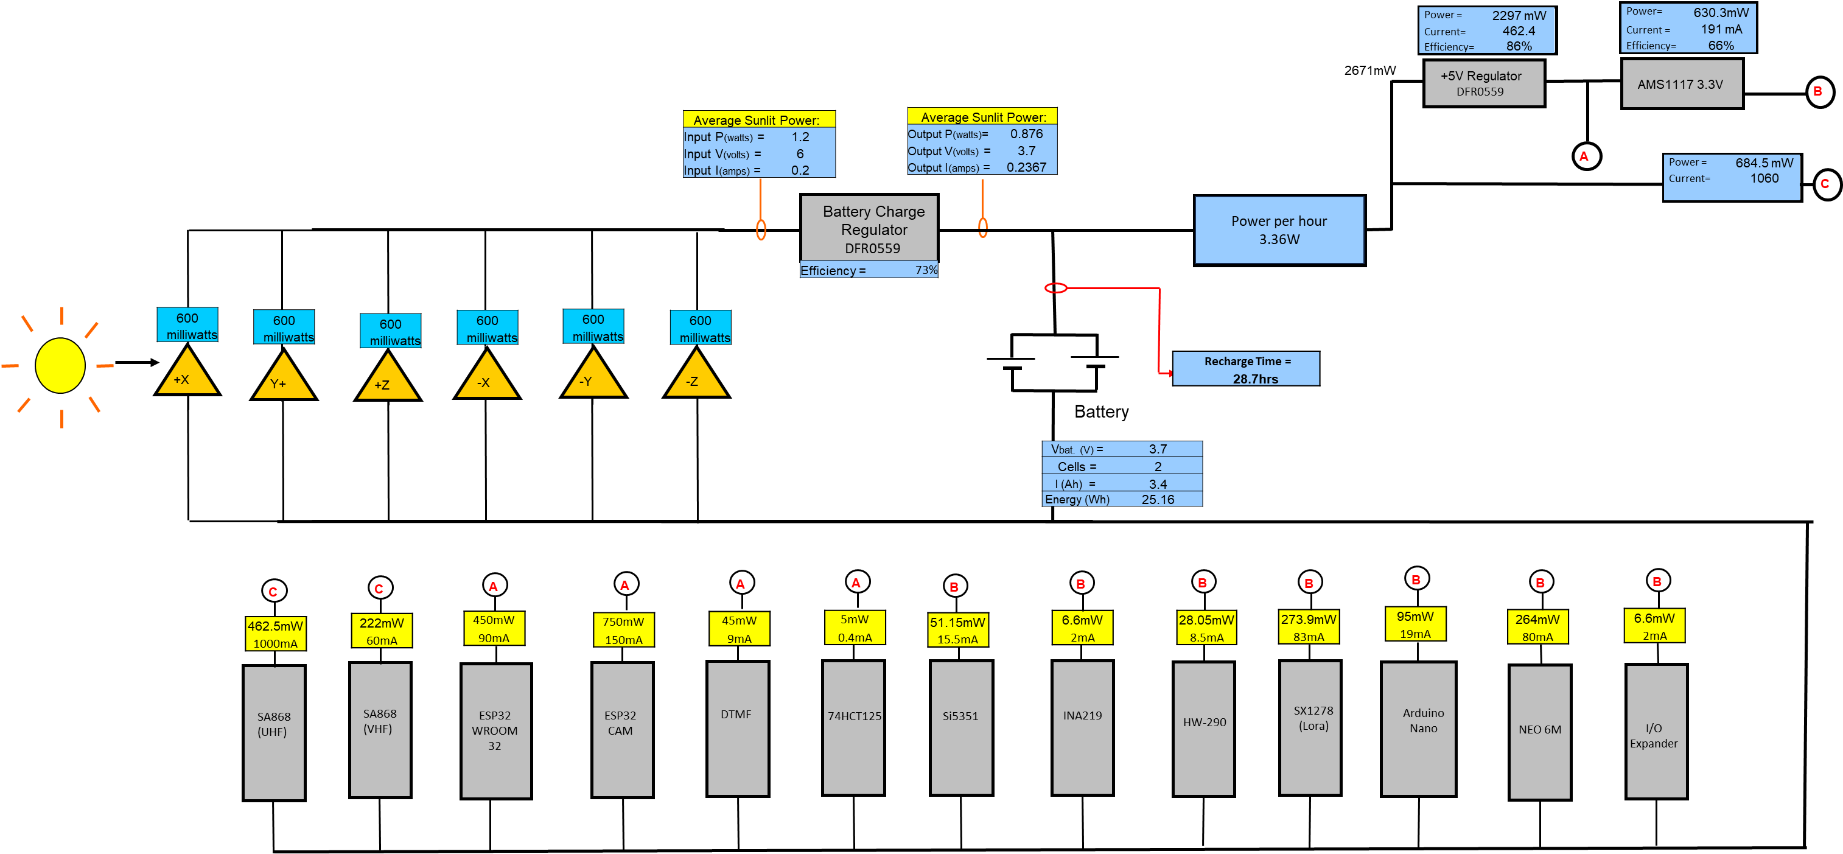

Slide 4


