Slide 1
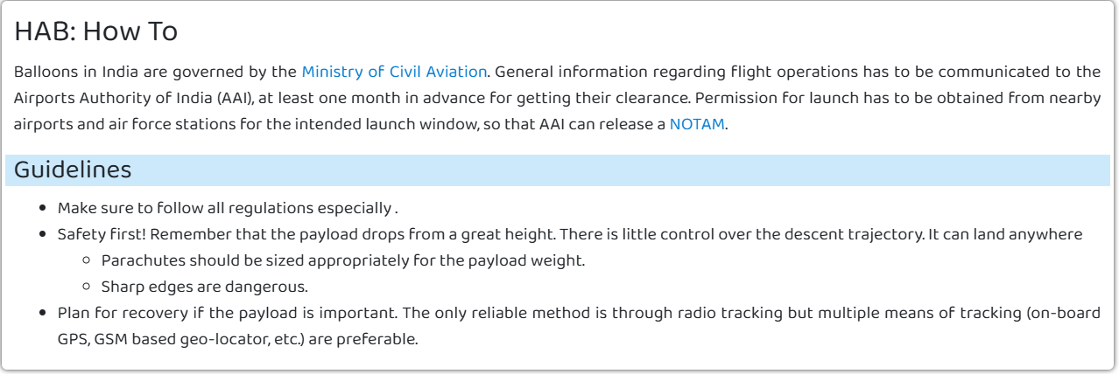
PERMISSION and REGULATIONS

Slide 2
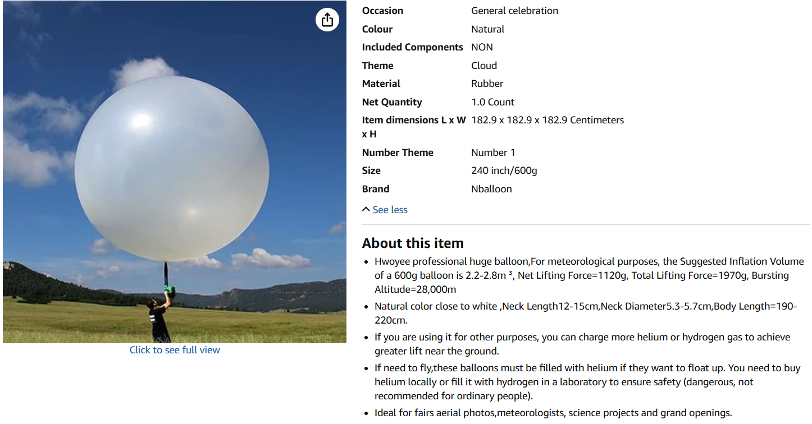


Slide 3
