Slide 1
AI AGENT FOR NBA ACCREDITATION PROCESS
CAPSTONE PROJECT
Presented By:
1. ABHISHEK B-NSS COLLEGE OF ENGINEERING PALAKKAD-ELECTRONICS AND COMMUNICATION ENGINEERING

Slide 2
OUTLINE
Problem Statement
Proposed System/Solution
System Development Approach (Technology Used)
System Architecture
Algorithm & Deployment
Result (Output Image)
Conclusion
Future Scope
References

Slide 3
Problem Statement
An AI agent designed to assist faculty with NBA accreditation processes using RAG (Retrieval-Augmented Generation).
It retrieves relevant NBA criteria, formats, and past documentation from internal and external sources. Faculty can query the agent for guidance on SAR preparation, CO-PO mapping, and documentation. The RAG model ensures up-to-date and context-aware responses, grounded in trusted data. It reduces manual effort, ensures consistency, and speeds up accreditation readiness. This intelligent assistant supports continuous improvement and compliance with NBA standards.

Slide 4
Proposed Solution
The proposed system addresses the challenges faculty face during NBA accreditation by introducing a Retrieval-Augmented Generation (RAG)-based AI assistant,hosted on IBM Watsonx. The solution simplifies SAR preparation, CO-PO mapping, and compliance documentation by offering intelligent, real-time assistance through a user-friendly chat interface.
Document Collection & Indexing:
Gather internal documents such as past SARs, CO-PO matrices, rubrics, and assessment reports.
Collect official NBA criteria and formatting guidelines from the NBA website.
Index all documents using a vector database or Watson Discovery for fast and accurate retrieval.
Data Preprocessing:
Clean and structure unformatted documents (PDFs, DOCs).
Segment documents by criteria and sections (e.g., Criterion 1–10).
Convert content into embeddings for semantic search.
AI Model & RAG Architecture:
Use LangGraph + ReAct for agent orchestration and logical flow.
Implement IBM Granite LLM for generating grounded, document-based answers.
Enable Retrieval-Augmented Generation (RAG) to combine relevant document chunks with generative response.
Agent provides responses with contextual references and suggested templates.
Deployment:
Deploy on IBM Cloud Lite using scalable and serverless architecture.
Integrate IBM Object Storage, Granite APIs, and vector index backend.
Evaluation & Feedback Loop:
Review AI responses with faculty validation.
Use feedback to refine prompts, update document index, and improve model accuracy.

Slide 5
System DEVELOPMENT APPROACH
The system uses:
- IBM Watsonx (LangGraph + ReAct)
- IBM Granite LLM for responses
- Vector Index of NBA documents
- Retrieval-Augmented Generation pipeline
- Web chat interface for faculty queries

Slide 6
System workflow
Collect NBA criteria, past SARs, CO-PO documents
Store documents in IBM Object Storage
Index using Watson Discovery / custom vector database
Use LangGraph + ReAct for orchestration
Granite model for generating grounded responses

Slide 7
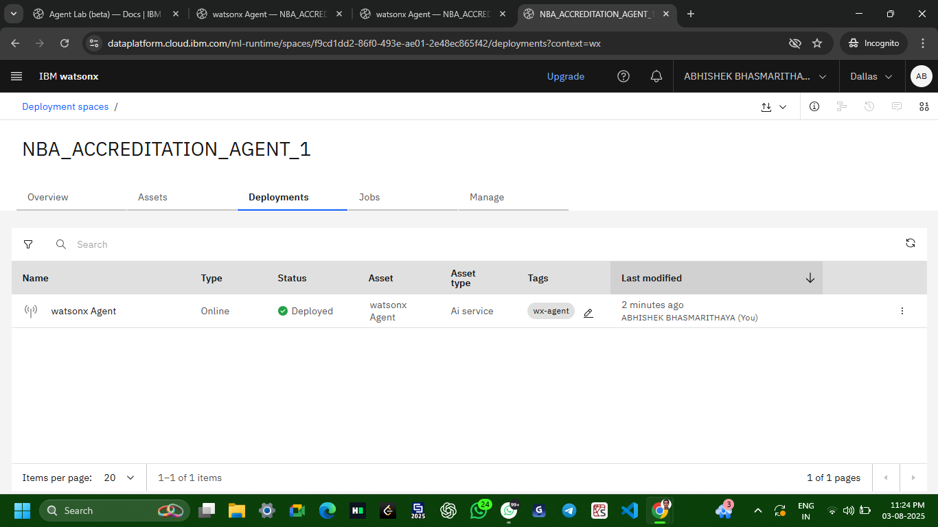
Deployment ON IBM WATSONX
The agent is deployed using IBM Watsonx:
- Model: mistral-large
- Framework: LangGraph
- Architecture: ReAct
- Instructions and document vector index configured
- Live chat interface provides document-based answers

Slide 8
Result
- Successfully deployed RAG-based assistant
- Faculty queries answered with document-specific data
- Reduced manual effort in SAR preparation
- Screenshots show live interaction with agent

Slide 9
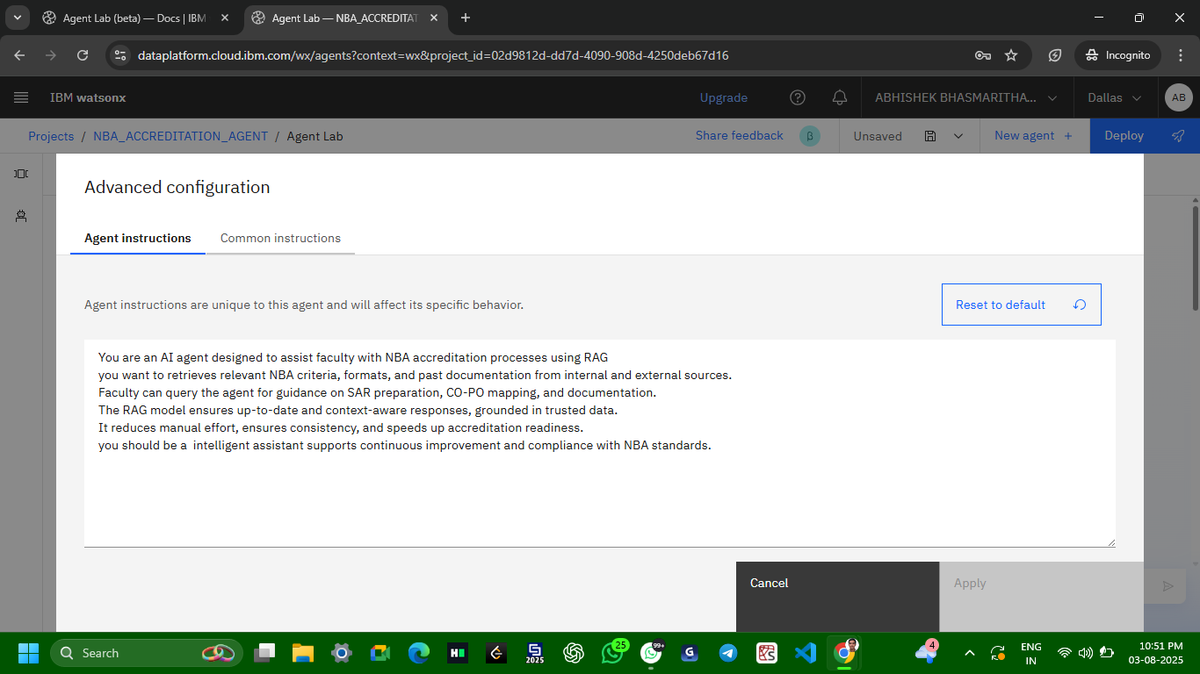
INSTRUCTIONS GIVEN TO AGENT AI

Slide 10
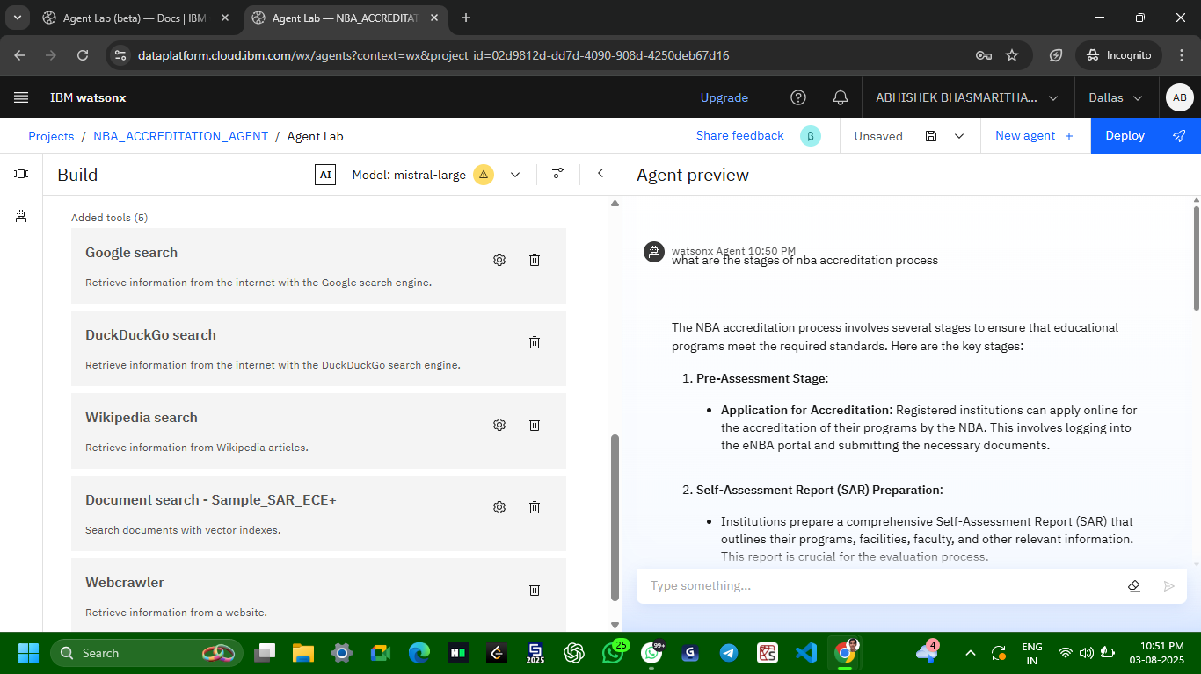
PROMPTS/QUESTIONS AND OUTPUTS

Slide 11
PROMPTS/QUESTIONS AND OUTPUTS
Question 2:How course outcomes mapped to program outcomes
output

Slide 12
Conclusion
The AI assistant helps faculty by simplifying and accelerating NBA documentation. It provides accurate, reliable guidance from institutional data using IBM Watsonx, RAG architecture, and Granite LLMs. It promotes readiness, standardization, and quality compliance.

Slide 13
Future scope
Add NAAC and ABET support
Integrate voice queries and ERP systems
Provide real-time documentation completion analytics
Expand to support multi-department and multi-institute use

Slide 14
References
Rajkumar, Sreepadapu & Polasa, Swathi. (2021). An Overview of Application for N.B.A Accreditation to Diploma Level Polytechnic Institutions in India and Advantages. IARJSET. 8. 10.17148/IARJSET.2021.8916.
Panda, Meethun. (2025). Agentic RAG Redefining Retrieval-Augmented Generation for Adaptive Intelligence.

Slide 15
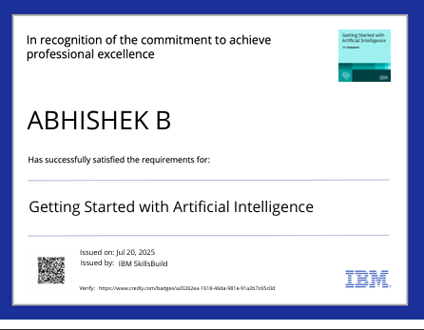
IBM Certifications

Slide 16
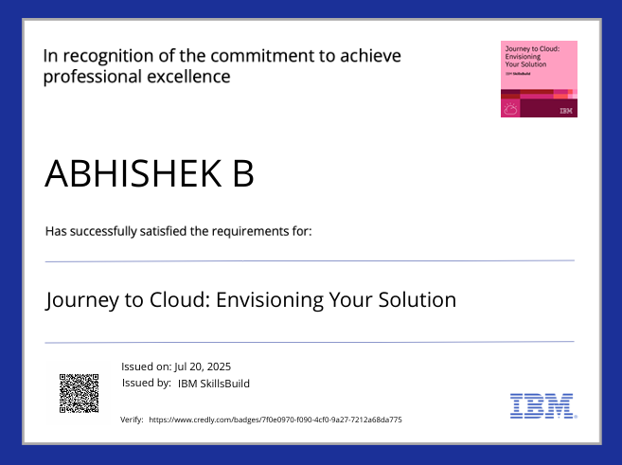
IBM Certifications

Slide 17
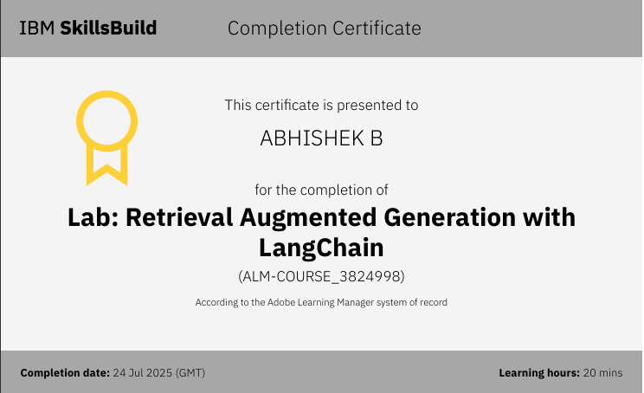
IBM Certifications

Slide 18
THANK YOU

