Slide 1
Kubernetes Failure Prediction - Hackathon Phase 1
TrailMakers |Rutuja Bhagat, Bhoomika R P , Abhishek Yelmamdi

Slide 2
Problem Statement -
Kubernetes clusters are prone to critical failures:"
"Pod crashes"
"Resource bottlenecks"
"Network disruptions"
"Objective: Develop an AI/ML model to predict these failures using historical and real-time metrics"

Slide 3
Approach
1. Data Collection: Sourced 10,000-sample dataset of cluster metrics .
2. Preprocessing: Imputed missing values (e.g., issue_type as No_Issue), normalized features, sorted chronologically
3. Feature Engineering: Generated 25 features (e.g., rolling averages, network_io_delta), selected 15 using Random Forest importance
4. Model Training: Trained XGBoost with 5-fold TimeSeriesSplit, class weighting (scale_pos_weight=22.9), and hyperparameter tuning"
5. Anomaly Detection: Added Isolation Forest (contamination=0.01) for hybrid model to detect outliers
6. Threshold Optimization: Defined custom thresholds for 9 issue types (e.g., node_failure: 0.7) to balance precision/recall
7. Validation: Evaluated on 80/20 split (2000 test samples) and noise test (std=0.05) for robustness

Slide 4
Data Overview
Source: 10,000-sample Kubernetes cluster metrics dataset sourced from the internet (Kaggle)
Features: 25 engineered (e.g., rolling averages, network_io_delta), 15 selected (e.g., node_ready_status, pod_restart_count)
Classes: 10 issue types (e.g., node_failure, pod_crash), 70% No_Issue, highly imbalanced
Split: 80/20 chronological (8000 training samples, 2000 test samples)
Dataset-link: kubernetes_health_ds1

Slide 5
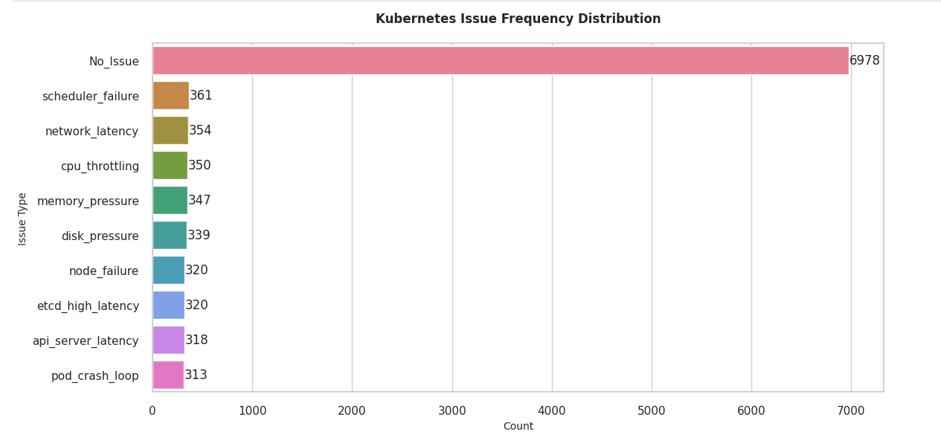

Slide 6
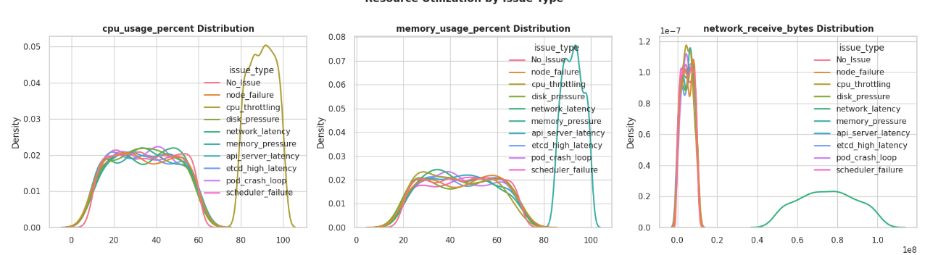

Slide 7
Model Architecture & Evaluation
Architecture Overview:
Data Input: Preprocessed 10,000 samples with 15 selected features
Primary Model: XGBoost with gradient boosting, 5-fold TimeSeriesSplit for temporal consistency
Parameters: scale_pos_weight=22.9 to address imbalance, tuned max_depth, learning_rate, and n_estimators
Anomaly Detection: Isolation Forest (contamination=0.01) to identify outliers in high-dimensional data
Hybrid Integration: Combined XGBoost probabilities with Isolation Forest anomaly scores for final predictions
Thresholds: Custom thresholds for 9 issue types (e.g., node_failure: 0.7, memory_pressure: 0.4)

Slide 8
Evaluation Approach:
Metrics: Weighted F1 Score, Precision, Recall, ROC-AUC
Training Validation: 5-fold cross-validation on 8000 samples
Test Validation: 2000-sample holdout set (clean data)
Robustness Test: Applied Gaussian noise (std=0.05) to simulate real-world variability
Outcome: High accuracy on clean data, assessed resilience under noise

Slide 9
Results
Cross-Validation (5-fold TimeSeriesSplit):"
"Average F1 Score: 0.998"
"Fold Scores: 0.9969, 0.9985, 0.9985, 0.9992, 0.9992"
"Demonstrates temporal stability across training data"
"Test Set (2000 samples):"
"XGBoost: F1: 0.999, Precision: 0.999, Recall: 0.999, ROC-AUC: 1.0"
"Hybrid Model: F1: 0.99, Precision: 0.99, Recall: 0.98"
"Near-perfect classification of 10 issue types on clean data"

Slide 10
Continued
Noise Test (std=0.05):
XGBoost F1: 0.96
Hybrid F1: 0.97
Minority class example: scheduler_failure F1 dropped from 1.0 to 0.60
Feature Importance:
node_ready_status: 0.1667
pod_restart_count: 0.0994
"network_transmit_bytes: 0.0980
Threshold Performance:
Custom thresholds yielded F1 scores of 0.993–1.0 across 9 issue types

Slide 11
Future Improvements
Real-World Validation: Test model on live Kubernetes cluster data with natural noise
Threshold Refinement: Adjust thresholds dynamically for varying cluster environments
Model Optimization: Reduce complexity (e.g., fewer features, simpler algorithms) for scalability
Data Expansion: Incorporate additional metrics (e.g., latency, error logs) for broader issue coverage
Deployment: Integrate model into a real-time monitoring system for proactive alerts

