Slide 1

CyberShield
Uncertainty-Aware Fraud Detection with Human-in-the-Loop Calibration for Cybercrime Intelligence
Presented by
Supervised by
Abhishek Yadav
Dr. Salam Michael Singh
Roll No. 230103041 | Semester VI | Project I (CS3201)
Department of Computer Science and Engineering IIIT Senapati, Manipur | April 2026

Slide 2
Problem Statement & Research Gap
Why existing fraud detection systems are insufficient for India's cybercrime landscape
PROBLEM CONTEXT
RESEARCH GAP MATRIX
Scale
1.12M+ cybercrime complaints filed in India in 2023 (MHA-NCRP). SMS and WhatsApp remain primary vectors.
Capability
SpamAssassin
Deep Spam (Roy 2020)
CyberShield
Uncertainty Routing
No
No
Yes — 4 Tiers
Binary ML
Existing classifiers force a hard decision boundary at P=0.5. There is no mechanism to express model uncertainty or abstain.
HITL Retraining Loop
No
No
Yes
Concept Drift
Fraudsters continuously evolve language. Static models degrade within weeks without active retraining.
Explainable Output
No
No
Yes — Heatmap
Auto Complaint Filing
No
No
Yes — NCRP PDF
No Action
Detection alone is insufficient. Victims have no structured, automated path from a flagged message to a formal complaint.
Velocity Intelligence
No
No
Yes
No Tracking
Repeat malicious artifacts (URLs, phone numbers) across multiple victims are not correlated by any existing system.
Concept Drift Resist.
No
No
Yes — HNM
Inference < 500ms
Yes
No
Yes

Slide 3
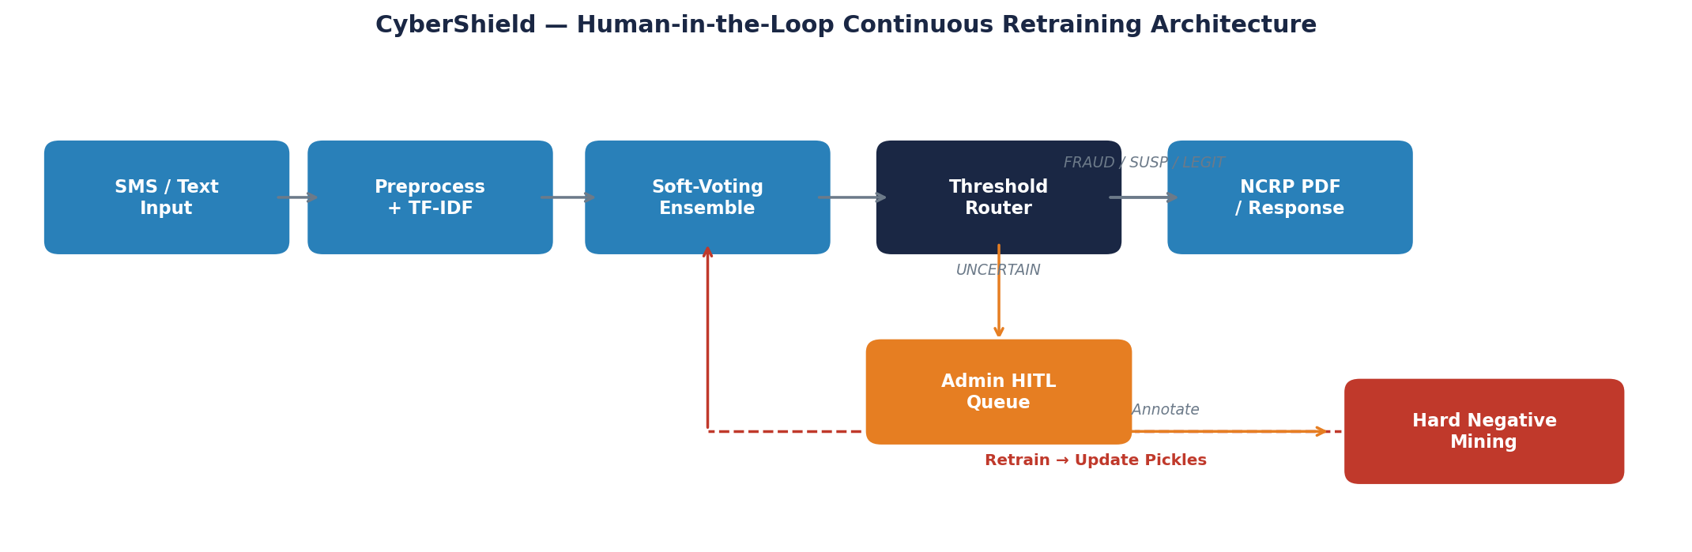
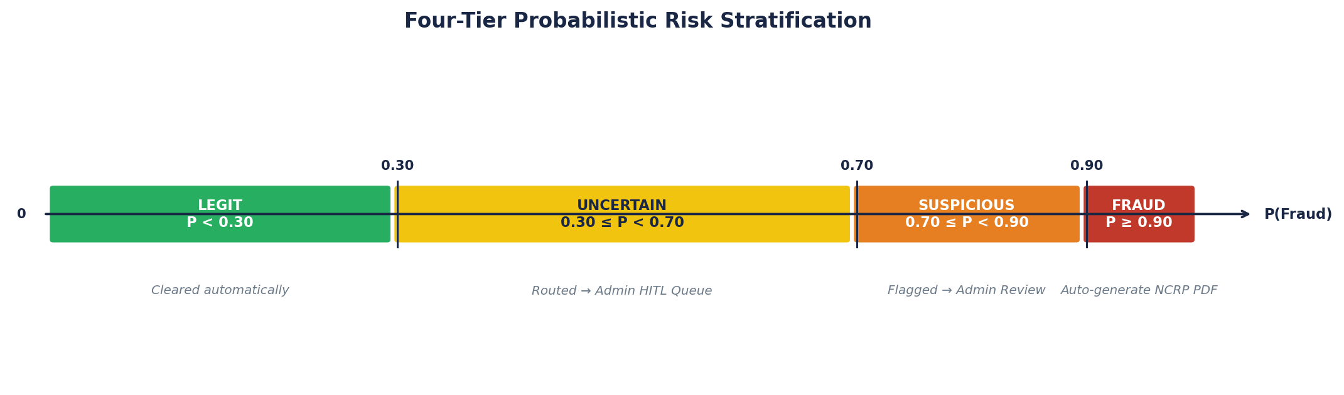
Proposed System — CyberShield
Architecture, methodology and the unique Human-in-the-Loop retraining loop
SYSTEM COMPONENTS
ML Ensemble
Soft-voting over Logistic Regression (w=0.2), Calibrated SVM (w=0.5), Naive Bayes (w=0.3) over 25,000-feature FeatureUnion TF-IDF
4-Tier Router
FRAUD (P>=0.90) | SUSPICIOUS (0.70-0.90) UNCERTAIN (0.30-0.70) | LEGIT (P<0.30) UNCERTAIN routed to HITL admin queue
Hard Negative Mining
UNCERTAIN + admin label -> boundary samples injected into retraining set (684 samples added) Model pickles updated offline without downtime
Velocity Tracker
Per-submission URL/phone extraction into velocity_db. MEDIUM>=1, HIGH>=2, CRITICAL>=4 Correlates repeat artifacts across victims
Explainability
LR coefficient weights mapped per token Word Risk Heatmap rendered per analysis Fully interpretable — no black-box output

Slide 4
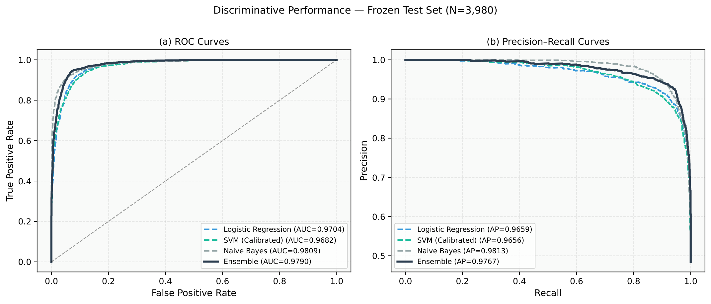
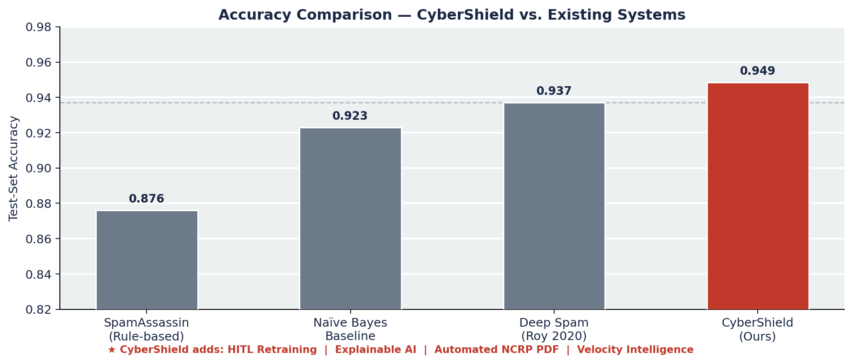
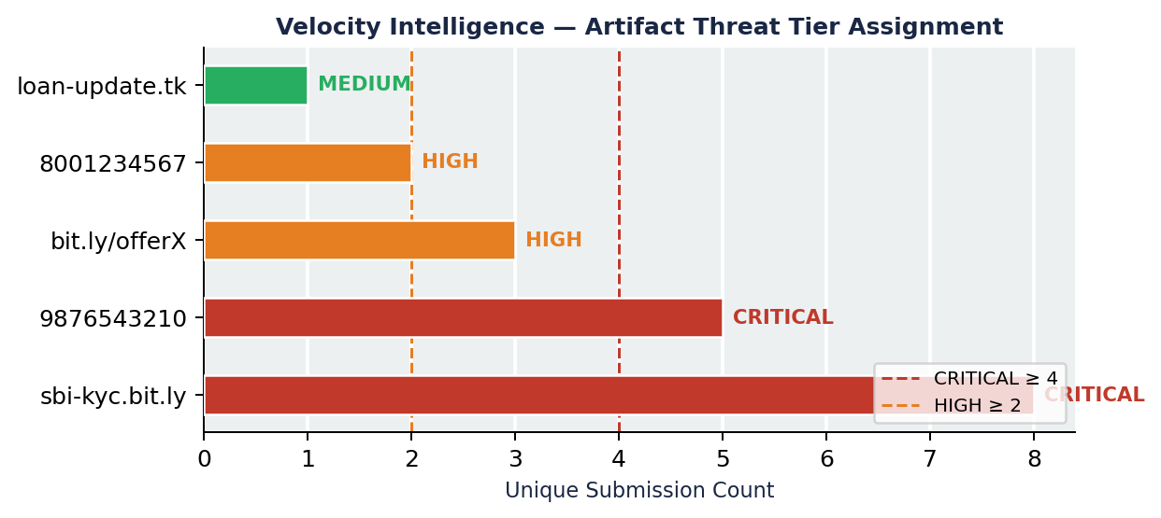
Experimental Results & Analysis
Evaluation on frozen test set (N=3,980) — 26,534 labeled samples across 8 datasets
94.85%
0.9899
0.9494
0.9440
<500 ms
Test Accuracy (Post-HNM)
ROC-AUC
Fraud Precision
Fraud Recall
Inference Latency
Hard Negative Mining — Ablation Study (pre-HNM vs post-HNM on frozen test set)
Metric
Pre-HNM
Post-HNM
Delta
Interpretation
Accuracy
0.9482
0.9485
+0.03%
Marginal shift; HNM targets boundary, not bulk
Fraud Recall
0.9419
0.9440
+0.21%
Key gain — fewer missed frauds post-HNM
Fraud Precision
0.9508
0.9494
-0.14%
Acceptable trade-off for higher recall
ROC-AUC
0.9893
0.9899
+0.06pp
Improved ranking across all thresholds

Slide 5
Conclusion & Future Scope
Summary of contributions and planned extensions
RESEARCH CONTRIBUTIONS
RESULTS AT A GLANCE
Novel 4-Tier Uncertainty Architecture
Test-Set Accuracy
94.85%
Replaces binary detection with probabilistic risk stratification. Uncertainty-aware routing is absent in all surveyed SMS fraud detection systems.
ROC-AUC
0.9899
Training Corpus
26,534 samples / 8 datasets
Human-in-the-Loop Active Retraining
Frozen Test Set
3,980 instances
UNCERTAIN predictions trigger a Hard Negative Mining pipeline that continuously re-calibrates the model against concept drift without external labeling cost.
Inference Latency
< 500ms on commodity hardware
HNM Recall Gain
+0.21pp fraud recall
Automated NCRP Complaint Generation
FUTURE SCOPE
First system to auto-produce a pre-filled NCRP-compliant PDF with extracted IoCs, probability score and complaint ID — directly bridging detection and law enforcement.
Near
Direct REST API integration with NCRP portal — eliminate manual PDF upload step
Velocity Intelligence Tracker
Near
OTP and QR-code artifact extraction to extend IoC coverage
Real-time cross-victim artifact correlation assigns CRITICAL/HIGH/MEDIUM threat tiers to repeat malicious URLs and phone numbers — a capability absent in prior work.
Mid
Multilingual NLP pipeline — Devanagari, Meitei Mayek script support
Explainable AI via Word Risk Heatmap
Mid
Transformer-based embeddings (BERT/IndicBERT) for deeper semantic modeling
LR coefficient-based token attribution makes each prediction interpretable to non-technical citizens and verifiable by administrators.
Federated learning across state cyber cells preserving victim data privacy
Long

Slide 6
References
[1] Almeida, T.A., Hidalgo, J.M.G., Yamakami, A. (2011). Contributions to the study of SMS spam filtering: new collection and results. ACM DocEng, pp. 259-262.
[2] Settles, B. (2012). Active Learning. Synthesis Lectures on Artificial Intelligence and ML. Morgan & Claypool Publishers.
[3] Holzinger, A. (2016). Interactive machine learning for health informatics: when do we need the human-in-the-loop? Brain Informatics, 3(2), 119-131.
[4] Chawla, N.V., Bowyer, K.W., Hall, L.O., Kegelmeyer, W.P. (2002). SMOTE: Synthetic Minority Over-sampling Technique. JAIR, 16, 321-357.
[5] Roy, S., et al. (2020). A Deep Learning based Artificial Intelligence Model for SMS Spam Detection. IJEAT, 9(3).
[6] Pedregosa, F. et al. (2011). Scikit-learn: Machine learning in Python. Journal of Machine Learning Research, 12, 2825-2830.
[7] Purkait, S. (2014). Phishing counter measures and their effectiveness. Information Management & Computer Security, 22(5), 382-420.
[8] Ministry of Home Affairs, Govt. of India (2023). Annual Report — National Cybercrime Reporting Portal (NCRP) Statistics 2023.
[9] Platt, J. (1999). Probabilistic outputs for Support Vector Machines. Advances in Large Margin Classifiers, MIT Press.
[10] National Crime Records Bureau (2023). Crime in India 2023 — Chapter 9: Cyber Crimes. NCRB, New Delhi.

