Slide 1

CyberShield: Uncertainty-Aware Fraud Detection
with Human-in-the-Loop Calibration for Cybercrime Intelligence
A report submitted for the course Project – I (CS3201)
Submitted By
Supervised By
ABHISHEK YADAV
Dr. Salam Michael Singh
Roll No. 230103041 | Semester VI
Department of Computer Science and Engineering
Indian Institute of Information Technology Senapati, Manipur
April, 2026

Slide 2
Introduction, Objective & Contribution
PROBLEM DEFINITION
CYBERSHIELD: PRIMARY CONTRIBUTIONS
Limitation of Binary Classification
Uncertainty-Aware Classification
Standard ML forces binary buckets (Fraud vs. Legit), failing on ambiguous phrasing, leading to high false-positive rates.
Probability-bounded risk strata (FRAUD, SUSPICIOUS, UNCERTAIN, LEGIT) replacing forced binary predictions.
Human-in-the-Loop Calibration
Administrative routing for uncertain data (0.30 ≤ P < 0.70) coupled with Hard Negative Mining for dynamic recalibration.
Semantic Evading & Concept Drift
Attackers leverage urgency and financial requests, constantly shifting vocabulary to evade static signature detection.
Token-Level Explainability
Word Risk Heatmaps utilizing model coefficient weights to visually highlight specific semantic tokens driving predictions.
Fragmented Reporting Workflows
Automated NCRP Adjudication
Victims lack automated tools to extract Indicators of Compromise (IoCs) and format actionable legal complaints for the NCRP.
One-click generation of NCRP-compliant PDFs containing extracted IoCs, ready for portal submission.
Velocity Intelligence Tracking
Database tracking the frequency velocity of malicious URLs and phone numbers to identify organized threat vectors.

Slide 3
Background / Existing Work
Existing Work / System
Approach Used
Primary Limitations
Proposed Solution (CyberShield)
SpamAssassin
Rule-based filtering with Bayesian Naive integration
Static rules become obsolete rapidly against novel semantic phrasing
Ensemble architecture with HNM retraining for concept drift resistance
SMS Spam Collection Baseline
Single Naive Bayes on TF-IDF feature vectors
Forces binary outcomes; lacks uncertainty acknowledgment
4-tier probabilistic routing based on confidence thresholds
MobiFish (Purkait, 2014)
URL-specific heuristics for smishing detection
Focuses solely on URLs, ignoring persuasive natural language text
FeatureUnion of NLP tokens and lexical artifact extraction
Deep Spam (Roy et al., 2020)
LSTM on word embeddings (Deep Learning)
Opaque "black-box" model; no citizen-facing explainability
Word Risk Heatmap generation using linear coefficient weights
NCRP Portal (Govt. of India)
Manual, unguided complaint entry by the victim
High friction workflow; users struggle to identify technical IoCs
Automated pre-filled PDF generation with extracted intelligence

Slide 4
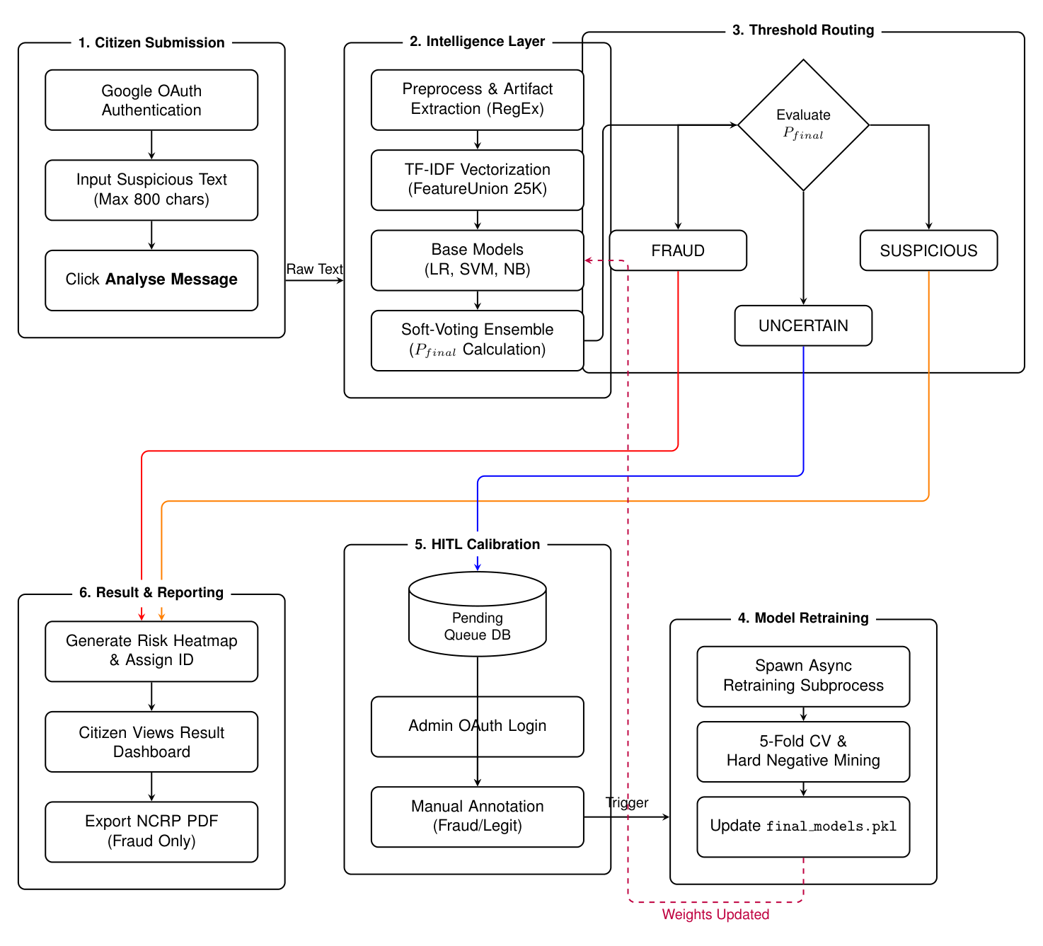
Proposed System / Architecture
SYSTEM DESIGN & TOOLS
Text Vectorization
FeatureUnion combining word n-grams (1,2) and char n-grams (2,5) into a 25,000-dimensional TF-IDF matrix.
Classification Engine
Mathematical ensemble of Logistic Regression, Support Vector Machines (Platt Scaled), and Naive Bayes.
Threshold Routing
P ≥ 0.90 (FRAUD): Auto PDF 0.30 ≤ P < 0.70 (UNCERTAIN): HITL Queue P < 0.30 (LEGIT): Cleared
Tech Stack
Python 3.11, Flask, Scikit-Learn, SQLite, ReportLab.
PROCESS WORKFLOW
Input → NLP Preprocessing → TF-IDF Transformation → Ensemble Scoring → Threshold Evaluation → Velocity Update → Output Generation.

Slide 5
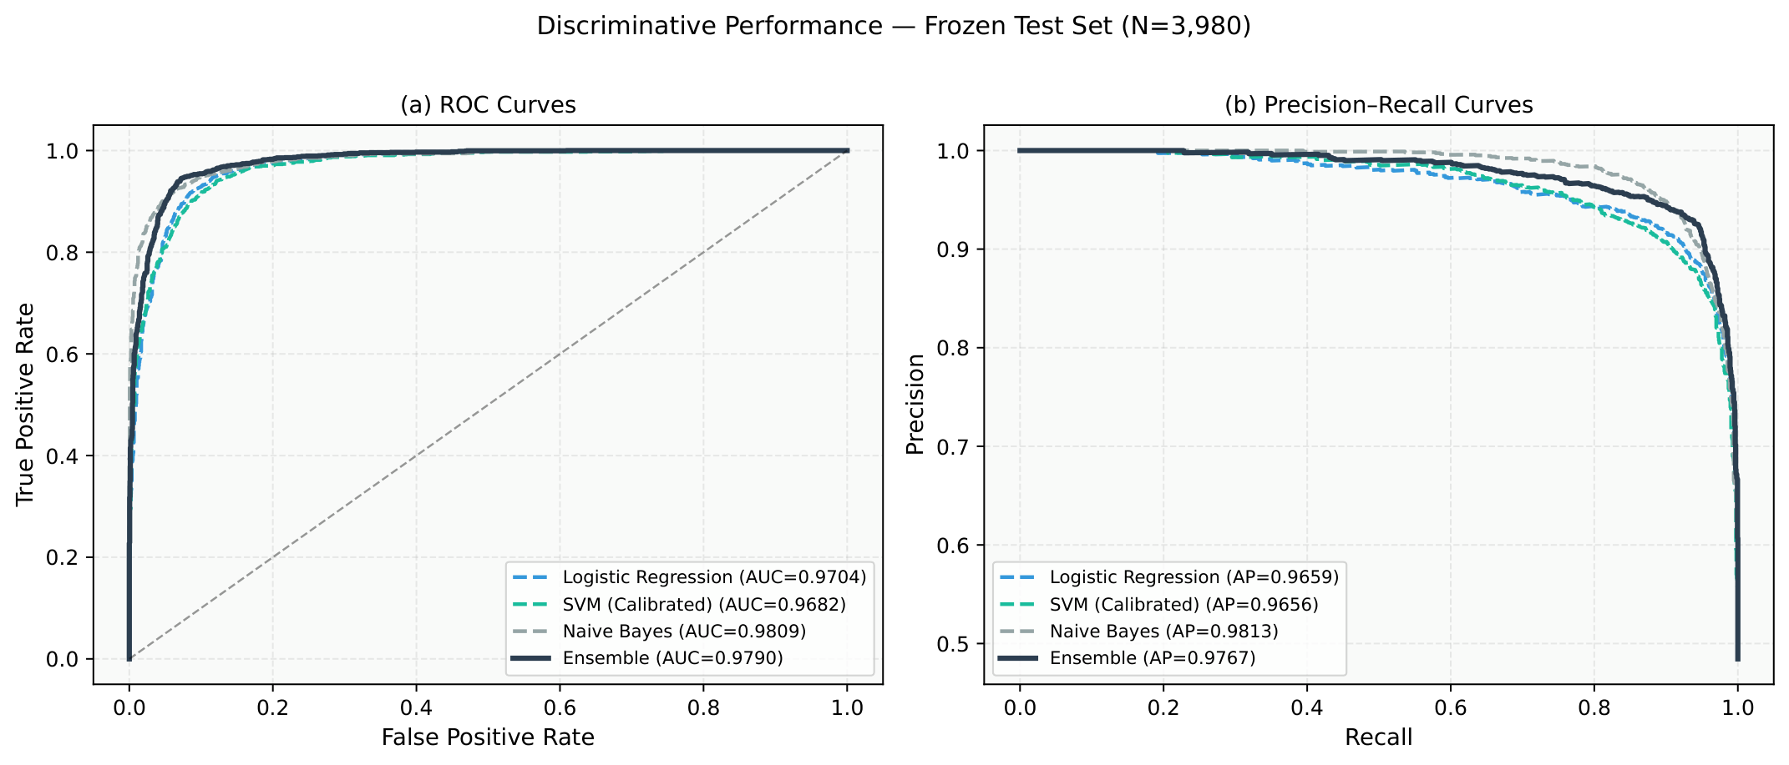
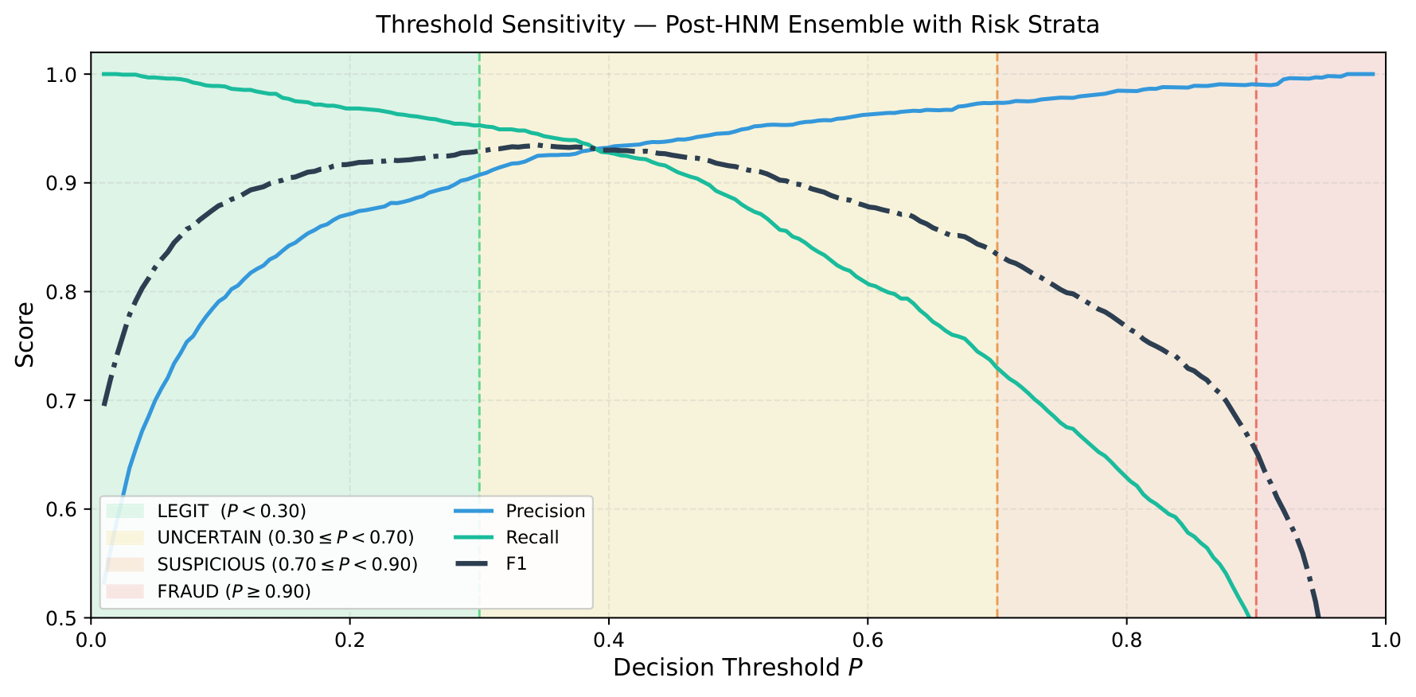
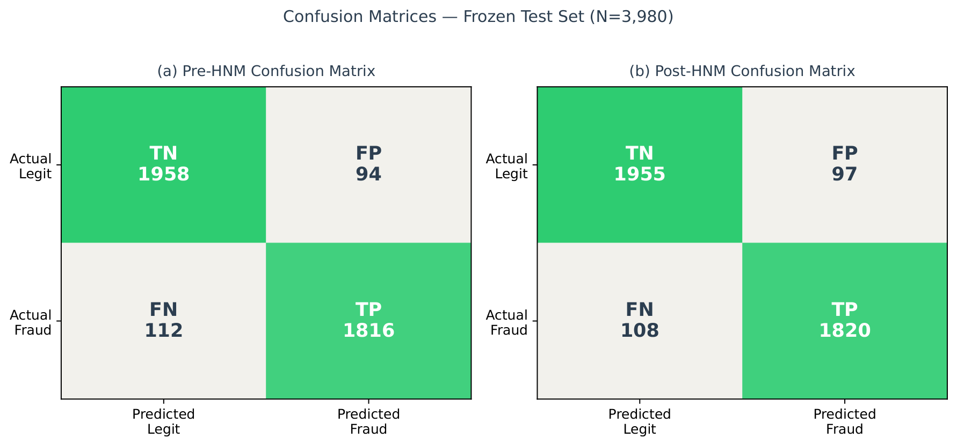
Result & Analysis
94.85%
0.9899
26,534
3,980
Test Accuracy
ROC-AUC
Labeled Dataset
Frozen Test Set
Hard Negative Mining (Ablation)
Metric
Pre-HNM
Post-HNM
Delta
Accuracy
0.9482
0.9485
+0.0003
Precision
0.9508
0.9494
-0.0014
Recall(Fraud)
0.9419
0.9440
+0.0021
Macro F1
0.9482
0.9484
+0.0002
ROC-AUC
0.9893
0.9899
+0.0006

Slide 6
Conclusion & Future Scope
SUMMARY OF WORK DONE
FUTURE SCOPE
Mathematical Efficacy
Near-Term
Direct REST API Integration with NCRP to eliminate manual PDF upload requirements.
The calibrated ensemble over a 25,000-feature TF-IDF matrix achieved 94.85% test-set accuracy and 0.9899 ROC-AUC.
Near-Term
Expansion of Artifact Extraction to include OTP/QR Code payload heuristics.
System Safety via Uncertainty
The wide UNCERTAIN band (0.30 ≤ P < 0.70) acts as a deliberate safety mechanism against catastrophic false negatives, proving that acknowledging uncertainty enhances, rather than weakens, AI safety in high-stakes environments.
Mid-Term
Implementation of a Multilingual NLP pipeline (e.g., Devanagari, Meitei Mayek).
Bridging the Intelligence Gap
By intertwining natural language semantic analysis with lexical Velocity Tracking and automated NCRP PDF generation, the project successfully bridges the gap between raw ML predictions and actionable law-enforcement intelligence.
Mid-Term
Integration of Transformer-based semantic embeddings (e.g., BERT/RoBERTa).
Operational Efficiency
The system achieves end-to-end inference latency under 500ms on commodity hardware, satisfying all non-functional constraints.
Long-Term
Deployment of Federated Learning architectures across state cyber-cells to preserve privacy.

Slide 7
References
[1] Almeida, T.A., Hidalgo, J.M.G., & Yamakami, A. (2011). Contributions to the study of SMS spam filtering. ACM DocEng, 259-262.
[2] Settles, B. (2012). Active Learning. Synthesis Lectures on AI and Machine Learning. Morgan & Claypool.
[3] Holzinger, A. (2016). Interactive machine learning for health informatics. Brain Informatics, 3(2), 119-131.
[4] Chawla, N.V. et al. (2002). SMOTE: Synthetic Minority Over-sampling Technique. JAIR, 16, 321-357.
[5] Roy, S. et al. (2020). A Deep Learning based AI Model for SMS Spam Detection. IJEAT, 9(3).
[6] Pedregosa, F. et al. (2011). Scikit-learn: Machine Learning in Python. JMLR, 12, 2825-2830.
[7] Purkait, S. (2014). Phishing counter measures and their effectiveness. Info. Mgmt. & Comp. Security, 22(5).
[8] Ministry of Home Affairs, Govt. of India (2023). Annual Report on Cybercrime - NCRP Statistics 2023.

