Slide 1
An Analysis of Pizza Sales Data using SQL

Slide 2
introduction
Hi, I'm Abhishek Sharma, and I aspire to become a data scientist. I’m fascinated by the power of data and how it can be used to uncover patterns, solve complex problems, and drive smarter decisions. My journey into data science is fuelled by a deep interest in analytics, machine learning, and data storytelling.
I have a strong foundation in mathematics, programming, and statistics, and I’m constantly improving my skills with tools like Python, SQL, R, and various machine learning frameworks. I love diving into datasets, finding hidden insights, and translating them into actionable solutions.
My goal is to work on impactful projects that use data to address real-world challenges, whether it’s optimizing processes, predicting outcomes, or enhancing customer experiences. I’m excited to grow in this field and contribute to innovative solutions that make a difference.

Slide 3
Project info
This project showcases a comprehensive analysis of pizza sales data using SQL. The goal is to derive meaningful insights into sales trends, customer preferences, and revenue generation by querying and aggregating data from a simulated pizza sales dataset.
Key Features:
Data Exploration: Analyzing sales performance, including top-selling pizzas, revenue distribution, and order frequency.
SQL Techniques: Utilizing advanced SQL concepts such as joins, window functions, aggregate functions, and subqueries for data analysis.
Visualization Integration: Preparing data for visualization in BI tools like Tableau or Power BI (optional).
Actionable Insights: Identifying key trends to optimize sales strategies and improve business performance.

Slide 4
Basic questions
Retrieve the total number of orders placed.
Calculate the total revenue generated from pizza sales.
Identify the highest-priced pizza.
Identify the most common pizza size ordered.
List the top 5 most ordered pizza types along with their quantities.

Slide 5
Intermediate questions:
Join the necessary tables to find the total quantity of each pizza category ordered.
Determine the distribution of orders by hour of the day.
Join relevant tables to find the category-wise distribution of pizzas.
Group the orders by date and calculate the average number of pizzas ordered per day.
Determine the top 3 most ordered pizza types based on revenue

Slide 6
Advanced questions
Calculate the percentage contribution of each pizza type to total revenue.
Analyze the cumulative revenue generated over time.
Determine the top 3 most ordered pizza types based on revenue for each pizza category

Slide 7
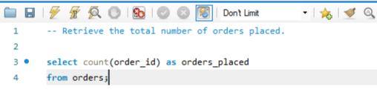

Retrieve the total number of orders placed.

Slide 8
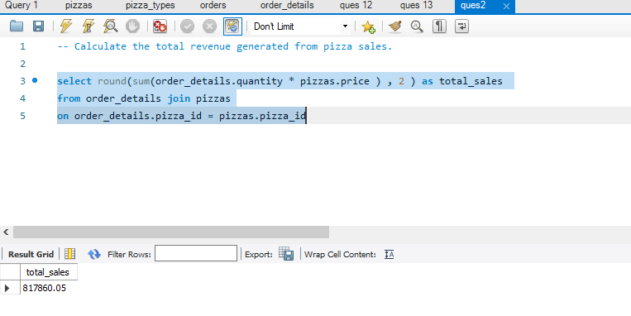
Calculate the total revenue generated from pizza sales.

Slide 9
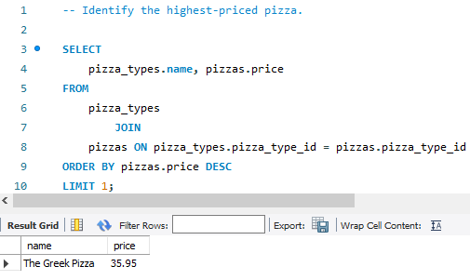
Identify the highest-priced pizza.

Slide 10
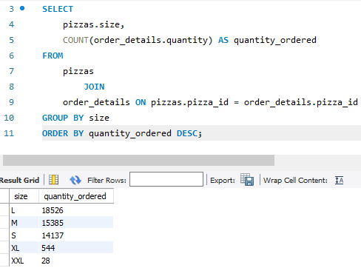
Identify the most common pizza size ordered.

Slide 11
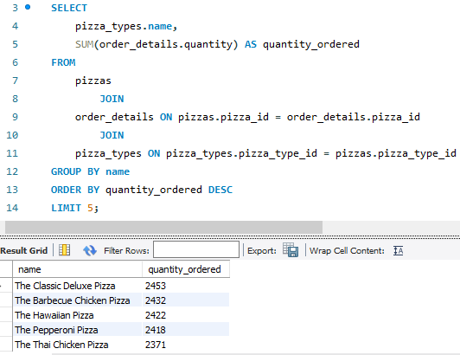
List the top 5 most ordered pizza types along with their quantities.

Slide 12
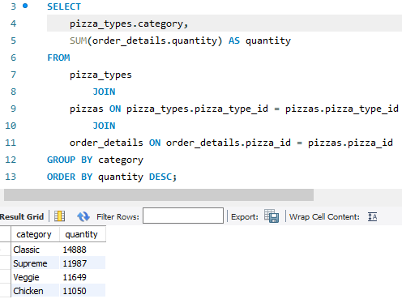
Join the necessary tables to find the total quantity of each pizza category ordered.

Slide 13
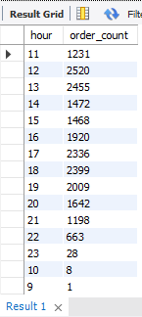
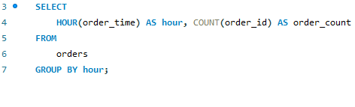
Determine the distribution of orders by hour of the day.

Slide 14
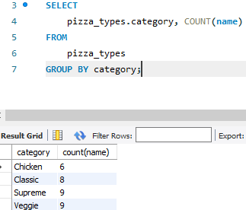
Join relevant tables to find the category-wise distribution of pizzas.

Slide 15
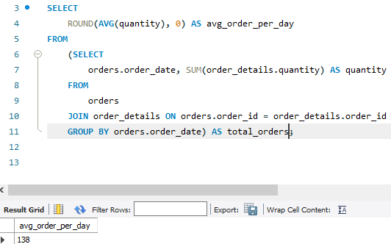
Group the orders by date and calculate the average number of pizzas ordered per day.

Slide 16
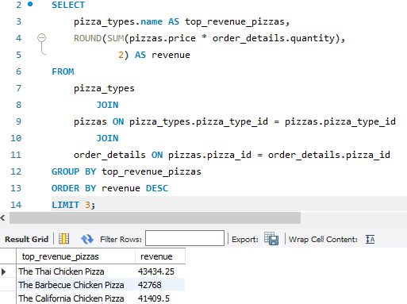
Determine the top 3 most ordered pizza types based on revenue

Slide 17
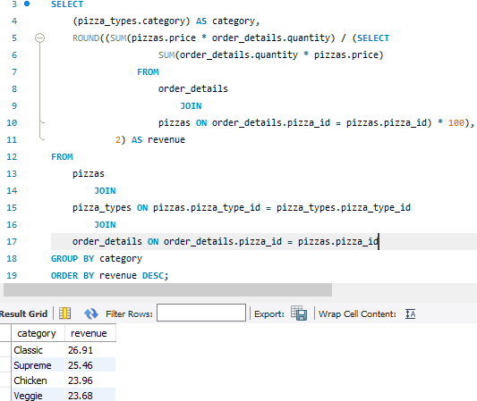
Calculate the percentage contribution of each pizza type to total revenue.

Slide 18
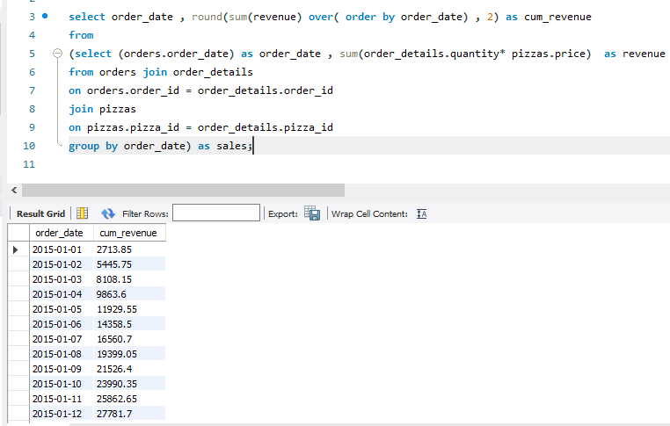
Analyze the cumulative revenue generated over time.

Slide 19
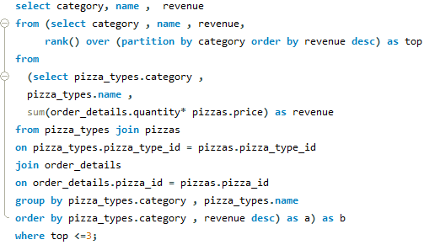
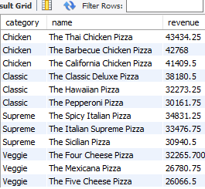
Determine the top 3 most ordered pizza types based on revenue for each pizza category

Slide 20
Conclusion
The Pizza Sales Analysis project demonstrates the power of SQL in exploring and analyzing data to derive valuable business insights. By leveraging SQL queries, we examined sales performance, identified top-selling pizzas, analyzed customer preferences, and tracked revenue trends. The use of advanced SQL techniques, such as window functions, joins, and aggregate calculations, allowed for an in-depth understanding of the dataset.
This project highlights how businesses can harness their data to optimize sales strategies, improve operational efficiency, and make data-driven decisions. The insights gained from this analysis can guide marketing efforts, inventory management, and customer engagement initiatives.
The Pizza Sales Analysis is not just a technical exercise but also a practical demonstration of how SQL can be used to address real-world challenges and drive business growth. This repository serves as a valuable resource for learning and applying SQL to data analysis projects.

