Slide 1

Department of Electronics and Communication Engineering
Parkinsons Disease Detection Using SVM
SI No. | NAME | USN
1 | Omkar Anvekar | 02FE21BEC055
2 | Abhishek Angadi | 02FE21BEC003
3 | Prajwal Hosakoti | 02FE21BEC060
4 | Anusha Karki | 02FE21BEC010

Slide 2
Problem Statement
Develop a predictive system for detecting Parkinson's Disease based on voice features.

Slide 3
Introduction
Parkinson's Disease is a chronic and progressive neurological condition affecting movement control.
The disorder is characterized by symptoms such as tremors, stiffness, and difficulty in balancing and coordination.
The project aims to develop a predictive model for the early detection of Parkinson's Disease.
The focus is on utilizing voice-related features extracted from individuals, as changes in voice patterns are often associated with Parkinson's.

Slide 4
What is SVM?
SVM stands for Support Vector Machine, and it is a supervised machine learning algorithm used for classification and regression tasks.
The primary goal of an SVM is to find a hyperplane that best separates data points of one class from another in a high-dimensional space.
SVMs are widely used in various applications, including image classification, text categorization, and bioinformatics. They are effective when dealing with high-dimensional data and are known for their ability to handle complex datasets.

Slide 5
Block diagram :
Data Collection
& Analysis
from .csv file (kaggle)
Import required modules
Data Preprocessing
Building a Predictive
System
Model Evaluation
(accuracy scores)
Model Training (SVM)

Slide 6
DATASET:
https://www.kaggle.com/code/cookies97/detecting-parkinson-s

Slide 7
EXPLANATION :
Start by setting up the project with the necessary tools and loading the Parkinson's Disease data.
Explore the data to see how it's structured and find any important patterns before building a model.
Organize the data by separating its parts (features and target), dividing it into training and testing sections, and making sure everything is on the same scale.
Pick a Support Vector Machine (SVM) with a linear kernel as the tool for classifying and sorting the data.
Train the chosen SVM model using the prepared training data.
Test how well the SVM model works by checking its accuracy on both the training and testing data.
Demonstrate the system's ability to predict by using it on new data.

Slide 8
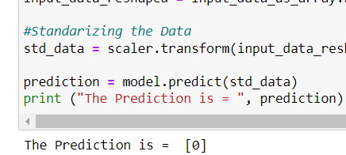
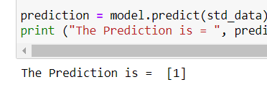
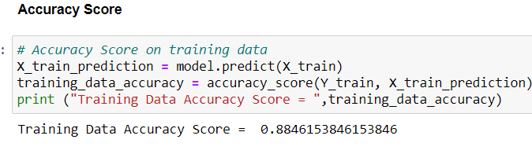
Output:

Slide 9
REFERENCE:
https://content.iospress.com/articles/journal-of-parkinsons-disease/jpd181474

Slide 10
Thank You

