Slide 1
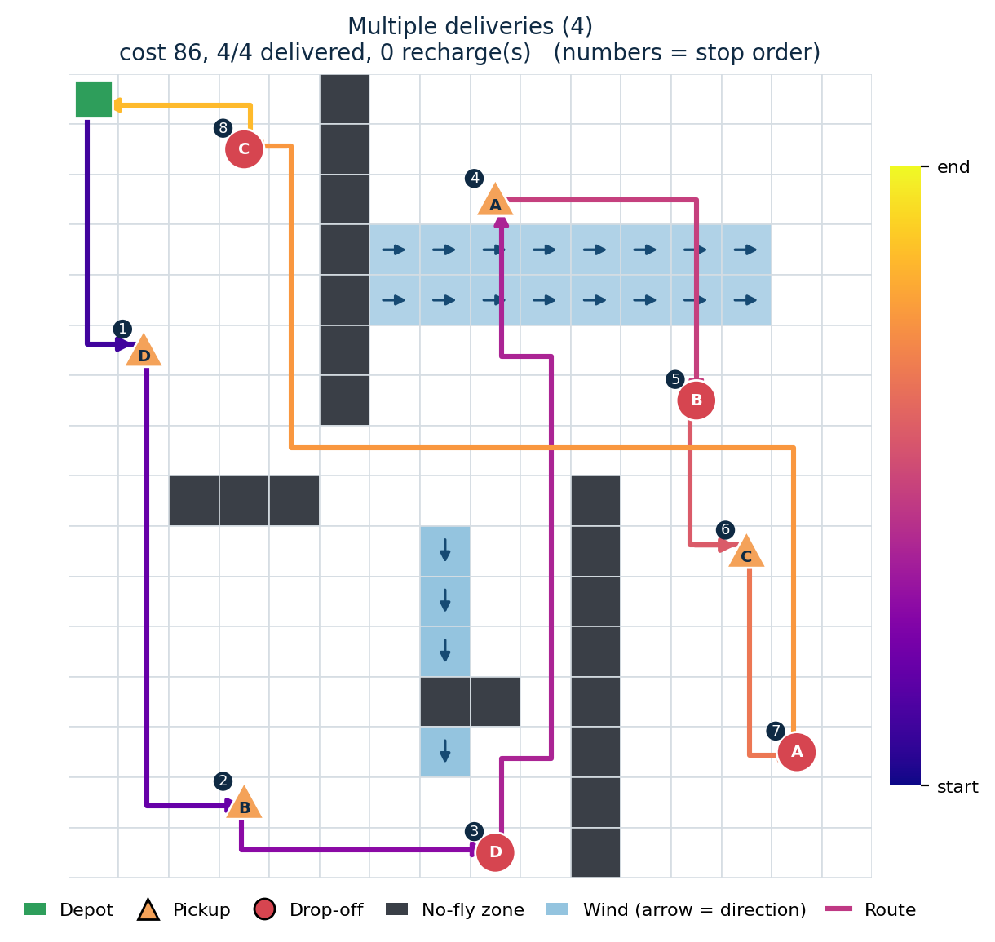
Intelligent Delivery Drone Agent
Grid-based path planning with wind and no-fly zones
Team 2_brain_cells
Shawn B Mathan AM.SC.U4AIE25147
Gautam P M AM.SC.U4AIE25112
Abhishek U Pai AM.SC.U4AIE25101
Classical AI only: search and heuristics. No ML, DL or RL.
Notes:
Introduce the team and the project. One line: our drone agent perceives its environment, reasons about routes and delivery order, decides what to do, and acts. It only uses classical AI techniques. The picture is one of our real simulation runs (4 deliveries).

Slide 2




Problem Statement
Q1
What problem is being solved?
Plan safe, low-cost delivery routes for an autonomous drone in a city-like grid.
Restricted airspace
No-fly zones (buildings, restricted areas) can never be entered.
Wind
Flying against the wind costs more, so the cheapest route is not always the shortest.
Urban delivery is hard: airspace is restricted, wind makes some moves more expensive, one drone must serve several stops, and its battery is limited.
Multi-stop routing
Several pickups and drop-offs. Each pickup must come before its drop-off.
Goal: minimise total mission cost with zero battery violations.
Limited battery
Every move uses battery, so the drone must be able to get home to recharge.
Notes:
Answer to professor's question 1. Real delivery drones face restricted airspace, weather and battery limits, and they have to serve more than one stop. Our project solves this on a grid world using classical search. The goal is the lowest total cost with no battery violations.

Slide 3
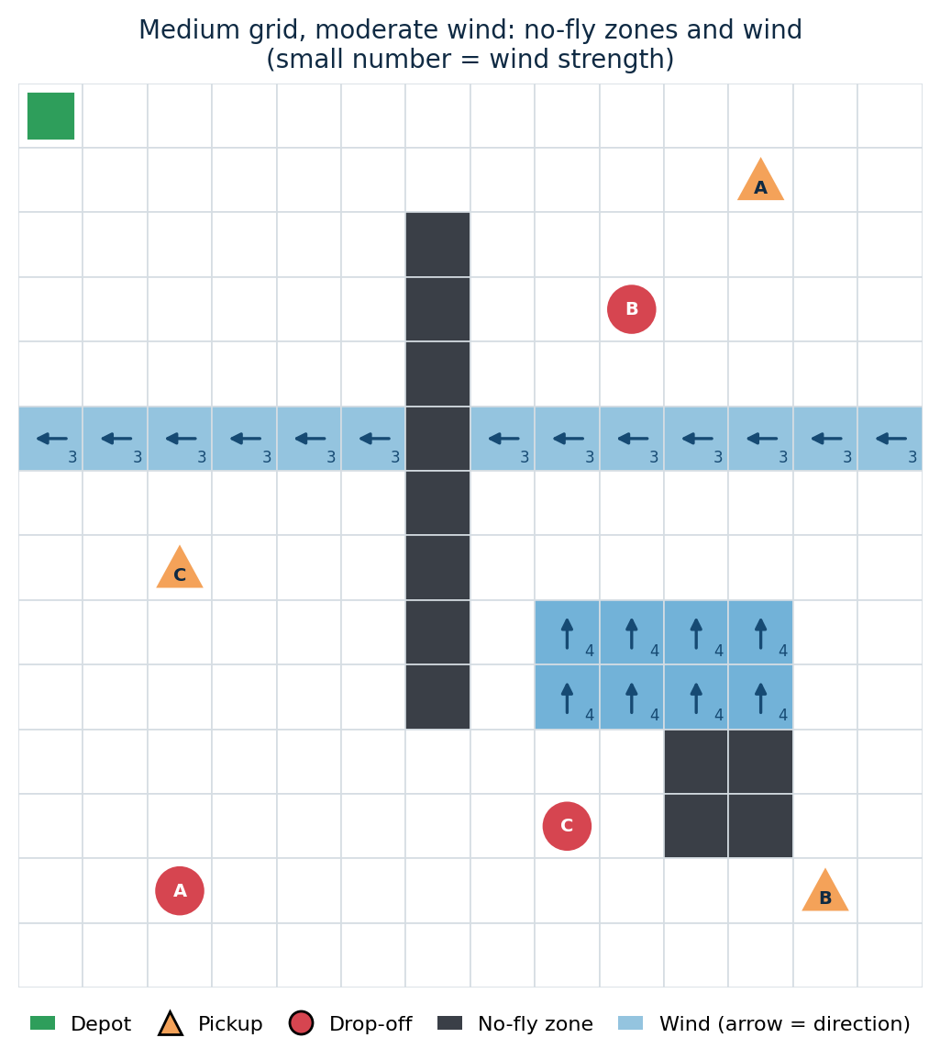
Operating Environment
Q2
Where does the agent operate?
A 2D grid of an urban or campus area
Free cell movement cost 1
No-fly zone can never be entered
Wind cell has a direction and a strength
Depot start point and recharging point
Pickup / drop-off triangle = pickup, circle = drop-off
Cost of entering a wind cell
flying with the wind: 1
flying across the wind: 1 + strength / 2 (rounded down)
flying against the wind: 1 + strength
Notes:
Answer to question 2. The agent operates in a 2D grid. Cells are free, no-fly, or wind. The picture is our medium scenario: a wall of no-fly cells, a wind band, and a patch blowing north. A step never costs less than 1, which is what lets Manhattan distance be an admissible heuristic for A*. We ran 5 scenarios from 8x8 up to 16x16.

Slide 4




Agent Percepts
Q3
What information does the agent receive?
Its position
Battery level
Packages carried
Which grid cell the drone is in right now.
How much battery is left. Every move uses it up.
Which deliveries are on board at the moment.
The drone plans with the whole map known in advance. It does not learn: it searches.
The full map
Pending deliveries
Where the no-fly zones are, and the wind direction and strength in every wind cell.
The list of requests, each with a pickup location and a drop-off location.
Notes:
Answer to question 3. At every step the drone knows its position, its battery, which packages it carries, the full map including wind vectors, and the list of pending delivery requests with pickup and drop-off locations. Everything is known up front, so the agent plans instead of learning.

Slide 5




Agent Decisions
Q4
What decisions can the agent make?
Every step
Planning the mission
Move
up, down, left or right to a neighbouring cell
Which delivery next
nearest neighbour, then 2-opt
Pick up
a package at its pickup location
Which route to follow
A* with the wind-aware cost
Drop off
a package at its destination
Recharge or go?
Before each leg the battery must cover that leg plus the flight from the stop back to the depot. If not, recharge first.
Return to depot
and recharge when the battery is low
Notes:
Answer to question 4. Low-level decisions every step: move in one of four directions, pick up, drop off, return to the depot. High-level decisions: which delivery to serve next, which route to take, and whether the battery is enough for the next leg plus the way home. If it is not enough, the drone recharges first. That is how we get zero battery violations.

Slide 6





Classical AI Techniques
Q5
Which classical AI techniques are used?
A* search
Uniform-Cost Search
Manhattan heuristic
Finds the cheapest path between two points using the wind-aware cost.
Baseline with the same cost function. Checks that A* is optimal.
Admissible because every step costs at least 1, so A* stays optimal.
Nearest Neighbor
2-opt
Brute-force order
Picks the closest allowed next stop. A drop-off only after its pickup.
Reverses parts of the route. A change is kept only if it is valid and cheaper.
Tries every valid order on small missions to measure how close the heuristics get.
No machine learning, deep learning or reinforcement learning anywhere in the project.
Notes:
Answer to question 5. A* does the path planning with Manhattan distance as the heuristic. UCS is the baseline: same cost function, so if A* gives the same cost as UCS the heuristic is working. Nearest Neighbor chooses the delivery order and 2-opt tries to improve it without ever breaking pickup-before-drop-off. Brute force is only used on small missions to see how far the heuristics are from the true best order. No ML, DL or RL.

Slide 7
System Workflow
Flow
Perceive, reason, decide, act
PLAN THE ORDER
1
2
3
4
Delivery requests
pickup and drop-off for each package
Nearest Neighbor
closest allowed stop next
2-opt improvement
keep only valid, cheaper swaps
Ordered stops
pickup always before drop-off
EXECUTE EACH STOP
8
7
6
5
Return to depot
log and final results
Fly, pick up, drop off
battery drops by move cost
A* path planning
wind-aware cheapest path
Battery check
leg plus way home must fit
Steps 5 to 7 repeat for every stop in the ordered list.
Not enough battery? Fly to depot, recharge, continue
Code: delivery_planner.py (1-4), simulation.py and drone.py (5-8), astar.py (6)
Notes:
Walk the flow left to right, then the second row right to left. Top row is planning: requests go to Nearest Neighbor, then 2-opt tries to improve the order, giving an ordered list of stops where each pickup comes before its drop-off. Bottom row is execution: before each leg the drone checks the battery covers the leg plus the way home, A* plans the path, the drone flies it and picks up or drops off, and at the end it returns to the depot. If the battery check fails, it goes to the depot to recharge first.

Slide 8
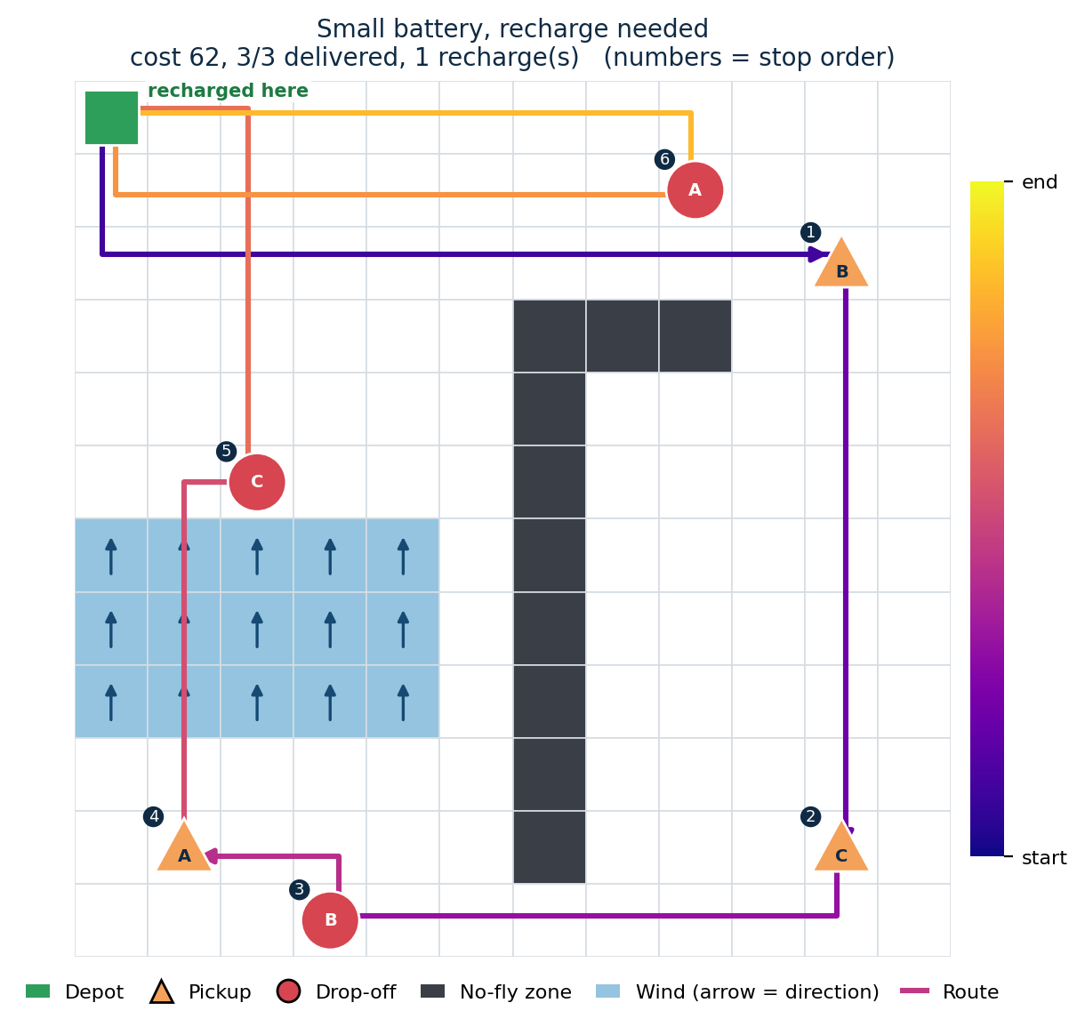
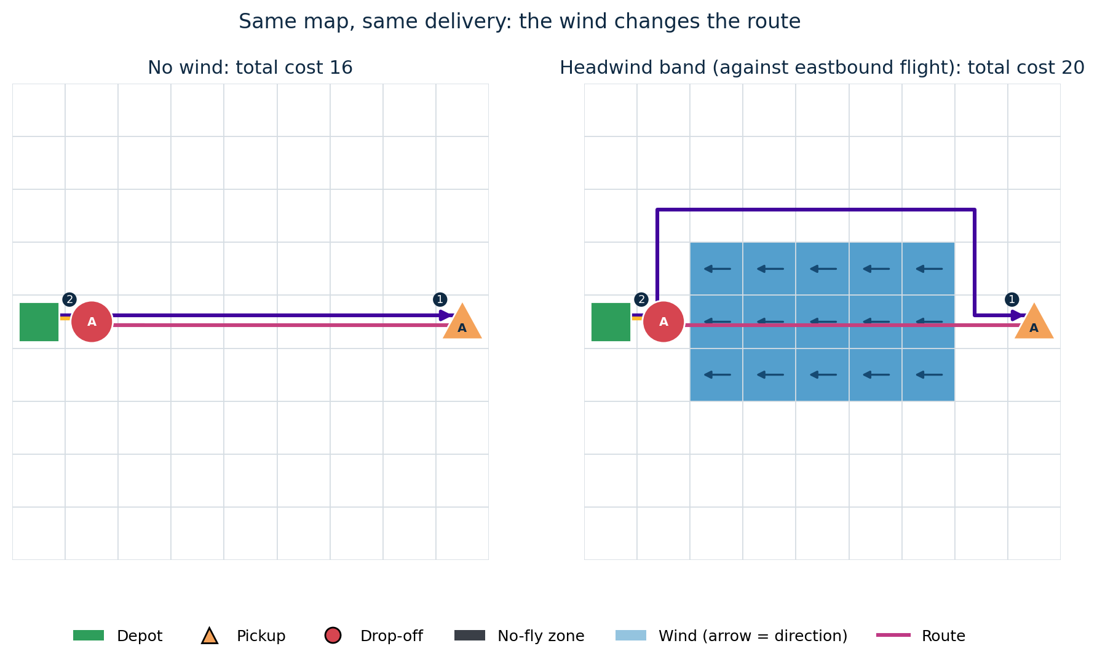
Simulation: Route Visualization
Demo
Real output from our simulator
Recharge scenario: with 7 battery left and 19 needed for the next leg, the drone flew home, recharged and still delivered 3 of 3 packages (cost 62).
Same delivery with and without wind: the drone goes around the headwind band on the way out and rides it as a tailwind on the way back. Total cost 20 instead of 16.
Notes:
These are screenshots of our own simulator output, not mock-ups. Left: the recharge scenario. The numbers on the map show the order of stops. After stop 5 the drone realises it cannot finish the last delivery on 7 units of battery, so it flies home, recharges, then delivers package A. Right: the same map with and without a headwind band. With wind the outbound path goes around the band, but on the way back the same wind is a tailwind so the drone flies straight through it.

Slide 9
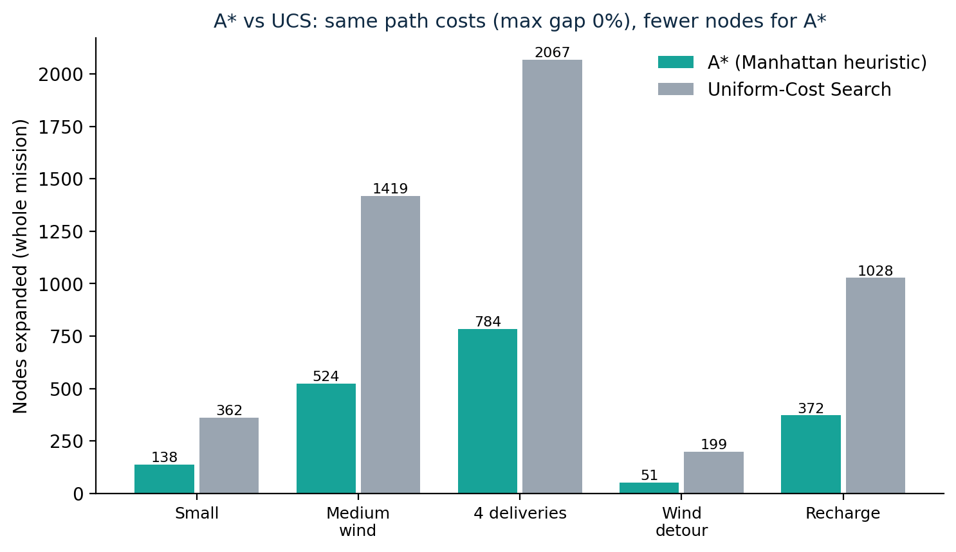
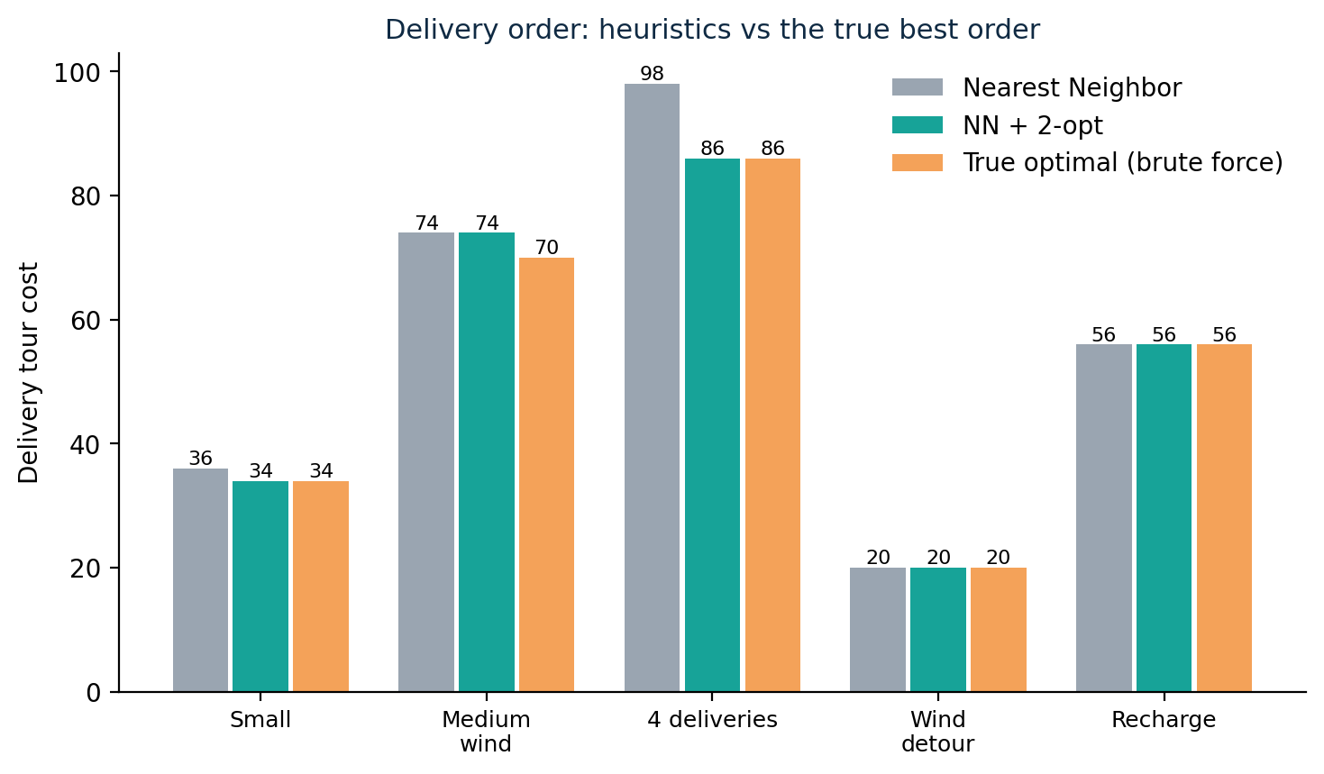
Experimental Results + Metrics
Q6
How is performance measured?
Scenario | Total mission cost | Deliveries completed | Avg delivery time (steps) | Path optimality gap | Computation time (ms) | Battery violations
Small grid, little wind | 34 | 2 / 2 | 23.0 | 0% | 1.6 | 0
Medium grid, moderate wind | 74 | 3 / 3 | 38.3 | 0% | 6.4 | 0
Multiple deliveries (4) | 86 | 4 / 4 | 50.5 | 0% | 11.7 | 0
Wind changes the route | 20 | 1 / 1 | 19.0 | 0% | 0.4 | 0
Small battery, recharge | 62 | 3 / 3 | 41.0 | 0% | 4.7 | 0
Notes:
Answer to question 6. Our six metrics are total mission cost, deliveries completed, average delivery time, path optimality gap, computation time and battery violations. All numbers come from results/experiment_results.csv. Across all scenarios the drone completed 13 of 13 deliveries with 0 battery violations. The path optimality gap compares A* with UCS and is 0% on every leg, which confirms A* is optimal here. A* expanded 1869 nodes versus 5075 for UCS, about 63% fewer. For delivery order, Nearest Neighbor plus 2-opt matched the brute-force optimum in 4 of 5 scenarios; in the medium windy scenario it was 5.7% above the best order (74 versus 70). Computation time depends on the machine.

Slide 10
Conclusion + Future Scope
13/13
0
Future scope
Wind that changes during the mission, with sensors that detect unexpected obstacles
Delivery priorities and time windows
Package capacity and several drones
A 3D airspace with altitude
Stronger tour search than 2-opt for larger missions
deliveries completed in all scenarios
battery violations
0%
63%
A* gap from the UCS optimum
fewer nodes expanded by A* than UCS
A classical agent with search and simple heuristics handled wind, no-fly zones, multiple deliveries and battery limits. Nearest Neighbor + 2-opt matched the best order in 4 of 5 scenarios and was 5.7% above it in the other.
Notes:
Wrap up. Everything ran with no machine learning. All 13 deliveries completed across the five scenarios, no battery violations, and A* matched the UCS optimum on every leg while expanding about 63% fewer nodes. Be honest about the limits: 2-opt is a heuristic, and in the medium windy scenario it was stuck 5.7% above the true best order. Future scope: dynamic wind and sensors, priorities, capacity and multiple drones, 3D airspace, and stronger tour search.

