Slide 1

Human Sensing Fan
PDPM Indian Institute of Information Technology, Design and Manufacturing, Jabalpur.
MEPR101
Group no 21
Shubham Khandelwal-2017350
Abhishek Vishwakarma-2017016
Bhoor Singh-2017078
Abhishek Meena-2017306
Ashok Meena-2017063

Slide 2
Introduction
Unfortunately fans do not have very efficient or useful features when it is desirable to change the direction of air flow.
Fans usually is static and needs to be physically redirected to direct air in the desired direction It requires physical effort which may be difficult if the user is of elderly age.
The fan can rotate back and forth at a set angle which is approximately 180 degrees. This option is wasteful as the fan may direct air at empty spaces for much of the rotation cycle. Thus, we decided to focus on a project that could solve the daily stresses and inconveniences of fan use by automating the process.

Slide 3
Applications
We can use this fan in any public area like railway platform, airport and bus stand etc.
It can also use in our hotel, office and homes.
It will be a boon to elderly and differently abled people.

Slide 4
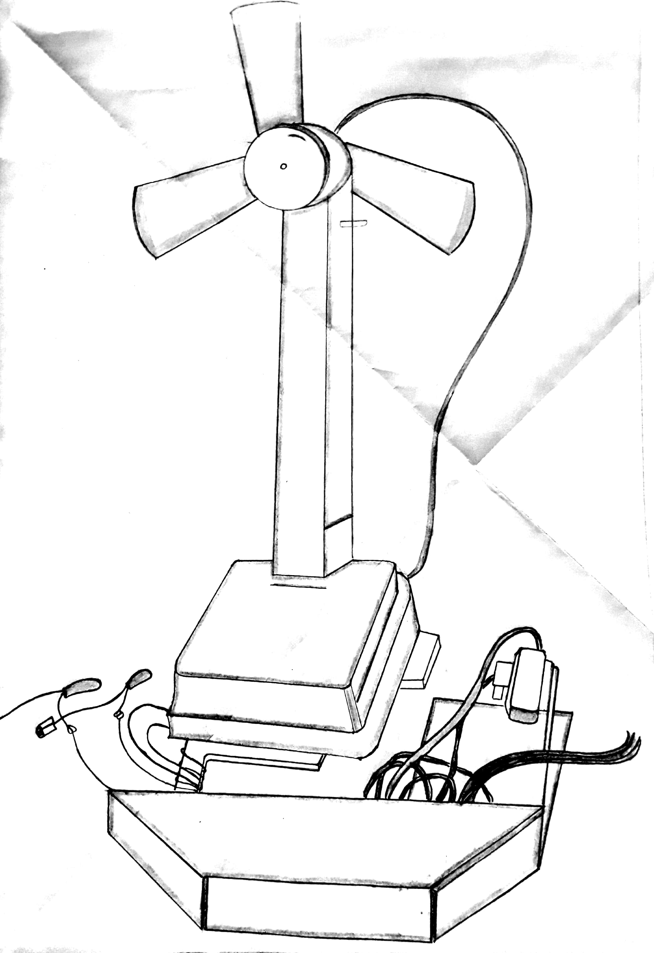
Proposed Design

Slide 5
Materials required
Components | Specifications | Quantity | Price | Site
Bread board | - | 2 | 180*2 | Amazon
Motor driver | 600mA,4.5-36V | 1 | 275 | Amazon
Battery | 12 | 1 |  | Amazon
Servo motors | 4.8-7.2V | 1 | 600 | Amazon
PIR sensors | 5-20V ,70mA | 4 | 750 | Amazon
Dc motor | 12V,1A | 1 | 200 | Ebay
Jumper wires | Male to female | 40 each | 350 | Amazon
Aluminium platform | 250*250*2 | 2 | 400 | Amazon
Arduino Uno with usb cable | Atmega 328 | 1 | 450 | Amazon
Miscallenous | Wires,resistor,capacitor,transistor,diodes,switch | As per requirement | 75 | Market

Slide 6
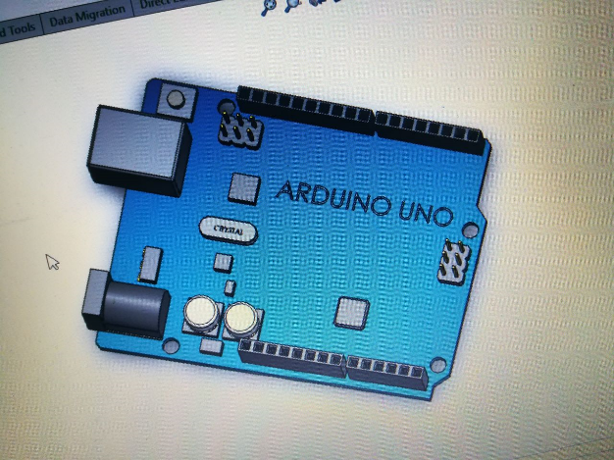
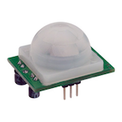
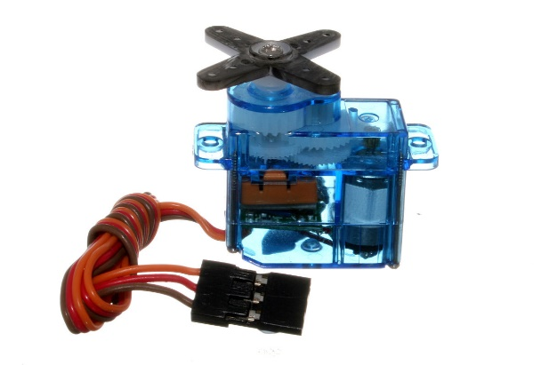
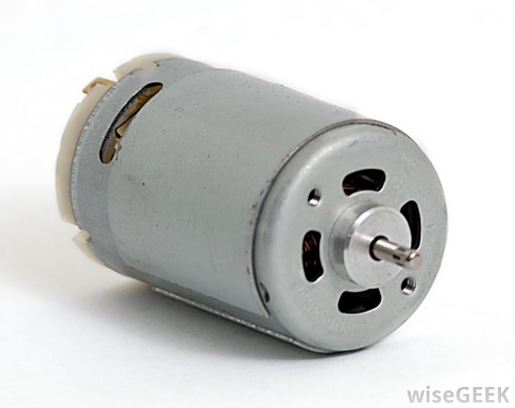
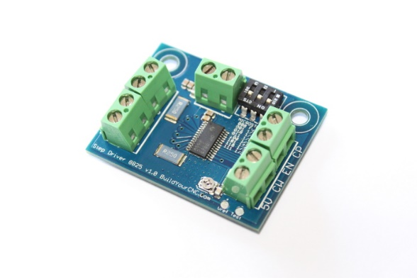
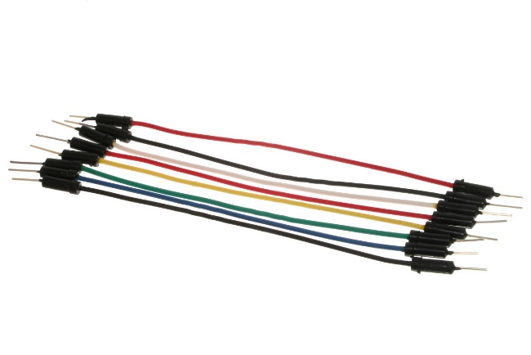
Components
Arduino Uno
Pir sensor
Servo motor
Jumper wires
Dc motor
Motor Driver

Slide 7
Summary
Our project idea is to make human sensing fan which will start on its own after sensing the presence of man using pir sensors and send signal to Arduino, arduino will turn on the fan after every 40 seconds arduino check the output of the sensor and if output is high then it will not switch off the electrical appliances and if output is low then it will turn off the electrical appliances. The device repeats this pattern continuously.Range of the PIR sensor is nearly 6 meters. It will be an innovative step in saving energy. Its will be of great help to senior citizens.

