Slide 1
Support Vector Machines (SVM)

Slide 2
What is SVM?
Definition:
Support Vector Machines (SVM) are powerful supervised learning models designed for classification and regression.
Why is SVM Important?
SVM is highly effective in handling small-to-medium-sized datasets with complex relationships.
Provides robust results even when classes overlap slightly.
Key Objective:
Identify the hyperplane that best divides the dataset into distinct classes while maximizing the margin (distance from the nearest data points).

Slide 3
How SVM Works?
Hyperplane:
A decision boundary that separates different classes in the feature space.
For 𝑛-dimensional data, the hyperplane is an 𝑛−1-dimensional flat surface.
Support Vectors:
These are the critical data points that influence the position and orientation of the hyperplane.
Removing a support vector can change the hyperplane significantly.
Kernel Trick:
A mathematical function that maps data into a higher-dimensional space.
Allows SVM to classify non-linearly separable data effectively.
Common kernels include linear, polynomial, and radial basis function (RBF).

Slide 4
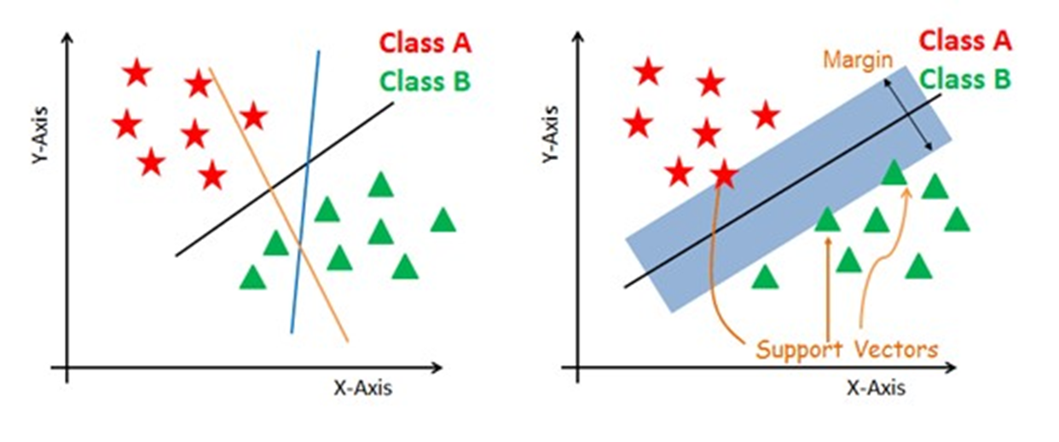
How SVM Works?

Slide 5
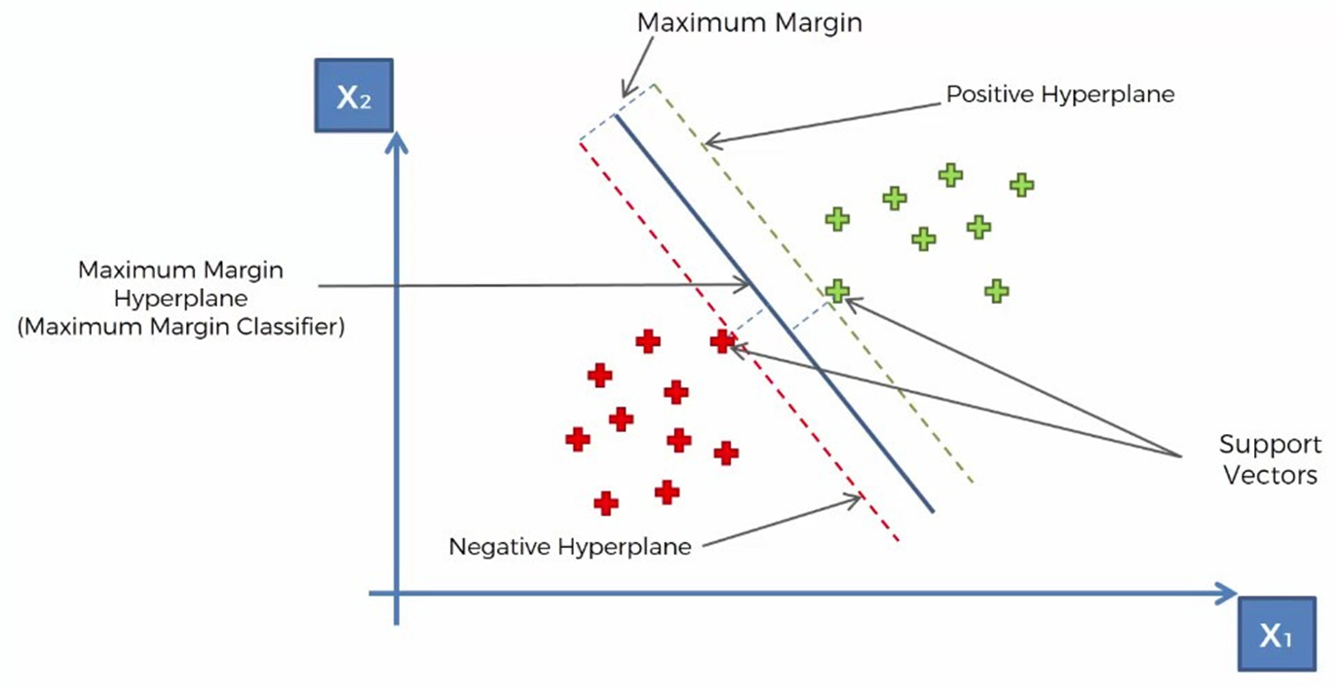
Decision Vectors

Slide 6
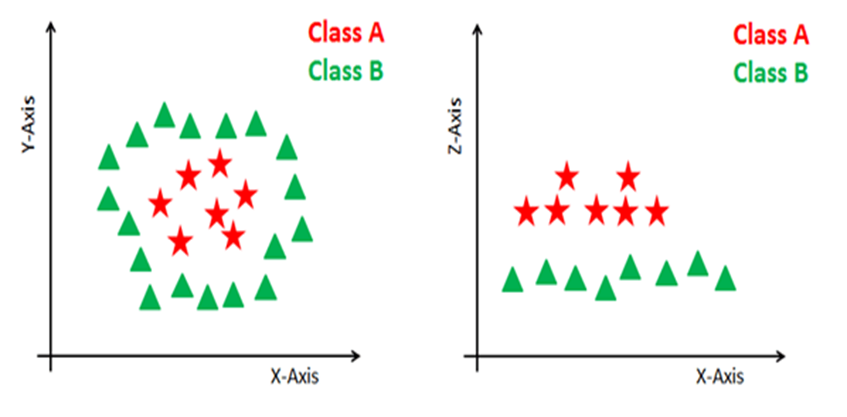
Non-linear and inseparable planes

Slide 7
SVM Kernels
Linear Kernel:
Equation: 𝐾(𝑥,𝑦)=𝑥⋅𝑦+𝑐
Best for datasets where classes are linearly separable.
Computationally less expensive.
Polynomial Kernel:
Equation: 𝐾(𝑥,𝑦)=(𝑥⋅𝑦+𝑐)𝑑
Maps the original feature space to a higher polynomial space.
Useful for datasets with curved boundaries.
RBF Kernel:
Equation: 𝐾(𝑥,𝑦)=exp⁡(−𝛾∥𝑥−𝑦∥2)
Excellent for non-linear data and handles complex relationships.
The parameter 𝛾 controls the influence of a single training example.
Sigmoid Kernel:
Equation: 𝐾(𝑥,𝑦)=tanh⁡(𝛼𝑥⋅𝑦+𝑐)
Often used as a proxy for neural networks.

Slide 8
Key Features of SVM
High-Dimensional Data:
SVM performs well in datasets with many features, such as text or image data.
Effective with Limited Samples:
SVM is robust when the number of data points is smaller than the number of dimensions (features).
Versatility with Kernels:
Kernels allow SVM to model highly complex relationships.
Regularization:
SVM incorporates a regularization parameter 𝐶 to avoid overfitting and control the trade-off between margin size and misclassification.

Slide 9
Applications of SVM
Text Classification:
Spam email detection, sentiment analysis, and topic categorization.
Image Classification:
Face detection, object recognition, and medical image segmentation.
Handwriting Recognition:
Recognizing handwritten characters for digital input or document analysis.
Bioinformatics:
Protein structure prediction, gene classification, and disease diagnosis.
Stock Market Prediction:
Predicting trends based on historical and technical indicators.

