Slide 1
Design And Analysis of Algorithms ESTABLISHING ELECTRIC GRID IN A TOWN USING BORUVKA’S ALGORITH
by
V. Abhiram (2010030180)
R. Vivek Vardhan Reddy (2010030142)
K. Sidharth Rao(2010030443)
A. Raghavendra Goud(2010030394)
Under the guidance of
(Ms. P. Sree Lakshmi)

Slide 2
ABSTRACT
Minimum spanning tree can be obtained for connected weighted edges with no negative weight using classical algorithms such as Boruvka's, Prim's and Kruskal. Here, we would like to presents a survey on the classical and the more recent algorithms with different techniques. It also contains comparisons of MST algorithm and their advantages and disadvantages.

Slide 3
Problem statement
Lets take a situation where we have a city which has so many towns in it, and the distances between pairs of the town are known. The goal is to create a system of electric power lines that would minimize the total distance (and thus the construction cost), yet reach every town. In this scenario, it is not necessary to connect each town to the “source of electricity” directly – it is enough to connect it to another town that already got the power.

Slide 4
The problem which we chose comes under the domain of GREEDY METHOD. Greedy is an algorithmic paradigm that builds up a solution piece by piece, always choosing the next piece that offers the most obvious and immediate benefit. So the problems where choosing locally optimal also leads to global solution are best fit for Greedy.
In this scenario, we have to find the MINIMUM COST SPANNING TREE. The cost of the spanning tree is the sum of the weights of all the edges in the tree. There can be many spanning trees. Minimum spanning tree is the spanning tree where the cost is minimum among all the spanning trees.

Slide 5
Existing solutions/ Naïve solutions
PRIM’S ALGORITHM:-
Prim's Algorithm is a greedy algorithm that is used to find the minimum spanning tree from a graph. Prim's algorithm finds the subset of edges that includes every vertex of the graph such that the sum of the weights of the edges can be minimized.
KRUSKAL’S ALGORITHM:-
Kruskal's Algorithm is used to find the minimum spanning tree for a connected weighted graph. The main target of the algorithm is to find the subset of edges by using which we can traverse every vertex of the graph. It follows the greedy approach that finds an optimum solution at every stage instead of focusing on a global optimum.

Slide 6
Proposed Algorithm Design Technique
BORUVKA’S ALGORITHM
Boruvka's algorithm is a greedy algorithm for finding a minimum spanning tree in a graph. The algorithm begins by finding the minimum-weight edge incident to each vertex of the graph, and adding all of those edges to the tree. Then, it repeats a similar process of finding the minimum-weight edge from each tree constructed so far to a different tree, and adding all of those edges to the forest. Each repetition of this process reduces the number of trees, within each connected component of the graph, to at most half of this former value, so after logarithmically many repetitions the process finishes.

Slide 7
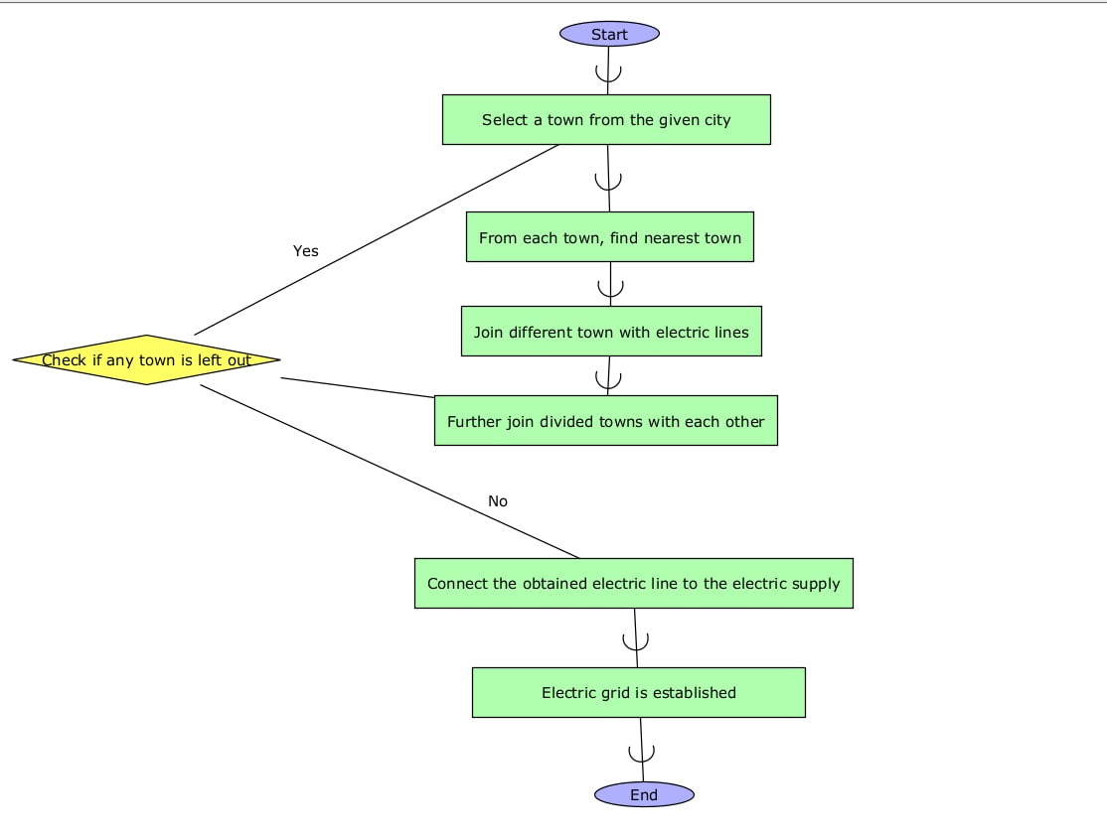
Flowchart

Slide 8
Hardware and Software Requirements
HARDWARE:
Modern Operating System:
Windows 7 or 10
Mac OS X 10.11 or higher, 64-bit
Linux: RHEL 6/7, 64-bit (almost all libraries also work in Ubuntu)
x86 64-bit CPU (Intel / AMD architecture)
4 GB RAM
5 GB free disk space
SOFTWARE:
Python3
Pycharm community(IDE)

Slide 9
Implementation
We have implemented this algorithm using python language. We created three python files and combined them to get the final output. The three python files used are:
Boruvkas.py
Graph.py
Test.py

Slide 10
Boruvka’s.py
In this python file, we declared all the logical functions, which will help us to find the optimum path to establish electric grid in town.
The class “def find_cheapest(self):” will help us to find the neighbouring streets with least distance, so that they can be connected, which results in formation of a path for the grid. This class will be repeated until all the streets are covered.

Slide 11
The class “union (self, x, y):” is used to club all the sub-divided towns/streets, and they fill be further joined and will be formed as one path, which will be followed to establish the electric grid.
Graph.py
Here, we use the package “matplotlib.pyplot”. This package will give us the benefit of working with graphs. Then, we use the package “network”. It is a package used to create, manipulate, and study the structure, dynamics and functions of complex graph networks.

Slide 12
This code is used for the assigning the attributes to the graphs, which will decide on the size of the appearance, the colour which will be used to represent the graph and the font and it’s size, which will be used for displaying the text on data.

Slide 13
Test.py
In this code, we use an additional package called “random”. This package will enable the computer to generate random graphs, according to the specifications mentioned by the user. Here, we even import the previous two codes too, as this is the final part of the code.
We use the class “def MST_problem(n)”. Here, we have to give the specifications of the graph which we want to work on, then we have to call the classes used in the previous parts of code. Thus, we get the final output of the graph, in a coloured format, which specifies us the electric grid established in town.

Slide 14
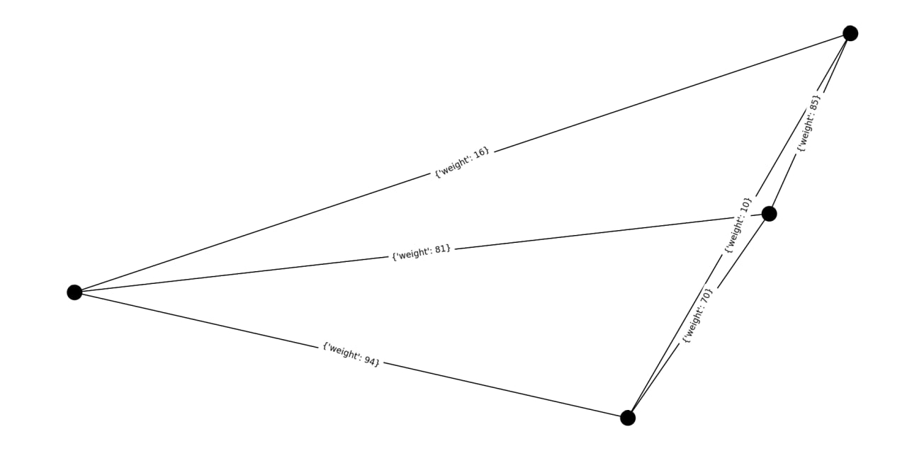
Output
Generation of Random Graph by the computer by using the package “random”

Slide 15
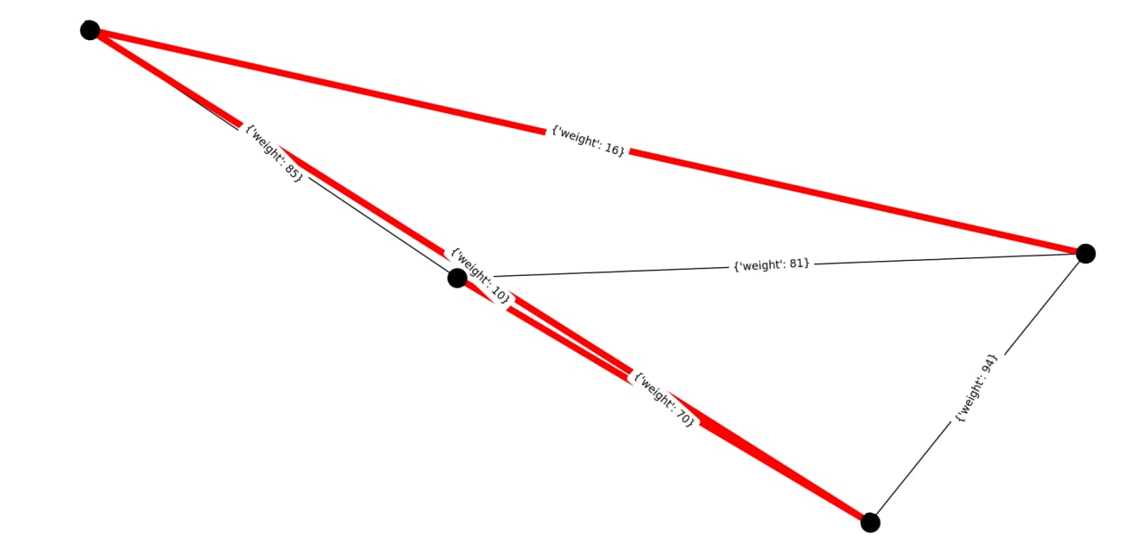
The shortest path of the graph, which follows Boruvka’s Algorithm. The shortest path is highlighted in red colour.

Slide 16
Future Scope
In the future, we will explore and test our developed algorithm “BORUVKA’S” in various domains. It is an important combinatorial optimization problem which is improved in recent times. The availability of reliable software, extremely fast and inexpensive hardware and high –level languages that make the modeling of complex problems faster have led to much greater demand for optimization tools. Keeping the above points of view our future work will more emphasize much larger problems on personal computers, much of the necessary data is routinely collected and tools exist to speed up both the modeling and the post optimality analysis.The front end can be also added to this.

Slide 17
Conclusion
Through this, we have seen how “BORUVKA’S” algorithm can be used to establish an Electric Grid in a Town. The major advantage of Boruvka’s algorithm over other algorithm is that, each node (street in the case of our project) will be individually assessed to know which is the nearest neighbouring town. By doing this, all the streets will be interconnected and the street nearest to the main power supply will be connected to it, thus providing electric supply throughout the town.

Slide 18
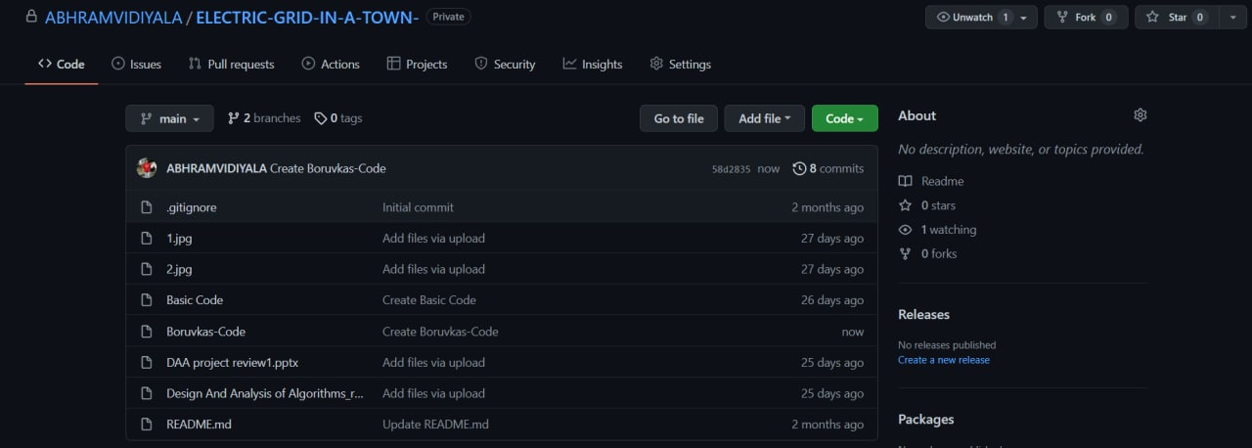
Github Commits

Slide 19
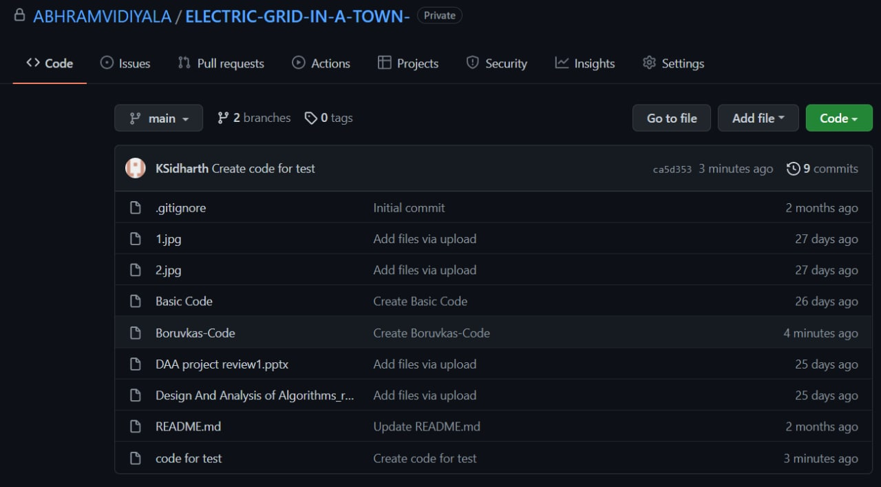

Slide 20
THANK YOU

