Slide 1


TRAVELLING SALESMAN OPTIMIZATION PROLEM USING ACO
Done By: -
V. Abhiram (2010030180)
A. Raghavendra (2010030394)
K. Sidharth (2010030443)
R. Vivek Vardhan (2010030142)

Slide 2
INTRODUCTION
Ant Colony Optimization technique is purely inspired from the foraging behavior of ant colonies, first introduced by Marco Dorigo in the 1990s. Ants communicate with each other using sound, touch and pheromone. Pheromones are organic chemical compounds secreted by the ants that trigger a social response in members of same species.
Ants live in community nests and the underlying principle of ACO is to observe the movement of the ants from their nests in order to search for food in the shortest possible path. Initially, ants start to move randomly in search of food around their nests. This randomized search opens up multiple routes from the nest to the food source. Now, based on the quality and quantity of the food, ants carry a portion of the food back with necessary pheromone concentration on its return path.

Slide 3
LITERATURE STUDY
The algorithmic world is beautiful with multifarious strategies and tools being developed round the clock to render to the need for high-performance computing. In fact, when algorithms are inspired by natural laws, interesting results are observed. Evolutionary algorithms belong to such a class of algorithms. These algorithms are designed so as to mimic certain behaviors as well as evolutionary traits of the human genome.
Different optimization techniques have thus evolved based on such evolutionary algorithms and thereby opened up the domain of metaheuristics. Metaheuristic has been derived from two Greek words, namely, Meta meaning one level above and heuriskein meaning to find. Algorithms such as the Particle Swarm Optimization (PSO) and Ant Colony Optimization (ACO) are examples of swarm intelligence and metaheuristics.

Slide 4
PROBLEM STATEMENT
Vehicle traffic congestion leads to air pollution, driver frustration, and costs billions of dollars annually in fuel consumption. Finding a proper solution to vehicle congestion is a considerable challenge due to the dynamic and unpredictable nature of the network topology of vehicular environments, especially in urban areas.
We tried to come up with a solution for this problem by using Ant colony optimization (ACO), which has been widely used for different combinatorial optimization problems. The traveling salesman problem (TSP) is one of the most important combinatorial problems. We present a bio-inspired algorithm, food search behavior of ants, which is a promising way of solving the Travel Salesman Problem.

Slide 5
SCOPE OF THE PROJECT
The TSP has several applications even in its purest formulation, such as planning, logistics, and the manufacture of microchips.
The TSP also appears in astronomy, as astronomers observing many sources will want to minimize the time spent moving the telescope between the sources; in such problems, the TSP can be embedded inside an optimal control problem.] In many applications, additional constraints such as limited resources or time windows may be imposed.

Slide 6
WAY TO SOLVE THE PROBLEM
The functioning of an ant colony provides indirect communication with the help pheromones, which ants excrete. The attractiveness of a given path depends on the quantity of pheromones that the ant feels. Pheromones excretion is governed by some rules and has not always the same intensity. The quantity of pheromones depends on the attractiveness of the route. The use of more attractive route ensures that the ant exudes more pheromones on its way back and so that path is also attractive for other ants.
The important characteristic of pheromones is evaporation. This process depends on the time. When the way is no longer used, pheromones are more evaporated and the ants begin to use other paths. What is important for ACO algorithm the moving of ants. This motion is not deterministic, but it has stochastic character, so the ants can find the path, which is firstly unfavorable, but which is ultimately preferable for food search.

Slide 7
The important characteristic is that a few individuals continuously use non-preferred path and look for another best way. ACO was formulated based on experiments with double path model, where the quantification was made similar to Monte Carlo method.
The base of this simulation was two artificial connections between the anthill and a food source. The simulation demonstrated that ants are able to find the shorter these two paths. A significant impact of this simulation was to quantify the behavior of ants. For practical use of ACO, it was necessary to project virtual ants. It was important to set their properties.
These properties help virtual ants to scan the graph and find the shortest tour. Virtual ants do not move continuously; they move in jumps, which means that, after a time unit, they will always be in another graph node. The absolved path is saved in ant memory. The created cycles are detected in ant memory. In the next tour, the ant decides on the base of pheromones power. Just because the property of pheromone evaporation, pheromones on shortest edges are stronger, because of the fact that the ant goes across these edges faster.

Slide 8
ALGORITHM USED
Given an n-city TSP with distances d_{ij}, the artificial ants are distributed to these n cities randomly. Each ant will choose the next to visit according to the pheromone trail remained on the paths just as mentioned in the above example. However, there are two main differences between artificial ants and real ants: (1) the artificial ants have “memory”; they can remember the cities they have visited and therefore they would not select those cities again. (2) The artificial ants are not completely “blind”; they know the distances between two cities and prefer to choose the nearby cities from their positions. Therefore, the probability that city j is selected by ant k to be visited after city i could be written as follows:

Slide 9
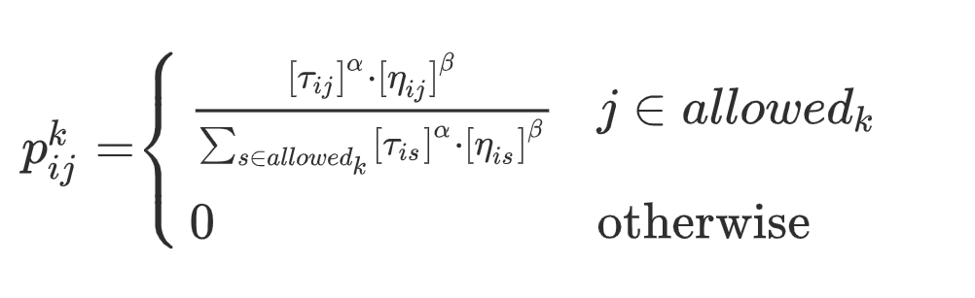

Slide 10
where τij is the intensity of pheromone trail between cities i and j, α the parameter to regulate the influence of τij, ηij the visibility of city j from city i, which is always set as 1/dij (dij is the distance between city i and j), β the parameter to regulate the influence of ηij and allowedk the set of cities that have not been visited yet, respectively.
At the beginning, l ants are placed to the n cities randomly. Then each ant decides the next city to be visited according to the probability p_{ij}^{k} given by Eq. (1). After n iterations of this process, every ant completes a tour. Obviously, the ants with shorter tours should leave more pheromone than those with longer tours. Therefore, the trail levels are updated as on a tour each ant leaves pheromone quantity given by Q/L_{k}, where Q is a constant and L_{k} the length of its tour, respectively. On the other hand, the pheromone will evaporate as the time goes by.

Slide 11
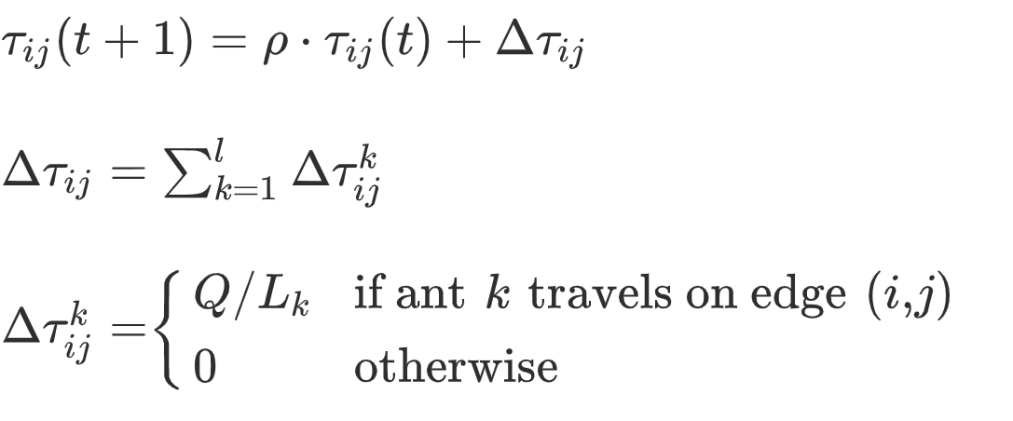
Then the updating rule of τ_{ij} could be written as follows:
where t is the iteration counter, ρ ϵ [0, 1] the parameter to regulate the reduction of τ_{ij}, Δτ_{ij} the total increase of trail level on edge (i, j) and Δτ_{ij}^{k} the increase of trail level on edge (i, j) caused by ant k, respectively.

Slide 12
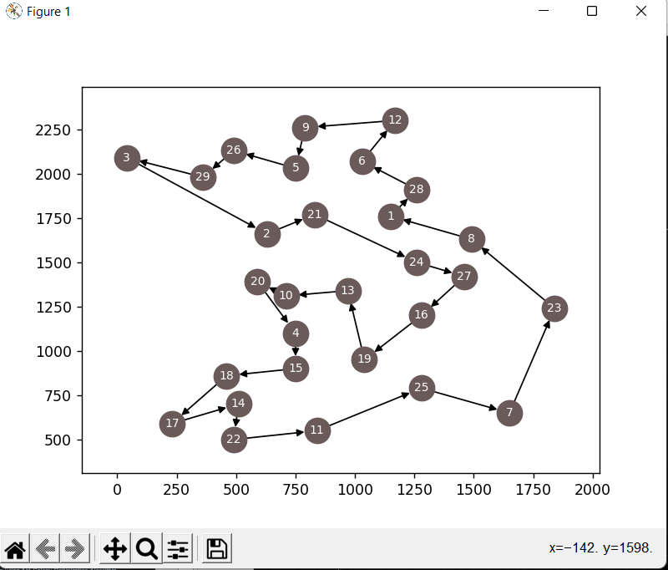
OUTPUT

Slide 13
CONCLUSION
In this presentation, we came up with an efficient approach for solving Travelling Salesman Problem using Ant Colony Optimization Algorithm.
This algorithm turns out to be a very effective technique to find out the minimum distance between multiple cities to be covered, and thus solving the Travelling Salesman Optimization problem.

Slide 14
THANK YOU

