Slide 1
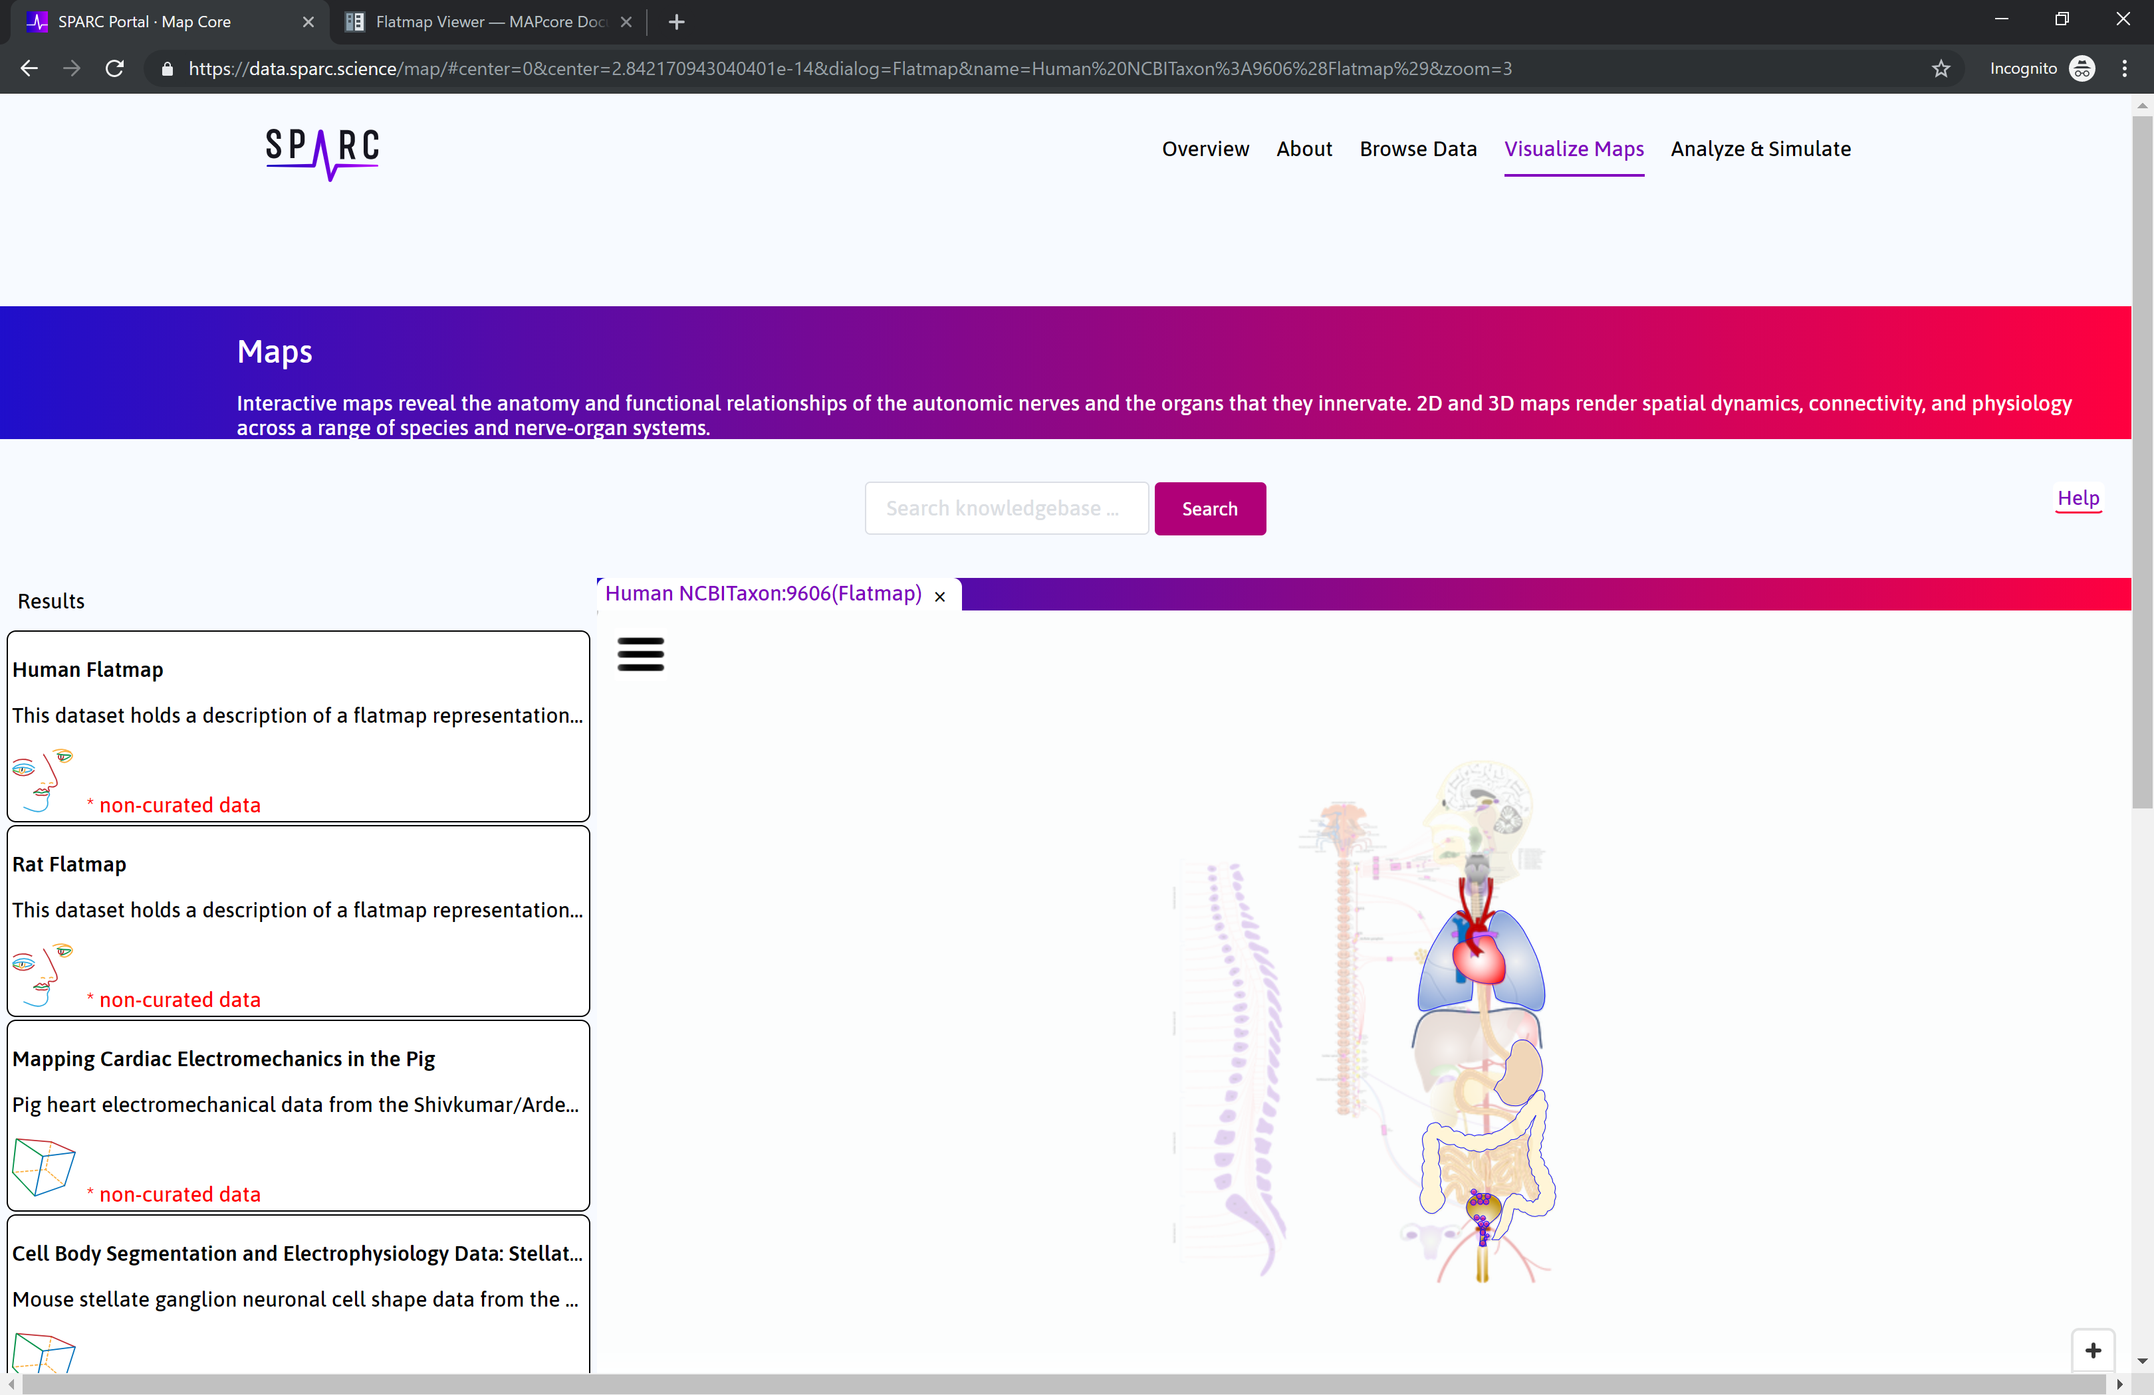

Slide 2
B
A
C

