Slide 1
Image Display Settings

Slide 2
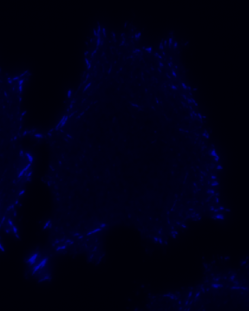
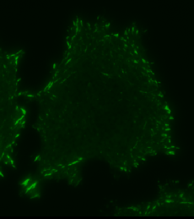
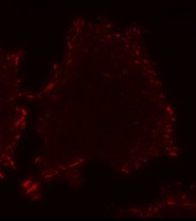
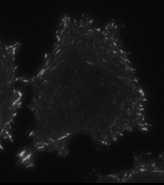
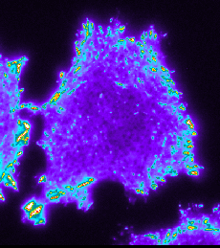
Image Display: Look Up Tables (LUTs)
Avoid blue and red look up tables.
The human eye is most sensitive to green.
Greyscale is best.
Multicolour look up tables can highlight dim and bright features in the same image.
Brown, J Cell Sci., 120, 1703-1705 (2007)
Notes:
Avoid blue and red look up tables (LUTs) because the human eye is not very sensitive to these colours. Green is better, but greyscale is best. Notice the details in the centre of this cell that are difficult to see in the coloured images. Rainbow or other LUTs that use multiple colours give the eye the ability to see even more detail. The eye can see about 20 different levels of intensity. So with the rainbow LUT the eye can see 20 levels of blue, 20 levels of green, 20 levels or red and so on.

Slide 3
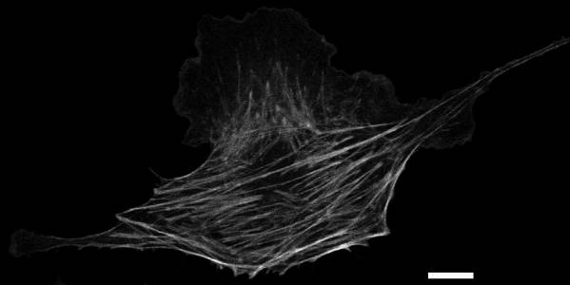
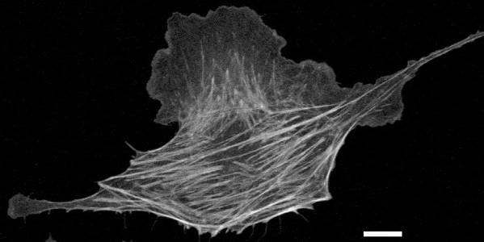
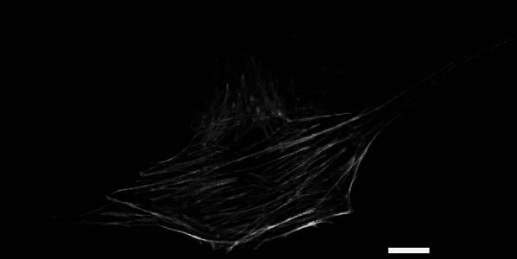
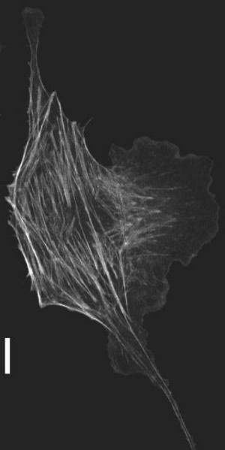
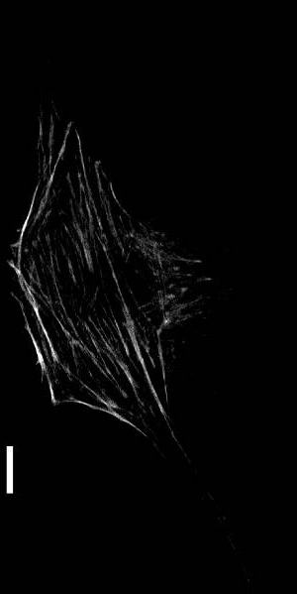
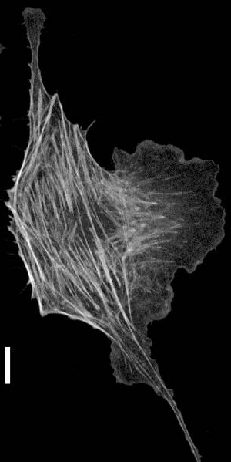
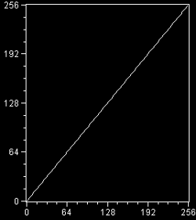
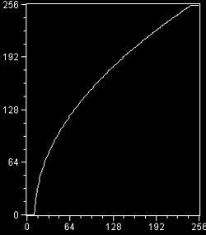
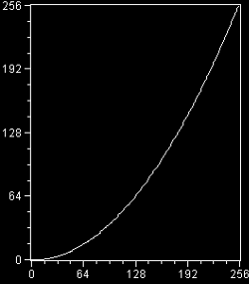
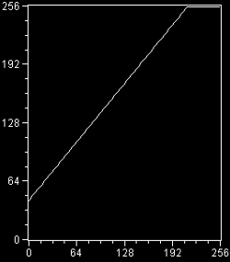
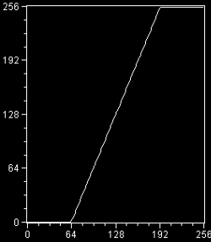
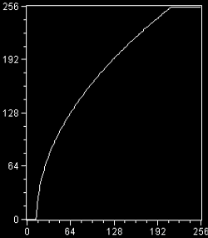
Image Display: Gamma, Brightness and Contrast
linear
gamma 2
gamma 0.5
brightness
contrast
All Three
Display
Intensity
Image Intensity
Brown, J Cell Sci., 120, 1703-1705 (2007)
Notes:
Different display settings can be used to emphasize or highlight certain features in images. The Gamma, Brightness and Contrast settings can be used to enhance images. The lower panel here shows the relationship between the image intensity and the display intensity. Note that the image data is not impacted just how the image is displayed. NOTE that with FIJI/ImageJ if you use the gamma feature it does perform a mathematical operation and changes the image intensity data.
Gamma can be used to emphasize dim features without making bright features look saturated. In the opposite manner it can minimize dim features and highlight bright ones. This is a non-linear operation so it is important that if it is used it is stated in the figure caption. Brightness will make all pixels brighter including background and contrast changes the slope of the curve relating display and image intensity. A combination of all three is often best. Make sure the exact same settings are used for all images in a panel if the intensity will be compared. Explain what settings were used in the figure caption. In some software, the gamma values are reversed with low levels highlighting dim features and high levels highlighting bright features.

Slide 4
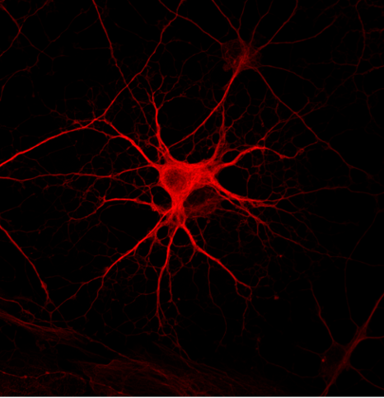
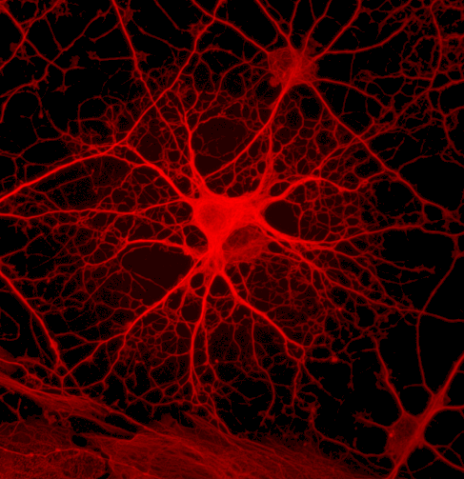
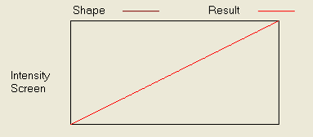
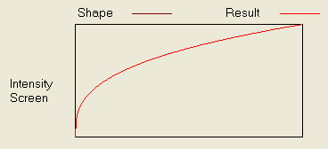
Image Display: Gamma Factor Enhances Dim Features
Linear
Non-linear
Zeiss LSM 510 Confocal Manual
Notes:
Excellent example of when to use the gamma factor to enhance dim features without the cell body looking saturated as it would if just brightness was adjusted.

Slide 5
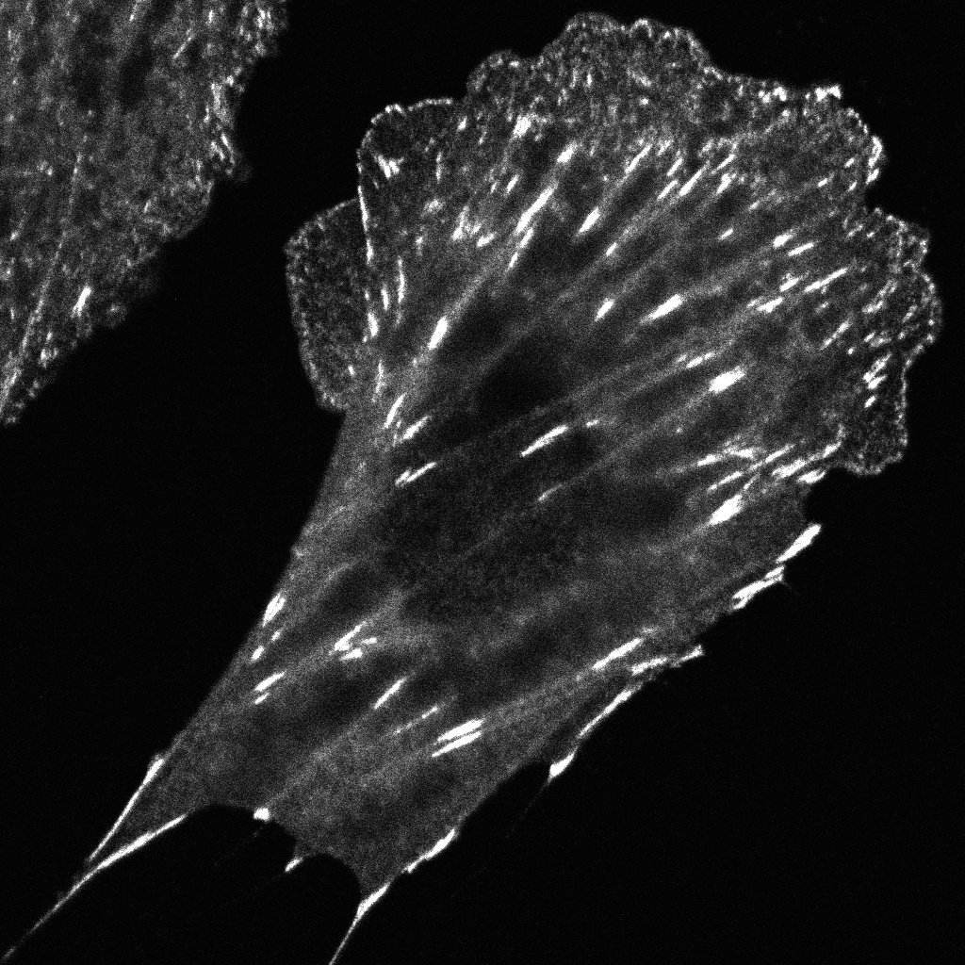
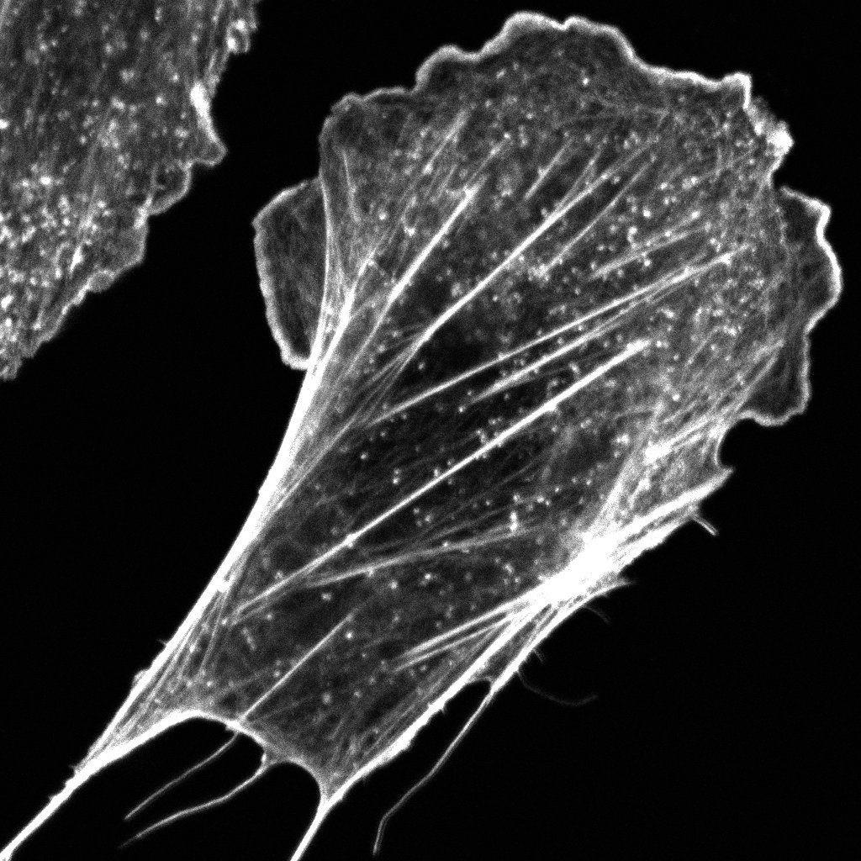
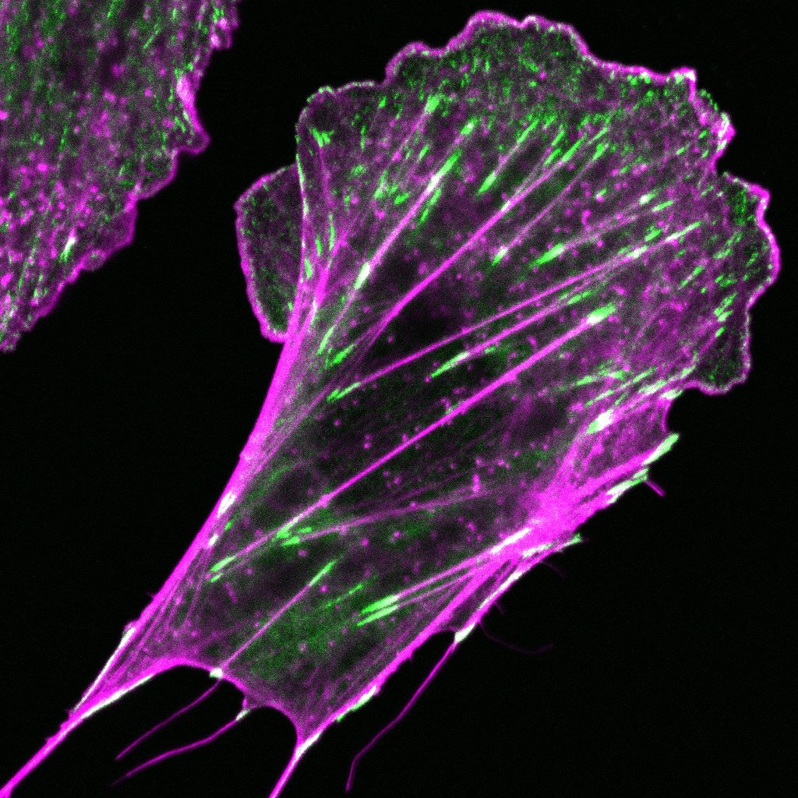
Image Display: Colour Overlays
Use greyscale for individual images and only colour in overlays.
Make the font of the protein/target name the colour it is in the overlay image.
Use arrows to highlight common features.
Avoid red and green, it is not colour blind friendly.
Paxillin-EGFP
Actin Phalloidin-405
Claire Brown, McGill Advanced BioImaging Facility (ABIF)
Notes:
Individual image panels should be shown in greyscale and the text for the staining should be shown in the colour of the overlay. Here the adhesion protein paxillin is shown in green and the actin phalloidin stain is in magenta. These are colour blind friendly colours. Green and red overlays cannot be seen by about 10% of the male population.

Slide 6
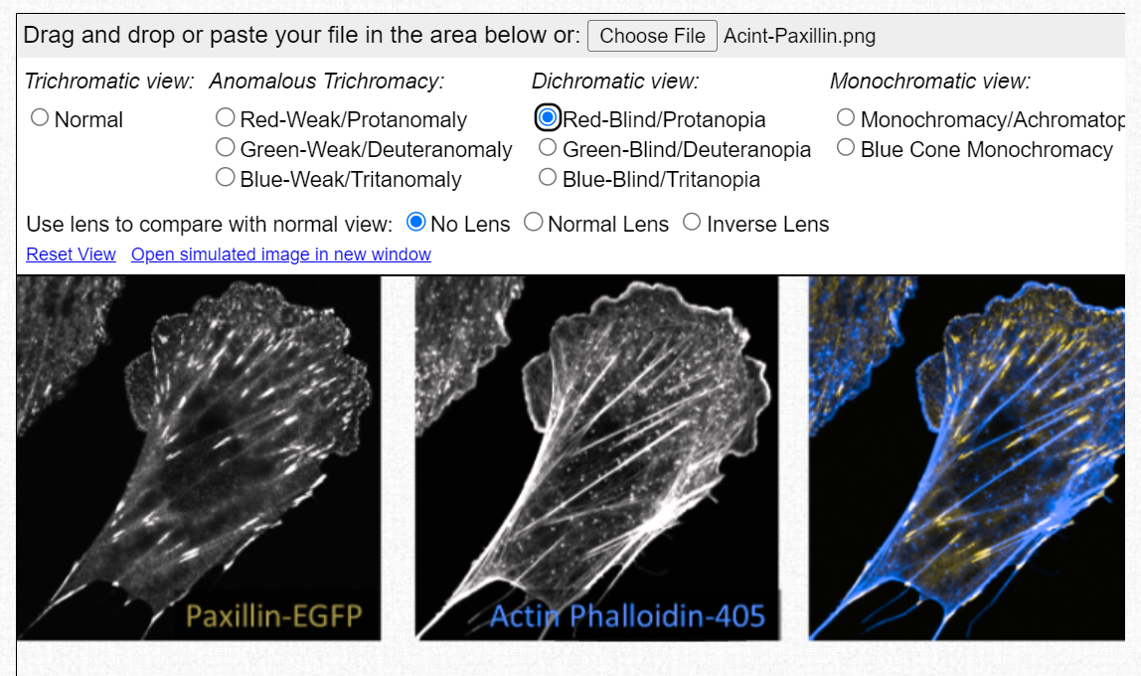
Colour Blind Checker – Can Be Used for Event Flyers as Well
https://www.color-blindness.com/coblis-color-blindness-simulator/
Claire Brown, McGill Advanced BioImaging Facility (ABIF)
Notes:
Use a colour blind online checker to make sure your figures are good for colour blind people. There are many but this is one example. You can also check other images such as event flyers.

Slide 7
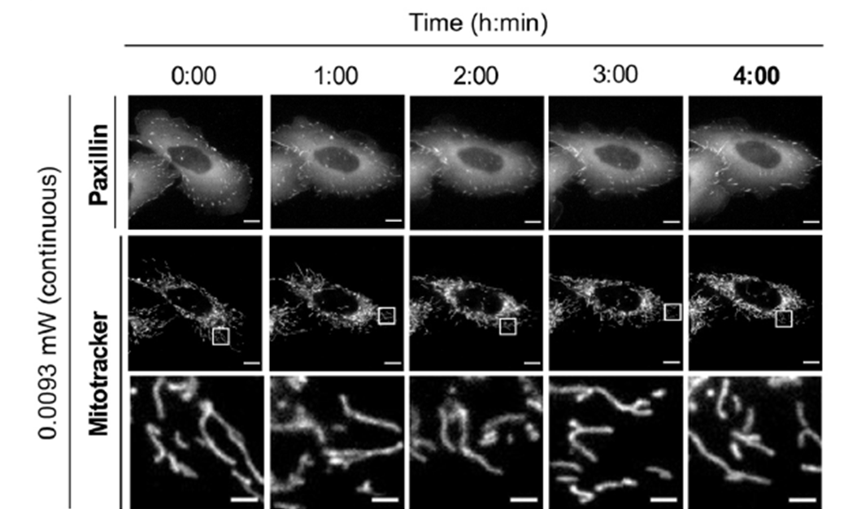
Scale Bars and Time Stamps
Scale bars need to be displayed. The size can be on the image of in the figure caption.
If there are regions of interest that are zoomed in on there should be a separate scale bar.
If timelapse is done, the time stamp is required.
Scale bars are 10 μm for whole-cell images and 2 μm for magnified images.
Kiepas et al, J. Cell Sci. (2020) 133, jcs242834. doi:10.1242/jcs.242834

Slide 8
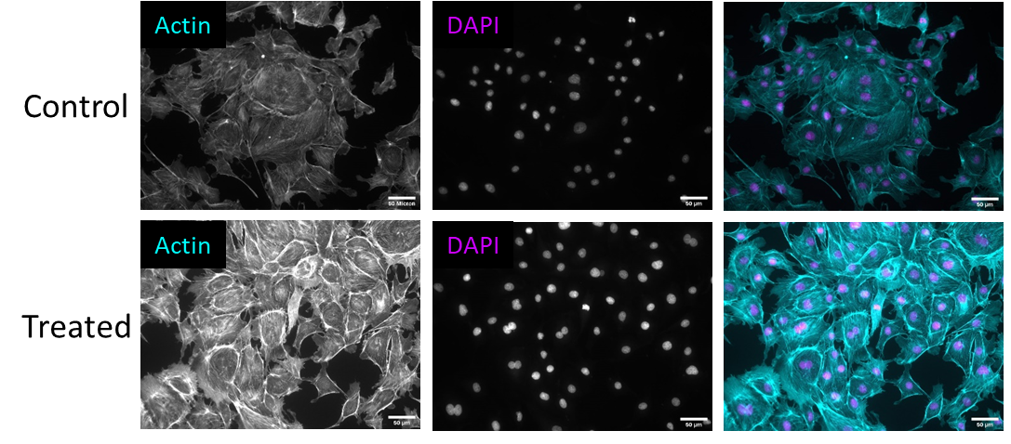
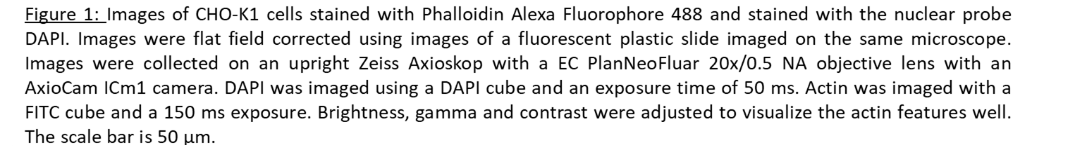
Detailed Figure Captions and Scale Bars are Needed
Claire Brown, McGill Advanced BioImaging Facility (ABIF)
Notes:
It is important that images have scale bars. Detailed figure captions should describe how the images were captured, information about the sample and how the image display was adapted.

Slide 9
Sampling & Statistics

Slide 10
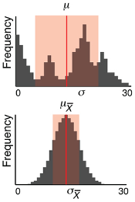
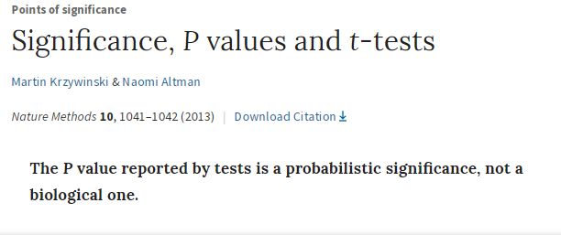
Statistics/Data Display are Important
These two data sets have the same mean
Nature Statistics Webpage
https://www.nature.com/collections/qghhqm/
Notes:
The nature statistics webpage has a lot of information about different statistical tests.

Slide 11
Box Plot
All data points are shown. Outliers are easy to identify.
***
1.5x Standard
Deviation
75th percentile
of the data
Mean
Median
25th percentile
of the data
1.5x Standard
Deviation
* P>0.050
** P<0.010
*** P<0.001
Notes:
The box plot is one form of data display that gives a lot more information than a bar chart. The P values in this figure were calculated with n=number of cells rather than the number of experiments. Best to keep outliners in the figure and let people evaluating the work make their own conclusions.

Slide 12
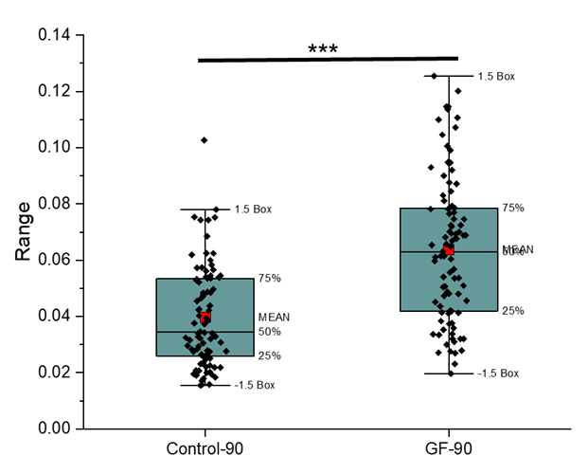
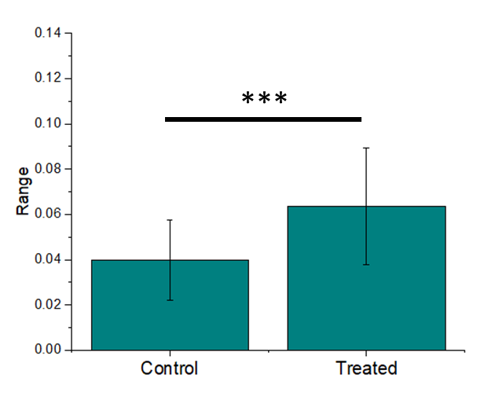
Box Plot vs Bar Chart
Notes:
Same dataset as the previous slide showing limited information from a bar chart.

Slide 13
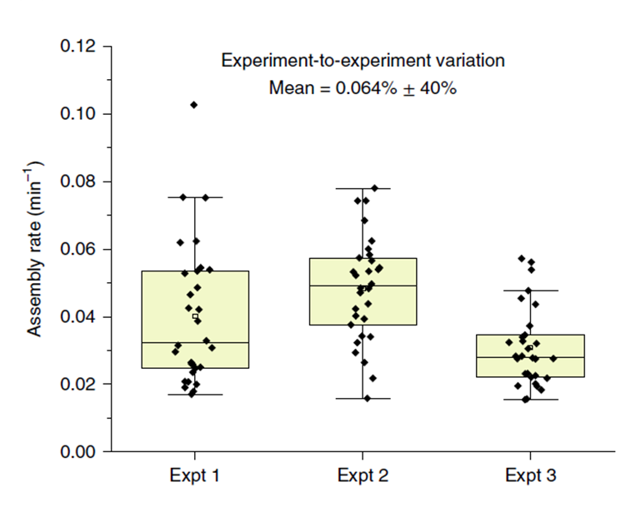
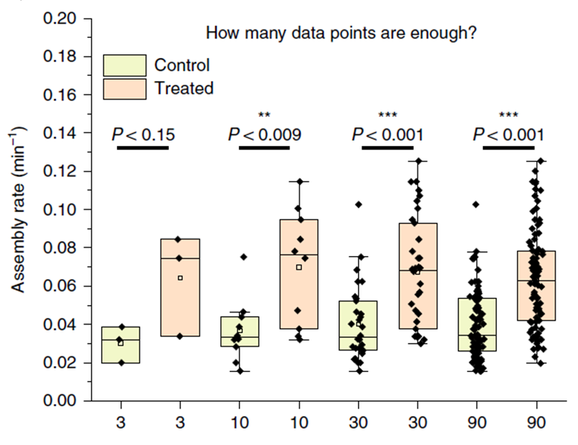
Quantitative Data
Experimental replicates. Three complete experiments, three different days.
Take at least 10 images per sample.
Have a minimum of 30 cells per sample.
The n-value should really be the number of experiments.
https://www.nature.com/articles/s41596-020-0307-7
Notes:
General guidelines are to have a minimum of three experimental replicates. That is, doing the full experiment three independent times. If there is a lot of variability or trends are not consistent then it is best to do a fourth experimental replicate. The second panel shows that there should be a minimum of 10 data points, 30 data points is ideal and more data points will allow you to see the distribution of the data more clearly and potentially identify interesting subpopulations. The p-values were calculated with an n value of the total number of data points not the number of experiments.

Slide 14
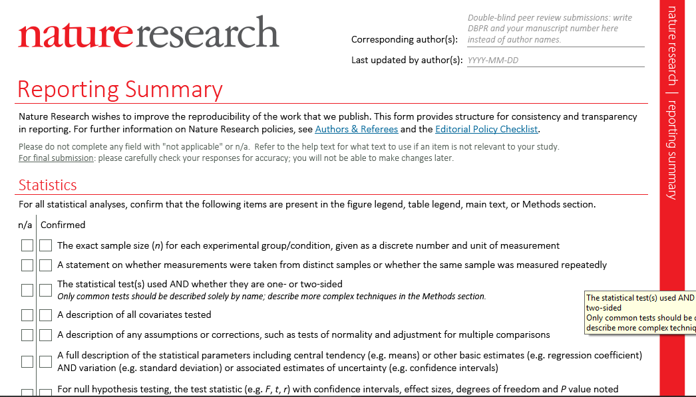
See Journal Guidelines
https://www.nature.com/documents/nr-reporting-summary.pdf
Notes:
The journals are now requesting that authors declare the types of statistical methods they use and if there are any outliers eliminated from the analysis.

Slide 15
Statistical comparison of means
Statistics is often employed to confirm whether two or more results are significantly different to each other to support or reject experimental observations.
This is usually done in either supporting the null hypothesis, or rejecting it:
  Null hypothesis: Mean 1 = Mean 2
  Alternative hypothesis: Mean 1 ≠ Mean 2
  Statistical tests of the null hypothesis analyse how similar two datasets are. These include the t-test and the ANOVA test.
Notes:
The null hypothesis tests if the means of two distributions are significantly different. The t-test is done pairwise with two datasets. The Anova test looks at multiple pairs within multiple data sets or experimental conditions.

Slide 16

T-Test
A t-test analyses the probability that other samples selected from each group being compared will be as different as the samples I have now. The output is a t-value:
A high t-value indicates that the distributions are different.
Higher t-value if:
  High difference in the means (mean 1 – mean 2).
  Narrow population distribution (i.e. standard deviation, SD1, SD2) so less chance of distribution overlap.
  Large sample size (n1, n2)
$$\frac{mean 1 −mean 2}{\sqrt{\frac{{SD1}^{2}}{n1}\frac{{SD2}^{2}}{n2}}}$$
Notes:
This is how to calculate the t-value for two population means. The n value is usually the number of datapoints.

Slide 17
P-Value, t-test Options
The t-value is used to determine a probability, P. This is usually done automatically in statistics software but can be determined from probability tables.
Use degrees of freedom = n1+n2-2
P < 0.05, 5% probability if the experiment was repeated that a significant difference would not be found.
P < 0.01, 1% probability if the experiment was repeated that a significant difference would not be found.
P<0.001, 0.1% probability if the experiment was repeated that a significant difference would not be found.
Notes:
This is the standard way that most people calculate the P value and report it.

Slide 18
P-Value, t-test Options
Independent Samples – two different experiments
Paired Samples – before and after pairs of data
One-tailed – means must be higher or lower, takes into account ONE side of each distribution (upper of one, lower of the other).
Two-tailed – means can be higher or lower than each other, takes into account both sides of each distribution (upper and lower limits).
Two-tailed is more conservative. Ensure there is really a difference.
Notes:
T-tests can be done in many ways and this slide outlines how.

Slide 19
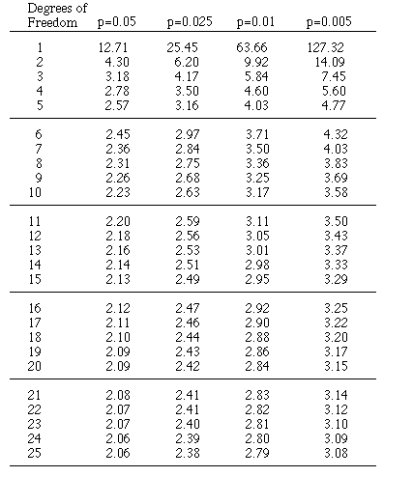
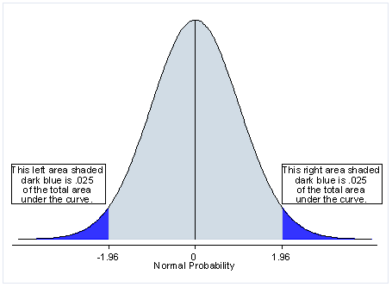
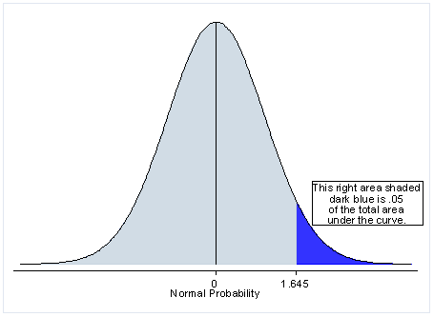
P-Value, t-test Options
2.5% at each end of the distribution
5% at one end of the distribution
t values
Notes:
This slide shows a more visual way to see the one-tailed versus two tailed t-test.

Slide 20
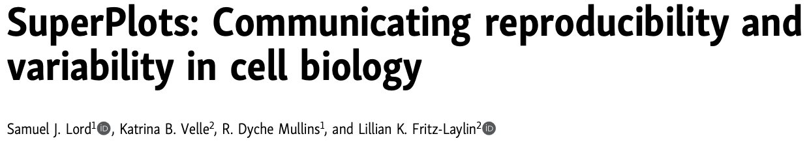
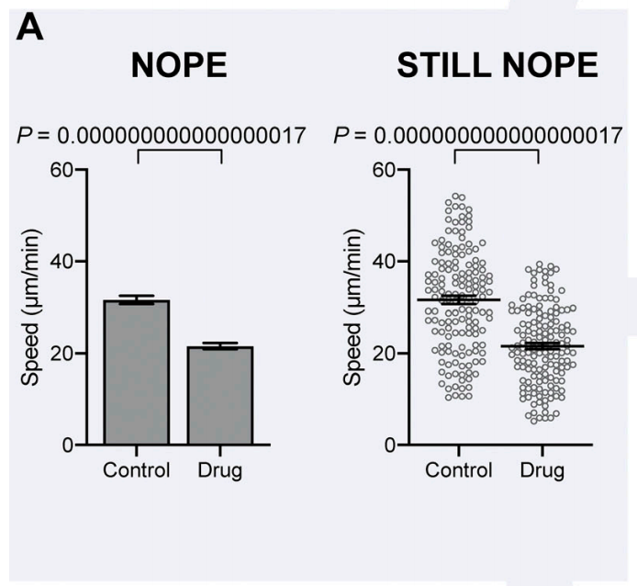
SuperPlots
It is better to use the n value as the number of experiments.
Not number of cells or number of features (vesicles, adhesions).
If n is too large P will almost always be significant.
https://pubmed.ncbi.nlm.nih.gov/32346721/
Notes:
This is an excellent paper that is highly recommended. It is a bit different than what has been presented in these slides and is becoming the standard in the life sciences.

Slide 21
SuperPlots
It is better to use the n value as the number of experiments.
Not number of cells or number of features (vesicles, adhesions).
If n is too large P will almost always be significant.
https://pubmed.ncbi.nlm.nih.gov/32346721/
Notes:
This figure shows that plots showing all data points are much better than those showing a bar graph. However, calculating the p-value with all data points inflates differences. Essentially with such a high n-value almost any slight difference in means of populations will result in a very small P-value or high significance. The paper then goes on to say that the n-value should really be the number of experiments not the number of datapoints (cells, vesicles, etc).

Slide 22
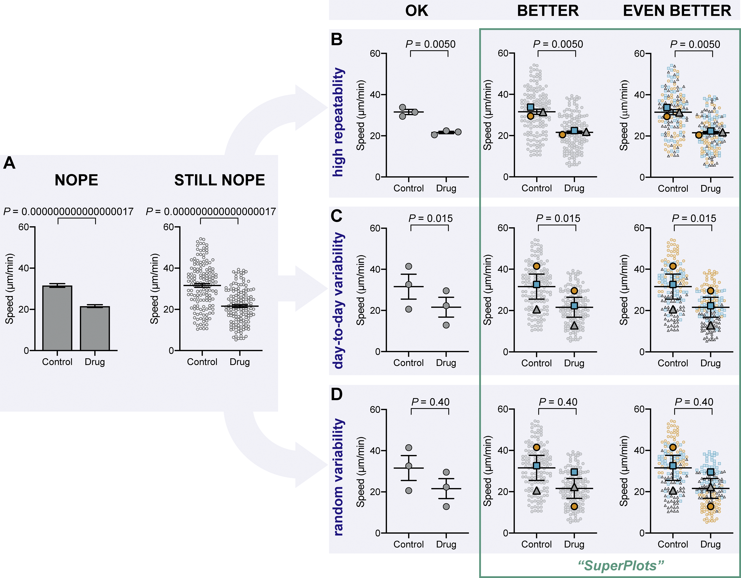
SuperPlots: Communicating reproducibility and variability in cell biology
SuperPlots provides guidelines for the best way to present experimental data.
Best to show all data points and colour code them for experimental replicate.
For statistics the n value should be the number of experiments.
https://pubmed.ncbi.nlm.nih.gov/32346721/
Notes:
The top panel shows all data points and then the mean from each experimental replicate. The first panel just shows the means. The second all the data points and the means. The third is best showing all the data points colour coded for each experimental replicate. The power of the display in B is clear in panels C and D. In panel C, it is clear that with the drug treatment the cell speed decreases. The control cell speed varies from day-to-day but there is a clear impact of the drug to slow down the cells. In panel D, showing all the datapoints makes it clear that the data is not reproducible and the drug trend is not clear. Sometimes the cells slow down, sometimes they speed up and sometimes there is no effect. It is impossible to see the day-to-day or random variability without the use of super plots. Not that the P values calculated with n=3 experiments reflect that there is no significant difference in the means with the random variability.
Figure Caption from the Publication:
The importance of displaying reproducibility. Drastically different experimental outcomes can result in the same plots and statistics unless experiment-to-experiment variability is considered. (A) Problematic plots treat n as the number of cells, resulting in tiny error bars and P values. These plots also conceal any systematic run-to-run error, mixing it with cell-to-cell variability. (B–D) To illustrate this, we simulated three different scenarios that all have identical underlying cell-level values but are clustered differently by experiment: B shows highly repeatable, unclustered data, C shows day-to-day variability, but a consistent trend in each experiment, and D is dominated by one random run. Note that the plots in A that treat each cell as its own n fail to distinguish the three scenarios, claiming a significant difference after drug treatment, even when the experiments are not actually repeatable. To correct that, “SuperPlots” superimpose summary statistics from biological replicates consisting of independent experiments on top of data from all cells, and P values were calculated using an n of three, not 300. In this case, the cell-level values were separately pooled for each biological replicate and the mean calculated for each pool; those three means were then used to calculate the average (horizontal bar), standard error of the mean (error bars), and P value. While the dot plots in the “OK” column ensure that the P values are calculated correctly, they still fail to convey the experiment-to-experiment differences. In the SuperPlots, each biological replicate is color-coded: the averages from one experimental run are yellow dots, another independent experiment is represented by gray triangles, and a third experiment is shown as blue squares. This helps convey whether the trend is observed within each experimental run, as well as for the dataset as a whole. The beeswarm SuperPlots in the rightmost column represent each cell with a dot that is color-coded according to the biological replicate it came from. The P values represent an unpaired two-tailed t test (A) and a paired two-tailed t test (B–D). For tutorials on making SuperPlots in Prism, R, Python, and Excel, see the supporting information.

Slide 23
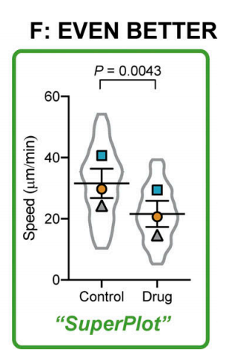
SuperPlots
Supplemental information describes how to generate plots in Prism, Excel, R, and Python
https://pubmed.ncbi.nlm.nih.gov/32346721/
Notes:
This is another way to display the figure showing the outline of the population distribution. The paper also has supplemental materials showing exactly how to generate SuperPlots using Prism, Excel, R and Python.

Slide 24
PlotsOfData – online tool
https://huygens.science.uva.nl/PlotsOfData/
Click the "Data Upload" tab (if not already clicked)
Select "Paste data" on the left, after which a text input area named "Paste data below:" should appear
Copy-paste your columns of data from Excel (with column headers) to the "Paste data below:" text input area
Select "Tab (from Excel)" as a delimiter
Click "Submit Data”
Your columns of data should appear on the right - check to make sure things are in order (number of columns, rows, etc). Note that spaces in columns headers will be replaced with underscores. Continued…
https://huygens.science.uva.nl/PlotsOfData/
Notes:
PlotsOfData is an excellent online tool to make super plots.

Slide 25
PlotsOfData – online tool
https://huygens.science.uva.nl/PlotsOfData/
Click on the "Plot" tab, wait a few seconds (depends on connection and amount of data), a plot should appear with all your data.
On the left, you can select different ways of visualizing the data and adjust display parameters.
You can then download your plot in an appropriate format.
Click Data Summary to get some stats on the dataset.
https://huygens.science.uva.nl/PlotsOfData/

Slide 26
What’s Wrong With These Figures?

Slide 27
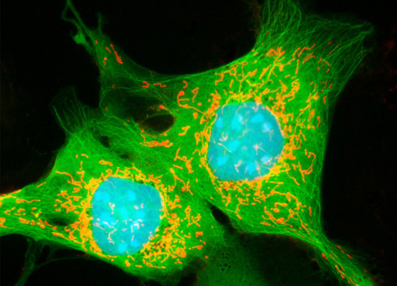
What’s Wrong with this Figure?
https://www.microscopyu.com/gallery-images/opossum-kidney-cortex-epithelial-cells-ok-line-1
Notes:
Display colours all look saturated. No scale bar. Not colour blind friendly.

Slide 28
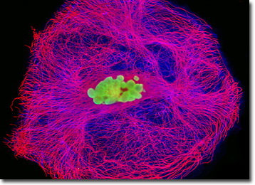
What’s Wrong with this Figure?
http://micro.magnet.fsu.edu/primer/techniques/fluorescence/gallery/cells/ptk1/ptk1cells.html
Notes:
Display colours all look saturated. No scale bar. Many not be colour blind friendly.

Slide 29
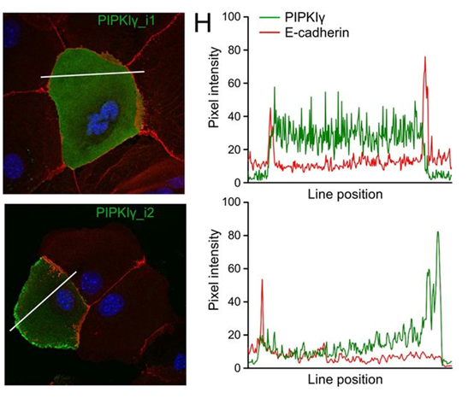
What’s Wrong with this Figure?
Notes:
No scale bar. Not colour blind friendly. No units on the x-axis of the line pixel intensity profiles.

Slide 30
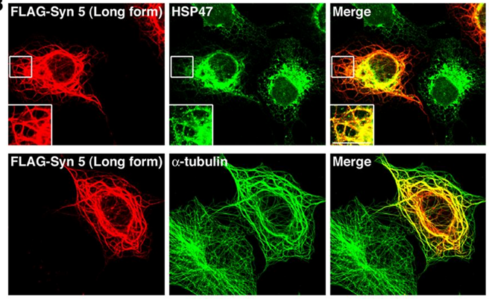
What’s Wrong with this Figure?
Notes:
Display colours all look saturated. No scale bar. Not colour blind friendly.

Slide 31
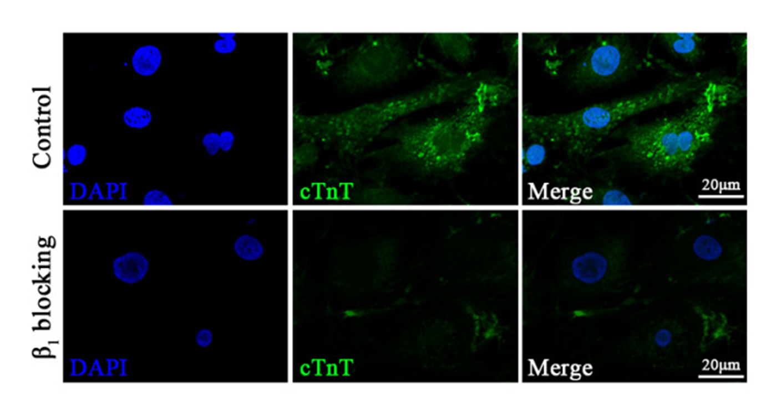
What’s Wrong with this Figure?
Notes:
Blue display colour looks saturated in the first panel. Why does the DAPI stain also decrease with the treatment? Not colour blind friendly.

Slide 32
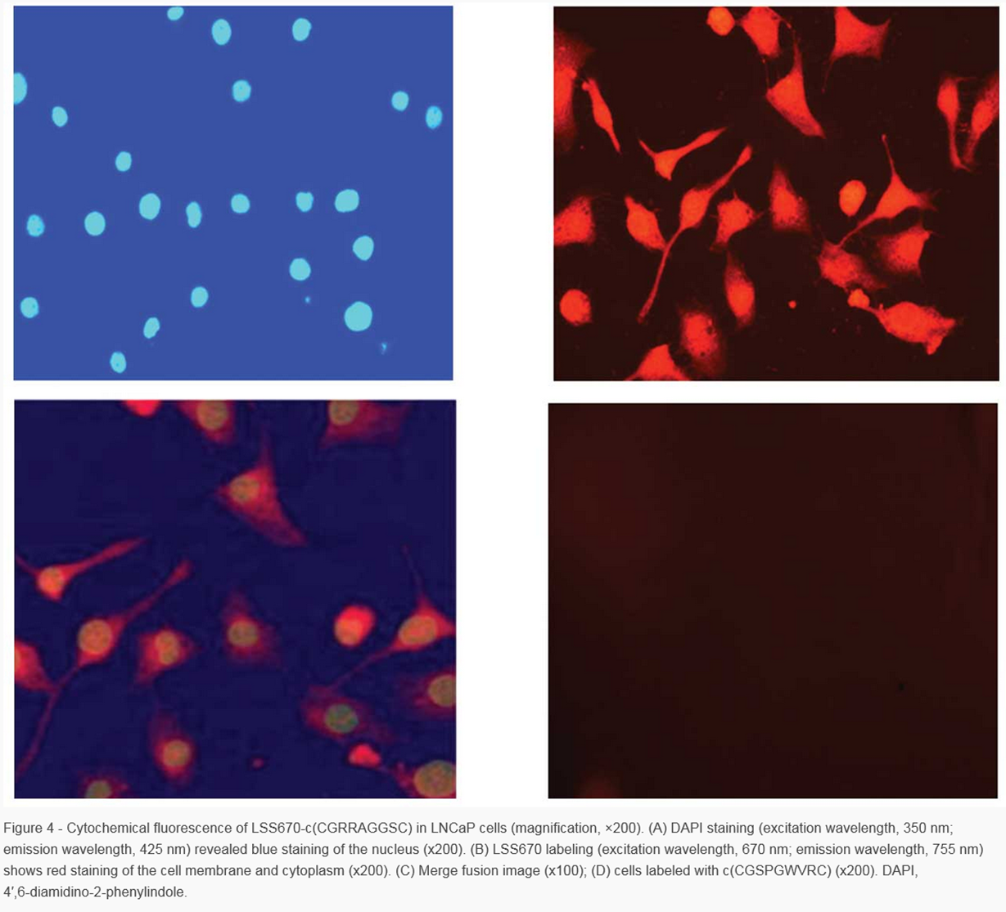
What’s Wrong with this Figure?
http://www.spandidos-publications.com/ol/4/3/443
Notes:
Display colours all look saturated. No scale bar. Not colour blind friendly.

