Slide 1
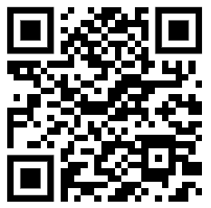

Creative Commons License of All Materials
Advanced BioImaging Facility (ABIF) Training Materials and Derivatives © 2009-2026 are licensed under Creative Commons Attribution-NonCommercial-ShareAlike 4.0 International. To view a copy of the detailed license including definitions, visit https://creativecommons.org/licenses/by-nc-sa/4.0/

Slide 2
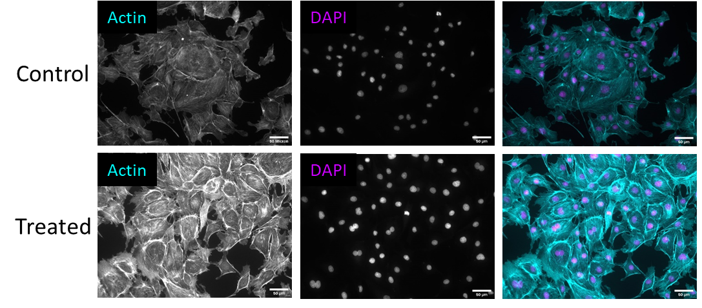
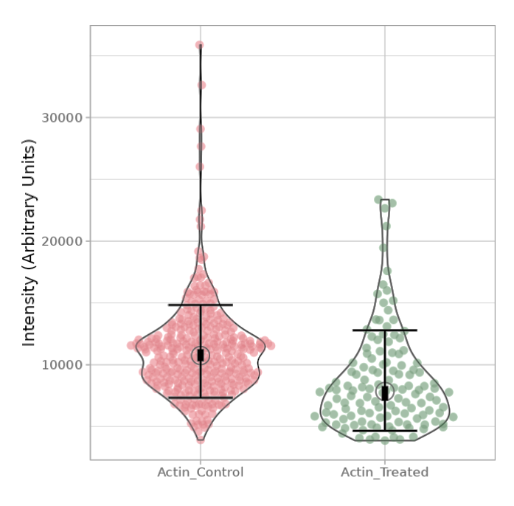
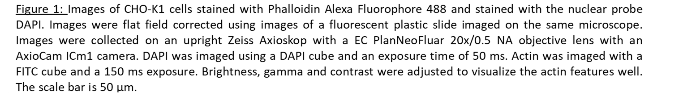

Detailed Figure Captions and Scale Bars are Needed
Mean = 11080 ± 3750
Mean = 8720 $±$ 4070
Notes:
It is important that images have scale bars. Detailed figure captions should describe how the images were captured, information about the sample and how the image display was adapted.

