Slide 1


Introduction to
Robotic Process Automation
AI DRIVEN CODE GENERATION
Register No : 2116 220701007
Name : ABIRAMI.PL
Guide Name : Mrs. J. JINU SOPHIA
Designation : Assistant Professor (SG)
Department : Computer Science & Engineering

Slide 2
Abstract
The AI-Driven Code Generator is an advanced IRPA project that automates code creation and distribution with efficiency and precision. By integrating AI with RPA, it streamlines repetitive coding tasks, allowing users to focus on strategic activities. The process involves user input for a problem statement, recipient email, and desired filename, followed by automation interacting with ChatGPT to generate code. The code is then saved in Notepad and emailed to the recipient using UiPath's email automation. Built on UiPath’s RE Framework, the solution ensures structured workflows, robust exception handling, and scalability, offering a cutting-edge approach to intelligent automation in software development

Slide 3
Need for the Proposed System
The proposed system automates code generation and distribution, replacing manual efforts with a streamlined, efficient process. Leveraging UiPath's automation capabilities, it collects user inputs, interacts with ChatGPT to generate code, saves it in Notepad, and emails it to the recipient. Built on the RE Framework, it ensures scalability, structured workflows, and robust exception handling, enhancing efficiency, reducing errors, and delivering a seamless experience for developers and stakeholders.

Slide 4
Advantages of the Proposed System
Efficiency: Automates repetitive coding tasks, significantly reducing time and effort.
Accuracy: Minimizes human errors in code generation and distribution.
Scalability: Built on UiPath’s RE Framework, ensuring adaptability for future enhancements.
Seamless Integration: Combines AI and RPA for a streamlined workflow.
User-Friendly: Simplifies the process with minimal user intervention.
Consistency: Delivers structured and reliable outputs every time.
Enhanced Productivity: Frees up users to focus on strategic, high-value tasks.
Cost-Effective: Reduces manual labor and operational inefficiencies

Slide 5
Literature Survey
Paper: A. Kumar and R. Singh, "AI and RPA Integration for Software Development Automation," 2023
Advantages:
Demonstrates effective integration of AI and RPA for automating software development tasks.
Provides case studies that showcase real-world applications.
Highlights the reduction in time spent on repetitive coding tasks.
Proposes an innovative workflow that improves code quality and consistency.
Disadvantages:
Limited analysis of the performance metrics of the integrated system.
Focuses primarily on large-scale applications, limiting insights for smaller projects.
Potential challenges with integrating legacy systems into the automated workflow.

Slide 6
Main Objective
The main objective of the proposed system is to automate the process of code generation and distribution using AI and RPA, ensuring efficiency, accuracy, and scalability. By leveraging UiPath's capabilities and ChatGPT, the system simplifies coding tasks, minimizes human intervention, and enhances productivity, enabling users to focus on high-value activities.

Slide 7
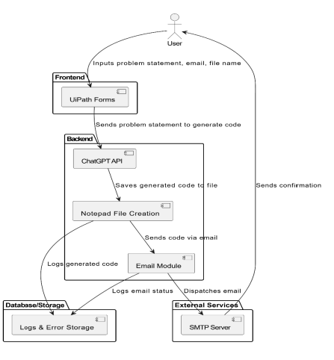

Architecture

Slide 8
System Requirements
Hardware:
Processor: Dual-Core or higher (Intel i3/AMD equivalent).
RAM: 4 GB (8 GB recommended).
Storage: 100 GB free space (SSD preferred for better performance).
Network: Stable internet connection (5 Mbps or higher) for smooth interaction with AI tools like ChatGPT.
Software:
Operating System: Windows 10/11, macOS, or Linux.
Tools: UiPath Studio, UiPath Robot, UiPath Orchestrator for RPA automation tasks.
Development Platform: .NET (or any suitable environment for integrating with UiPath and external APIs like ChatGPT).
Data Source: Excel or a database for storing user inputs (e.g., email addresses, problem statements, file names).

Slide 9
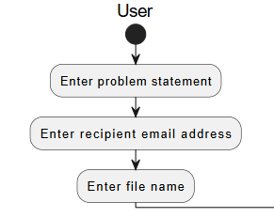
Functional Description
Module 1: Getting inputs
This module collects essential inputs from the user to automate the code generation and sharing process. The user provides a problem statement for AI-driven code generation, the recipient's email address to send the generated code, and a file name for saving the code. Once these inputs are entered, the system processes them to generate the code, save it with the specified name, and email it to the recipient efficiently.

Slide 10
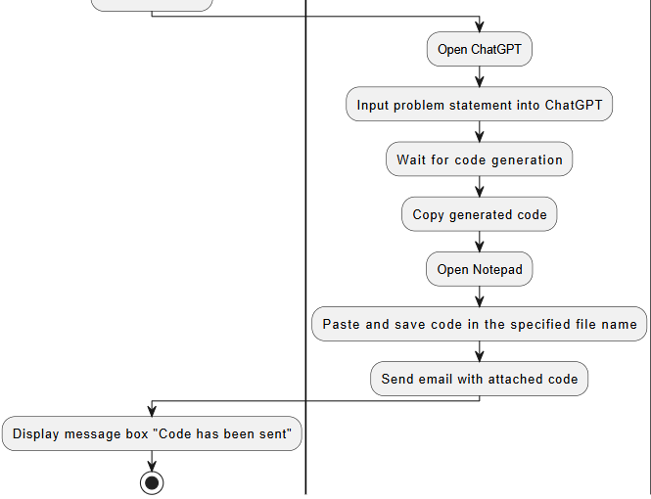
Functional Description
Module 2: Code generation & uploading process
This module automates the process of generating, saving, and sharing code. It begins by opening ChatGPT, where the problem statement provided by the user is inputted for code generation. After waiting for the generated code, the system copies it and opens Notepad to paste and save the code with the specified file name. Finally, the system attaches the saved file to an email and sends it to the recipient. Upon successful completion, a message box displays, confirming that the code has been sent.
Activity Diagram-Module 2:

Slide 11
Table Design
Problem Statement: Stores the description of the coding task provided by the user for code generation.
Recipient Email: Captures the email address where the generated code will be sent.
File Name: Stores the user-defined name under which the generated code will be saved.
Generated Code: Holds the code generated by ChatGPT based on the provided problem statement.
File Path: Specifies the location where the generated code file is saved.
Email Status: Indicates whether the email with the attached code file was successfully sent.

Slide 12
Process Design
The bot prompts the user to input the problem statement, email address, and file name as the required details for the process.
Once the inputs are provided, the bot opens the ChatGPT webpage in the browser, maximizes the browser window for better visibility, and prepares for interaction.
The problem statement entered by the user is automatically typed into the text area on ChatGPT, and the process is executed to generate the output.
After a 20-second delay, the system waits for the code generation to complete. The generated output is then copied from the ChatGPT interface.
The bot opens Notepad, pastes the generated code into it, and saves the file using the file name provided by the user.
The saved file is attached to an email and sent to the recipient's email address specified by the user.
Upon successful email delivery, a notification appears, confirming to the sender that the “email has been sent successfully.”

Slide 13
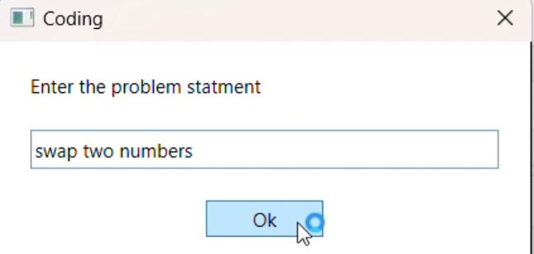
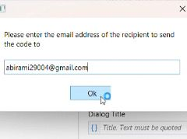
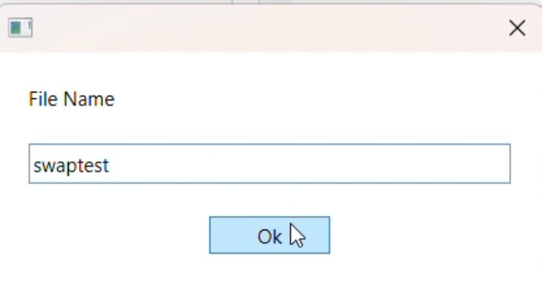
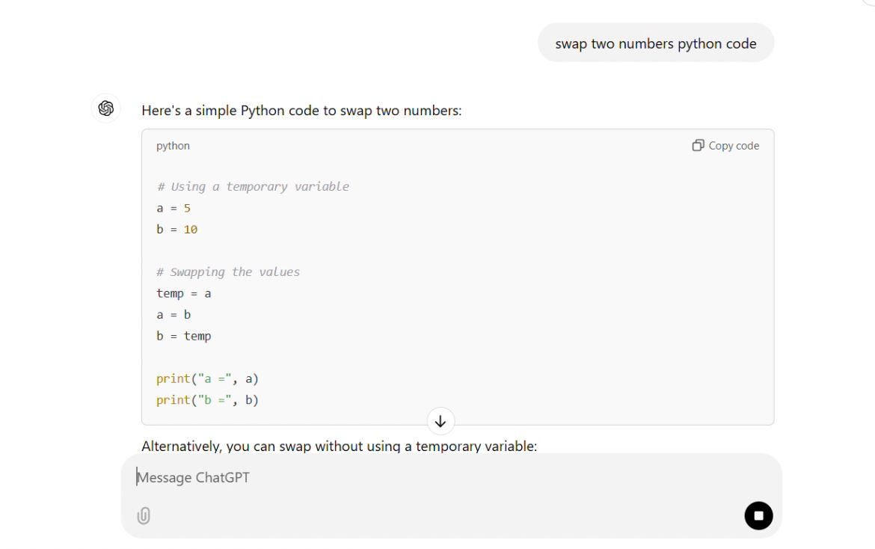
Implementation

Slide 14
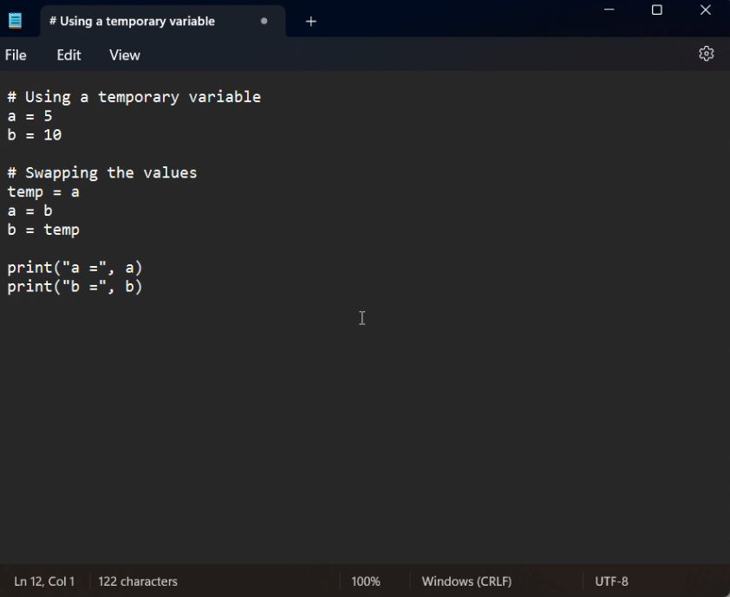
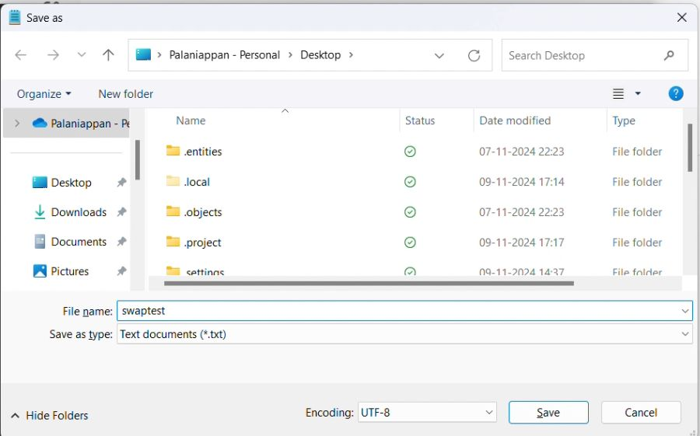
Implementation

Slide 15
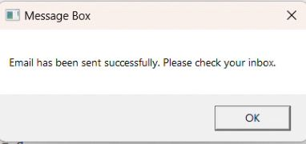
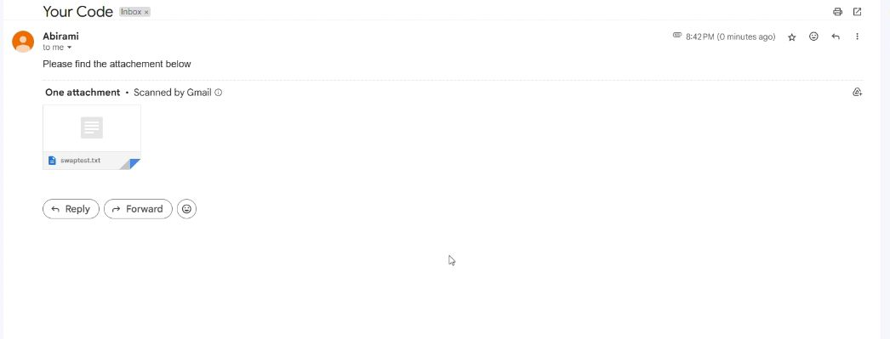
Implementation

Slide 16
Testing
Test Description: Verify if the generated code is saved as a file and sent to the recipient with a confirmation.
qInput: Problem statement: "Create a Python program to reverse a string," recipient email: "test@example.com," file name: "reverse_string.py.“
Expected Output: Code is saved as reverse_string.py, sent to test@example.com, and a notification appears: "Email has been sent successfully.“
Actual Output: Code saved as reverse_string.py, emailed to test@example.com, and confirmation notification displayed.

Slide 17
Conclusions
The "AI-Driven Code Generator" project effectively streamlines the process of code generation, saving, and sharing. By leveraging ChatGPT for automatic code generation based on user-provided problem statements, and integrating file saving and email functionality, the system reduces manual effort and ensures quick, accurate delivery of code. This automation enhances productivity, making it easier for users to generate and share solutions efficiently, with a clear focus on accuracy and user experience. The project demonstrates the potential of combining AI with automation tools to optimize workflows.

Slide 18
Future Enhancement
Multi-Language Support: Extend the system to support multiple programming languages, allowing users to choose the language for code generation.
User Interface (UI): Develop a user-friendly interface for seamless interaction, where users can input details and track progress easily.
Code Validation: Integrate code validation to ensure the generated code is error-free and meets predefined standards before saving and sending it.

Slide 19
References
[1] UiPath Documentation
[2] How to block websites on Chrome, Safari, and more
.

Slide 20
Thank You

