Slide 1
Project documentation -
Crypto Historical Prices
ABISHEK.K.S
Sri Sairam Engineering College
UPD : 16-08-2023
FD: 24-03-2023

Slide 2
STATUS SUMMARY
DB/Table creation and Handling
Delivery date is end of Q3
Estimate cost of $14,000
Project will deliver after Contoso update in Q4
Contoso date of delivery is July 20xx

Slide 3
TABLE-creation
TOOLS USED: phpMyAdmin(XAMPP V3.3), localhost-DB
Used phpMyAdmin to create a database on localhost.
Initial insert lead to an error where unwanted entries were inserted in the first row.
A tracking feature was implemented to keep track of DB
Initial inserts were not capable of handling large data in the ‘marketcap’ column. The table was dropped, schema was altered to create a new table with appropriate values.
The new table had successfully accommodated the large values.

Slide 4
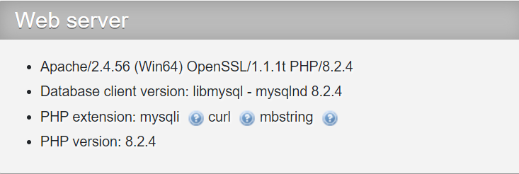
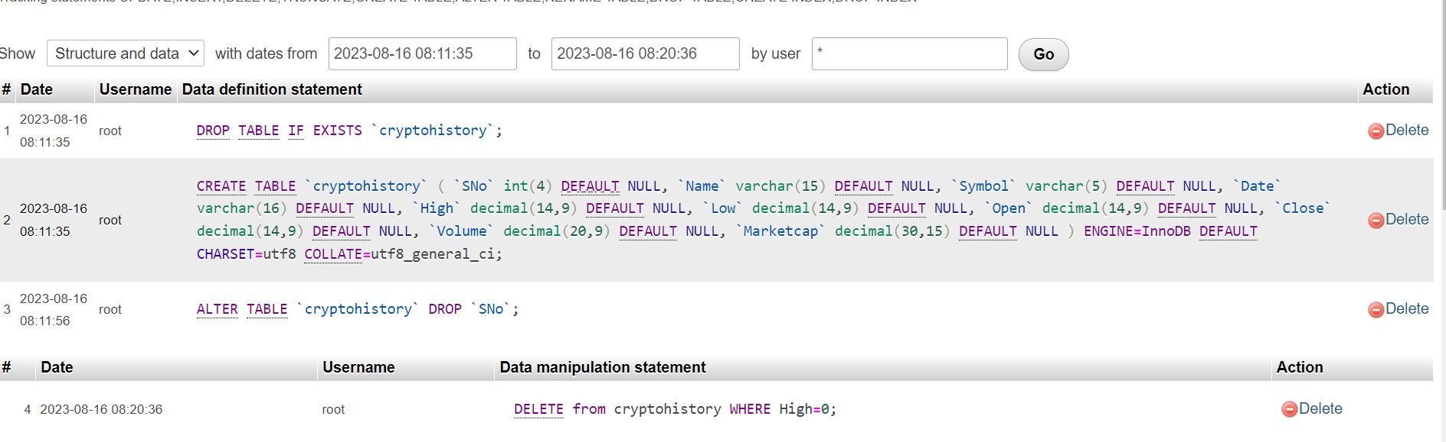
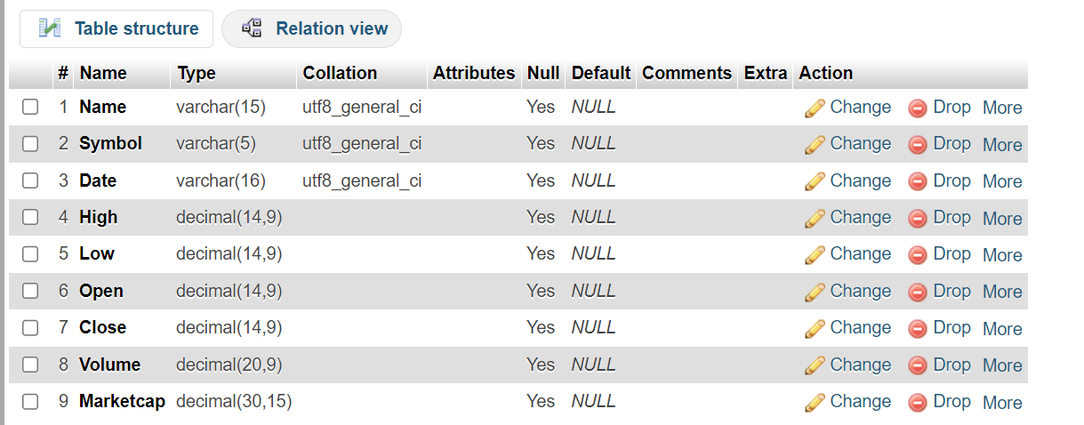
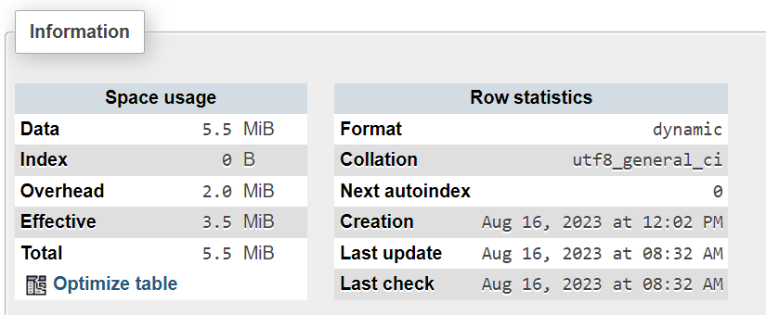
DB-SERVER INFO
Tracking report
TABLE STRUCTURE

Slide 5
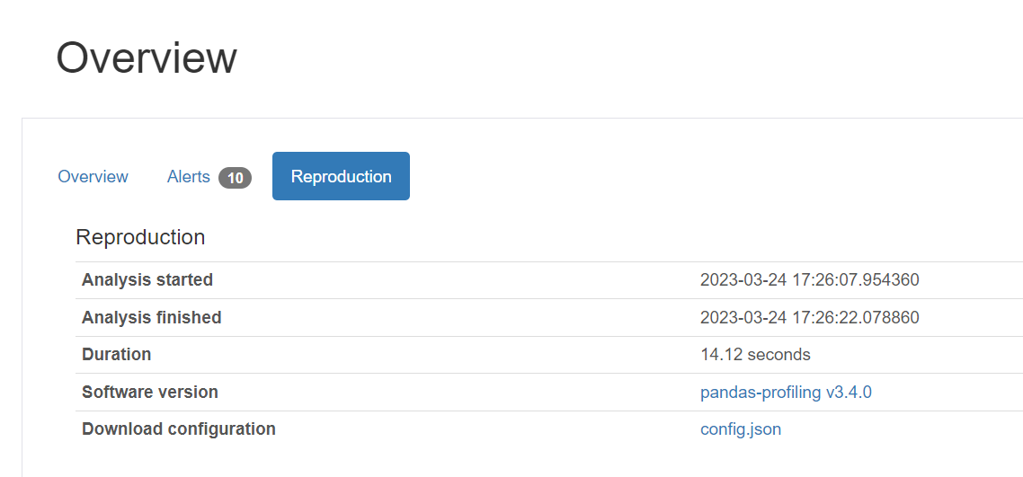
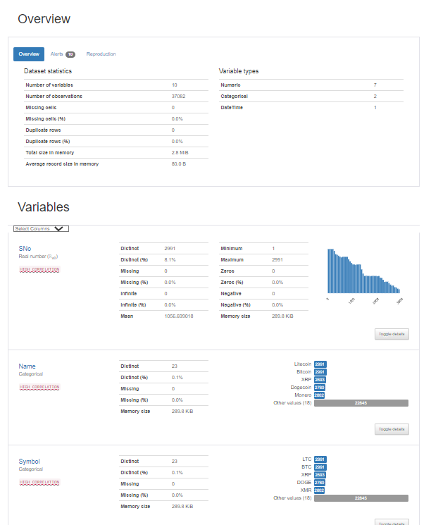
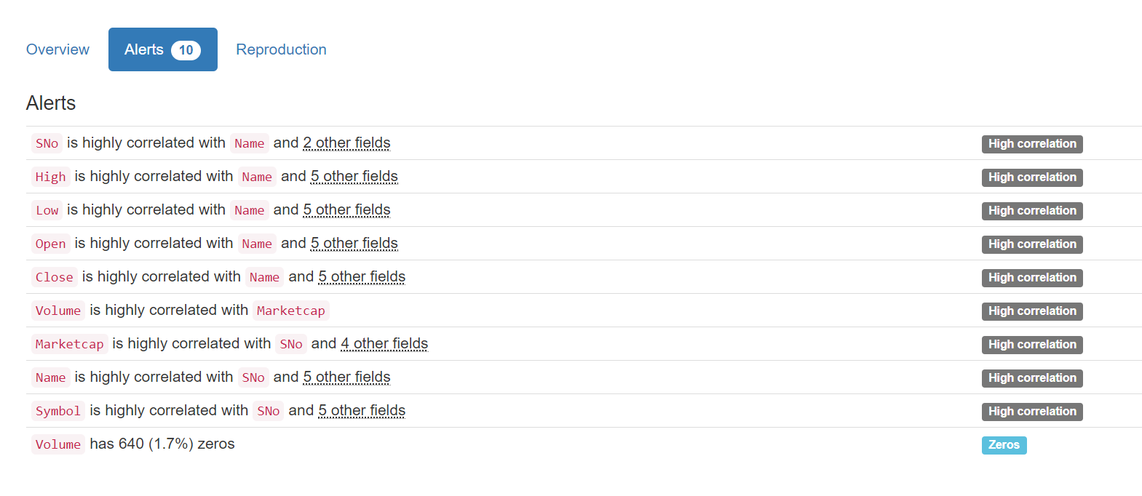
Python scripting
Modules : Pandas, Pandas Profiling
Used Pandas_profiling module to create HTML profile reports

Slide 6
OBJECTIVES
To carry out analysis on market cap values and chalk out percentages of market cap shares
To forecast values using AI facilitated BI tools for a period of 4 years.
Predict market cap and volume for a period of 3 years

Slide 7
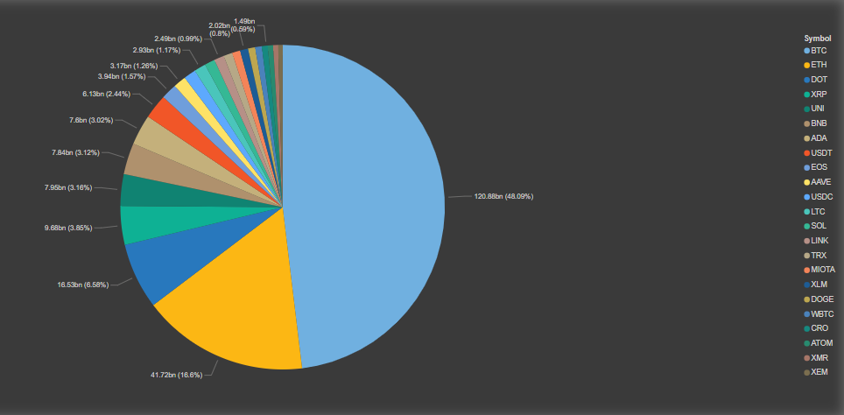
1. Market cap analysis
Projection Of Costs
$14,000 projection for project
Main source from angel investors
The following Pie Chart illustrates the average market cap percentages held by each cryptocurrency.
Cost Overruns
$2,000 over budget
Closed gaps in communication with staff to present future budget issues
Project can track to remain on budget based on planning and current projections

Slide 8
FINDINGS
Bitcoin has held the highest market cap share amongst the given crypto-currencies at a massive 48.09%.
Ethereum ranks second as such, with 16.6% of total market cap held over the years.
Polkadot (DOT) ranks third , with over 6% of distribution.
The top 3 crypto currencies have held a share of over 70% of the total market cap.
This unequal share may be a direct consequence of :
a) Cost
b) Mining Limitations
c) No: of units in circulation
VI. XEM holds the lowest percentage of market cap at less than 0.50%

Slide 9
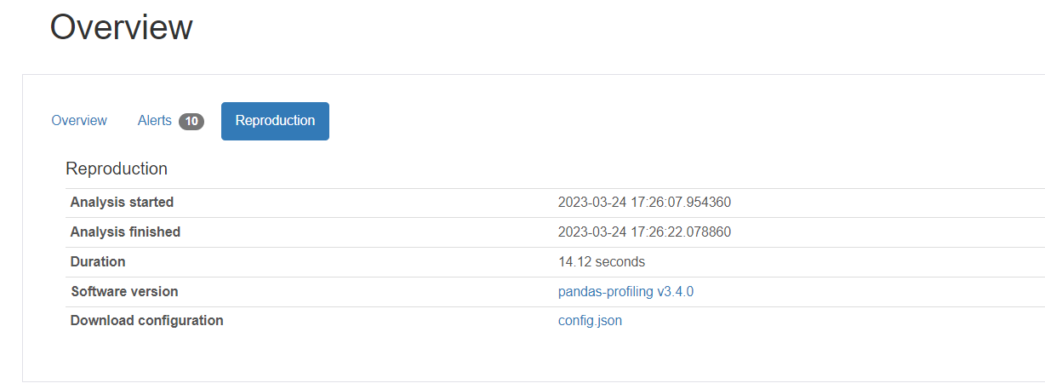
Volume prediction via forecasting
Power BI forecasting has been used to generate forecast reports of volume for the respective cryptocurrencies.
These have been attested in the PowerBI Dashboard and may be referred.
Initial profiling reports were also made using profiling modules in python

