Slide 1

CENSUS INDIA 2011 REPORT
Prepared by: k.s.abishek
MAIL : sec21it128@sairamtap.edu.in
6th April 2023
upd: 20-08-2023

Slide 2
INTRODUCTION:
The Census 2011 is the 15th National census survey conducted by the Census Organization of India. Mr. C. Chandramouli is the Commissioner & Registrar General of the Indian 2011 Census. The 2011 Indian National Census has been conducted in 2 phases - house listing and population.
The national census survey covered all the 28 states of the country and 7 Union territories including 640 districts, 497 cities, 5767 tehsils & over 6 lakh villages.
Spread across 28 states and 8 union territories, the census covered 640 districts, 5,924 sub-districts, 7,935 towns and more than 600,000 villages.
A total of 2.7 million officials visited households in 7,935 towns and 600,000 villages, classifying the population according to gender, religion, education and occupation. The cost of the exercise was approximately ₹2,200 crore (US$280 million) – this comes to less than $0.50 per person, well below the estimated world average of $4.60 per person.

Slide 3
The National Population Register household schedule contained 9 questions.
Name of the person and resident status
Name of the person as should appear in the population register
Relationship to head
Gender
Date of birth
Marital status
Educational qualification
Occupation/Activity
Names of father, mother and spouse

Slide 4




AVERAGE POPULATION
AVERAGE COST
HIGHEST COST
LOWEST COST
UTTAR PRADESH
(HIGHEST)
199,812,341
>199 MILLION INR
34,592,027
>34 MILLION INR
(EST. PER STATE)
3,630,788,367.82
UTTAR PRADESH
>3 BILLION INR
11,71,538.34
LAKSHADEEP
>11 LAKH INR
TOTAL POPULATION
*1,210,720,939
>1.21 BILLION
TOTAL AREA
*32,87241
>3 MILLION
TOTAL COST
2200 CRORE
AVG DECADAL GROWTH
*19.60%

Slide 5
Tabular Descriptions
TABULAR DESCRIPTIONS
Rank | State | Capital | Population | % of Total Population | Cost(INR)
1 | Uttar Pradesh | Lucknow | 19,98,12,341 | 16.5 | 3630788368
2 | Maharashtra | Mumbai | 11,23,74,333 | 9.28 | 2041953060
3 | Bihar | Patna | 10,40,99,452 | 8.6 | 1891590267
4 | West Bengal | Kolkata | 9,12,76,115 | 7.54 | 1658577518
5 | Andhra Pradesh | Hyderabad | 8,45,80,777 | 6.99 | 1536916588
6 | Madhya Pradesh | Bhopal | 7,26,26,809 | 6 | 1319701136
7 | Tamil Nadu | Chennai | 7,21,47,030 | 5.96 | 1310983075
State - Name of state
Capital – Capital of state
Population – Population of state
% of Total Population – Percentage with respect to total population
Cost(INR)- Cost in INR computed using : Population*Average value
8 | Rajasthan | Jaipur | 6,85,48,437 | 5.66 | 1245593072
9 | Karnataka | Bengaluru | 6,10,95,297 | 5.05 | 1110162128
10 | Gujarat | Gandhinagar | 6,04,39,692 | 4.99 | 1098249135
11 | Odisha | Bhubaneshwar | 4,19,74,218 | 3.47 | 762713162.3
12 | Kerala | Thiruvananthapuram | 3,34,06,061 | 2.76 | 607021253.5
13 | Jharkhand | Ranchi | 3,29,88,134 | 2.72 | 599427105.5
14 | Assam | Dispur | 3,12,05,576 | 2.58 | 567036259
15 | Punjab | Chandigarh | 2,77,43,338 | 2.29 | 504123961.5
16 | Chhattisgarh | Raipur | 2,55,45,198 | 2.11 | 464181578
17 | Haryana | Chandigarh | 2,53,51,462 | 2.09 | 460661202.8

Slide 6
35+ territories surveyed
18 | Delhi | Delhi | 1,67,87,941 | 1.39 | 305053534.7
19 | Jammu and Kashmir |  | 1,25,41,302 | 1.04 | 227887893.2
20 | Uttarakhand | Dehradun | 1,00,86,292 | 0.83 | 183277927.1
21 | Himachal Pradesh | Shimla | 68,64,602 | 0.57 | 124736625.2
22 | Tripura | Agartala | 36,73,917 | 0.3 | 66758714.91
23 | Meghalaya | Shillong | 29,66,889 | 0.25 | 53911315.07
24 | Manipur | Imphal | 27,21,756 | 0.21 | 49457005.39
25 | Nagaland | Kohima | 19,78,502 | 0.16 | 35951343.2
26 | Goa | Panaji | 14,58,545 | 0.12 | 26503208.93
27 | Arunachal Pradesh | Itanagar | 13,83,727 | 0.11 | 25143691.68
28 | Puducherry | Pondicherry | 12,47,953 | 0.1 | 22676543.47
29 | Mizoram | Aizawl | 10,97,206 | 0.09 | 19937321
30 | Chandigarh | Chandigarh | 10,55,450 | 0.09 | 19178573.07
31 | Sikkim | Gangtok | 6,10,577 | 0.05 | 11094789.53
32 | Andaman and Nicobar Islands | Port Blair | 3,80,581 | 0.03 | 6915534.15
33 | Dadra and Nagar Haveli | Silvassa | 3,43,709 | 0.03 | 6245533.348
34 | Daman and Diu | Daman | 2,43,247 | 0.02 | 4420039.191
35 | Lakshadweep | Kavaratti | 64,473 | 0.01 | 1171538.341
35+ territories
28 states
7 union territories
640 districts
7395 towns

Slide 7
Census Comparison
CENSUS 2001
CENSUS 2011
Total population | 1,028,737,436 (21.5%)
Most populous ​region | Uttar Pradesh (166,053,600)
Least populous ​region | Sikkim (541092)
Total population | 1,210,193,422 ( 17.70%⁾
Most populous ​state | Uttar Pradesh (199,812,341)
Least populous ​state | Sikkim ((610,577)

Slide 8
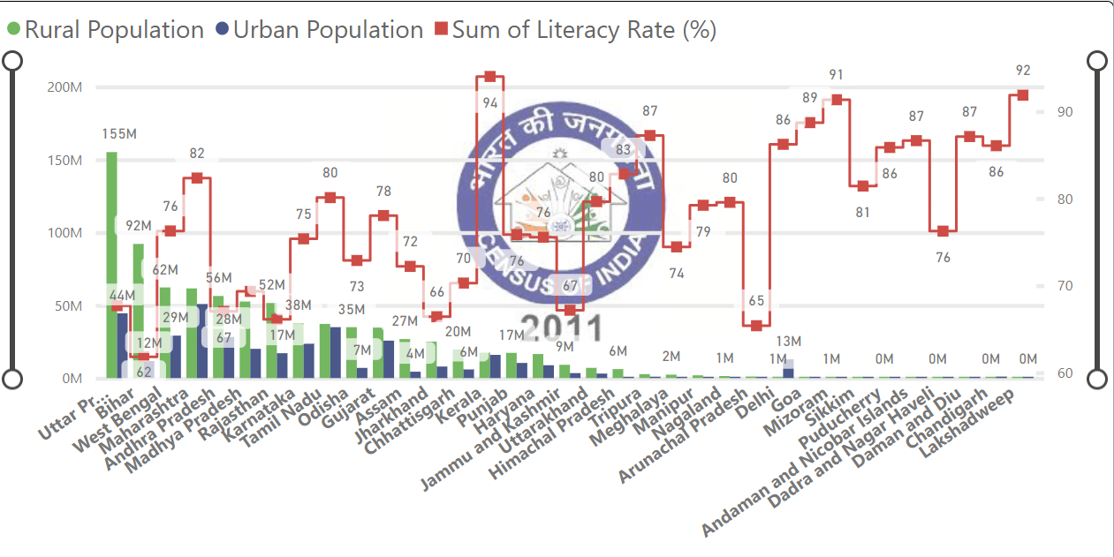
Examining Possible Literacy Rate-Urban population trends.
It could be said that states with higher urban population may have higher literacy rates. To draw conclusions on this premise, data on Urban population was analysed and the following results were obtained.

Slide 9
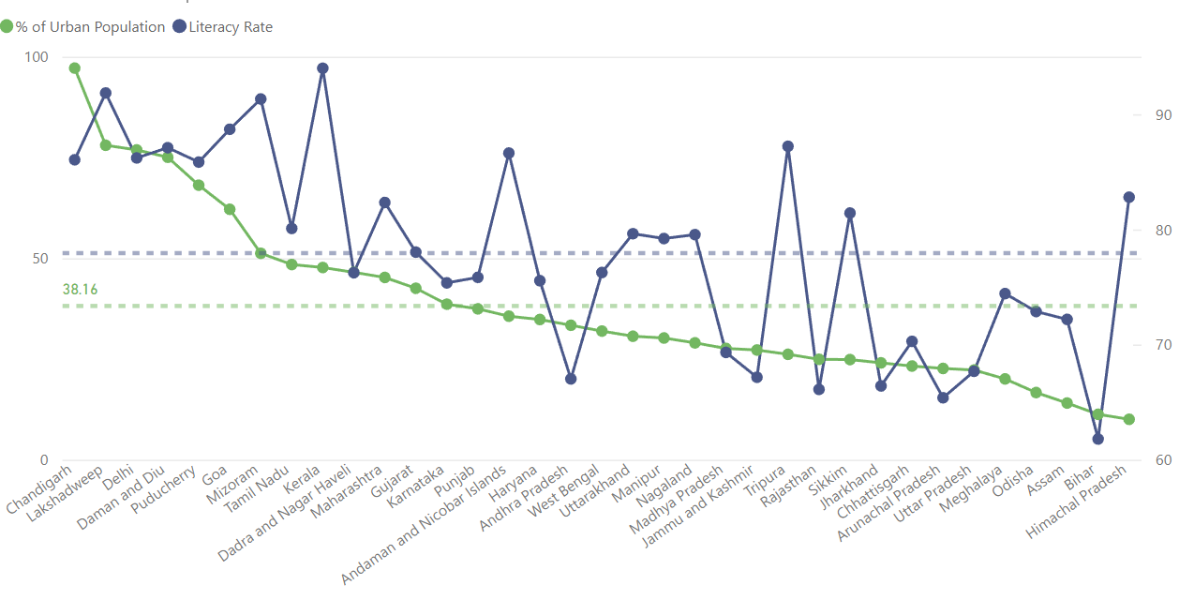
Examining Possible Literacy Rate-Urban population trends with population percentages

Slide 10
INSIGHTS GAINED
Literacy Rate may hold a vague relation with the percentage of urban population. For ex:
The mean literacy rate for the country stands at 77.94 % and the mean urban population ratio (in %) stands at 38.16 %.
The following states had an above average urban population ratio: [Format is State-Literacy Rate]
Chandigarh -86.05
Lakshadweep – 91.85
Delhi-86.21
Daman & Diu- 87.10
Puducherry- 85.85
Goa-88.70
Mizoram-91.33
Tamil Nadu-80.09
Kerala-94.00
Dadar & Nagar Haveli-76.24
Gujarat-78.03
Karnataka-75.36

Slide 11
North-eastern states had a comparable literacy rate , always nearing the average national literacy rate. Even though a few states had a literacy rate lower than the national average, it is agreeable for their disposition, for instance, in the case of Meghalaya, the Literacy rate stands just above 74%, but the percentage of Urban population is at a meagre 20.06%.
Andhra Pradesh, Madhya Pradesh, West Bengal, Karnataka, Punjab, Haryana, Jammu & Kashmir, Rajasthan, Jharkhand, Chhattisgarh, Arunachal Pradesh, Odisha, Assam, Meghalaya ,Bihar, Assam had below average literacy rates, with Bihar having the lowest literacy rate in the country at 61.80%.

Slide 12
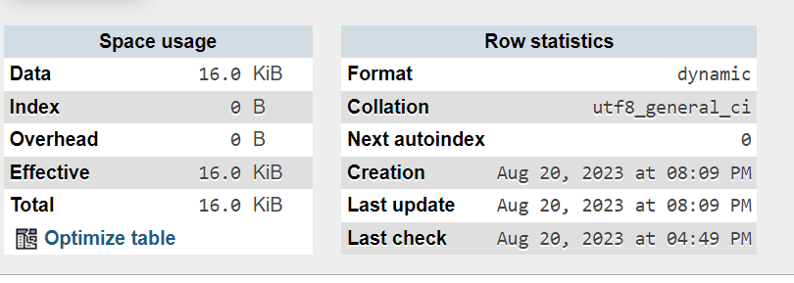
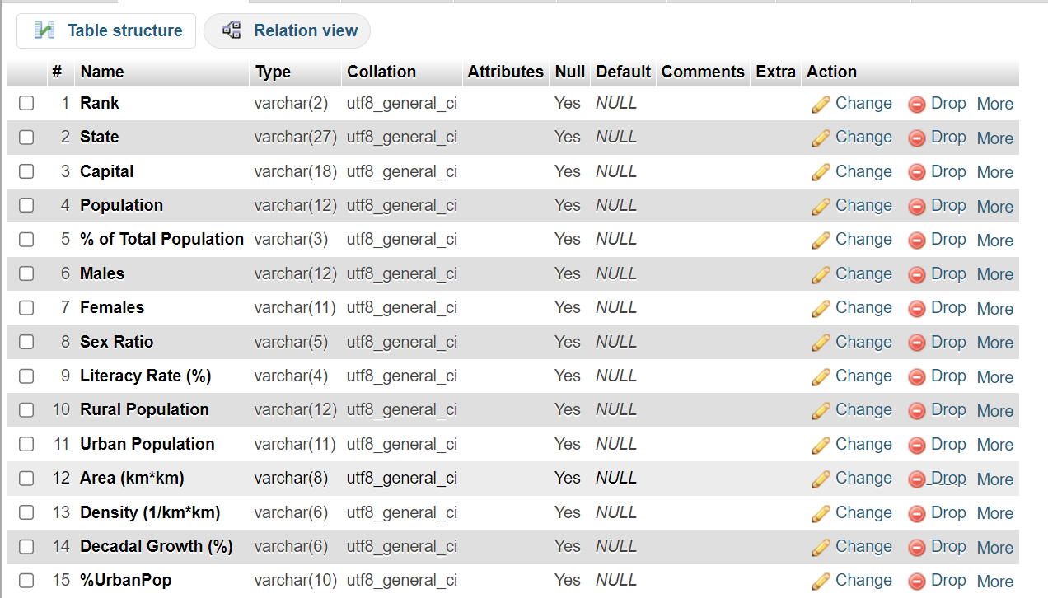
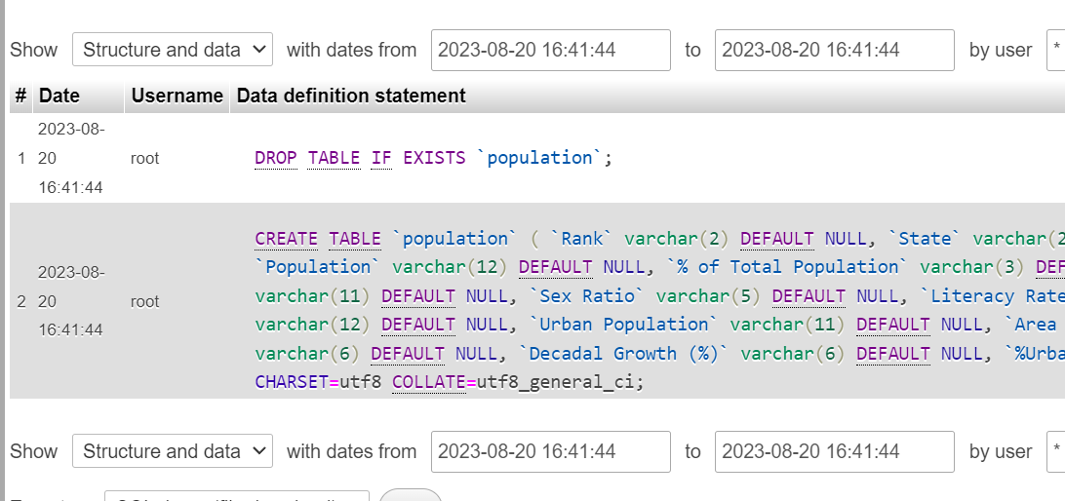
DB-TABLE CREATION
Phpmyadmin was used to create a table on a database at localhost. The table was created successfully and tracking versions were also created. The results are attested below.

Slide 13
REFERENCES
2011 CENSUS:
https://en.wikipedia.org/wiki/2011_Census_of_India
2001 CENSUS:
https://en.wikipedia.org/wiki/2001_Census_of_India
DATASET SOURCE:
https://www.kaggle.com/datasets/themrityunjaypathak/2011-census-of-india?resource=download

