Slide 1
AI agent for chronic disease monitoring
EDUNET AICTE INTERNSHIP
Presented By:
Student name : ABISHEK.S
College Name & Department : Global Institute of Engineering And Technology-Vellore
B.Tech Information Technology

Slide 2
OUTLINE
Problem Statement
Technology used
Wow factor
End users
Result
Conclusion
Git-hub Link
Future scope
IBM Certifications

Slide 3
Problem Statement
An AI agent for chronic disease monitoring helps patients and healthcare providers manage long-term conditions effectively. It continuously analyzes health data from wearables, medical records, and patient inputs to detect early warning signs. Using AI and predictive analytics, it offers personalized insights, medication reminders, and lifestyle recommendations. The agent supports diseases like diabetes, hypertension, and heart conditions with real-time monitoring and alerts. It enables proactive care, reduces hospital visits, and improves patient adherence to treatment plans. This intelligent assistant bridges the gap between patients and providers, enhancing chronic care outcomes.
Proposed Solution: Develop an AI-powered agent that continuously monitors chronic diseases by analyzing data from wearables, medical records, and patient inputs. It provides real-time alerts, personalized health insights, medication reminders, and lifestyle recommendations for conditions like diabetes, hypertension, and heart diseases.

Slide 4
Technology used
IBM cloud lite services
Natural Language Processing (NLP)
Vector Indexing
Artificial Intelligence
IBM Granite model

Slide 5
IBM cloud services used
IBM Cloud Watsonx AI Studio
IBM Cloud Watsonx AI runtime
IBM Cloud Agent Lab
IBM Granite foundation model
Cloud Object Storage

Slide 6
Wow factors
This agent will revolutionize chronic disease care by enabling real-time health tracking, reducing hospital admissions, improving treatment adherence, and empowering both patients and providers through intelligent, personalized insights.
Unique Features:
Continuous monitoring via wearable and health record integration
Personalized recommendations for medication, diet, and lifestyle
Real-time alerts for critical health deviations
Predictive analysis for early detection of complications
Daily symptom tracking with natural language input
Smart reminders for medication and health check-ins
Secure data sharing with healthcare providers for better collaboration

Slide 7
End users
Patients with chronic conditions (e.g., diabetes, hypertension, heart disease)
Caregivers and family members
Healthcare Providers(Doctors , Nurses, Specialists)
Hospitals and Clinics
Telemedicine platforms
Health insurance companies
Government and public health agencies

Slide 8
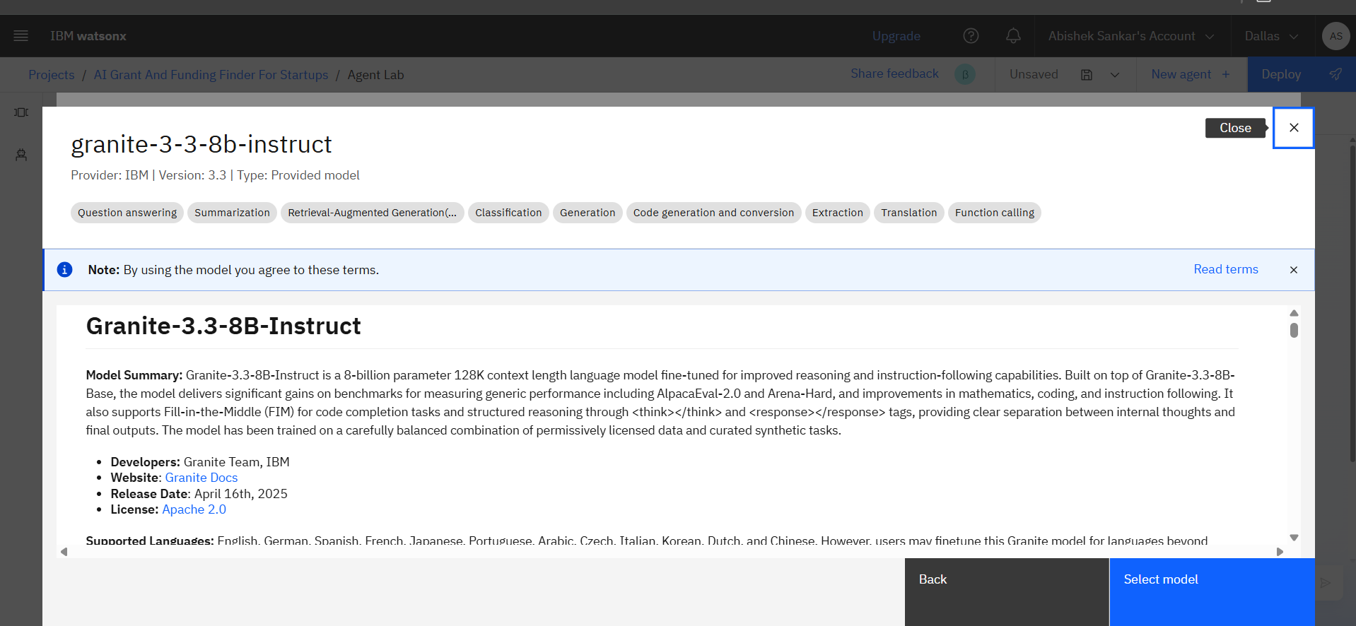
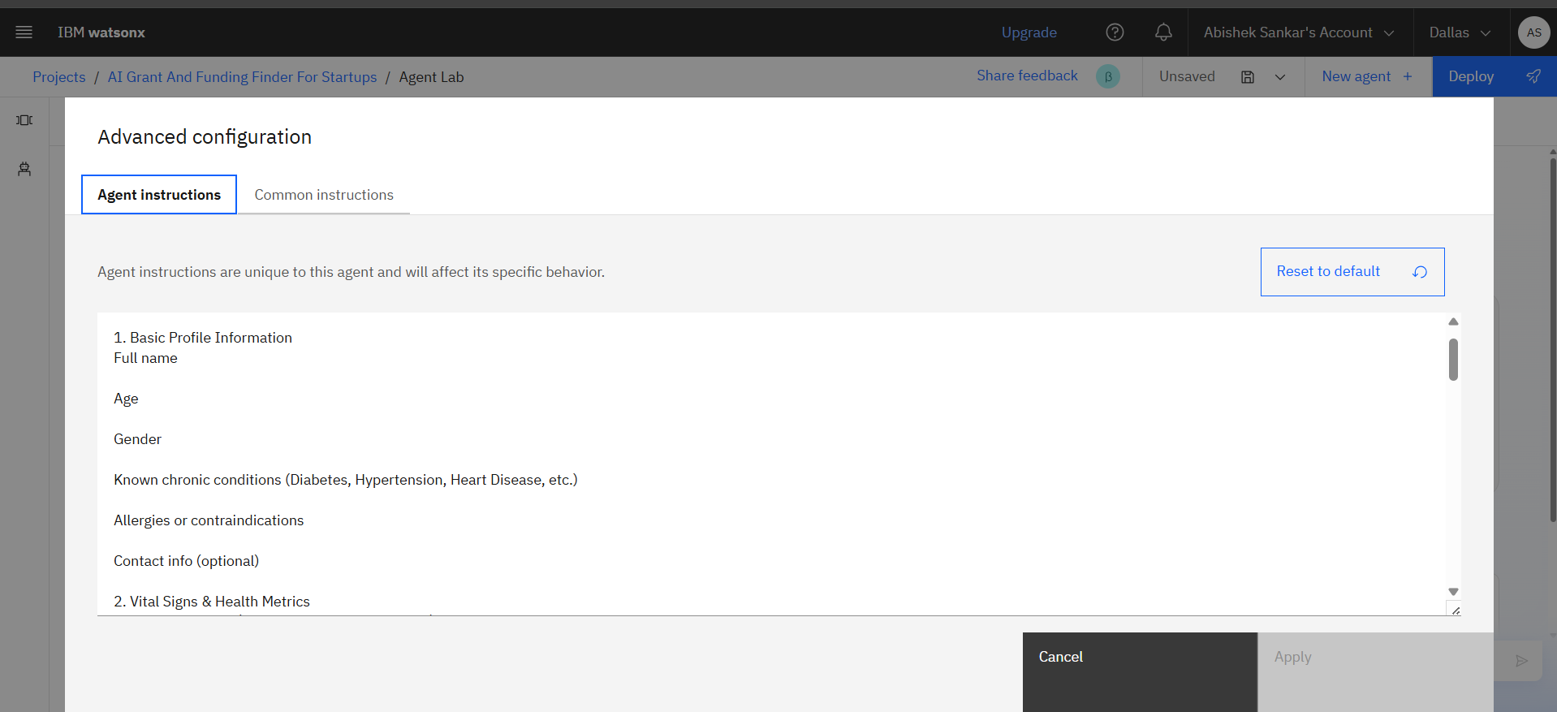
Results
Using Granite Model
Adding Instructions

Slide 9
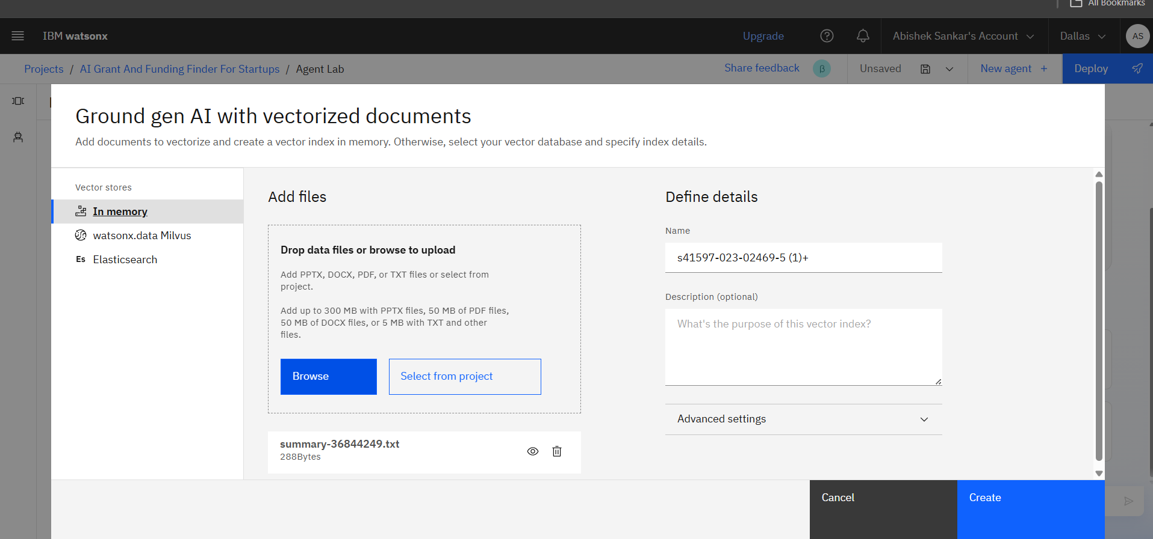
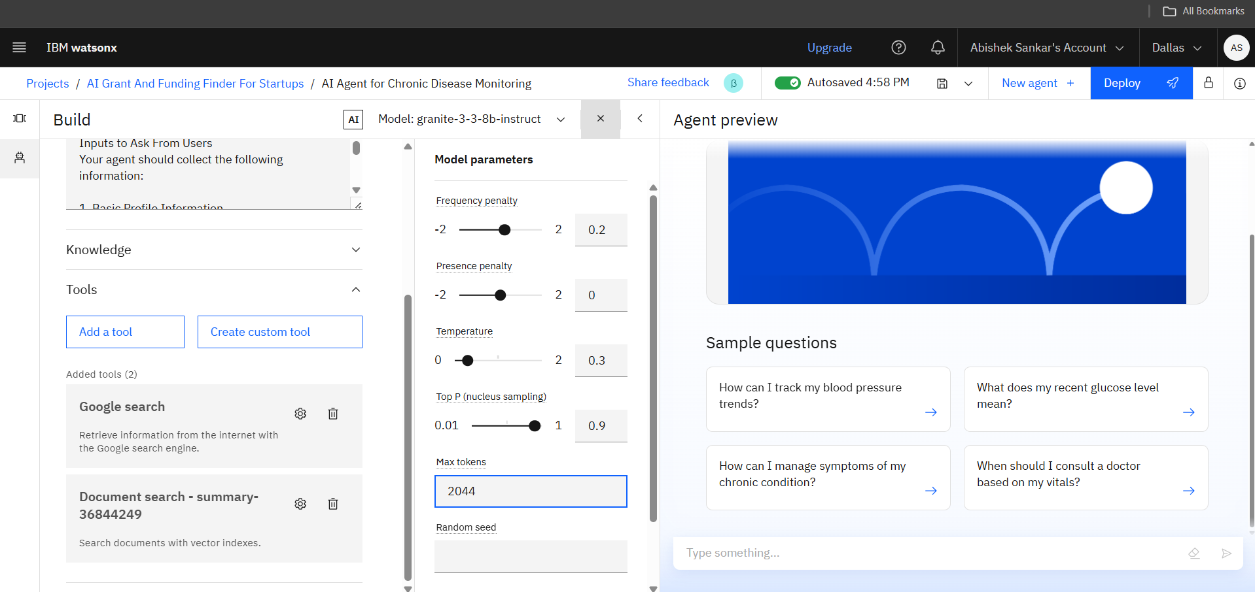
Results
Vectorized Documents
Model Parameters

Slide 10
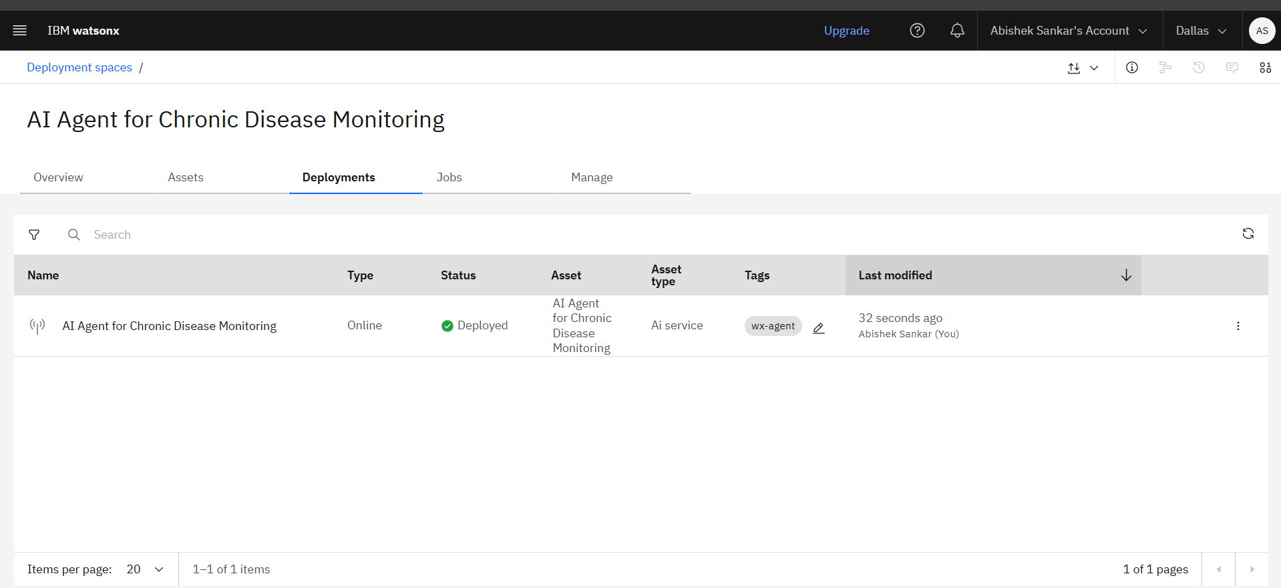
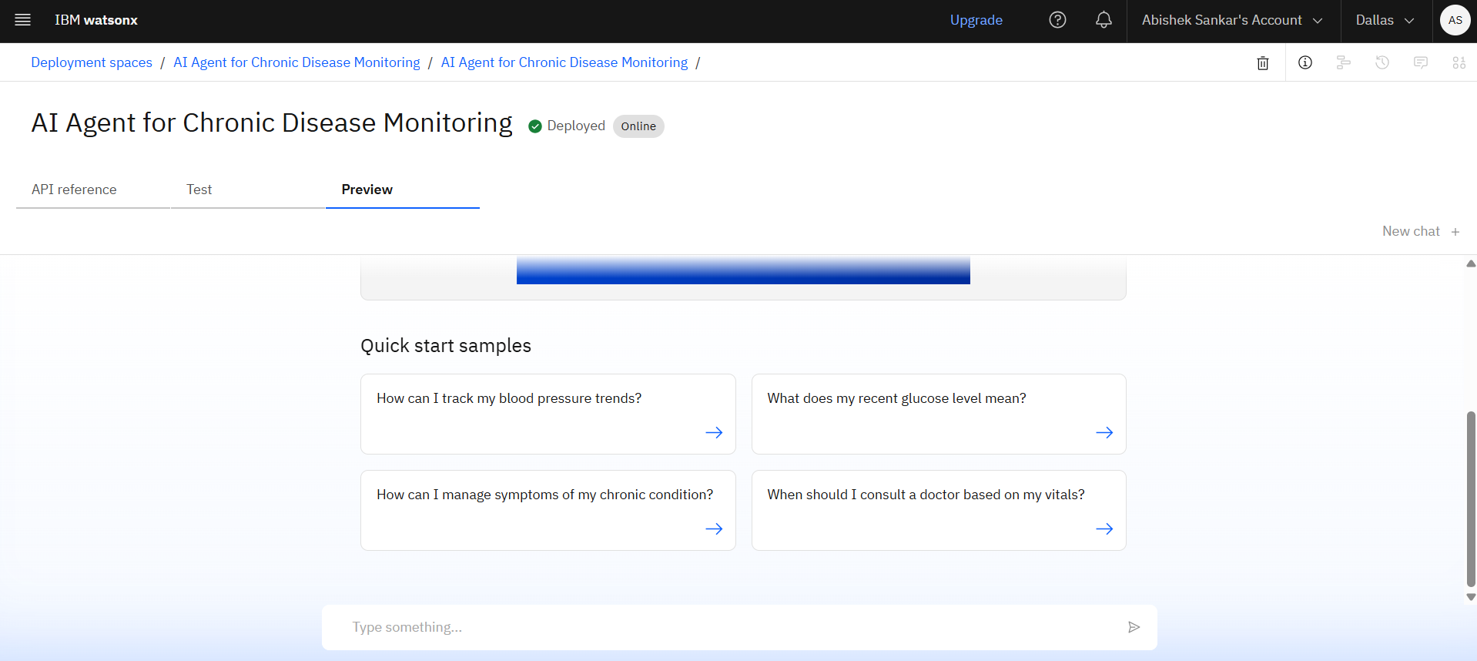
Results
Agent Deployed
Sample Questions

Slide 11
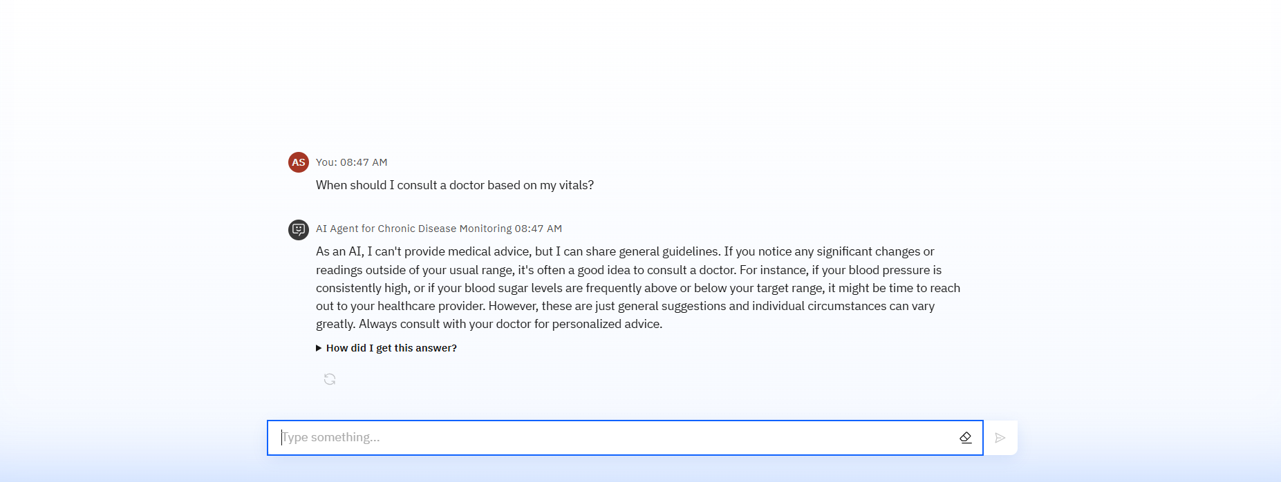
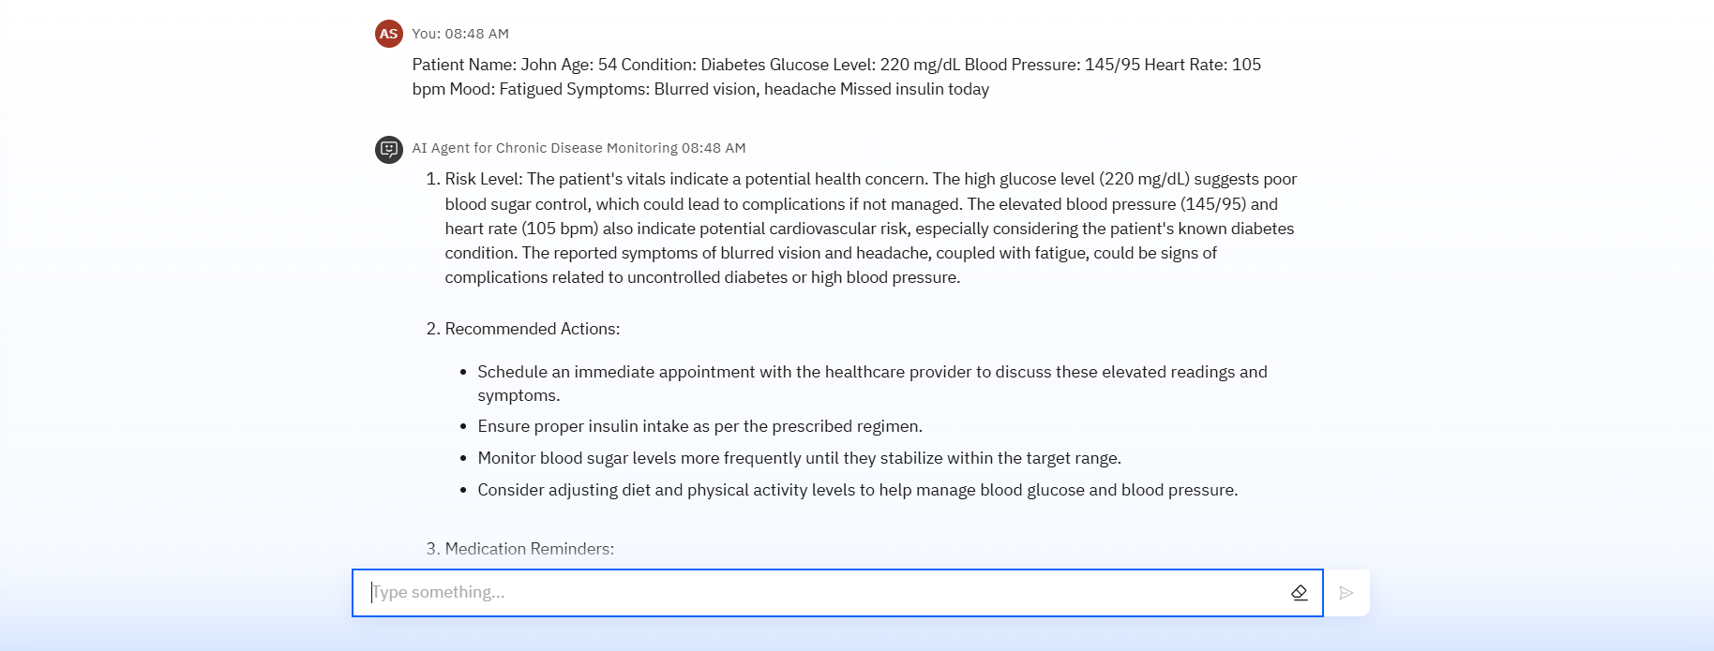
Results
Answer Generated For Sample Question
Customized User Input and Generated Result

Slide 12
Conclusion
The agent delivers personalized insights, monitors patient vitals in real-time, and provides timely alerts to prevent complications.
It enhances chronic care by automating follow-ups, managing health data, and supporting informed clinical decisions.
Health AI agents boost efficiency, adherence, and proactive care across both individual and institutional healthcare systems.

Slide 13
GitHub Link
LINK : https://github.com/ABISHEK-S-15/edunet-intern.git

Slide 14
Integration with Telemedicine and EHR systems
Future scope
Multilingual Health Support for regional and global accessibility
Voice – Enabled Health Interaction for elderly and visually impaired patients
Real-Time Caregiver Collaboration and shared dashboards
Predictive Risk Modeling for emerging comorbidities
Integration with Telemedicine and HER Systems
AI-Assisted Report Generation for clinicians and insurance claims

Slide 15
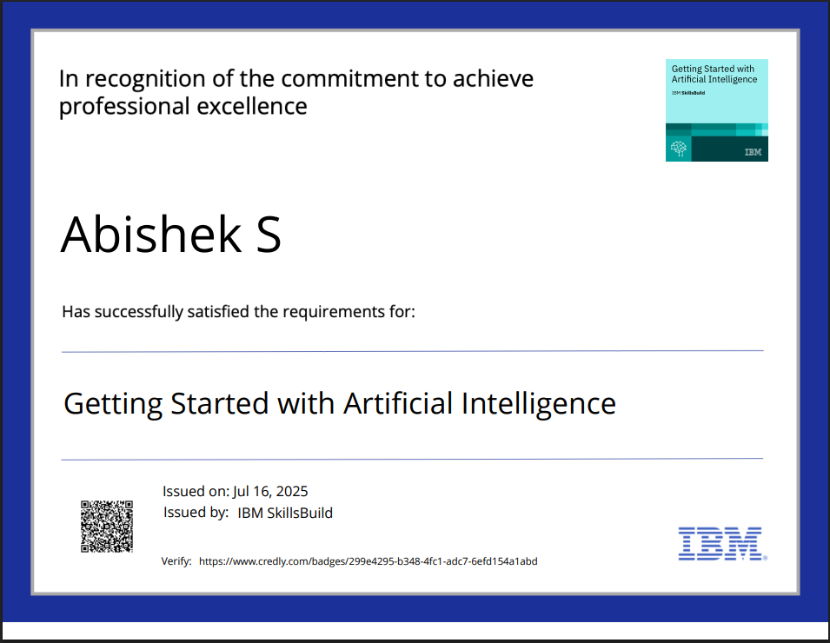
IBM Certifications

Slide 16
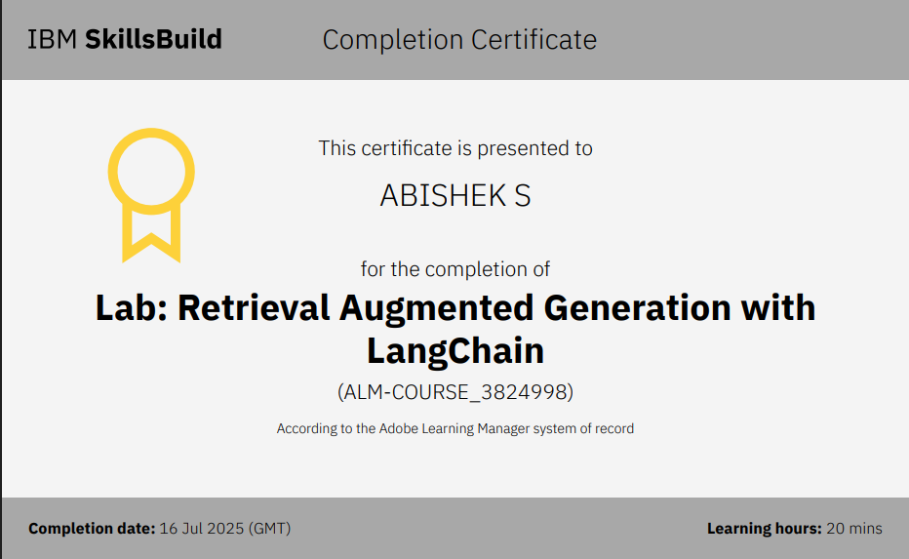

Slide 17
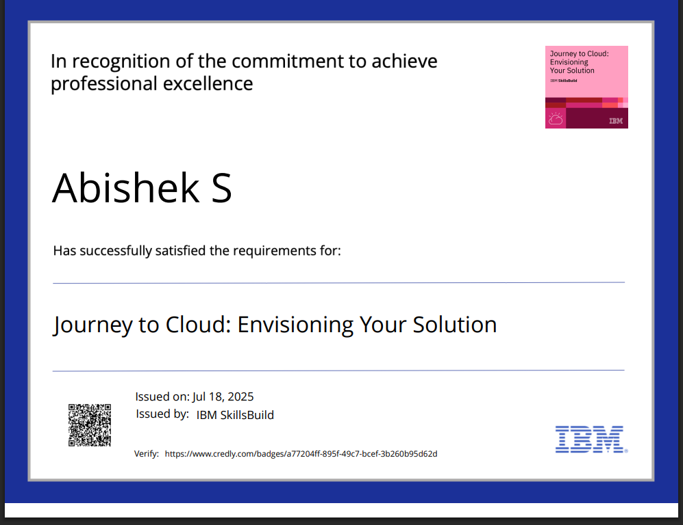

Slide 18
THANK YOU

