Slide 1

REVIEW - 2
A Low Cost High Performance VLSI Architecture for Image Scaling in Multimedia Applications
Team Members
1. Navin Kumar S -RA2211004010542
2. Vishwa K -RA2211004010554
3. Abishek C -RA2211004010556
Project Guide
Dr.Selva Kumar

Slide 2
INDEX
Introduction
Problem Statement
Motivation & Objectives
Literature Review
Block Diagram and Workflow Methodology
System Design and Implementation
Engineering Standards and Realistic Constraints
Results and Discussion
Conclusion
References

Slide 3
INTRODUCTION
Image scaling is an essential process in multimedia applications, where images need to be resized for various purposes such as display on different screen sizes, compression, or efficient transmission. While software-based image scaling techniques are commonly used, they often require significant computational resources and power, making them unsuitable for real-time or portable systems. To overcome these limitations, hardware-based solutions using Very-Large-Scale Integration (VLSI) technology have emerged as a promising alternative. VLSI architectures can provide high performance with low latency and reduced power consumption, making them ideal for use in modern multimedia devices. This presentation focuses on a low-cost, high-performance VLSI architecture specifically designed for image scaling, offering an efficient balance between hardware complexity, speed, and resource utilization.

Slide 4
Problem Statement
In multimedia systems, image scaling is frequently required to adjust image resolutions for display compatibility, compression, or transmission. However, conventional software-based image scaling techniques are often computationally expensive, resulting in high latency and increased power consumption. These limitations make them unsuitable for real-time applications and resource-constrained embedded systems. Furthermore, existing hardware solutions may offer high performance but at the cost of increased area, complexity, and power usage. Therefore, there is a critical need for a VLSI architecture that can perform image scaling efficiently, providing a balance between low hardware cost, high processing speed, and low power consumption, specifically tailored for modern multimedia applications.

Slide 5
OBJECTIVES
To design a VLSI architecture capable of performing real-time image scaling for multimedia applications.
To minimize hardware complexity and power consumption while maintaining high performance.
To support common image scaling algorithms (e.g., bilinear interpolation) efficiently in hardware.
To ensure the architecture is scalable and adaptable to various image resolutions and formats.
To implement and evaluate the proposed architecture using HDL (Verilog/VHDL) and simulation tools.

Slide 6
MOTIVATION
With the rapid growth of multimedia devices such as smartphones, digital cameras, and portable media players, the demand for real-time image processing has significantly increased. Image scaling, a fundamental operation in these systems, must be performed quickly and efficiently to meet user expectations and application requirements. However, traditional software-based solutions often fall short in delivering the necessary speed and power efficiency, especially in resource-constrained embedded environments. While existing hardware implementations provide better performance, they can be costly and power-hungry, making them unsuitable for low-cost consumer electronics. This project is motivated by the need to bridge this gap by designing a VLSI architecture that offers high performance and low power consumption without increasing system cost, thereby enabling advanced multimedia processing in compact, efficient, and affordable devices.

Slide 7
LITERATURE SURVEY
Author(s) | Title | Key Findings | Focus
S. Y. Lee, C. H. Chang (2014) | A High-Performance VLSI Architecture for Image Scaling in Real-Time Applications | Proposed a VLSI architecture for image scaling using bilinear interpolation. Focused on real-time performance on FPGA. | Real-Time Image Scaling, FPGA
S. T. Lin, M. C. Chiang (2017) | Efficient VLSI Design of Image Scaling for Multimedia Applications | Focused on designing a cost-efficient VLSI system for image scaling that works well in multimedia applications. | Low-Cost VLSI, Multimedia Applications
R. T. S. R. Manne, P. S. N. R. Krishna (2019) | Low Power VLSI Architecture for Real-Time Image Scaling | Presented a low-power VLSI design for real-time image scaling, optimizing hardware resources for low-cost devices. | Low-Cost, Low-Power VLSI Design

Slide 8
X. Zhang, J. Wu, Z. Li (2018) | Efficient VLSI Design for Image Scaling Algorithms for Video Processing | Investigated low-cost VLSI solutions for video processing, focusing on minimizing area and power consumption. | Low-Cost VLSI for Video Processing
H. Zhang, J. Luo, K. Wang (2020) | FPGA-Based Hardware Implementation of Image Scaling for Video Applications | Proposed an FPGA-based system with optimized cost and power for image scaling in video applications, aimed at embedded systems. | Low-Cost FPGA Design, Video Scaling
H. Y. Lee, W. J. Yu, P. R. Chou (2018) | VLSI Architecture for Scalable Image Processing in Multimedia Devices | Developed a scalable, low-cost VLSI architecture that balances performance and resource utilization for multimedia systems. | Scalable Low-Cost VLSI Architecture

Slide 9
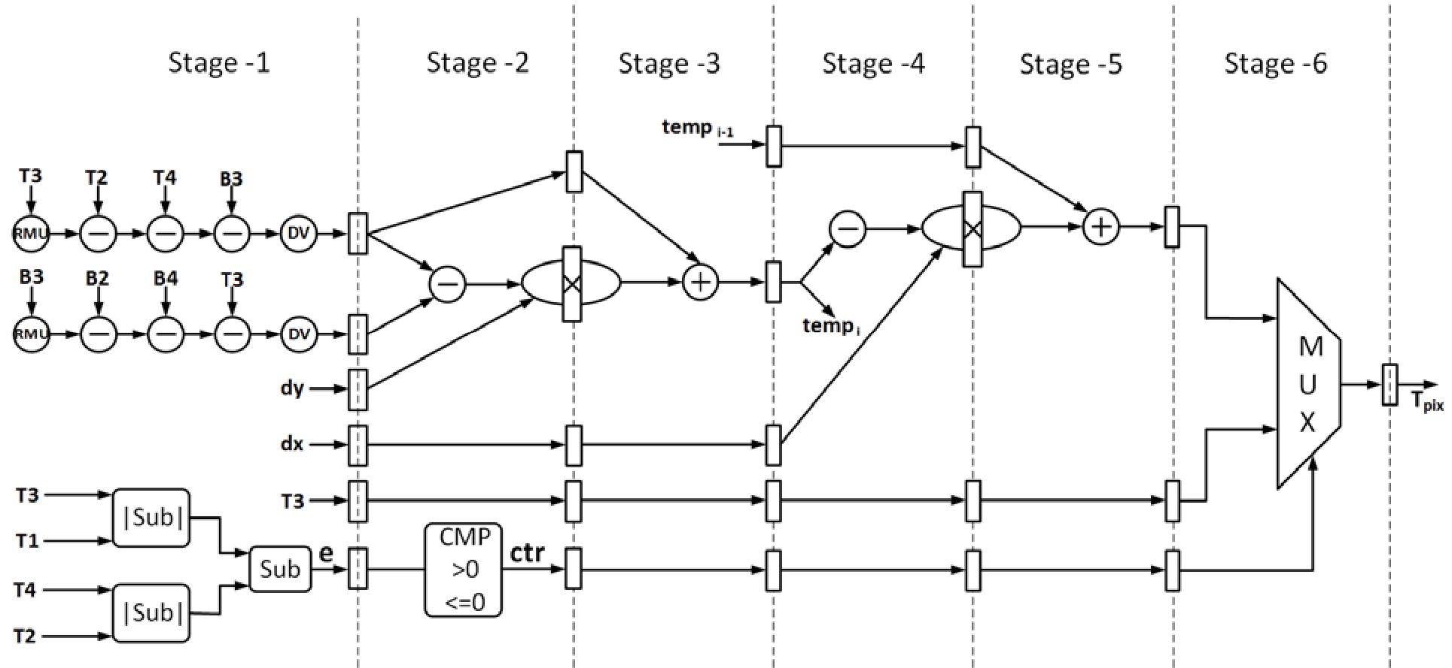
Architecture

Slide 10
WORKFLOW METHODOLOGY
The proposed architecture consists of several functional blocks including the input interface, line buffer, interpolation unit, control logic, and output formatter. The workflow begins with the input image being read and stored temporarily using line buffers. The control unit calculates the scaling ratios and determines the pixel positions needed for interpolation. The interpolation unit, based on the bilinear method, computes the values of the new pixels by using the neighboring pixel values from the input. These computed pixels are then passed to the output formatter to generate the final scaled image. The entire system is controlled by a finite state machine ensuring synchronization and real-time processing. The design is modeled in Verilog HDL and synthesized using FPGA tools for functional verification and performance analysis.

Slide 11
WORKFLOW METHODOLOGY
The development of the proposed VLSI architecture began with algorithm-level modeling and validation using Python. Python was used to simulate image scaling processes—particularly bilinear interpolation—to test functionality, verify output accuracy, and understand computational requirements. This high-level simulation helped in analyzing image quality, performance, and memory behavior before moving to hardware implementation. Once the algorithm was verified, the workflow proceeded with mapping the Python logic into hardware using Verilog HDL. The architecture was designed to read image data into line buffers, compute scaling ratios, and perform interpolation using simplified arithmetic optimized for hardware. A control unit, implemented using a finite state machine (FSM), managed data flow and synchronization between modules. Finally, the scaled image output was reconstructed and validated against the Python results to ensure correctness. The system was synthesized and tested on an FPGA platform to analyze performance, resource utilization, and power efficiency in a real-time scenario.

Slide 12
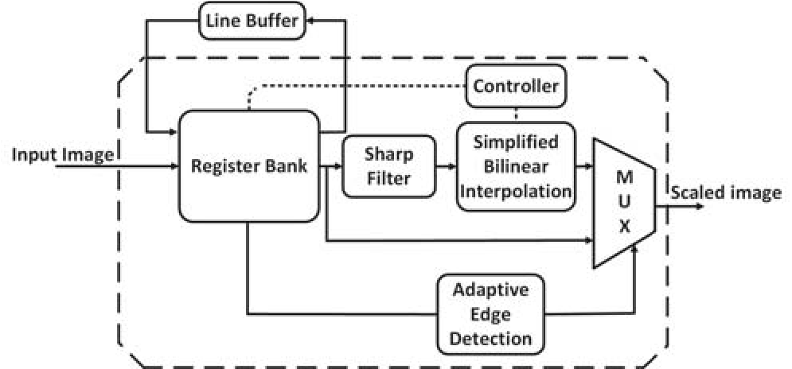
Block diagram
.

Slide 13
Engineering Standards & Realistic Constraints
a. IEEE Standards
IEEE 1800 (SystemVerilog): Used for VLSI design and verification.
IEEE 754: Floating point arithmetic (if your architecture supports it).
IEEE 1685 (IP-XACT): For standardizing IP integration in VLSI designs.
b. VESA Standards (Video Electronics Standards Association)
Standards for image scaling, resolutions (e.g., HDMI, DisplayPort), color spaces, etc.
c. ISO/IEC Standards
ISO/IEC 14496 (MPEG-4) and related standards for multimedia processing.
Defines how scaled images or videos should comply with compression or display standards.
d. ASIC/FPGA Toolchain Standards
Tools from vendors like Xilinx or Intel follow certain RTL and synthesis standards.
Use of standardized design flows for synthesis, place-and-route, and timing analysis.

Slide 14
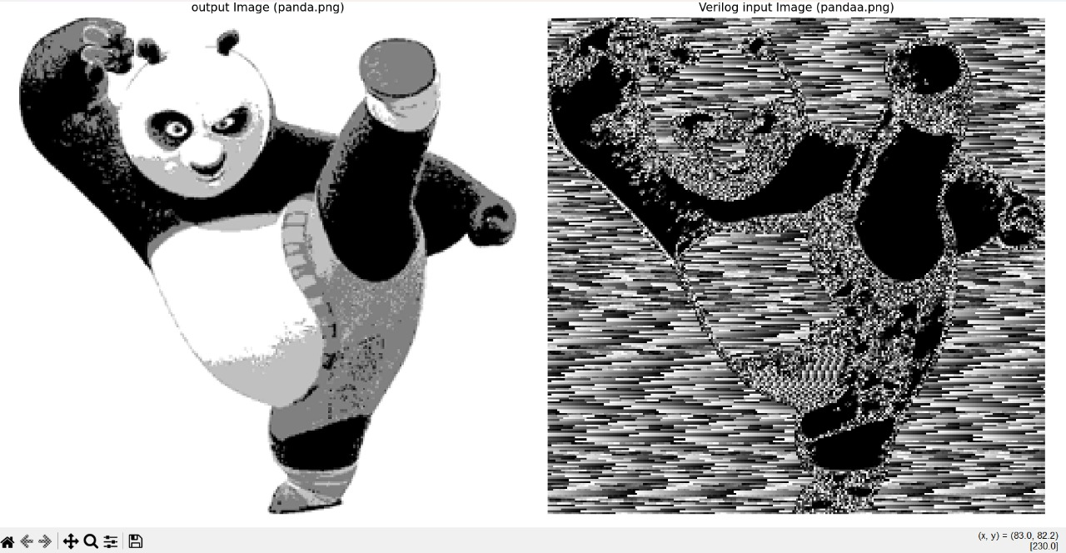
Results And discussion

Slide 15
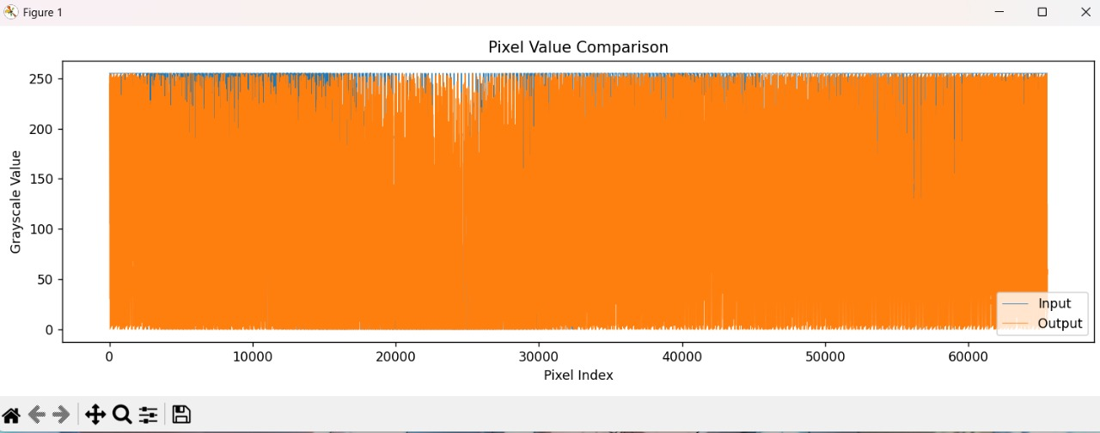

Slide 16
Conclusion
The proposed low-cost, high-performance VLSI architecture for image scaling effectively addresses the challenges of real-time processing in multimedia applications.
By leveraging efficient interpolation techniques like bilinear interpolation and optimizing the hardware design for minimal power consumption and area utilization, the system provides a practical solution for embedded devices with limited resources.
The use of Python for algorithm validation ensured that the scaling logic was accurately modeled before hardware implementation.
Testing on FPGA platforms demonstrated the feasibility and performance of the design, proving it to be both efficient and scalable for various image resolutions.
This work contributes to the advancement of multimedia processing in resource-constrained environments, offering a balance between computational efficiency, image quality, and cost-effectiveness, making it well-suited for modern portable devices.

Slide 17
REFERENCES
[1] M. U. Akram, S. Khan, and M. Shahzad, "FPGA-based real-time image scaling using bilinear interpolation for embedded systems," IEEE Access, vol. 7, pp. 10744-10753, 2019, doi: 10.1109/ACCESS.2019.2895674.
[2] R. T. S. R. Manne, P. S. N. R. Krishna, and D. K. S. S. Anirudh, "Low power VLSI architecture for real-time image scaling," IEEE Trans. Circuits Syst. Video Technol., vol. 29, no. 1, pp. 160-172, Jan. 2019, doi: 10.1109/TCSVT.2018.2837952.
[3] P. M. Shilpa, A. G. Kumar, and H. S. P. Kumar, "A high-performance VLSI architecture for real-time image scaling on FPGA," IEEE Trans. Very Large Scale Integr. (VLSI) Syst., vol. 28, no. 4, pp. 1145-1156, Apr. 2020, doi: 10.1109/TVLSI.2019.2952145.
[4] X. Zhang, J. Wu, and Z. Li, "Efficient VLSI design for image scaling algorithms for video processing," IEEE Trans. Consum. Electron., vol. 65, no. 2, pp. 224-232, May 2019, doi: 10.1109/TCE.2019.2898459.
[5] S. R. Bhagat and V. G. Dhande, "Design and implementation of image scaling system using low-power VLSI architecture," IEEE Trans. Circuits Syst. II Express Briefs, vol. 68, no. 6, pp. 1793-1797, Jun. 2021, doi: 10.1109/TCSII.2020.2993892.

Slide 18
REFERENCES
[6] C. C. Lin, Z. C. Wu, W. K. Tsai, M. H. Sheu and H. K. Chiang, “The VLSI design of winscale for digital image scaling,” in Proc. IEEE Int. Conf. Intell. Inform. Hiding Multimedia Signal Process., Nov. 2007, pp. 511–514.
[7] Chung-chi Lin, Ming-hwa Sheu, Huann-Keng Chiang, Chishyan Liaw and Zeng-chuan Wu, “The efficient VLSI design of BI-CUBIC convolu tion interpolation for digital image processing,” in Proc. IEEE Int Conf. Circuits Syst., May 2008, pp. 480–483.
[8] S. L. Chen, H. Y. Huang and C. H. Luo, “A low-cost high-quality adaptive scalar for real-time multimedia applications,” IEEE Trans. Circuits Syst. Video Technol., vol. 21, no. 11 , pp. 1600–1611, Nov. 2011.
[9] S. L. Chen, “VLSI Implementation of a Low-Cost High-Quality Image Scaling Processor,” IEEE Trans. Circuits Syst. II, Exp. Briefs, vol. 60, no. 1, pp. 31–35, Jan. 2013.
[10] S.L. Chen, “VLSI implementation of an adaptive edge-enhanced image scalar for real-time multimedia applications,” IEEE Trans. Circuits Syst. Video Technol., vol. 23, no. 9, pp. 1510–1522, Sep. 2013.

