Slide 1

Python pygame

Slide 2
title
PENALTY SOCCER game

Slide 3

team name
RAMPAGE’S SOCCER TEAM

Slide 4
Team number
15

Slide 5
TEAM MEMBERS
ABISHRAJ
ALTEN
ANUSUYA

Slide 6
ACADEMIC MENTOR :
MR. SATHISH

Slide 7
ABSTRACT
The title of our game is penalty soccer game .This project is about a penalty game in football . This project was developed by using python pygame . There are two players in the game . We are focusing developing a 2D Penalty Soccer Game . Each player will have a 5 penalty shoots. In this game Goal Keeper will save the ball or allow the ball . If Goal Keeper allow the ball the point will increase by 1 for each player . If Goal Keeper save the ball the point will not increase and decrease for each player.In order to improve the match success rate, we proposed a penalty kick strategy based on two-player shooting method which is used in two different defense patterns. In this strategy, a shooting method is applied when the opponent goalkeeper run out to destroy the ball and a reflecting shooting method is used when the goalkeeper stays at the goal line.

Slide 8
MODULES
Modified the python code.
changed a background for the game.
changed a character for the players .
changed the logo for the team.

Slide 9
REQUIREMENTS
SOFTWARE :
THONNY
LANGUAGE :
PYTHON

Slide 10
MODEL PROGRAM
m = pygame.image.load('images/lmanit.png')
point = pygame.image.load('images/point.png')
back = pygame.image.load('images/back.png')
frnt_1 = pygame.image.load('images/front-1.jpg')
img_instr = pygame.image.load('images/intro.png')
img_play1 = pygame.image.load('images/Play.png')
home_icn = pygame.image.load('images/home.png')
home_icn1 = pygame.image.load('images/home1.png')
icn = pygame.image.load('images/icon.jpg')
img_sky = pygame.image.load('images/sky2.png')
banner = pygame.image.load('images/BANNER.png')
img_goalpost = pygame.image.load('images/goalpost.png')
img_aud = pygame.image.load('images/audi.png')
line1 = pygame.image.load('images/line.png')
line2 = pygame.image.load('images/boundry.png')

Slide 11
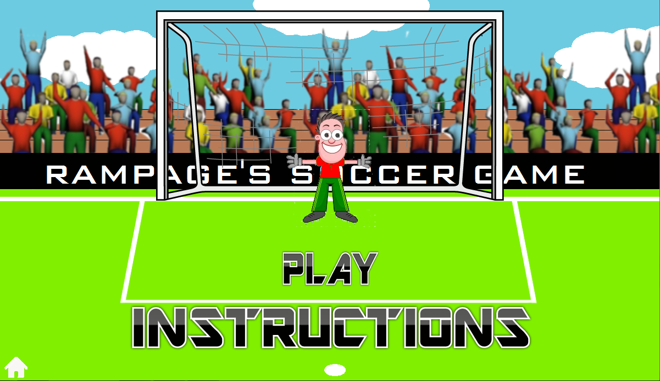
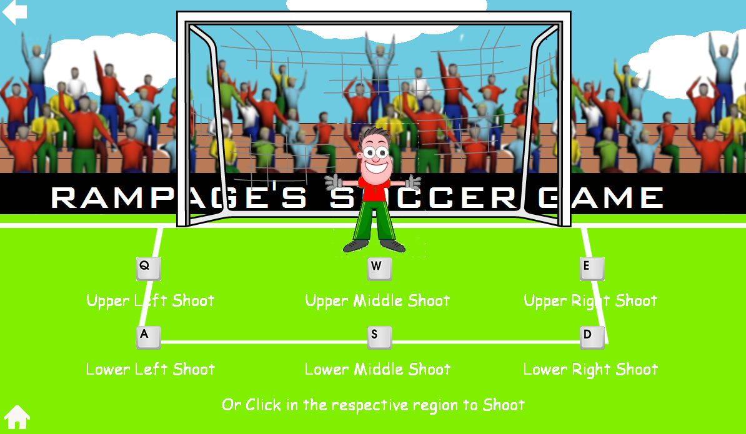
pygame

Slide 12
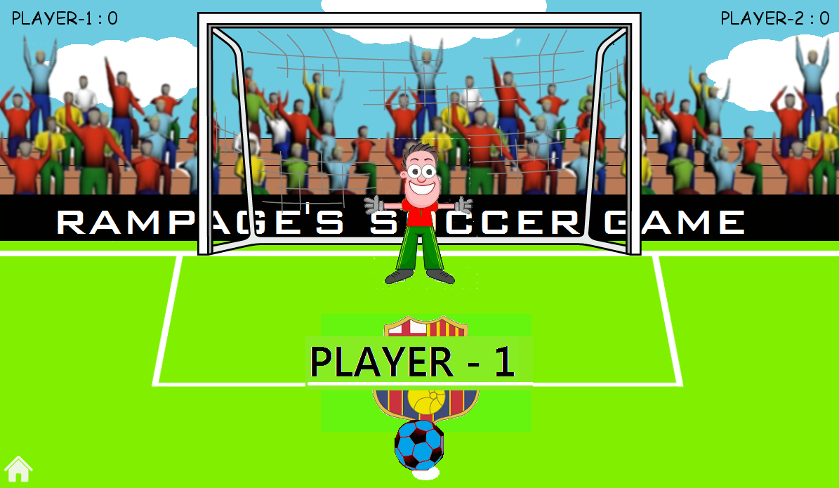
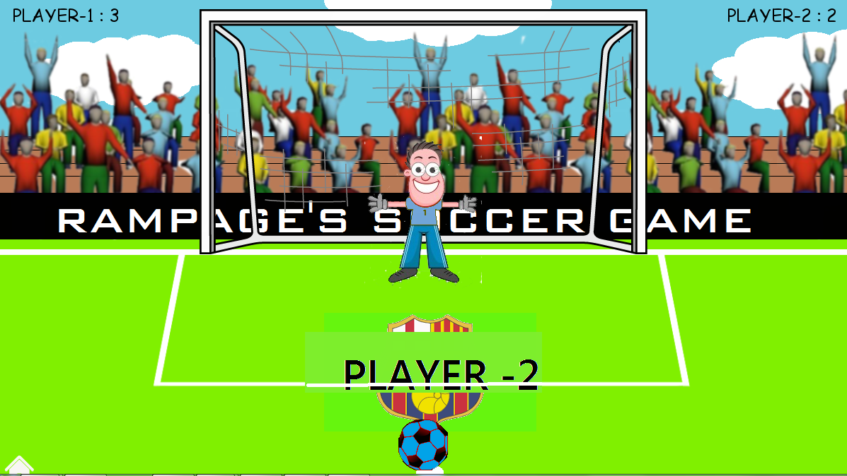
PYGAME

Slide 13
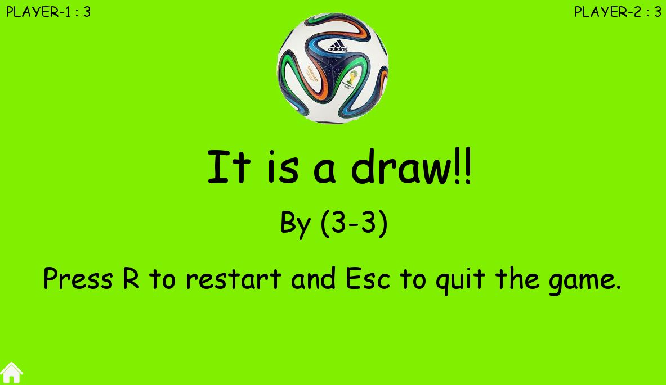
PYGAME

Slide 14
Thank you…….

