Slide 1
Lab 0 Welcome & Tools Setup
Davit Markarian

Slide 2
Lab Logistics
Labs release after the class ends
Check the Schedule to see their release dates
Labs can be found in Canvas > Assignments
Also linked on the Schedule
Labs are due at 11:59 PM on their listed due date
Lab 0 is due on April 8th
3 AM late due time (no penalty)
Start labs early
Please review the Syllabus collaboration and GenAI policies

Slide 3
Lab 0 Rundown
Software Setup Guide
Docker
Git/GitHub
OpenROAD-flow-scripts
Running OpenROAD for the first time
Making changes to design parameters
Using the GUI to make analyses
Submission with Google Docs/Gradescope and GitHub Classroom

Slide 4
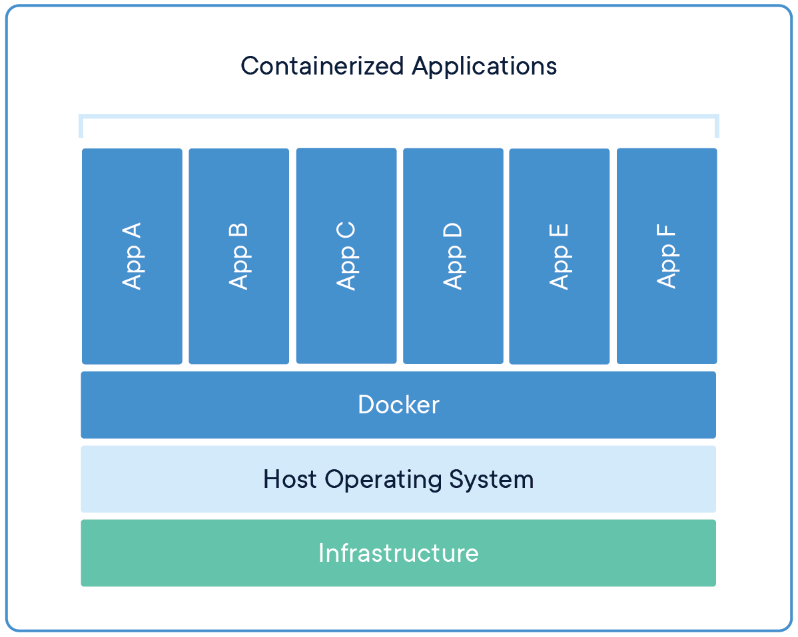
Docker
Docker is an app that lets you spin up “containers” – isolated copies of Linux-based operating systems prepackaged with apps
For this course, we provide a downloadable container image for OpenROAD and OpenROAD-flow-scripts
You can run OpenROAD without a Linux machine and without spending time on software dependencies
For this lab, you will install Docker and run our container
You will follow the Software Setup guide (also pinned on Canvas)

Slide 5
Realizing the Flow
OpenROAD, like the commercial tools, is inert without scripting → we must write tcl or Python scripts to realize implementation
In 260B, you achieved this by guided writing or copying of scripts
then, running them stage-by-stage.
This is an error-prone process
Stages must be executed in the correct order
Tools are large and complex: many configurable variables with scattered documentation
Need for a starting-point “reference flow”

Slide 6
OpenROAD-flow-scripts
ORFS is a batteries-included flow for OpenROAD
It includes highly configurable scripts that you can use to complete implementation
Driven by Makefiles with well-documented variables.
It also includes test designs and PDKs
Great for testing, exploration, and research
For this course, we will use the included open IHP 130nm SG12G2 process
Includes scripting hooks between flow stages
You can your custom implementation behavior on top of ORFS

Slide 7
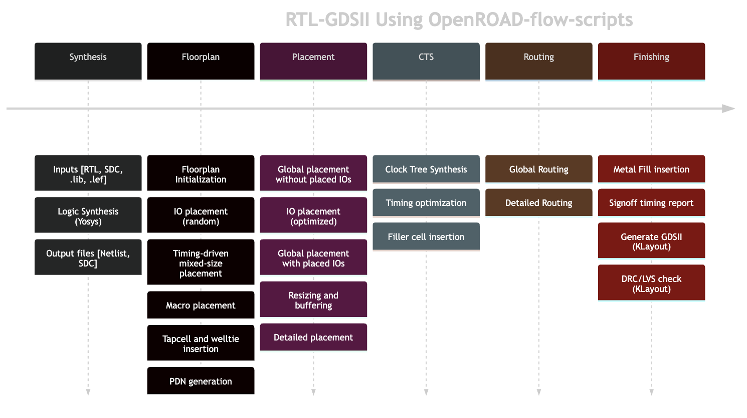
OpenROAD-flow-scripts

Slide 8
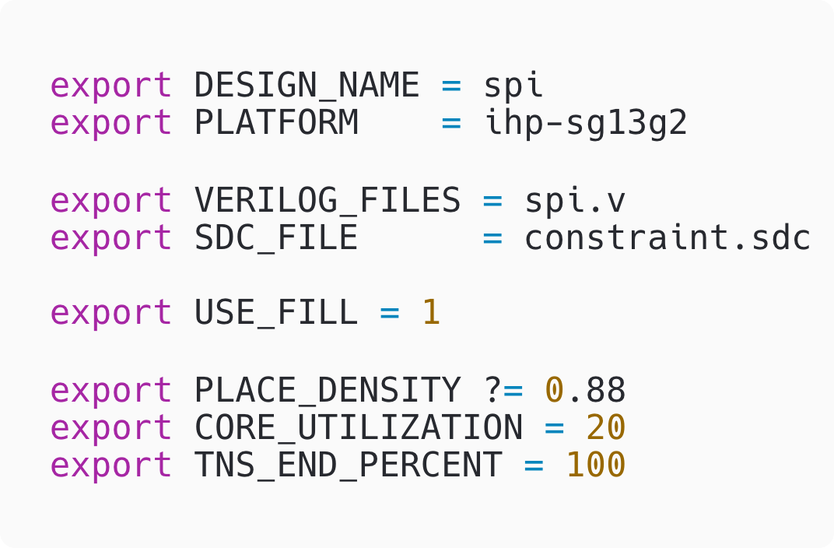
config.mk
config.mk is what control an implementation in ORFS
Just set flow variables
ORFS is driven by flow/Makefile, which pulls your design’s config.mk
Building a design is as easy as: DESIGN_CONFIG=./designs/ihp-sg13g2/gcd/config.mk make

Slide 9
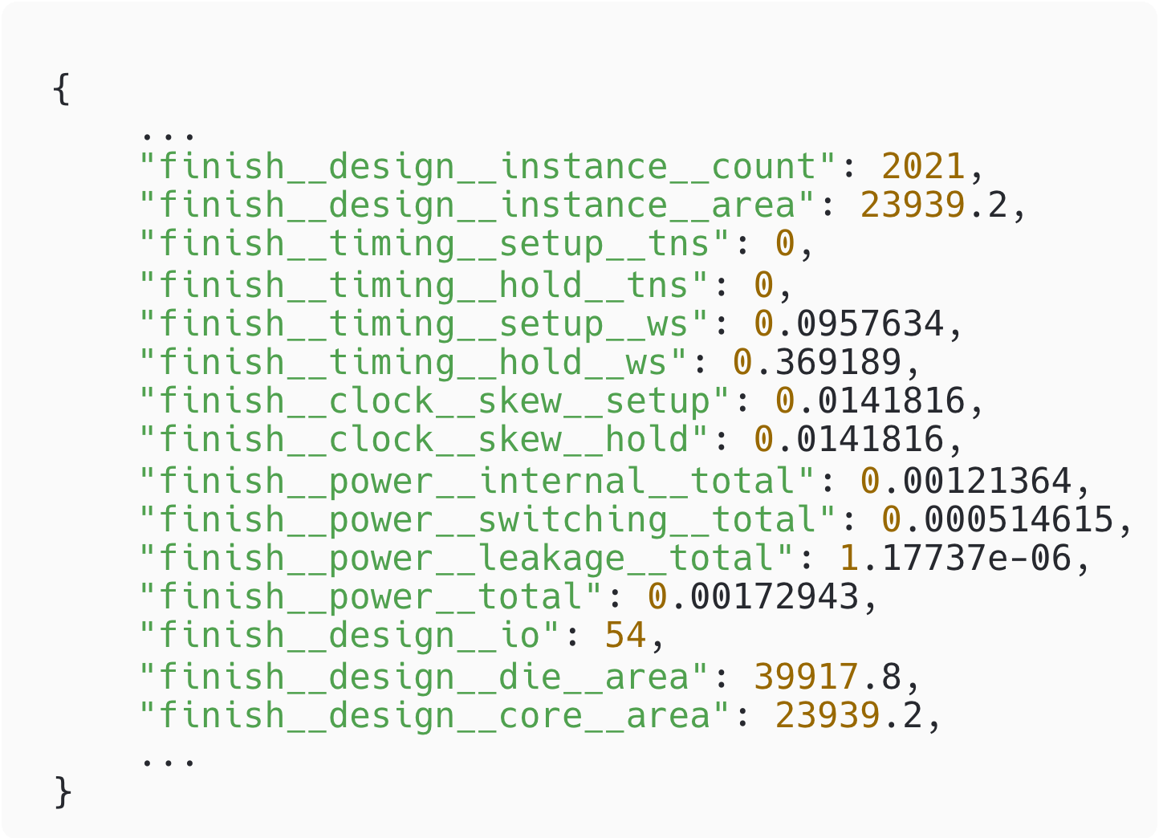
Outputs
ORFS will output what you expect from a flow:
GDS, DEF, SPEF, Netlist
for every stage
ORFS will also output reports
QoR as you expect
+ stage-by-stage logs/renders
+ machine-readable reports (JSON)
You can open interactive sessions for any stage
make open_final / make gui_final

Slide 10
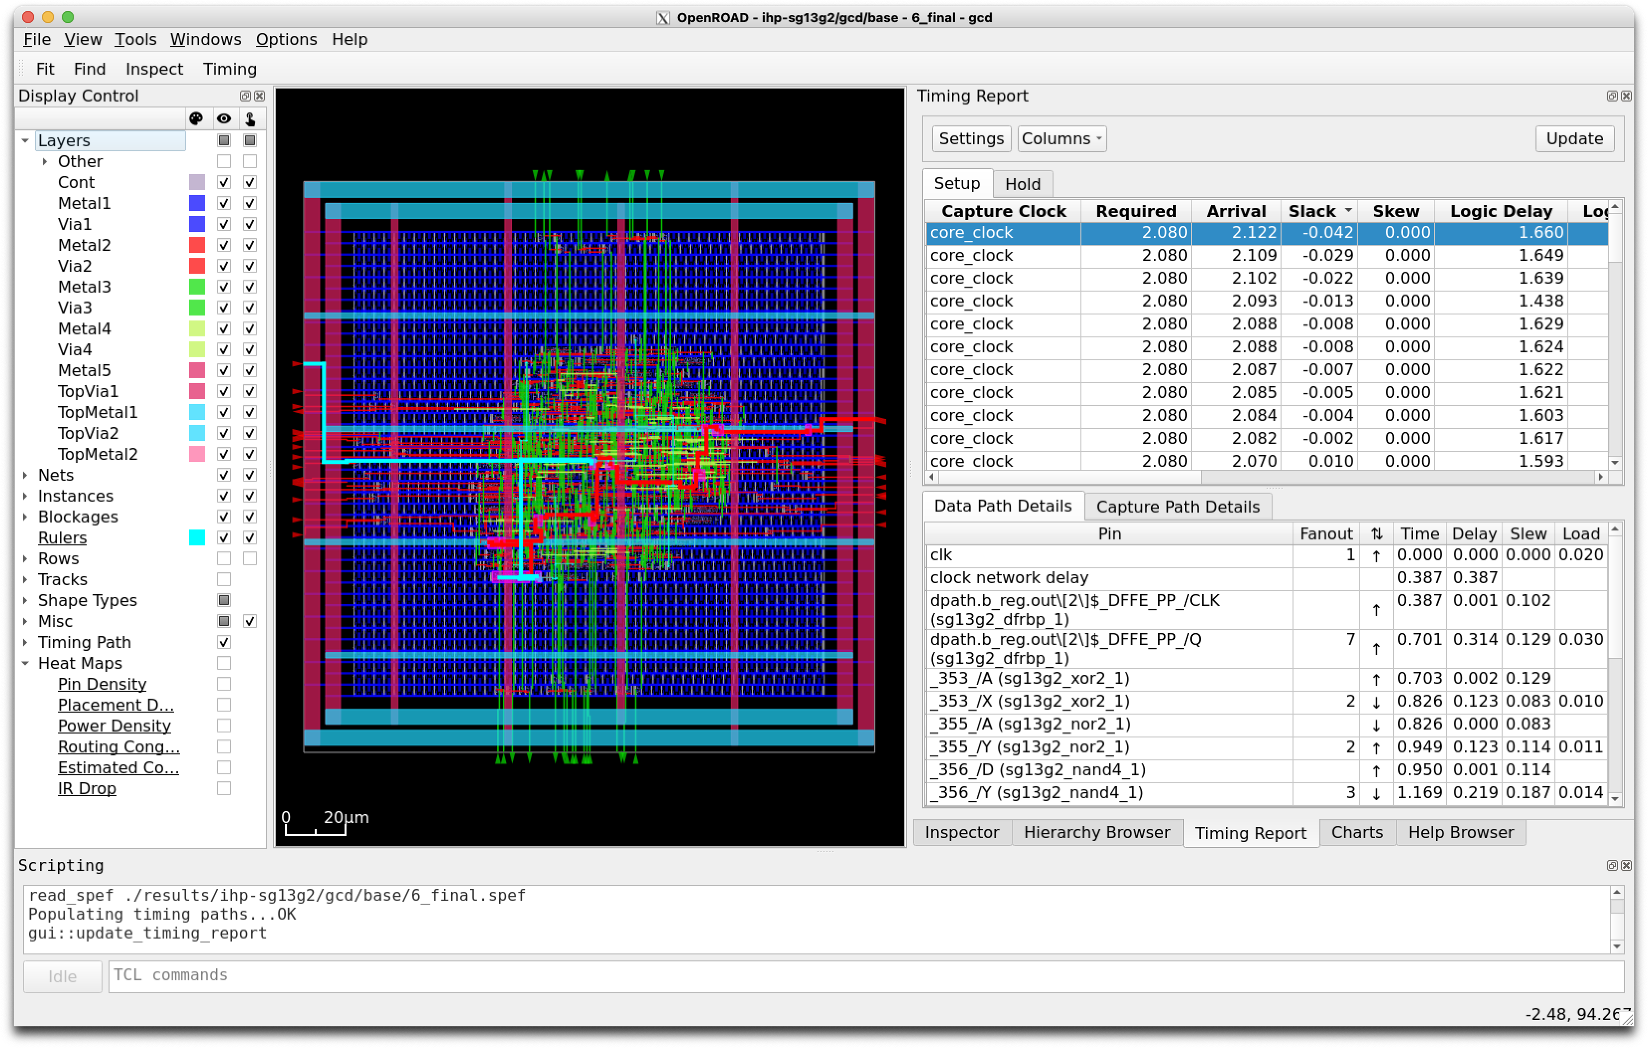
OpenROAD GUI

Slide 11
Git & GitHub
Git is the most popular source version control system
If you are unfamiliar, please look at an intro guide.
GitHub is an online platform hosting Git repositories
If you do not have an account, create one.
GitHub Classroom lets you submit Git repos containing your work for this course
You will get invitation links to each lab submission within the lab report template
Some labs will have starter code too
For the first time, you must associate your GitHub account to your name on the class roster. Please do this carefully.
The Git and GitHub command line tools are part of our container

Slide 12
Completion & Submission
Go to Canvas > Assignments and follow the instructions to make a copy of the lab report template on Google Docs
You will follow the lab instructions to
Perform the full software setup as noted in the Guide.
Run the container and experiment with ORFS and the OpenROAD GUI
Join the GitHub Classroom assignment, clone the repo to your container, and push your results into it
In your browser, verify the GitHub repo – your latest commit is your submission
Export your report to PDF and upload it to Gradescope

Slide 13
Final Notes
With this lab, now is the time to iron out software issues → Use Piazza and Office Hours
Skim both the Software Setup Guide and the Lab 0 template before getting started
Start early
Leave time in case you need software support
This lab requires both a large software download (7 GB) and runs of ORFS, which both take time

