Slide 1
ECE 260C Logic Synthesis
Cho Moon

Slide 2
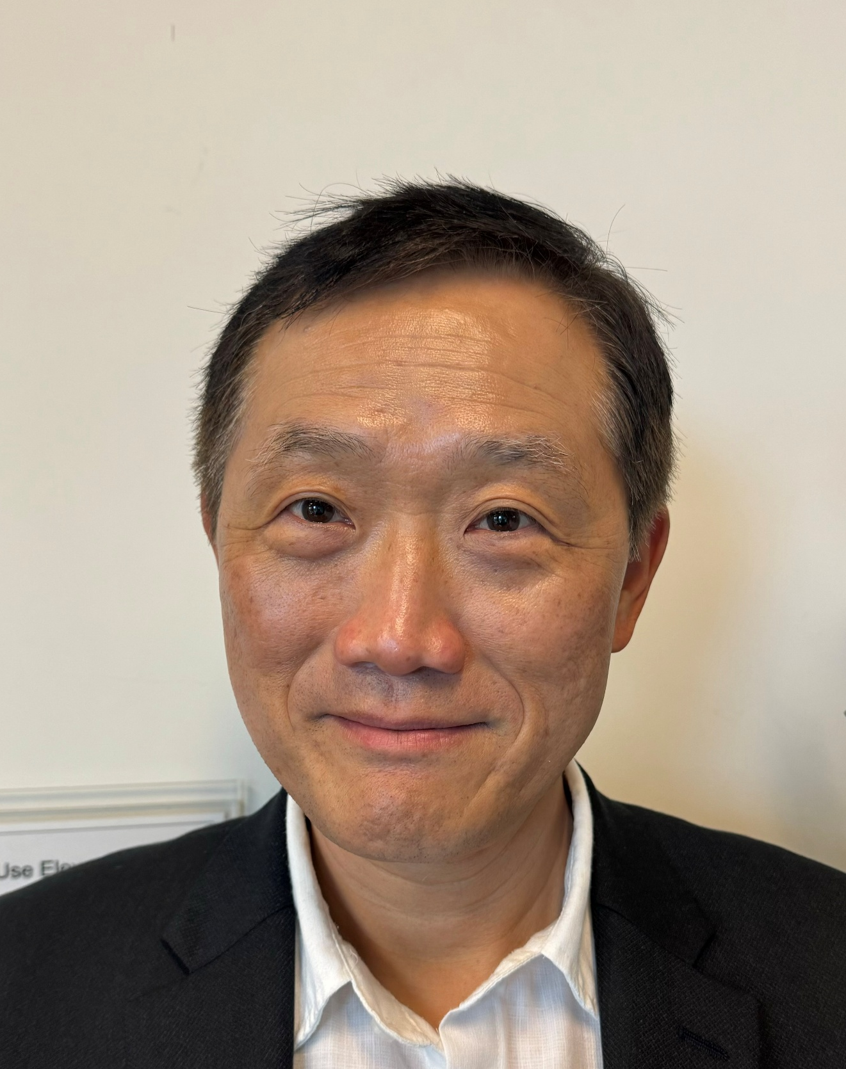
Bio
Cho Moon has over 25 years of experience in EDA. He is currently a distinguished engineer at Precision Innovations. He has led advanced node development for tools like PrimeTime, Fusion Compiler and First Encounter at Synopsys, Blaze DFM, Cadence and other EDA and semiconductor companies.
He has expertise in static timing analysis, pre-route and post-route optimization, Engineering Change Order (ECO) optimization, logic synthesis and formal verification.
He holds a PhD from UC Berkeley. Bob Brayton was his advisor.

Slide 3
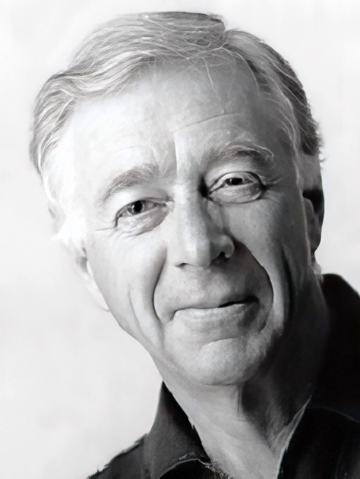
Bob Brayton’s Favorite Quote
Your manuscript is both good and original. Unfortunately, the part that is good is not original, and the part that is original is not good.
Samuel Johnson
Prof. Bob Brayton

Slide 4
Outline
Introduction
Two-level Logic Synthesis
Multi-level Logic Synthesis
Classical
Contemporary
Technology Mapping
Classical
Contemporary

Slide 5
Why Logic Synthesis?
Indispensable
Problem is too hard without it
Similar to C++/C compilers
Big impact on final PPA (performance, power and area)
Foundation for many applications like
Verification
Timing analysis
Testing
Sequential optimization
Notes:
Logic synthesis is a necessary foundation for logic optimization and verification/test. As P&R tools evolve with stronger resynthesis functionality to meet tighter PPA goals, the need for sound logic synthesis only increases.

Slide 6
Design Flow
Where does logic synthesis fit in?
System Specification
Verification
Yosys
RTL
ABC
ABC
Logic synthesis
Technology mapping
OpenROAD
Physical synthesis
Manufacturing
Notes:
Yosys works to elaborate and synthesize a technology mapped netlist from RTL that OpenROAD can then place and route. Both utilize ABC.
Yosys calls into ABC to perform logic optimization and technology mapping, while Yosys itself handles RTL elaboration and a large set of structural transformations, such as hierarchy flattening or adder synthesis. OpenROAD uses ABC to perform physical resynthesis, providing ABC with STA timing data.
https://github.com/The-OpenROAD-Project/OpenROAD/tree/master/src/rmp

Slide 7
Synthesis Example (Yosys + ABC)
module adder1 (
input clk,
input a,
input b,
input cin,
output reg sum,
output reg cout
);
reg [1:0] result;
always @(posedge clk) begin
result <= a + b + cin;
sum <= result[0];
cout <= result[1];
end
endmodule
module adder1(clk, a, b, cin, sum, cout);
wire _0_;
wire _1_;
input a;
wire a;
input b;
wire b;
input cin;
wire cin;
input clk;
wire clk;
output cout;
wire cout;
wire \result[0] ;
wire \result[1] ;
output sum;
wire sum;
sky130_fd_sc_hd__xor3_1 _2_ ( .A(cin), .B(a), .C(b), .X(_1_) );
sky130_fd_sc_hd__maj3_1 _3_ ( .A(cin), .B(a), .C(b), .X(_0_) );
sky130_fd_sc_hd__dfxtp_1 \cout$_DFF_P_ ( .CLK(clk), .D(\result[1] ),.Q(cout) );
sky130_fd_sc_hd__dfxtp_1 \result[0]$_DFF_P_ ( .CLK(clk), .D(_1_),.Q(\result[0] ) );
sky130_fd_sc_hd__dfxtp_1 \result[1]$_DFF_P_ ( .CLK(clk), .D(_0_), .Q(\result[1] ) );
sky130_fd_sc_hd__dfxtp_1 \sum$_DFF_P_ ( .CLK(clk), .D(\result[0] ), .Q(sum) );
endmodule
RTL (Register Transfer Level) Specification
= “Behavioral” Verilog
Gate-level Netlist Implementation
= “Structural” Verilog

Slide 8
Problem
Given
Initial design
Design constraints
Timing
Power
Area
Target technology libraries
Produce
Optimal gate-level netlist that meets design constraints
Very hard optimization problem!

Slide 9
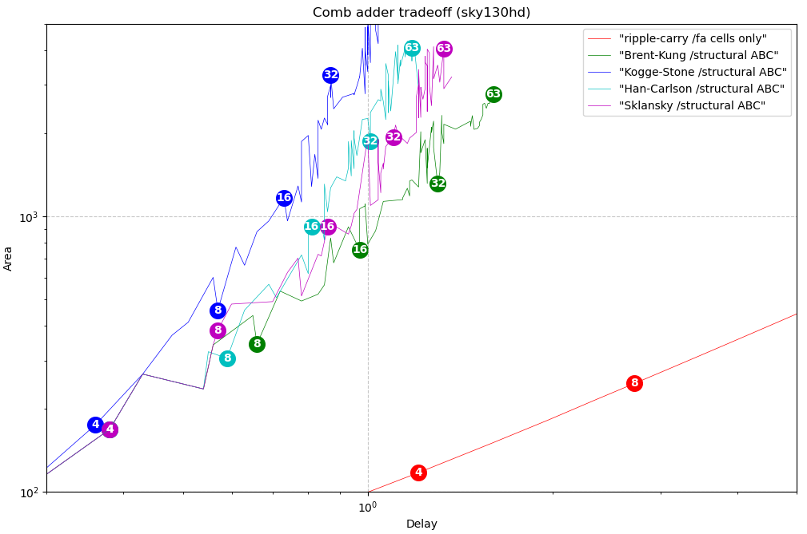
Adder Choices
Area vs. delay tradeoff for different adders with varying bit widths
Slide Courtesy of Martin Poviser and Emil Tywoniak at YosysHQ
Notes:
Synthesis of large inferred structures, like the adders demonstrated here (but also multipliers or memories), demonstrate the breadth of the solution space that synthesis can address. Power, Performance, and Area tradeoffs need to be accounted for.

Slide 10
Combinational Logic Synthesis
2-level
Logic opt
netlist
tech
independent
multilevel
Logic opt
Logic Synthesis
Library
tech
dependent
Library
netlist
Slide courtesy of Devadas, et. al

Slide 11
Boolean Functions
f(x) : B^{n} B
B = {0, 1}, x = (x₁, x₂, …, x_{n})
x₁, x₂, … are variables
x₁, x₁, x₂, x₂, … are literals
each vertex of B^{n} is mapped to 0 or 1
the onset of f is a set of input values for which f(x) = 1
the offset of f is a set of input values for which f(x) = 0

Slide 12

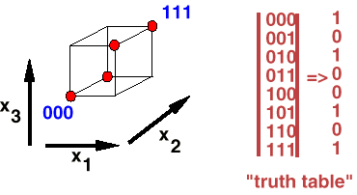

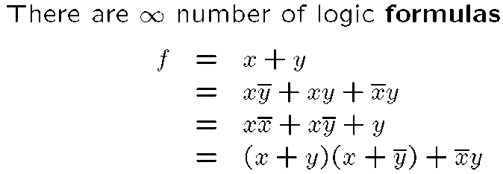

Logic Formulas
Slide courtesy of Devadas, et. al
Notes:
A cube (diagrammed) represents a product (AND) of inputs.

Slide 13
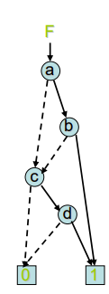
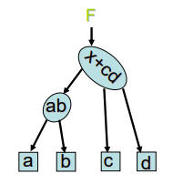
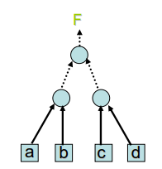
Logic Representation
Sum of products (SOP): F= ab + cd
Product of sums (POS): F = (a+c)(a+d)(b+c)(b+d)
Truth Table (TT)
F | 0 | 0 | 0 | 1 | 0 | 0 | 0 | 1 | 0 | 0 | 0 | 1 | 1 | 1 | 1 | 1
abcd | 0000 | 0001 | 0010 | 0011 | 0100 | 0101 | 0110 | 0111 | 1000 | 1001 | 1010 | 1011 | 1100 | 1101 | 1110 | 1111
Binary decision diagram (BDD)
Logic Network (LN)
And-inverter Graph (AIG)
Slide Courtesy of Alan Mischenko
Notes:
Optimizing logic can be done on these graph representations (BDD, LN, AIG). AIGs scale the best to larger logic. Balancing an AIG as a tree can be thought of as improving timing. Minimizing number of nodes correlates to lower area.

Slide 14
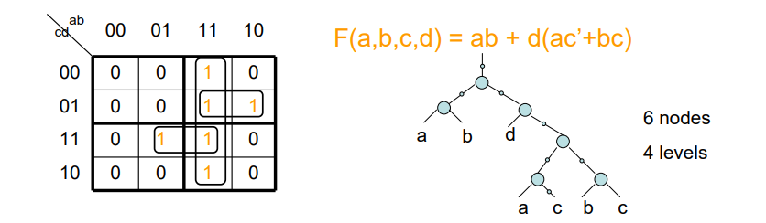
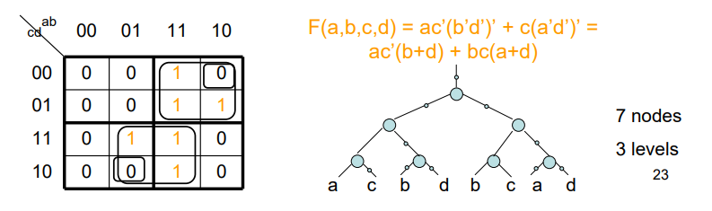
Which Representation and Which Optimization?
Design Size | # Inputs | Representation | Optimization | Tools
Small | <= 16 | Truth Table (TT) Sum of Products (SOP) | Minimize number of products or literals ab is better than abc ab is better than abc + abc’ | Espresso
Medium | 16-100 | Binary Decision Diagrams (BDD) Logic Network (LG) And-inverter Graph (AIG) | Minimize number of nodes or widths Minimize “area” or levels Minimize number of nodes or levels | SIS VIS, MVSIS ABC
Large | > 100 | And-inverter Graph (AIG) | Minimize number of nodes or levels | ABC
Slide Courtesy of Alan Mischenko

Slide 15
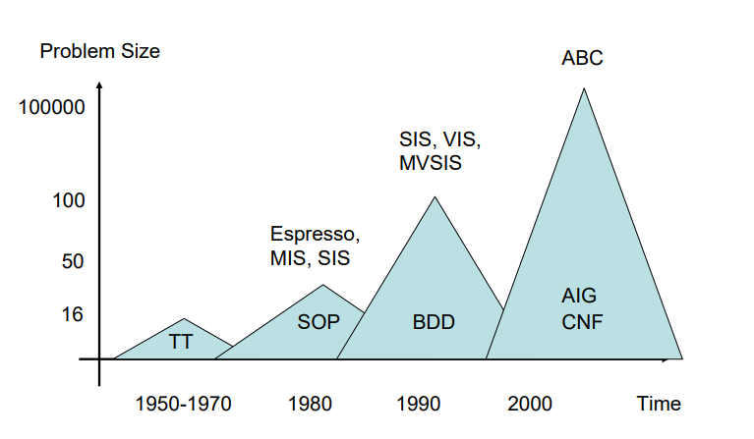
Historical Perspective
Slide Courtesy of Alan Mischenko

Slide 16
Outline
Introduction
Two-level Logic Synthesis
Multi-level Logic Synthesis
Classical
Contemporary
Technology Mapping
Classical
Contemporary

Slide 17
Two-level Logic Synthesis Problem
Given an arbitrary logic function in two-level form, produce a smaller representation.
For sum-of-products (SOP) implementation on PLAs (programmable logic arrays), fewer product terms and fewer inputs to each product term mean smaller area.
I1
O1 = I1 I2 + I1’ I2’
O2 = I1’ I2’
I2
O1
O2

Slide 18
Sum-of-products (SOP)
A function can be represented by a sum of cubes (products):
f = ab + ac + bc
Since each cube is a product of literals, this is a “sum of products” representation
A SOP can be thought of as a set of cubes F
F = {ab, ac, bc} = C
A set of cubes that represents f is called a cover of f.
F={ab, ac, bc} is a cover of f = ab + ac + bc.

Slide 19
Prime Cover
A cube is prime if there is no other cube that contains it
(for example, b c is not a prime but b is)
A cover is prime iff all of its cubes are prime
c
a
b

Slide 20
Irredundant Cube
A cube c of a cover C is irredundant if C fails to be a cover if c is dropped from C
A cover is irredundant iff all its cubes are irredundant (for example, F = a b + a c + b c)
c
a
b
Not covered

Slide 21
Quine-McCluskey Method
We want to find a minimum prime and irredundant cover for a given function.
Prime cover leads to min number of inputs to each product term.
Min irredundant cover leads to min number of product terms.
Quine-McCluskey (QM) method (1960’s) finds a minimum prime and irredundant cover.
Step 1: List all minterms of on-set: O(2^n) n = #inputs
Step 2: Find all primes: O(3^n) n = #inputs
Step 3: Construct minterms vs primes table
Step 4: Find a min set of primes that covers all the minterms: O(2^m) m = #primes

Slide 22
QM Example
F = a’ b’ c’ + a b’ c’ + a b’ c + a b c + a’ b c
Find a minimum set of primes that covers all the minterms
“Minimum column covering problem”
 | b’ c’ | a b’ | a c | b c
a’ b’ c’ | X
a b’ c’ | X | X
a b’ c |  | X | X
a b c |  |  | X | X
a’ b c |  |  |  | X
Essential primes

Slide 23
ESPRESSO – Heuristic Minimizer
Quine-McCluskey gives a minimum solution but is only good for functions with small number of inputs (< 10)
ESPRESSO is a heuristic two-level minimizer that finds a “minimal” solution
ESPRESSO(F) {
do {
reduce(F);
expand(F);
irredundant(F);
} while (fewer terms in F);
verfiy(F);
}

Slide 24
ESPRESSO ILLUSTRATED
Reduce
Expand
Irredundant

Slide 25
Outline
Introduction
Two-level Logic Synthesis
Multi-level Logic Synthesis
Classical
Contemporary
Technology Mapping
Classical
Contemporary

Slide 26
Multi-level Logic Synthesis
Two-level logic synthesis is effective and mature
Two-level logic synthesis is directly applicable to PLAs and PLDs
But…
There are many functions that are too expensive to implement in two-level forms (too many product terms!)
Two-level implementation constrains layout (AND-plane, OR-plane)
Rule of thumb:
Two-level logic is good for control logic
Multi-level logic is good for datapath or random logic

Slide 27
Multi-level Logic Synthesis Problem
Given
Initial logic network
Design constraints
Arrival times, required times, power consumption, noise immunity, etc…
Target technology libraries
Produce
a minimum “cost” netlist consisting of the gates from the target libraries such that design constraints are satisfied

Slide 28
Modern Approach to Logic Optimization
Divide logic optimization into two subproblems:
Technology-independent optimization
determine overall logic structure
estimate costs (mostly) independent of technology
simplified cost modeling
Technology-dependent optimization (technology mapping)
binding onto the gates in the library
detailed technology-specific cost model
Orchestration of various optimization/transformation techniques for each subproblem
Slide courtesy of Keutzer

Slide 29
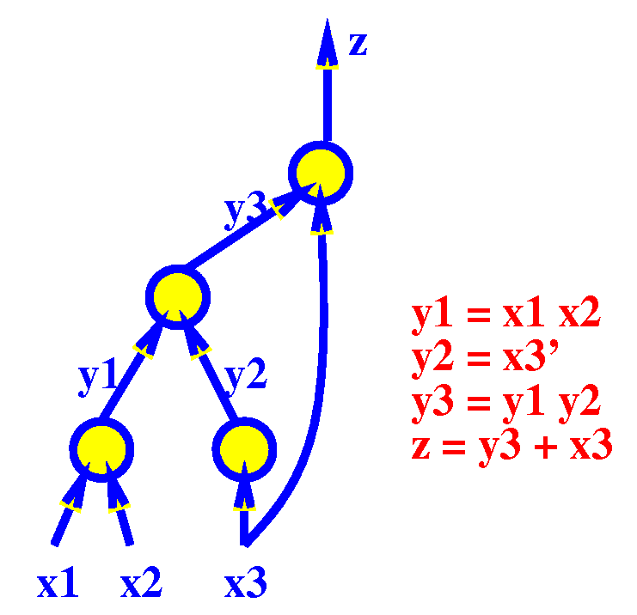
Network Representation
Logic Network:

Slide 30
Node Representation: Sum of Products (SOP)
Example:
abc’+a’bd+b’d’+b’e’f (sum of cubes)
Advantages:
easy to manipulate and minimize
many algorithms available (e.g. AND, OR, TAUTOLOGY)
two-level theory applies
Disadvantages:
Not representative of logic complexity. For example,
f=ad+ae+bd+be+cd+ce
f’=a’b’c’+d’e’
These differ in their implementation by an inverter.
hence not easy to estimate logic; difficult to estimate progress during logic manipulation

Slide 31
Technology-Independent Optimization
Technology-independent optimization is a bag of tricks:
Two-level minimization (also called simplify)
Constant propagation (also called sweep)
f = a b + c; b = 1 => f = a + c
Decomposition (single function)
f = abc+abd+a’c’d’+b’c’d’ => f = xy + x’y’; x = ab ; y = c+d
Extraction (multiple functions)
f = (az+bz’)cd+e g = (az+bz’)e’ h = cde
⇓
f = xy+e g = xe’ h = ye x = az+bz’ y = cd

Slide 32
More Technology-Independent Optimization
More technology-independent optimization tricks:
Substitution
g = a+b f = a+bc
⇓
f = g(a+c)
Collapsing (also called elimination)
f = ga+g’b g = c+d
⇓
f = ac+ad+bc’d’ g = c+d
Factoring (series-parallel decomposition)
f = ac+ad+bc+bd+e => f = (a+b)(c+d)+e

Slide 33
Outline
Introduction
Two-level Logic Synthesis
Multi-level Logic Synthesis
Classical
Contemporary
Technology Mapping
Classical
Contemporary

Slide 34
Motivation for Contemporary Synthesis
Classical combinational tech-independent synthesis
suboptimal
complicated
hard to implement
slow
What if we replace it with something that is
suboptimal, but
simple
easy to implement
fast
Slide Courtesy of Alan Mischenko & Bob Brayton
Notes:
Contemporary methods look to apply a similar set of logic optimizations but with logic representations that are more amenable to large scales.

Slide 35
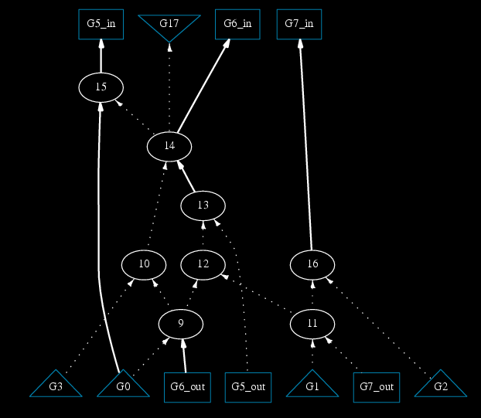
And-Inverter Graph (AIG)
Every node is two-input AND
Dotted line denotes inversion
Primary inputs and register outputs at bottom
Primary outputs and register inputs at top
Can represent any set of logic functions
Slide Courtesy of Alan Mischenko & Bob Brayton
Notes:
And-Inverter Graphs are the most common logic representation and are used by Berkeley ABC, an open-source synthesis system.
https://people.eecs.berkeley.edu/~alanmi/abc/

Slide 36
Logic Network vs. AIG
Logic network in SIS
Equivalent AIG in ABC
f
f
z
z
x
y
y
x
e
a
b
c
d
a
b
c
d
e
AIG is a logic network of 2-input AND nodes and inverters (dotted lines)
Slide Courtesy of Alan Mischenko & Bob Brayton

Slide 37
One AIG Node – Many Cuts
Combinational AIG
AIG can be used to compute many cuts for each node
Each cut in AIG represents a different SIS node
No a priori fixed boundaries
Implies that AIG manipulation with cuts is equivalent to working on many logic networks at the same time
f
a
b
c
d
e
Different cuts for the same node
Slide Courtesy of Alan Mischenko & Bob Brayton
Notes:
Cuts are a necessary part of logic synthesis, particularly in technology mapping. Each cut can represent a standard cell or FPGA LUT in the target technology.
Each possible cut (which can be animated through in the slides) represents a new logic network (seen in the previous slide). The benefit of the AIG is that it separates this cut generation process from the rest of the logic optimization process rather than explicitly encoding cuts in its structure.

Slide 38
k-Feasible Cuts
Definition. A set of nodes C is a k-feasible cut for a node n if
(1) all the paths from the primary inputs (PIs) to node n pass through at least one node in C,
(2) the number of nodes in C does not exceed k
n
3-feasible cuts of n:
C1 = { p, k }
C2 = { a, b, s }
k | Average number of cuts per node
4 | 6
5 | 20
6 | 80
7 | 150
p
k
s
Not 3-feasible cuts of n:
C3 = { p, b, c }
C4 = { a, b, s, c }
a
b
c
PIs: a, b, c
Slide Courtesy of Alan Mischenko & Bob Brayton
Notes:
A k-feasible cut is a cut with a certain number of maximum nodes.

Slide 39
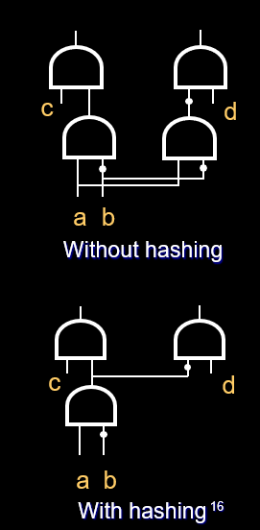
AIG Structural Hashing
Leads to a compact representation
Is applied during AIG construction
Propagates constants
Makes each node structurally unique
Slide Courtesy of Alan Mischenko & Bob Brayton
Notes:
Structural hashing (referred to as strash-ing in ABC and related papers) aims to introduce a “partially canonical” form to the AIG by replacing redundant logic with a single instantiation of logic. This reduces the number of nodes in the AIG, which can allow more cuts to be explored. Canonical forms of logic can speed up technology mapping further by allowing for faster matching i.e. the canonical AIG of a possible technology cell and the canonically AIG of a behaviorally-equivalent cut of a design’s logic network should be the same.
See more details here: https://people.eecs.berkeley.edu/~alanmi/publications/2005/tech05_fraigs.pdf

Slide 40
AIG Resubstitution
Resubstitution considers a node in a logic network and expresses it using a different set of fanins
X
X
Notes:
Resubstitution over a node tries to express the same behavior of that node using different fan-ins. These fan-ins can be primary inputs, outputs of existing nodes, or outputs of new nodes. Resubstitution may be referred to by the number of nodes it is allowed to add to the network (e.g. 0-resub, 1-resub, ..., N-resub).
The goal of resubstitution can be different i.e. to reduce the number of nodes (correlating with area), improve the balance of the tree (correlating with timing), more detailed estimated cost (timing/power/area) of nodes (based on some early techmapping), etc.
See a (non-AIG) example here: https://msoeken.github.io/papers/2020_date.pdf

Slide 41
AIG “speedup”
Timing Criticality
Critical nodes
Used by many traditional algorithms
Critical edges
Used by ABC
ABC pre-computes critical edges of critical nodes
Reduces computation
An edge between critical nodes may not be critical
See illustration: edge 1→3
Primary outputs
4
4
3
3
2
2
1
1
Primary inputs

Slide 42
Delay-Oriented Restructuring
Using traditional MUX-restructuring
AKA generalized select transform
x and y are the critical edge inputs

Slide 43
AIG Rewriting
Pre-computing subgraphs
Consider function f = abc
Rewriting subgraphs
Rewriting node A
Subgraph 1
Subgraph 2
Subgraph 3
A
A
⇒
a
a
b
a
b
a
c
b
c
a
b
a
c
Subgraph 1
Subgraph 2
b
c
a
c
Rewriting node B
B
⇒
B
a
a
b
a
c
b
c
a
b
a
c
Subgraph 2
Subgraph 1
In both cases 1 node is saved
Slide Courtesy of Alan Mischenko & Bob Brayton

Slide 44
Combinational Synthesis By AIG Rewriting
iterate 10 times {
for each AIG node {
for each k-cut
derive node output as function of cut variables
if ( smaller AIG is in the pre-computed library )
rewrite using improved AIG structure
}
}
Note: each AIG node has, on average, 5 4-cuts compared to a SIS node with only 1 cut
Rewriting at a node can be very fast – using hash-table lookups, truth table manipulation, disjoint decomposition
Slide Courtesy of Alan Mischenko & Bob Brayton

Slide 45
Experimental Results (MCNC)
A. Mischenko, S. Chatterjee, R. Brayton, “DAC-Aware AIG Rewriting: A Fresh Look at Combinational Logic Synthesis”, DAC 2006
Slide Courtesy of Alan Mischenko & Bob Brayton

Slide 46
Outline
Introduction
Two-level Logic Synthesis
Multi-level Logic Synthesis
Classical
Contemporary
Technology Mapping
Classical
Contemporary

Slide 47
Technology-Dependent Optimization
Technology-dependent optimization consists of
Technology mapping: maps logic network to a set of gates from technology libraries
Local transformations
Discrete resizing
Cloning
Fanout optimization (buffering)
Logic restructuring
Slide courtesy of Keutzer

Slide 48
Classical Technology Mapping
Input
Technology independent, optimized logic network
Description of the gates in the library with their cost
Output
Netlist of gates (from library) which minimizes total cost
General Approach
Construct a subject DAG for the network
Represent each gate in the target library by pattern DAG’s
Find an optimal-cost covering of subject DAG using the collection of pattern DAG’s
Canonical form: 2-input NAND gates and inverters
DAGON: Technology Binding and Local Optimization by DAG Matching
(K. Keutzner, 1987)
Notes:
https://ieeexplore.ieee.org/document/1586250

Slide 49
DAG Covering
DAG covering is an NP-hard problem
Solve the sub-problem optimally
Partition DAG into a forest of trees
Solve each tree optimally using tree covering
Stitch trees back together
Slide courtesy of Keutzer
Notes:
Divide and conquer over the DAG

Slide 50
Tree Covering Algorithm
Transform netlist and libraries into canonical forms
2-input NANDs and inverters
Visit each node in BFS from inputs to outputs
Find all candidate matches at each node N
Match is found by comparing topology only (no need to compare functions)
Find the optimal match at N by computing the new cost
New cost = cost of match at node N + sum of costs for matches at children of N
Store the optimal match at node N with cost
Optimal solution is guaranteed if cost is area
Complexity = O(n) where n is the number of nodes in netlist

Slide 51
Tree Covering Example
Find an ``optimal’’ (in area, delay, power) mapping of this circuit
into the technology library (simple example below)
Slide courtesy of Keutzer

Slide 52
Library Gates
Element/Area Cost
Tree Representation (normal form)
INVERTER 2
NAND2 3
NAND3 4
NAND4 5
Slide courtesy of Keutzer

Slide 53
Trivial Covering
subject DAG
7 NAND2 (3) = 21
5 INV (2) = 10
Area cost 31
Can we do better with tree covering?
Slide courtesy of Keutzer

Slide 54
Optimal Covering
ND2
AOI21
ND3
INV
ND3
``subject tree’’
INV 2
ND2 3
2 ND3 8
AOI21 4
Area cost 17
Slide courtesy of Keutzer

Slide 55
Summary of Classical Technology Mapping
DAG covering formulation
Separated library issues from mapping algorithm (can’t do this with rule-based systems)
Tree covering approximation
Very efficient (linear time)
Applicable to wide range of libraries (std cells, gate arrays) and technologies (FPGAs, CPLDs)
Weaknesses
Problems with DAG patterns (Multiplexors, full adders, …)
Large input gates lead to many patterns

Slide 56
Outline
Introduction
Two-level Logic Synthesis
Multi-level Logic Synthesis
Classical
Contemporary
Technology Mapping
Classical
Contemporary

Slide 57
AIG Technology Mapping
Input: A logic network (And-Inverter Graph)
Output: A netlist of K-LUTs implementing AIG and optimizing some cost function
f
f
Technology
Mapping
a
b
c
d
e
a
b
c
d
e
The subject graph
The mapped netlist

Slide 58
Sample ABC Scripts
Area Optimization Script
Command | Function
strash | transform combo logic into AIG by "structural hashing"
dch | similar to &dch decompose to AND-INV and tech map subject to timing constraints
map –B 0.9 | perform std cell mapping of the current network using 2-level logic minimization approach (Boolean matching + resynthesis) -B 0.9 delay multiplier to bias gate selection (0.0 = area mode, 1.0 = delay mode)
topo | rearrange nodes to be in topological order for STA
stime –c | perform STA using liberty library
buffer –c | perform buffering and sizing on mapped network
upsize –c | selectively increase gate sizes on the critical path
dnsize –c | selectively decrease gate sizes while maintaining delay
Delay Optimization Script
Command | Repeat | Function
&get –n | X1 | convert current network into GIA (generalized-iterative-and)
&st |  | perform structural tech map by considering physical layout
&dch |  | decompose to AND-INV and tech map subject to timing constraints
&nf |  | perform tech mapping of the network using network flow algorithm
&st | X5 | perform structural tech map by considering physical layout
&syn2 |  | perform secondary delay/area opt subject to timing constraints
&if –g –K 6 |  | perform FPGA tech map based on priority cuts
&synch2 |  | perform 2nd stage sequential opt including retiming and clock gating
&nf |  | perform tech mapping of the network using network flow algorithm
&put | X1 | put current network into memory buffer
buffer –c |  | perform buffering and sizing on mapped network
topo |  | rearrange nodes to be in topological order for STA
stime –c |  | perform STA using liberty library
upsize –c |  | selectively increase gate sizes on the critical path
dnsize –c |  | selectively decrease gate sizes while maintaining delay

Slide 59
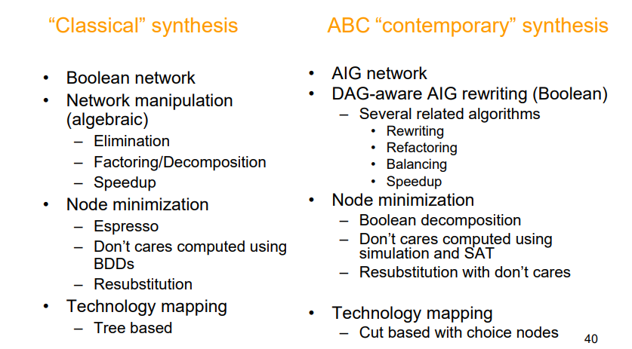
Comparison of Classical vs. AIG Synthesis
Slide Courtesy of Alan Mischenko & Bob Brayton

Slide 60
Thank You

