Slide 1
ECE 260C, Spring 2025 On Manufacturability
Andrew B. Kahng
Kahng ECE 260C SP25

Slide 2
“PPAC” = ?
PPAC is why the industry continues “Moore’s Law scaling”
Must see sufficient benefit from move to the next technology node
Power, Performance, Area
Dynamic/Static power, SAIF/VCD, …
Incremental STA-driven sizing + buffering + synthesis operations
Better floorplans, better P&R tools, better “Opt” (remove overdesign)
What about Cost?
Yield = fraction of chips produced that are “good” (sellable)
Cost of chip: (cost of fabricating, testing a wafer) / (yield * #chips/wafer)
Higher yield is good (Manufacturability); higher #chips/wafer also good (Area)
“good” means passing both functional and parametric criteria
Functional: works correctly
Parametric: is sellable (performs at spec, not too leaky, won’t fail in a week, …)
Kahng ECE 260C SP25

Slide 3
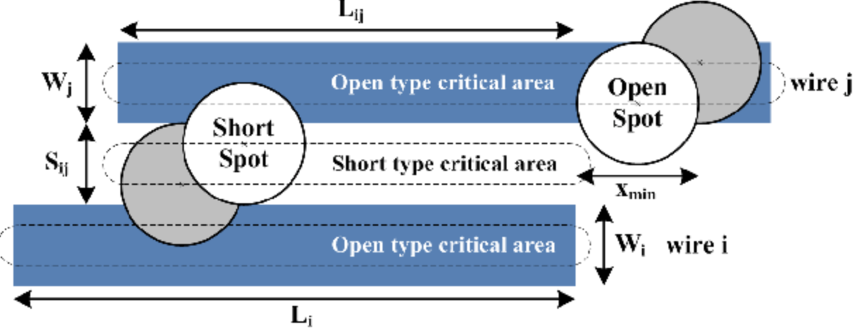
Functional Yield
No physical faults: “opens”, “shorts” etc.
DFT, ATPG, ATE, … spans EDA and Test supplier industries
“Critical area” = vulnerability to particular defect sizes see the dashed outlines
How much of my layout will suffer an “open” if an open spot of a particular size were to randomly appear?
Wider wires → layout is less vulnerable
How much of my layout area will suffer a “short” if extra material of a particular size were to randomly appear?
Wider spaces → layout is less vulnerable
“Spread, Fatten and Fill”
Kahng ECE 260C SP25
Notes:
Critical area – vulnerability to particular defect sizes (see diagram)
The area is the point of center of circular failure spots (open/short) given a specific size of spot
Open fault areas are centered on wire
Closed fault areas are centered on spacing between two wires
→ wider wires = fewer opens, wider spacing = fewer shorts
“Spread (out wires), fatten (wires to make wider), and fill (free area)” methodology in early 2000s to improve manufacturability
Cost of failure goes up by 10x at every stage – problem caught at design time vs manufacturing vs packaging vs shipping vs …

Slide 4
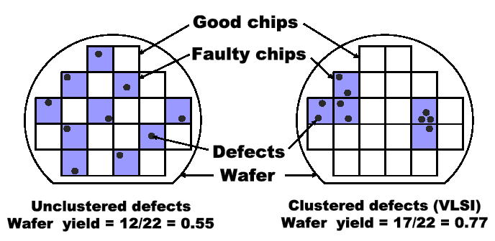
Enormous Engineering Efforts …
Modeling of defects
E.g., clustering
Cleanroom technologies
E.g., factory layout, airflow, robots, …
“Class 1 cleanroom” etc. link
“Design for Manufacturability”
E.g., to first order, make chip smaller (~cubic yield loss w/area)
Better layouts: “Spread, fatten, fill”, avoid risky patterns, follow “recommended rules” aka “DFM rules”, …
Redundancy / error tolerance
Doubled vias and contacts
Error detection/correction in memories
Better OPC / mask flows
DFM → DTCO (design-technology co-optimization) → STCO link link link
Note: hard to cleanly separate timing, power, reliability, yield …
Kahng ECE 260C SP25

Slide 5
NDR, Redundancy Levers

Slide 6
Specification of NDRs in LEF, DEF
…
NONDEFAULTRULE NDR3W3S
LAYER M1
WIDTH 0.07 ;
SPACING 0.07 ;
END M1
LAYER M2
WIDTH 0.21 ;
SPACING 0.21 ;
END M2
LAYER M3
WIDTH 0.21 ;
SPACING 0.21 ;
END M3
….
END NDR3W3S
END LIBRARY
UNITS DISTANCE MICRONS 2000
…
NONDEFAULTRULE NDR3W3S
- net1
+ LAYER M1 WIDTH 140
SPACING 140
+ LAYER M2 WIDTH 420
SPACING 420
+ LAYER M3 WIDTH 420
SPACING 420
….
….
END NONDEFAULTRULES
…
END DESIGN
NDR name
Single-width and –spacing (default rule)
Triple-width and -spacing
DEF
LEF
Notes:
Note the difference in LEF (defined in microns) and DEF (defined in DBU, 2000 DBU = 1 micron)

Slide 7
Track Impact of NDRs
Routable track
Occupied track
Routable Region
track #
9
5
8
4S
3
2S
7
1S
4
6
2
5
4W
wire segment
1W
3
2W
4
1
2
3
2
1
1
(a) 1W1S, track cost = 1
(b) 2W2S, track cost = 3
(c) 4W4S, track cost = 7
Track cost = Number of routing tracks unavailable to the detailed router because of increase in the required spacing to neighboring wires when applying NDRs
Key: Router centers each wire segment on a track gridline

Slide 8
Use of NDRs in Clock Routing
Eliminate noise
Coupling capacitance induces delay uncertainty → increase spacing
Prevent EM violation
Large buffers driving minimum-width wires violate current density limit → wider wires have improved EM/IR robustness
Reduce variation
Smaller geometries and more resistive interconnects (and, multiple patterning steps) induce large variations of parasitics and delays → wider wires have less variation
Reduce power (complementary: reduce skew)
Wide wires have larger capacitance and increase dynamic power → motivates “Smart NDRs” (e.g., by wire tapering) to reduce capacitance
Kahng ECE 260C SP25

Slide 9
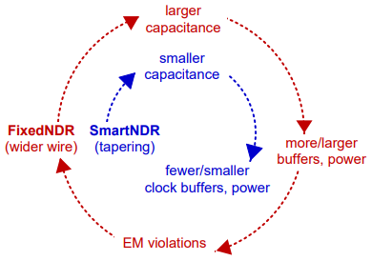
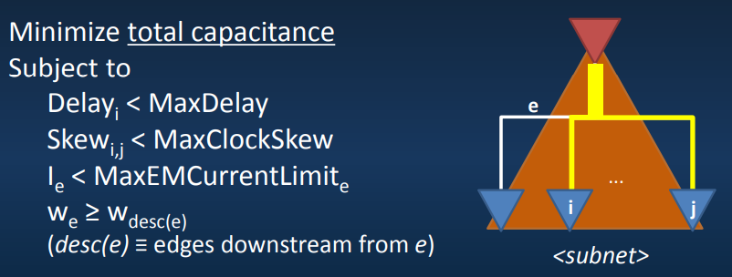
Smart NDRs for Clock Power Reduction link link
Vicious vs. Virtuous cycles: Fixed NDRs vs. Smart NDRs
Can optimize wire segment widths in a clock subnet
Notes:
Smart NDRs
Smaller capacitance → fewer/smaller clock buffers/power usage
Uses tapering – selecting smaller wire segment width in a clock subnet
Avoids viscous cycle (pictured)

Slide 10
Via Doubling For Redundancy
Single-cut via →
Double-cut via (“via doubling”)
During Routing?
or After Routing?
Why redundant vias?
Improve yield: redundant via is “insurance” for via opens
Improve timing yield: the resistance of partially blocked vias increases
Reservoirs of metal for electromigration reliability
Etc.
Observation:
The first 70-80% of vias can be easily doubled even for very congested designs
Notes:
Redundant Vias is a technology for yield improvement, which doubles single-cut via.
Via doubling can be performed during routing or after routing.
Via doubling is recommended by manufacture since it can improve yield, i.e., redundant via is “insurance” for via opens.
It can also improve timing yield since the resistance of partially blocked vias increases which may affect timing yield.
One observation is that 70-80% vias can be easily doubled even for very congested designs.
The question is: can we improve more?

Slide 11
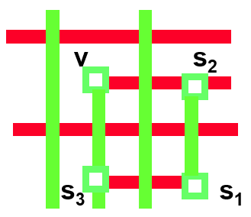
Short-Loop Paths to Add Redundancy
Short-loop paths
Create detours to double vias which cannot otherwise be doubled with an adjacent single via (figure: via “v” is made redundant with a short loop)
Up to 97.5% via doubling coverage by IBM Boeblingen in early 2000’s
May lead to antenna / timing issues
Kahng ECE 260C SP25
Notes:
We may use short loop paths to create detours to double the vias which can not be doubled with single via.
Up to 97.5% via doubling coverage is reported in ISQED 2006 paper.
However, short loop paths may lead to antenna problems and timing issues since it introduce more redundant wires.
So, can we have 100% via doubling coverage with short loop paths?

Slide 12
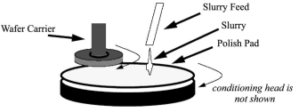
CMP Fill
https://vlsicad.ucsd.edu/Publications/Journals/j40.pdf
https://vlsicad.ucsd.edu/Publications/Journals/j84.pdf
Notes:
CMP (Chemical-Mechanical Planarization/Polishing)
The top of the wafer is polished off with slurry – used to size metal/oxide layers, make chip thinner, and maintain thickness required to reduce lithographic “defocus”

Slide 13
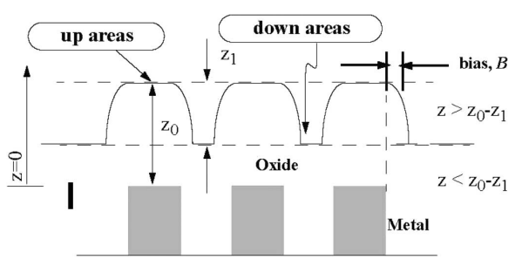
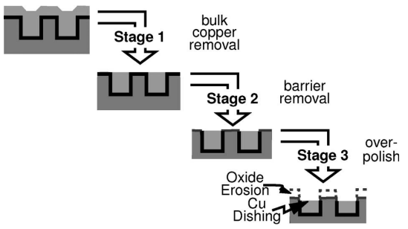
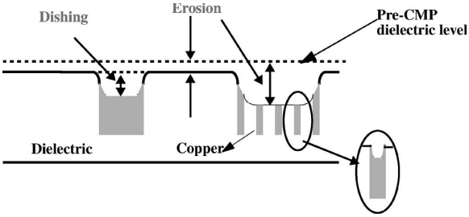
Planarization = Flat Wafer Topography
Planarize oxide
Starting topography depends on layout pattern
Figure: D. Ouma, MIT 1998
Planarize copper
Multiple materials
Erosion of dielectric, dishing of wide (soft) metal → “slotting” needed
Figures: T. Tugbawa, MIT 2002

Slide 14
Manufacturability: Layout Density Control (“Fill”)
Area fill or “dummy fill”: electrically inactive; floating or grounded
Area fill insertion (and, slotting)
Decreases local density variation (→ area density design rules)
Decreases post-CMP interlayer dielectric (ILD) erosion, conductor dishing
CMP: Chemical-Mechanical Polishing (Planarization)
Cf. “Filling and Slotting: Analysis and Algorithms”, ISPD-98
Must satisfy min, max area density limits in all windows of given size and “step” (e.g., density between 20-80% in 100um x 100um windows, with step size = 25um)
Post-CMP ILD thickness
Features
Area fill
features
Notes:
Area insertion must meet (crude) ruleset from foundry.

Slide 15
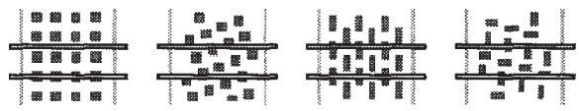
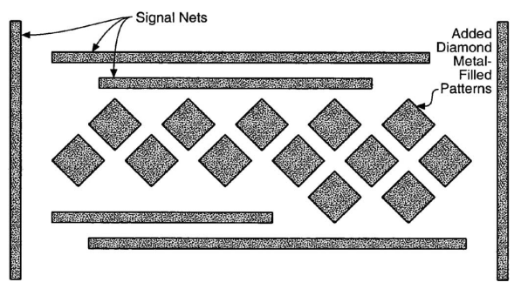
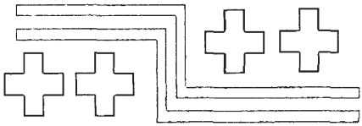
Other Examples https://vlsicad.ucsd.edu/Publications/Journals/j84.pdf
Top (l-r): traditional, staggered, alternating, basket-weave why?
Bottom: diamond and plus-sign patterns
Notes:
Two common modes of dummy fill – tiled/staggered vs. Track-like dummy fill
Tiled reduces capacitances, Larger tiles reduce data sizes for GDS.
Other fill patterns existed (pictured above)
In the 90’s, fill designs were considered highly proprietary to different design houses, with different designs primarily aiming to reduce parasitic coupling

Slide 16
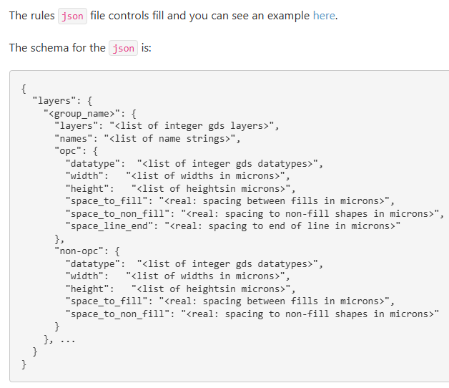
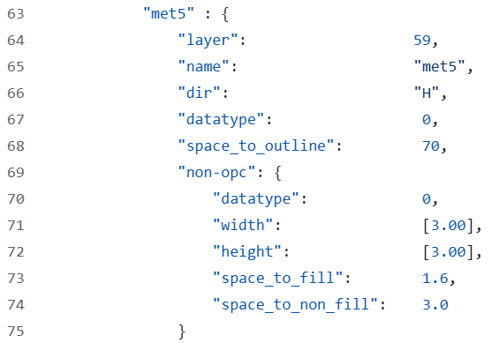
OpenROAD: “max”, “fixed pattern” (types)
https://openroad.readthedocs.io/en/latest/main/src/fin/README.html#example-scripts
“fin” = layout finishing
Metal fill can be part of output gds (foundry can insert fill as well)
SKY130 M5 example: fixed pattern = fixed density of 42.5% (how did I see this?)
Notes:
fin is the layout finishing module in OpenROAD that can insert fills (the foundry can also insert fills after receiving the GDS)
Support for OPC-like fill (thin wires running next to existing wires) and non-OPC fill (rectangular tiles)

Slide 17
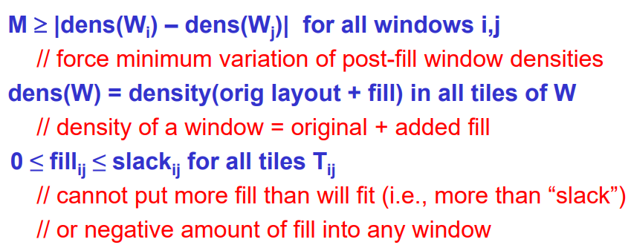
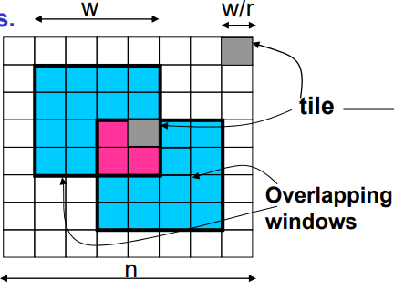
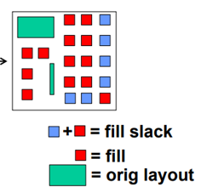
“Smart Fill” https://vlsicad.ucsd.edu/Publications/Journals/j40.pdf
Note: many ways that “dummy fill” can be smarter
Less data volume (GDS, OASIS compressibility)? Friendly to IP reuse? Smooth density gradient? Grounded fill for PI/SI? Timing-aware,-fixing? Control both area and perimeter of metal layout? (see papers at https://vlsicad.ucsd.edu)
One key type of “smarter”: don’t add a maximum amount of fill !!!
Capacitance = delay and power; data volume considerations as well
“Optimal” fill: minimize “M” in the linear program https://vlsicad.ucsd.edu/courses/cse101-w18/slides-w18/cse101-w18-Lecture13-linearprog.pdf
“Fill slack” = maximum amount of fill that can possibly be added into a given “file”

Slide 18
OpenRCX
Thanks: Dimitris Fotakis and David Overhauser

Slide 19
Capacitance Extraction
What is distribution of charge on conductor surfaces and in dielectrics?
Solve Maxwell’s equations → electric field and potential everywhere
C = Q/V → obtain capacitance values
Slow and accurate: 3D field solvers
Quick and dirty: 1D (per-unit length total cap) or 2D (per-unit area cap + per-unit length lateral, fringing cap)
Good in practice: 2.5D ≈ 2D + corrections for adjacent layers
OpenRCX is a 2.5D method
Key challenge: building the (lookup table, interpolation) model for “corrections …”

Slide 20
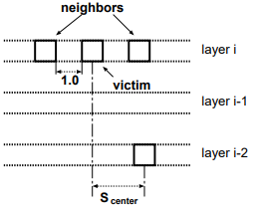
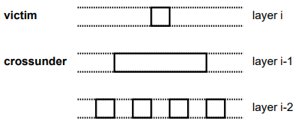
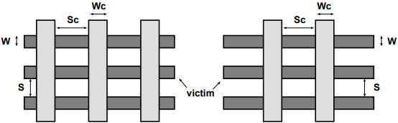
DAC 1997: “Five Foundations”
https://vlsicad.ucsd.edu/Publications/Conferences/69/c69.pdf
Foundations (1997) for lookup tables and interpolations
1. Shielding effects of ground, and same-layer neighbors
2. High metal density on Layer i (e.g., with dummy fill !) decouples Layers i-1, i+1
3. Layers i ± 2 can be treated as ground planes; no need to look beyond
4. Left/right same-layer couplings can be treated independently, and neighbor widths have little impact
5. Above/below crossunders can be treated independently
Systematic design of experiments (patterns), use of field solvers

Slide 21
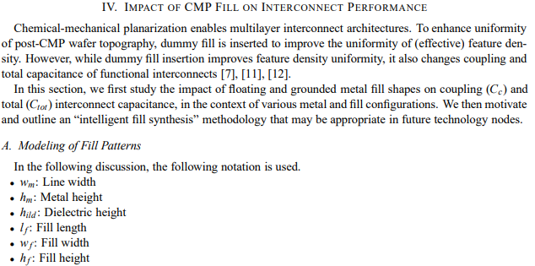
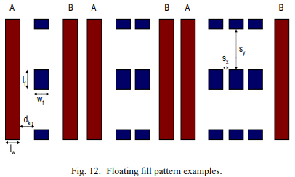

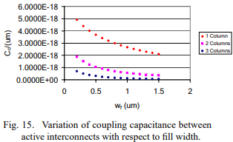
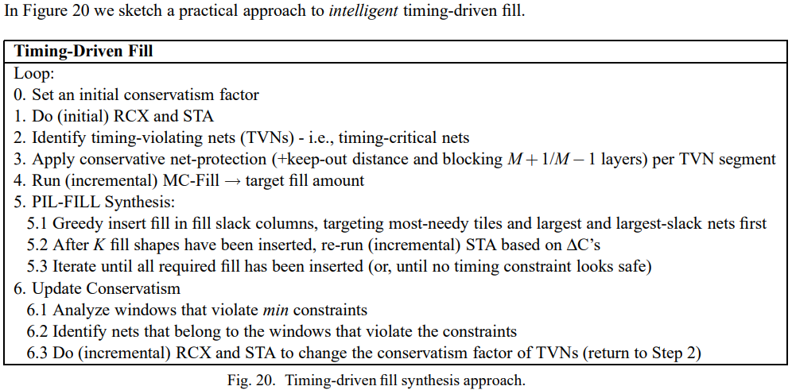
Can Go Much Deeper (e.g., Fill Impact)
https://vlsicad.ucsd.edu/Publications/Conferences/205/c205.pdf

Slide 22
OpenRCX in the Design Flow
No Metal Fill Flow
Metal Fill Flow
Floorplanning
Floorplanning
Placement
Placement
CTS
CTS
Note 1: if metal fill is present in the design it will be extracted as grounded wires.
Note 2: The challenge is that metal fill consideration is much larger area than pattern size; existence of fill must be either explicit or built in the extractor
Routing
Routing
OpenRCX
Metal Fill Gen
Model File (1)
STA
OpenRCX
Model File (1) - No Metal Fill including in Pattern Modeling
STA
Thanks: Dimitris Fotakis and David Overhauser

Slide 23
OpenRCX Internal Flow
Read Design (LEF, DEF, ODB)
Net Connectivity
Read Model File
RC Graph Generation
Build Geometry Structures
Extract Resistance per Wire
Extract Capacitance per Wire
Thanks: Dimitris Fotakis and David Overhauser

Slide 24
Extraction Model Creation

Slide 25
(2.5D) Extraction Model Creation
Determine the characteristics of the process from the foundry technology information (e.g. itf or ict file)
Layer specs, wire shape, dielectrics stack, WEE tables, Thickness tables, Rho tables, …
Create a large number of patterns of interconnect and transistor-level test structures
Interconnect-level test structures differ from transistor-level structures
Run each pattern through a golden reference extractor
Field solver requires proper shape, enlargements, thickness and dielectrics
Based on golden reference results, build extraction models
Verify model results versus test results and design layouts
Thanks: Dimitris Fotakis and David Overhauser

Slide 26
Golden Reference Tool to Build Models
Test Patterns
(physical)
Field
Solver
Golden
Data
e.g. Rapheal, Quickcap, Fast(er)cap
Process
Tech
File
Processor
Extractor Models
Pattern
Generator
Model
Builder
Extractor
OR
e.g. StarRC, Quantus
Test
Patterns
(drawn)
Extensive test pattern coverage helps determine which effects are significant
The model builder decides which effects need to be modeled in the extractor
Golden
Extractor
Golden
Data
Note: OpenRCX does NOT include explicit Metal Fill in the modeling patterns
Thanks: Dimitris Fotakis and David Overhauser

Slide 27
Verifying Models
Test
Patterns
(drawn)
Design
Examples
Golden
Extractor
Golden
Data
Golden
Extractor
Golden
Data
Compare
Compare
Processor
Extractor Models
Processor
Extractor Models
Extractor
Extract
Data
Extractor
Extract
Data
Verify using test patterns (once per process)
Verify using sample designs
Thanks: Dimitris Fotakis and David Overhauser

Slide 28
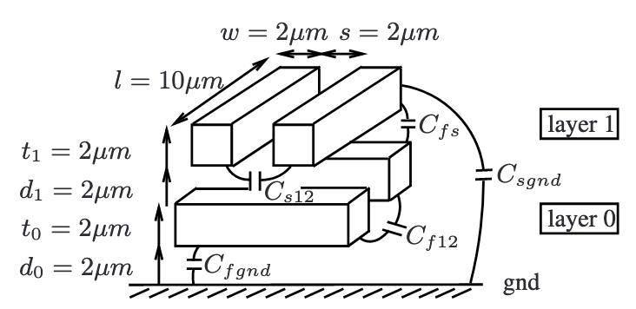
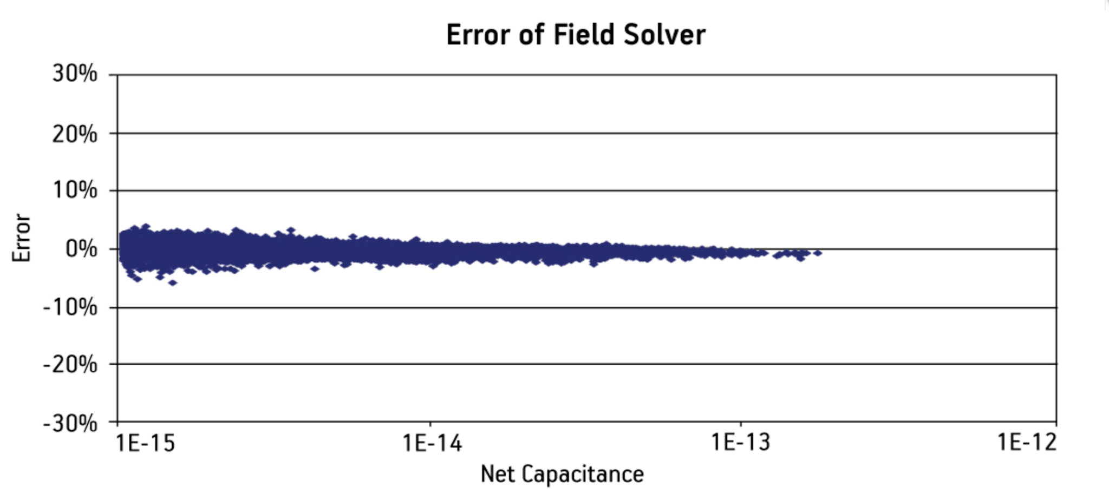
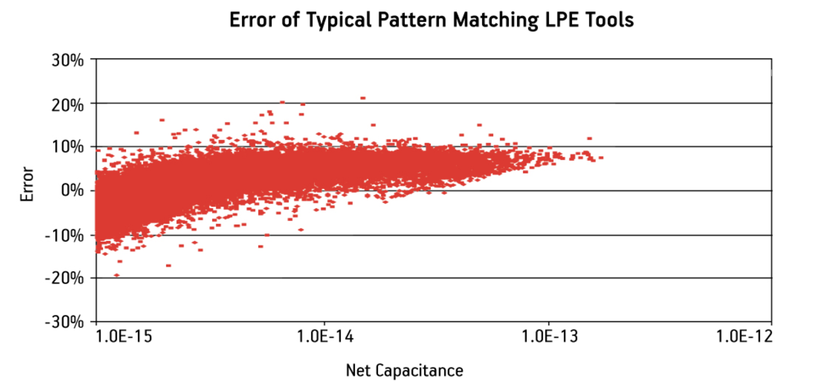
Extraction Accuracy Plots
Field solver error is generally versus a golden reference field solver (e.g. Quickcap vs. Raphael)
Layout Parameter Extractor (LPE) results are compared versus a field solver and LPE models are generally skewed positive so that net capacitance is never underestimated
Thanks: Dimitris Fotakis and David Overhauser

Slide 29
OpenRCX Calibration Patterns
Structures to calibrate OpenRCX are relatively simple
Designed for ~65nm node, in ~2004 !
Coupling capacitances are computed only for same-layer neighbors and parallel diagonal wires
Layers above or below are not necessarily adjacent layers (!)
Min width-centric extraction rules are based on LEF
Non-min width only used on power nets, not signal nets
Non-min width infrastructure added in November 2024
Resistance was also based on LEF, not calculated
Resistance as function of width and spacing added in November 2024
Thanks: Dimitris Fotakis and David Overhauser

Slide 30
OpenRCX Pattern A
Measure
CC_MC_ML
CC_MC_MR
CC_MC_gnd
R_MC
ML
MC
MR
M_s
M_s
M_w
M_w
M_w
Coupling Cap = f(M_w, M_s, M)
Grounded Cap = f(M_w, M_s, M)
R_MC
Thanks: Dimitris Fotakis and David Overhauser

Slide 31
OpenRCX Pattern B
Measure
CC_MC_ML
CC_MC_MR
CC_MC_Munder
CC_MC_gnd
…
ML
MC
MR
…
M_s
M_s
M_w
M_w
M_w
Coupling Cap = f(M_w, M_s, M, Munder)
Grounded Cap = f(M_w, M_s, M, Munder)
Thanks: Dimitris Fotakis and David Overhauser

Slide 32
OpenRCX Pattern C
Measure
CC_MC_ML
CC_MC_MR
CC_MC_Mover
CC_MC_gnd
ML
M_s
MC
M_s
MR
M_w
M_w
M_w
Coupling Cap = f(M_w, M_s, M, Mover)
Grounded Cap = f(M_w, M_s, M, Mover)
Thanks: Dimitris Fotakis and David Overhauser

Slide 33
OpenRCX Pattern D
Measure
CC_MC_ML
CC_MC_MR
CC_MC_Mover
CC_MC_Munder
CC_MC_gnd
ML
M_s
MC
M_s
MR
M_w
M_w
M_w
Coupling Cap = f(M_w, M_s, M, Mover, Munder)
Grounded Cap = f(M_w, M_s, M, Mover, Munder)
Thanks: Dimitris Fotakis and David Overhauser

Slide 34
OpenRCX Pattern E
Measure
CC_MC_OC
CC_MC_gnd
MO_w
OC
OR
ds
MO_s
MC
MR
M_w
M_s
M_w
Diagonal Cap = f(M_w, M_s, ds, M, Mover)
Thanks: Dimitris Fotakis and David Overhauser

Slide 35
Potential Roadmap …
(Deeper dive in May 29 guest lecture: Dimitris Fotakis)
Multi-width and variable spacing
OpenRCX is written to support this
Extraction rules need to be expanded
Coupling capacitance to secondary neighbors
OpenRCX and rules still need to support
Resistance dependent on neighbor
Merged in November 2024
Lithography effects
Handled at model creation (drawn to physical) for field solver
Thanks: Dimitris Fotakis and David Overhauser

Slide 36
Non-Symmetric Coupling to 1st, 2nd Neighbors
Not currently implemented, but infrastructure exists as of November 2024 (see extFlow_v2, extmain_v2 etc.)
w2
w1
w3
M
s1
M
s2
M
s3
CC
Cg
Coupling Cap= function(w, s, M), height is set
Fringe (Ground) Cap= function(w, s, M)
Thanks: Dimitris Fotakis and David Overhauser

Slide 37
More? E.g., HVH Routing
A2_w
A2_s
A1rn
A1_w
Measure
CC_MC_ML1
CC_MC_MR1
CC_MC_A1C
CC_MC_A2C
CC_MC_B1C
CC_MC_B2C
CC_A1C_B1C
CC_MC_A2r1
R_MC
…
A2_offset
A1r1
A1_s
A1C
A2ln
…
A2l1
A2C
A2r1
…
A2rn
A1f1
…
B1rn
…
A1fn
B1r1
B1_s
B1C
Ml_n
ML1
MC
MR1
Mr_n
B1_w
…
ML_s
MR_s
…
B1f1
…
ML_w
MC_w
MR_w
B1fn
B2ln
…
B2l1
B2C
B2r1
…
B2rn
B2_w
B2_s
Typical density area (50um)²
Thanks: Dimitris Fotakis and David Overhauser

