Slide 1



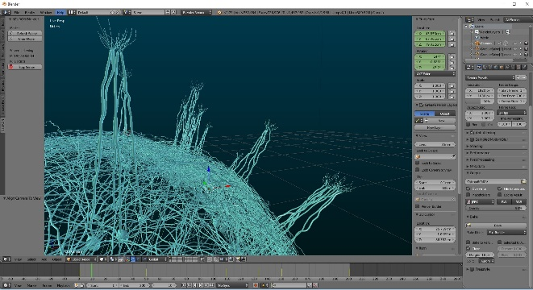

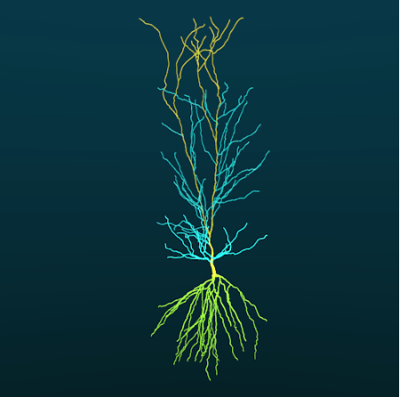
.org
NEURON Python Library
Blender Add-on
from blenderneuron import neuronstart

