Slide 1
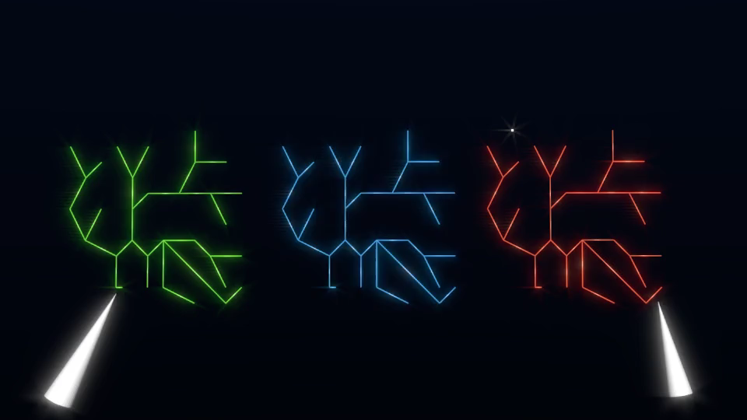

Neuron A
Neuron B
Neuron C
-75 mV
35 mV

