Slide 1



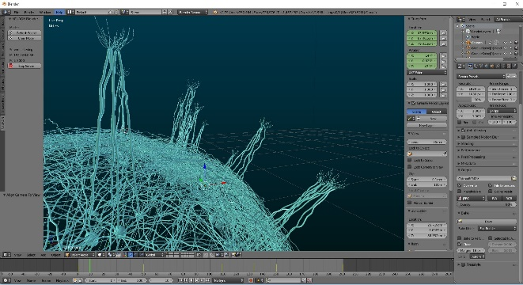

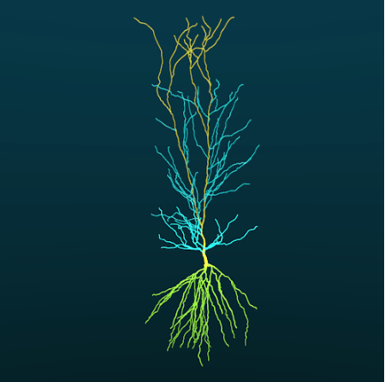
.org
NEURON HOC/Python Library
Blender Add-on

