Slide 1
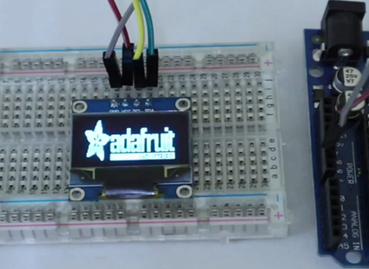
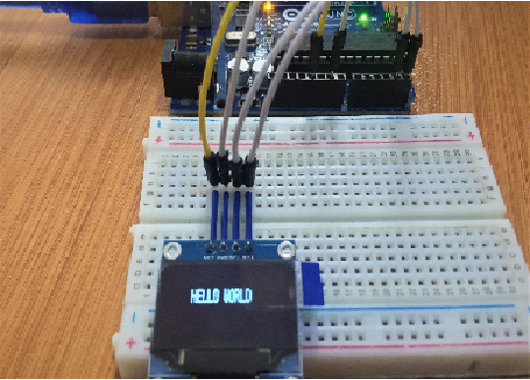
Interfacing of OLED
www.ableducation.com
www.ablkart.com

Slide 2
OLED
OLED (Organic Light-Emitting Diode) is a self light-emitting technology composed of a thin, multi-layered organic film placed between an anode and cathode. In contrast to LCD technology, OLED does not require a backlight.
OLED possesses high application potential for virtually all types of displays and is regarded as the ultimate technology for the next generation of flat-panel displays.
www.ableducation.com
www.ablkart.com

Slide 3
Working of OLED
The main component in an OLED display is the OLED emitter - an organic (carbon-based) material that emits light when electricity is applied. The basic structure of an OLED is an emissive layer sandwiched between a cathode (which injects electrons) and an anode (which removes electrons).
www.ableducation.com
www.ablkart.com

Slide 4
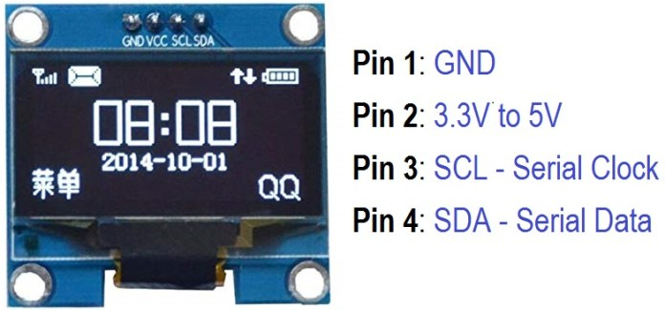
Pin Diagram of OLED
www.ableducation.com
www.ablkart.com

Slide 5
Components Required
Arduino UNO Board
0.96″ I2C OLED Display
Breadboard
Connecting Wires
www.ableducation.com
www.ablkart.com

Slide 6
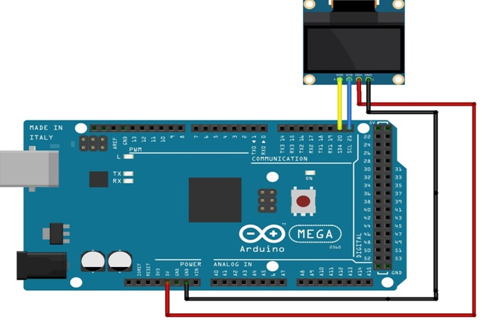
Connection Diagram
www.ableducation.com
www.ablkart.com

Slide 7
Connections
Connect the pins of OLED with the following pins of Arduino Mega , as shown below.
5v--------------------VCC
GND-----------------GND
SDA of arduino--------------SDA
SCL of arduino---------------SCL
www.ableducation.com
www.ablkart.com

Slide 8
Install Required Libraries
Adafruit_GFX.h https://github.com/adafruit/Adafruit-GFX-Library
Adafruit_SSD1306.h https://www.github.com/adafruit/Adafruit_SSD1306
Wire.h this library will be installed by default.
www.ableducation.com
www.ablkart.com

Slide 9
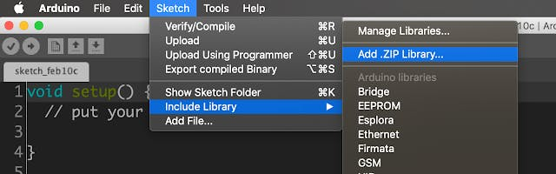
Either you can download the libraries from github and add the ZIP file in Arduino IDE using add.zip library option.
www.ableducation.com
www.ablkart.com

Slide 10
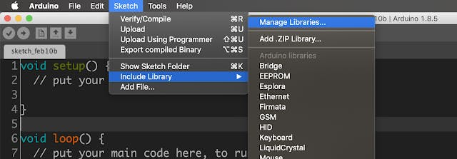
Or you can install the libraries directly from Arduino IDE from Manage Libraries.
Follow the below steps to install.
www.ableducation.com
www.ablkart.com

Slide 11
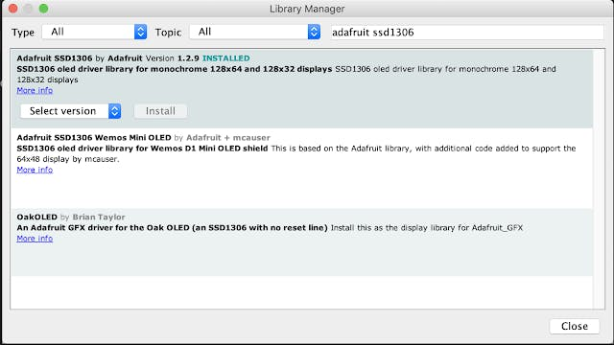
Open manage library from sketch -> include library -> manage libraries.
Then search for AdafruitSSD1306 and click on the install button.
www.ableducation.com
www.ablkart.com

Slide 12
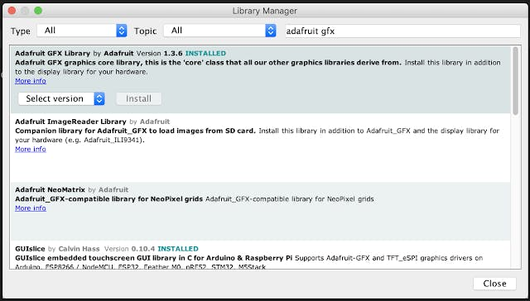
Then search for the Adafruit GFX and click the install button. Now we have successfully installed the required libraries for this project.
www.ableducation.com
www.ablkart.com

Slide 13
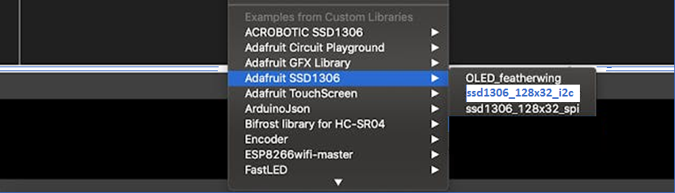
Adafruit Example Code
Let's upload the adafruitSSD1306 library example program and test our setup.Open the example program from File -> Examples -> Adafruit SSD1306 -> ssd1306_128x32_i2c, because We are using OLED display with I2C interface with the screen size of 128x64.
www.ableducation.com
www.ablkart.com

Slide 14
Project Link : https://youtu.be/7xWjEkj3oxs
www.ableducation.com
www.ablkart.com

