Slide 1
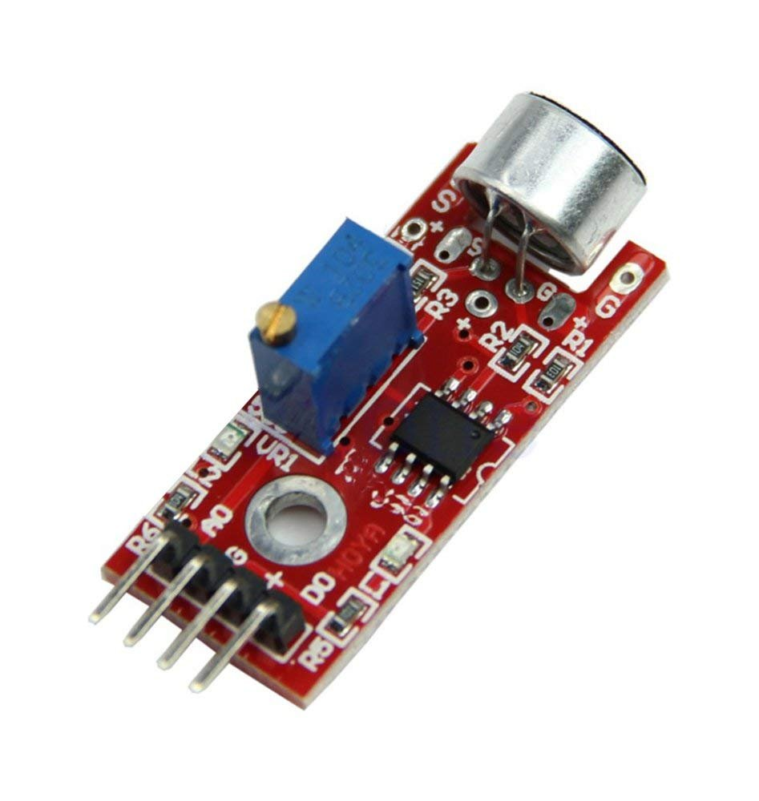
Interfacing of Sound sensor module with Arduino Mega
www.ablkart.com

Slide 2
Sound sensor
The Sound sensor module provides an easy way to detect sound and is generally used for detecting sound intensity.
When the sensor detects a sound, it processes an output signal voltage which is sent to a microcontroller then performs necessary processing.
The Sound Detector is a small board that combines a microphone and some processing circuitry. It provides not only an audio output, but also a binary indication of the presence of sound, and an analog representation of it's amplitude.
www.ablkart.com

Slide 3
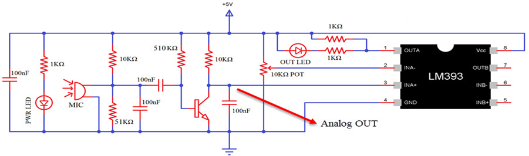
Schematic of Sound Sensor
There are several Sound Sensor Modules available in the market that are implemented using different ICs like LM324, LM393, LM344, LM386 etc. So, check your sound sensor for the main IC and determine its schematic.
To understand more about the sound sensor module, know the schematic. Below is LM393 Voltage Comparator IC.
www.ablkart.com

Slide 4
How does it works?
The Sound sensor has a thin piece of material called a diaphragm that vibrates when hit by sound waves (similar to how your eardrum vibrates when hearing sound).
The vibration of the diaphragm is converted by the sensor into an electrical signal.
www.ablkart.com

Slide 5
Components required
Arduino Mega
Sound sensor module
LED
USB cable
Breadboard
Jumper wires(male to male)
www.ablkart.com

Slide 6
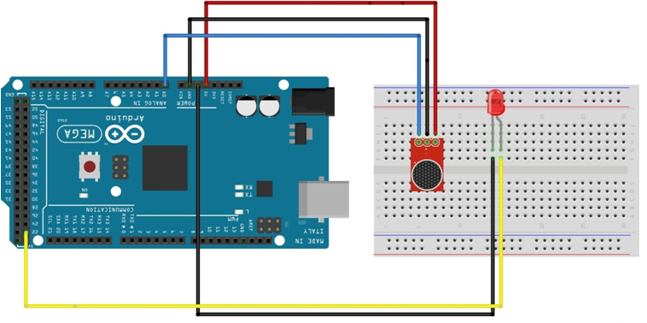
Connection Diagram
www.ablkart.com

Slide 7
Connections
Connect A0 pin of sound sensor with A0 pin of Arduino Mega.
Connect Vcc and GND(ground) pin of sound sensor with Arduino 5V and GND respectively.
Connect LED Positive pin to 22 (digital pin ) of Arduino.
Connect LED’s ground pin with Arduino GND pin.
www.ablkart.com

Slide 8
Project Link : https://youtu.be/VCNgzr_5y_g
www.ablkart.com

