Slide 1
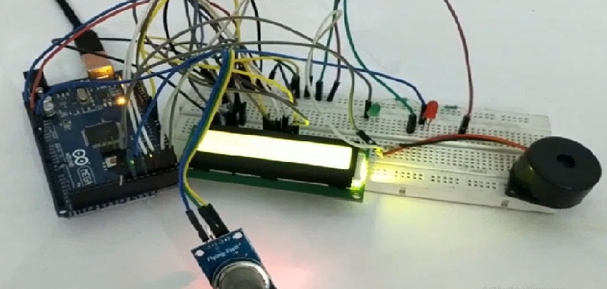
Pollution Detector
www.ablkart.com

Slide 2
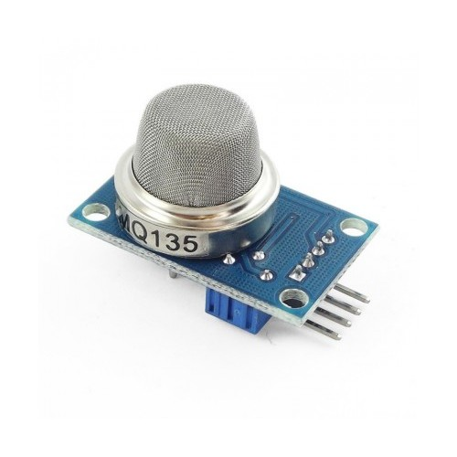
Air Quality Sensor(MQ-135)
MQ135 Gas Sensor module for Air Quality having Digital as well as Analog output. Sensitive material of MQ135 gas sensor is SnO2, which with lower conductivity in clean air. When the target combustible gas exist, The sensors conductivity is more higher along with the gas concentration rising. MQ135 gas sensor has high sensitivity to Ammonia, Sulphide and Benze steam, also sensitive to smoke and other harmful gases. It is with low cost and suitable for different application.
.
www.ablkart.com

Slide 3
Working of MQ135 (Air Quality Sensor)
The MQ-135 gas sensor senses the gases like ammonia nitrogen, oxygen, alcohols, aromatic compounds, sulfide and smoke.
MQ-135 gas sensor can be implementation to detect the smoke, benzene, steam and other harmful gases. It has potential to detect different harmful gases.
The MQ-135 Gas sensor consists of a tin dioxide (SnO2), a perspective layer inside aluminium oxide micro tubes (measuring electrodes) and a heating element inside a tubular casing.
The end face of the sensor is enclosed by a stainless steel net and the back side holds the connection terminals.
www.ablkart.com

Slide 4
Working of MQ135 (Air Quality Sensor)
Ethyl alcohol present in the breath is oxidized into acetic acid passing through the heat element. With the ethyl alcohol cascade on the tin dioxide sensing layer, the resistance decreases.
By using the external load resistance the resistance variation is converted into a suitable voltage variation.
www.ablkart.com

Slide 5
Working of project
Basically in this project we have interfaced Air quality sensor with Arduino Mega to check the level of smoke(impurities) in the environment which has been shown on 16x2 LCD display. At normal level, green led will glow and as the smoke level increases, red led will glow and alert will create through buzzer.
www.ablkart.com

Slide 6
Components required
Arduino Mega
MQ-135
Big buzzer
LEDs
Resistors(220ohm)
Breadboard
Jumper wires
16x2 LCD
Potentiometer
www.ablkart.com

Slide 7
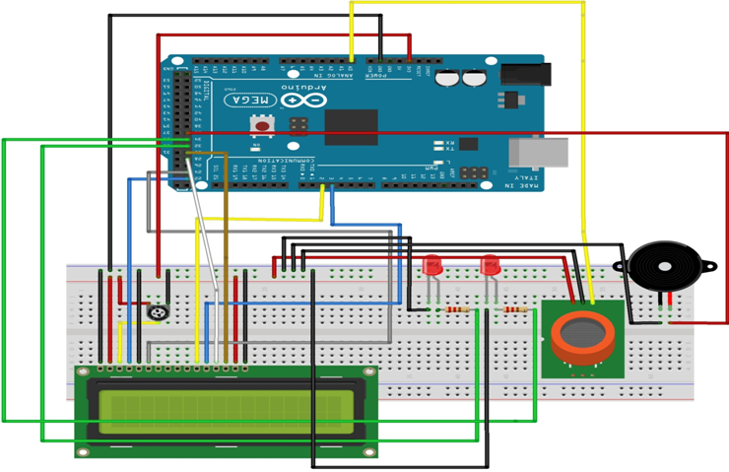
Connection Diagram
www.ablkart.com

Slide 8
MQ135 sensor and other connections :
Connect A0 pin of MQ135 sensor with A0 pin of Arduino Mega.
Connect Vcc and GND(ground) pin of MQ135 sensor with Arduino’s 5V and GND respectively.
Connect LED 1 positive with 32 pin of Arduino and LED’s negative with GND of Arduino.(Connect resistor of 220 ohms)as shown in interfacing circuit.
Connect LED 2 positive with 34 pin of Arduino and LED’s negative with GND of Arduino .(Connect resistor of 220 ohms)as shown in interfacing circuit.
Connect buzzer’s positive with 36 pin of Arduino and buzzer’s negative with GND of Arduino.
www.ablkart.com

Slide 9
Connections for LCD :
PIN1 or VSS to ground
PIN2 or VDD or VCC to +5v power
PIN3 or VEE to potentiometer (gives maximum contrast best for a beginner)
PIN4 or RS (Register Selection) to PIN22 of ARDUINO
PIN5 or RW (Read/Write) to ground
PIN6 or E (Enable) to PIN24 of ARDUINO
PIN11 or D4 to PIN2 of ARDUINO
PIN12 or D5 to PIN3 of ARDUINO
PIN13 or D6 to PIN28 of ARDUINO
PIN14 or D7 to PIN30 of ARDUINO
PIN15 or A to +5V of ARDUINO
PIN16 or K to GND of ARDUINO
www.ablkart.com

Slide 10
Project Link : https://youtu.be/q8mjT8qvMos
www.ablkart.com

