Slide 1
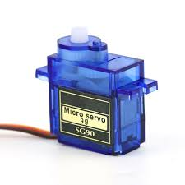
Interfacing of Servo motor SG90
ablkart.com

Slide 2

Servo Motor
A Servo motor is an electrical device which can push or rotate an object with great precision. If you want to rotate and object at some specific angles or distance, then you use Servo motor. It is just made up of simple motor which run through servo mechanism.
It consists of three parts:
Controlled device
Output sensor
Feedback system
ablkart.com

Slide 3
Working principle of Servo motor
A Servo consists of a Motor (DC or AC), a potentiometer, gear assembly and a controlling circuit.
First of all we use gear assembly to reduce RPM and to increase torque of motor.
Say at initial position of servo motor shaft, the position of the potentiometer knob is such that there is no electrical signal generated at the output port of the potentiometer.
Now an electrical signal is given to another input terminal of the error detector amplifier.
Now difference between these two signals, one comes from potentiometer and another comes from other source.
ablkart.com

Slide 4
Working principle of Servo motor
It will be processed in feedback mechanism and output will be provided in term of error signal.
This error signal acts as the input for motor and motor starts rotating.
Now motor shaft is connected with potentiometer and as motor rotates so the potentiometer and it will generate a signal.
So as the potentiometer’s angular position changes, its output feedback signal changes. After sometime the position of potentiometer reaches at a position that the output of potentiometer is same as external signal provided.
ablkart.com

Slide 5
Components Required
Arduino Mega
Servo Motor
Jumper wires
ablkart.com

Slide 6
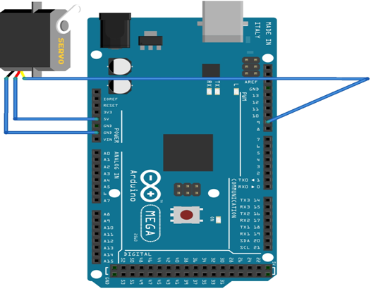
Connection Diagram
7pin
VCC
Ground
ablkart.com

Slide 7
Connections
Connect Red wire of servo with VCC(+5V) of Arduino.
Connect Black wire of servo with GND of Arduino.
Connect orange wire of servo with 9 pin Arduino.
ablkart.com

Slide 8
Project Link : https://youtu.be/c-E_ZuoaPYE
ablkart.com

