Slide 1
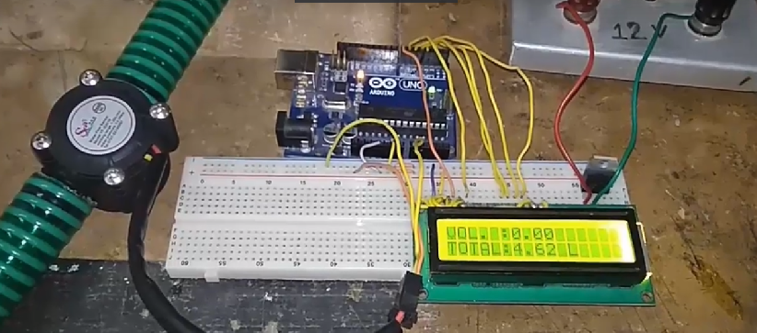
Water flow rate and Volume measurement
www.ablkart.com

Slide 2
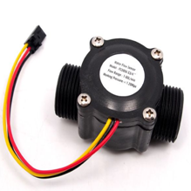
Water Flow sensor
Water Flow sensors are installed at the water source or pipes to measure the rate of flow of water and calculate the amount of water flowed through the pipe. Rate of flow of water is measured as liters per hour or cubic meters. Water flow sensor consists of a plastic valve from which water can pass. A water rotor along with a hall effect sensor is present the sense and measure the water flow.
When water flows through the valve it rotates the rotor. By this, the change can be observed in the speed of the motor. This change is calculated as output as a pulse signal by the hall effect sensor. Thus, the rate of flow of water can be measured.
www.ablkart.com

Slide 3
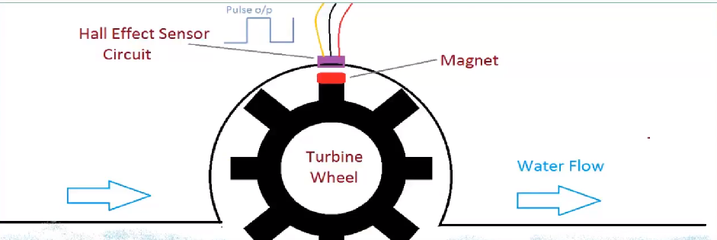
Working principle
The main working principle behind the working of this sensor is the Hall effect.
According to this principle, in this sensor, a voltage difference is induced in the conductor due to the rotation of the rotor.
This induced voltage difference is transverse to the electric current.
www.ablkart.com

Slide 4
Water flow sensors can measure the rate of flow of water either by measuring velocity or displacement.
These sensors can also measure the flow of water like fluids such as measuring milk in a dairy industry etc..
These sensors can be easily interfaced with microcontrollers like Arduino. For this, an Arduino microcontroller board for processing, a Hall effect water flow sensor, a 16×2 LCD display, and Breadboard connecting wires are required. The sensor is placed at the water source inlet or at the opening of the pipe.
www.ablkart.com

Slide 5
Components required
Arduino Mega
Water flow sensor
16x2 LCD
Jumper wires
Potentiometer(10k)
Breadboard
www.ablkart.com

Slide 6
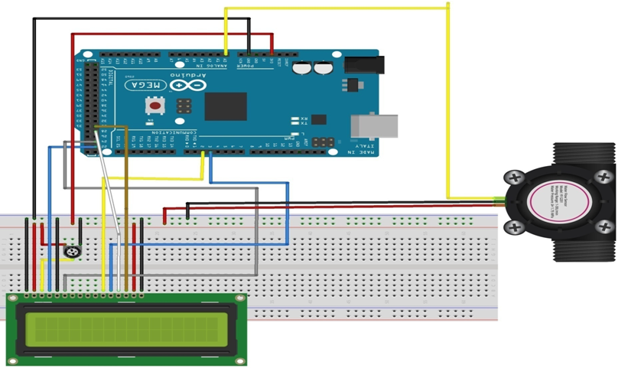
Connection Diagram
www.ablkart.com

Slide 7
Water flow sensor connections
Connect A0 pin of water flow sensor with A0 pin of Arduino Mega.
Connect Vcc and GND(ground) pin of water flow sensor with Arduino 5V and GND respectively.
www.ablkart.com

Slide 8
Connections for LCD :
PIN1 or Vss to ground
PIN2 or Vdd or Vcc to +5V power
PIN3 or Vee to potentiometer (gives maximum contrast best for a beginner)
PIN4 or RS (Register Selection) to PIN22 of Arduino
PIN5 or RW (Read/Write) to ground
PIN6 or E (Enable) to PIN24 of Arduino
PIN11 or D4 to PIN2 of Arduino
PIN12 or D5 to PIN3 of Arduino
PIN13 or D6 to PIN28 of Arduino
PIN14 or D7 to PIN30 of Arduino
PIN15 or A to +5V of Arduino
PIN16 or K to GND of Arduino
www.ablkart.com

Slide 9
Project Link : https://youtu.be/kbKnLTPTNbg
www.ablkart.com

