Slide 1
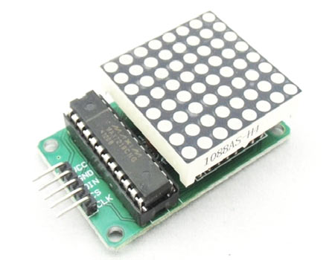
Interfacing of 8x8 LED Matrix with Arduino Mega
www.ablkart.com

Slide 2
What is 8x8 LED matrix
An 8 x 8 LED matrix display is used in this project to display the information. LED matrices are available in different styles like single color, dual color, multi-color or RGB LED matrix.
They are also available in different dimensions like 5 x 7, 8 x 8, 16 x 16, 32 x 32 etc. Based on the arrangement of the LEDs in the matrix, an LED matrix can be either common row anode or common row cathode.
In case of common row anode type LED matrix, the current sources (high or positive voltage) are given to the rows A-D and the current sinks (low or negative voltage or ground) are given to the columns 1-4.
www.ablkart.com

Slide 3
What is 8x8 LED matrix
In case of common row cathode type LED matrix, the current sources (high or positive voltage) are given to the columns 1-4 and the current sinks (low or negative voltage or ground) are given to the rows A-D.
www.ablkart.com

Slide 4
IC MAX 7219
The LED matrix can be driven in two ways. They are parallel (where each row or column are sent with parallel data) and serial (where the data is sent serially and an IC is used to convert this serial data into parallel data).
MAX 7219 is a common cathode display driver with serial input and parallel output. It is used to interface microprocessors and microcontrollers with 64 individual LEDs (8 x 8 LED matrix for example has 64 LEDs), seven segment LED displays up to 8 digits or bar graph displays.
The 8 x 8 LED matrix is connected to the MAX 7219 as shown in the circuit diagram and the data input is received from the Arduino board to the MAX 7219.
www.ablkart.com

Slide 5
Working of 8x8 LED matrix
In this interfacing, there will be a simple interface between Arduino and 8X8 LED Matrix to display information (even scrolling information and images can be displayed).
Even though a single 8 x 8 LED matrix with corresponding MAX 7219 IC is used in this interfacing, multiple LED matrices can be connected in series for long scrolling display.
www.ablkart.com

Slide 6
The working of the system is as follows:-
3 of the 14 available digital input / output pins are used to control the display driver IC MAX 7219. The 3 pins on the MAX7219 IC are clock, data in and load (or cs in case of MAX 7221 IC). A maximum clock frequency of 10MHz can be applied. DIN (Data in) accepts the serial data from the microcontroller or Arduino board.
It is 16 bit long where the first 8 bits (D0 – D7) are for driving the columns (SEG A-G and DP of the MAX 7219 IC) of the LED matrix and the next 8 bits (D8 – D15) are for driving the (DIG 0-7 of the MAX 7219 IC) rows of the LED matrix.
www.ablkart.com

Slide 7
The load pin (or CS or chip select pin in case of Max 7221 IC) latches the serial input data on its rising edge.
Another important pin on MAX 7219 is the ISET, which sets the peak current to the segment to drive all the LEDs. It is connected via a resistor (R1), which is called RSET. The capacitors filters out any noise in the supply.
When the serial data in is sent using the Arduino (through the program), the serial data is converted into segments and digits to drive columns and rows of the LED matrix. According to the data sent, the corresponding LEDs on the matrix light up and display the message.
www.ablkart.com

Slide 8
The program written here is for scrolling text display. It might be difficult to view long scrolling data on a single 8 x 8 LED matrix. Hence, multiple LED matrices can be chained to form a long matrix.
The no. of MAX 7219 ICs are equal to the no. of 8 x 8 LED matrices. In order to extend the display to multiple LED matrices, the Data OUT (DOUT) pin of the first MAX 7219 must be connected to the Data IN (DIN) pin of the second MAX 7219 IC. This process must be continued for multiple LED matrices.
(The positioning of the LED Matrix in the chain is important. The first LED matrix must be placed at the right of the chain.)
www.ablkart.com

Slide 9
Components Required:
Arduino Mega
8x8 LED Matrix
USB Cable
Jumper wires
BreadBoard
www.ablkart.com

Slide 10
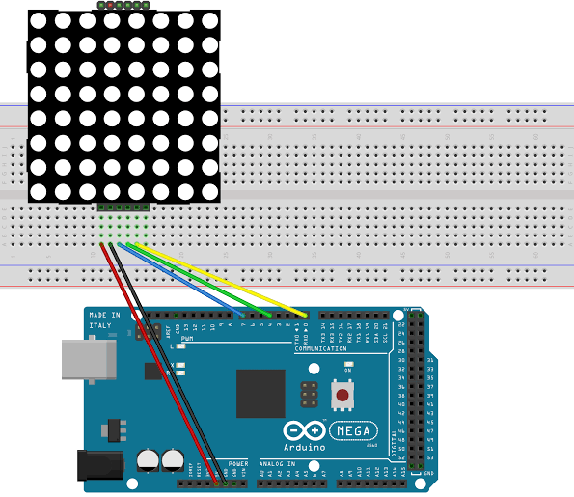
Connection Diagram
www.ablkart.com

Slide 11
Connections
Connect Vcc to +5V of Arduino.
Connect GND with GND pin of Arduino.
Connect DIN with 7 pin of Arduino.
Connect CLK with 6 pin of Arduino.
Connect CS with 5 pin of Arduino.
www.ablkart.com

Slide 12
Project Link : https://youtu.be/g0HrDOkY_Pc
www.ablkart.com

