Slide 1
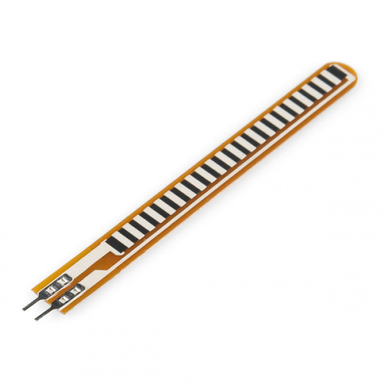
Interfacing of Flex sensor
ablkart.com

Slide 2
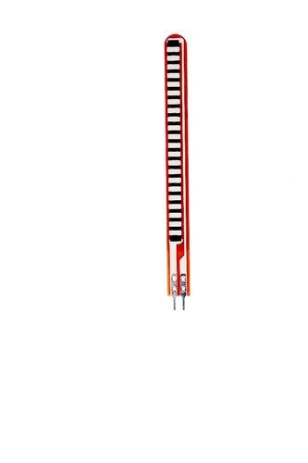
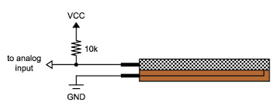
Flex sensor
A Flex sensor or Bend sensor is a sensor that measures the amount of deflection or bending . Usually, the sensor is stuck to the surface, and resistance of sensor element is varied by bending the surface. Since the resistance is directly proportional to the amount of bend it is used as goniometer, and often called flexible potentiometer.
ablkart.com

Slide 3
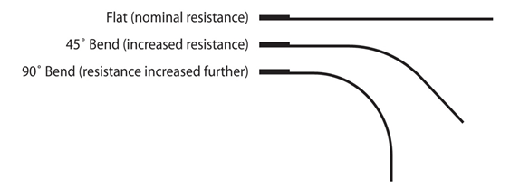
Working of Flex sensor
This sensor works on the bending strip principle which means whenever the strip is twisted then its resistance will be changed. This can be measured with the help of any controller. This sensor works similar to a variable resistance because when it twists then the resistance will be changed.
ablkart.com

Slide 4
Components Required
Arduino Mega
Flex Sensor
LED
BreadBoard
Resistor 10kohms
Jumper wires
ablkart.com

Slide 5
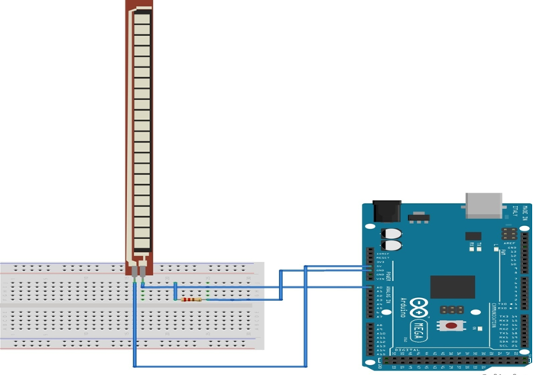
Connection Diagram
A0
Ground
VCC
ablkart.com

Slide 6
Connections
Connect first pin of flex sensor with A0 of Arduino.
Connect first pin again with resistor of 10k and then connect resistor with ground pin of Arduino.
Connect another pin of flex sensor with Vcc (+5V) of Arduino.
Now connect positive of LED with 22 pin of Arduino.
Connect negative of LED with ground of Arduino.
ablkart.com

Slide 7
Project link : https://youtu.be/W9sV0owZa78
ablkart.com

