Slide 1
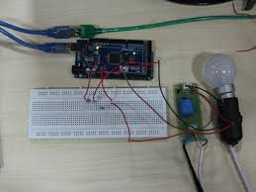
Automatic Street Light Control
www.ablkart.com

Slide 2
Two Channel relay
A relay is defined as an electrically operated switch; their main use is controlling circuits by a low-power signal or when several circuits must be controlled by one signal. This module incorporates 2 relays.
www.ablkart.com

Slide 3
Working of Two Channel relay :
The relay has two outputs-normally open and normally closed (NO and NC). When the IN1 or IN2 pin is connected to ground, NO will be open and NC will be closed, and when IN1 or IN2 is not connected to ground the opposite occurs. Connecting a circuit or device between one of these two pins, the common pin on the relay output, and a power source will allow you to toggle power to a circuit or device.
Connect an LED and 220 ohm resistor in series between the NO pin (the right pin) on the terminal block on one of the relays and ground, then connect a 5V power source to the common pin (the left pin) on one of the relays. Nothing will happen (yet).
www.ablkart.com

Slide 4
Next connect a toggle switch or button between ground and one of the middle two pins on the header strip on the relay module. The middle-left one corresponds to the left relay, and the middle-right one corresponds to the right relay. Connect the rightmost pin to 5V and the leftmost pin to ground.
When the switch is flipped or the button is pressed, either IN1 or IN2 will become connected to ground. The relay should make a loud click and the LED should turn on. A microcontroller can also be used to control IN1 and/or IN2 and cause the relay to trip.
www.ablkart.com

Slide 5
Working of LDR sensor
Reading a photo sensor with the Arduino Mega:
We will use a LDR and a resistor together in series. An LDR is simply a device that changes resistance based on ambient light. The brighter the light, the lower the resistance, the dimmer the light, the higher the resistance.
When there is no light , LDR will offer high resistance and less current flows through the resistor and voltage across resistor will be less near to GND.
When light falls on LDR, its resistance decreases and current flow through it increases. Then voltage across the resistor increases and pin 22 gets a HIGH signal.
www.ablkart.com

Slide 6
Working of project
When light does not fall on LDR, its resistance increases and current flow through it decreases. Then voltage across the resistor decreases and relay (work as switch) will allow the bulb to HIGH(glow).
When light falls on LDR, its resistance decreases and current flow through it increases. Then voltage across the resistor increases and relay (work as switch) will allow the bulb to LOW.
www.ablkart.com

Slide 7
Components Required:
Arduino Mega
Double channel relay module
LDR Sensor
Resistor (10k)
Bulb
Bulb holder
Electrical wire with plug
USB Cable
Jumper wires
Breadboard
www.ablkart.com

Slide 8
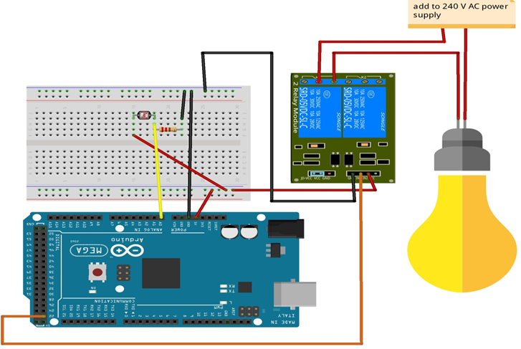
Connection Diagram
www.ablkart.com

Slide 9
Connections
Connect NO2 pin of relay with bulb holder pin through electrical wire.
Connect one electrical wire with COM2 pin of relay .
Connect one electrical wire with another pin of bulb holder.
Connect 1st pin of LDR sensor with A0 pin of Arduino.
Connect resistor(10k) with 1st pin of LDR sensor.
Then connect resistor’s another end with GND pin of Arduino
Connect 2nd pin of LDR sensor with (+5V) of Arduino.
Connect GND pin of relay with GND pin of Arduino and Vcc pin with Vcc(+5V) of Arduino.
Then connect INT2 pin with 22 pin of Arduino.
www.ablkart.com

Slide 10
Project Link : https://youtu.be/nOqQF9tpz5s
www.ablkart.com

