Slide 1
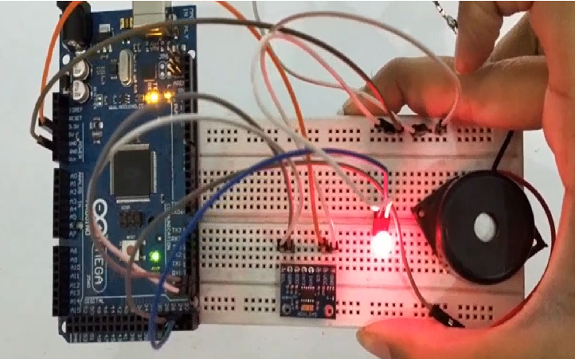
Earthquake Detector
www.ablkart.com

Slide 2
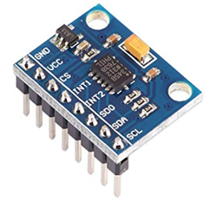
Accelerometer(ADXL345)
The ADXL345 is a small, thin, ultralow power, 3-axis accelerometer with high resolution (13-bit) measurement at up to ±16 g.
Digital output data is formatted as 16-bit two’s complement and is accessible through either a SPI (3- or 4-wire) or I2C digital interface.
The ADXL345 is well suited for mobile device applications. It measures the static acceleration of gravity in tilt-sensing applications, as well as dynamic acceleration resulting from motion or shock.
www.ablkart.com

Slide 3
Working of Accelerometer
This is a 3-axis accelerometer which can measure both static and dynamic forces of acceleration.
The unit of measurement for acceleration is meter per second squared (m/s^2). However, accelerometer sensors usually express the measurements in “g” or gravity. One “g” is the value of the earth gravitational force which is equal to 9.8 meters per second squared.
So, if we have an accelerometer positioned flat, with its Z-axis pointing upwards, opposite to the gravitational force, the Z-axis output of the sensor will be 1g. On the other hand, the X and Y outputs will be zero, because the gravitational force is perpendicular to these axes and doesn’t affect them at all.
www.ablkart.com

Slide 4
Working of project
In this project we will learn how to design Arduino Earthquake Detector Alarm with ADXL345. We have used ADXL345 3 axis Accelerometer as a sensor for detecting tilting, trembling or any shaking movement of earthquake. We have interfaced ADXL335 Accelerometer with Arduino and buzzer which creates alarm as Arduino Earthquake Detector Alarm .
www.ablkart.com

Slide 5
Components required
Arduino mega
ADXL345 Accelerometer
Big buzzer
LED
Bread board
Jumper wires
www.ablkart.com

Slide 6
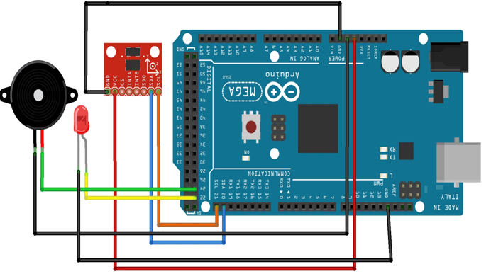
Connection Diagram
www.ablkart.com

Slide 7
Connections
Connect SDA pin of ADXL345 with 20 pin of Arduino.
Connect SCL pin of ADXL345 with 21 pin of Arduino.
Connect its Vcc with Arduino (+5V).
Connect its GND with Arduino GND.
Connect LED’s positive with 22 pin of Arduino and its negative with GND pin of Arduino.
Connect Buzzer’s positive with 24 pin of Arduino and its negative with GND pin of Arduino.
www.ablkart.com

Slide 8
Project Link : https://youtu.be/xVdbXf8STaY
www.ablkart.com

