Slide 1

Interfacing of MQ135 Air Quality Sensor
www.ablkart.com

Slide 2

Air Quality Sensor(MQ-135)
MQ135 Gas Sensor module for Air Quality having Digital as well as Analog output. Sensitive material of MQ135 gas sensor is SnO2, which with lower conductivity in clean air. When the target combustible gas exist, The sensors conductivity is more higher along with the gas concentration rising. MQ135 gas sensor has high sensitivity to Ammonia, sulfide and Benzene steam, also sensitive to smoke and other harmful gases. It is with low cost and suitable for different application.
.
www.ablkart.com

Slide 3
Working of MQ135 (Air Quality Sensor)
The MQ-135 gas sensor senses the gases like ammonia nitrogen, oxygen, alcohols, aromatic compounds, sulfide and smoke.
MQ-135 gas sensor can be implementation to detect the smoke, benzene, steam and other harmful gases. It has potential to detect different harmful gases.
The MQ-135 gas sensor consists of a tin dioxide (SnO2), a perspective layer inside aluminium oxide micro tubes (measuring electrodes) and a heating element inside a tubular casing.
The end face of the sensor is enclosed by a stainless steel net and the back side holds the connection terminals.
www.ablkart.com

Slide 4
Working of Air Quality Sensor
Basically in this project we have interfaced Air Quality sensor with Arduino Mega to check the level of smoke in the environment which has been shown on serial monitor in Arduino IDE.
www.ablkart.com

Slide 5
Components required
Arduino Mega
MQ-135 (Air Quality Sensor)
Breadboard
Jumper wires
www.ablkart.com

Slide 6
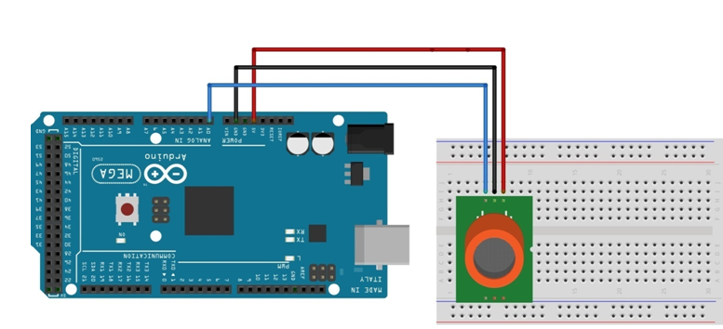
Connection Diagram
VCC
VCC
GND
A0
www.ablkart.com

Slide 7
MQ135 sensor connections :
Connect A0 pin of MQ135 sensor with A0 pin of Arduino Mega.
Connect Vcc pin of MQ135 sensor with Arduino’s (+5V).
Connect GND pin of MQ135 sensor with Arduino’s GND pin.
www.ablkart.com

Slide 8
Project Link : https://youtu.be/evl0s529wgM
www.ablkart.com

