Slide 1
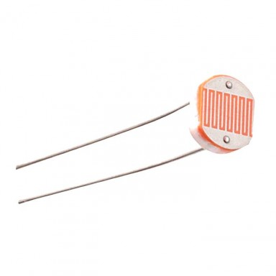
Interfacing of LDR sensor
www.ablkart.com

Slide 2
Light Dependent Resistor
An LDR is a component that has a (variable) resistance that changes with the light intensity that falls upon it. This allows them to be used in light sensing circuits. A Light Dependent Resistor (LDR) or a photo resistor is a device whose resistivity is a function of the incident electromagnetic radiation. Hence, they are light sensitive devices. They are also called as photo conductors, photo conductive cells or simply photocells.
www.ablkart.com

Slide 3
Working of LDR sensor
Reading a photo sensor with the Arduino Mega:
We will use a LDR and a resistor together in series. An LDR is simply a device that changes resistance based on ambient light. The brighter the light, the lower the resistance, the dimmer the light, the higher the resistance.
When there is no light , LDR will offer high resistance and less current flows through the resistor and voltage across resistor will be less near to GND.
When light falls on LDR, its resistance decreases and current flow through it increases. Then voltage across the resistor increases and pin 22 gets a HIGH signal.
www.ablkart.com

Slide 4
Components required
Arduino mega
LDR sensor
LED
Resistor (10k)
Breadboard
Jumper wires
www.ablkart.com

Slide 5
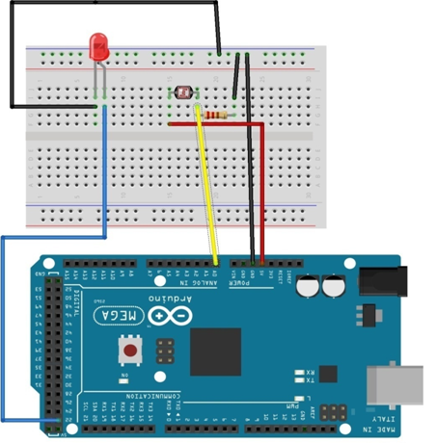
Connection Diagram
www.ablkart.com

Slide 6
Connections
Connect 1st pin of LDR sensor with A0 pin of Arduino.
Connect resistor(10k) with 1st pin of LDR sensor.
Then connect resistor’s another end with GND pin of Arduino
Connect 2nd pin of LDR sensor with (+5V) of Arduino.
Connect LED’s positive to 22 pin of Arduino and LED’s negative with GND of Arduino.
www.ablkart.com

Slide 7
Project Link : https://youtu.be/Cc8CTB25uyU
www.ablkart.com

